Slide 1

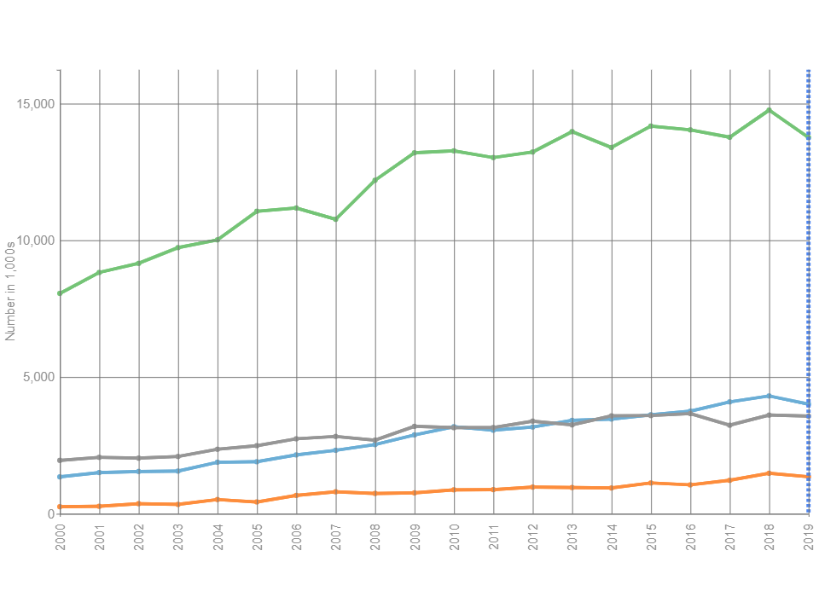
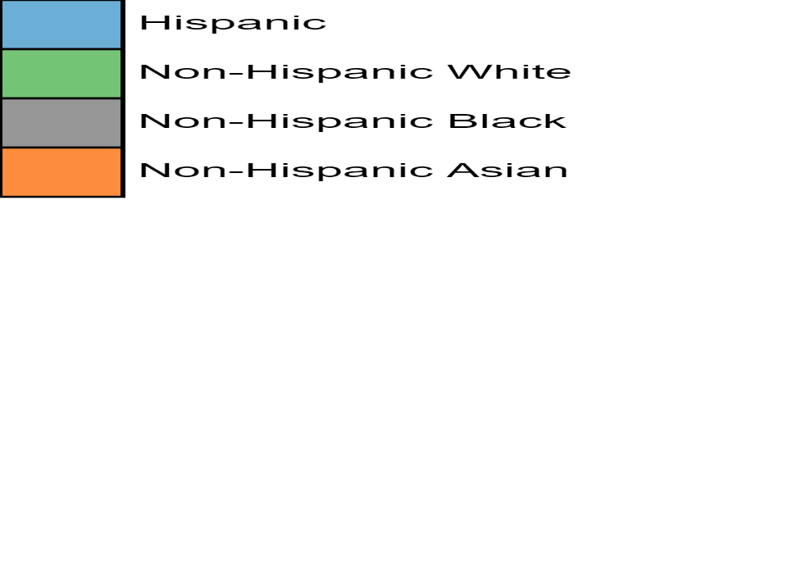
Diagnosed Diabetes, Race-Ethnicity, Adults Aged 18+ Years, Number in 1,000s, National
Number in 1,000s ( Race-Ethnicity )
Source:
www.cdc.gov/diabetes/data
Disclaimer: This is a user-generated report. The findings and conclusions are those of the user and do not necessarily represent the views of the CDC.
National Center for Chronic Disease Prevention and Health Promotion
Division of Diabetes Translation

