Slide 1
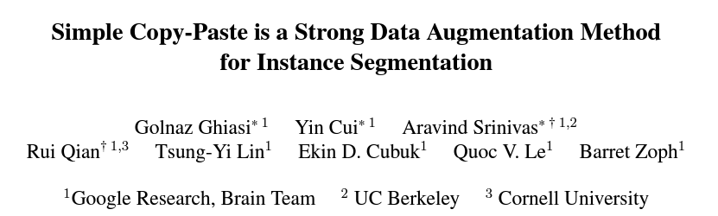
CVPR 2021
Citation: 581
Presentor: Jaemin Jeong
Notes:
Hello, today my presentation is Simple Copy-Paste that a Strong Data Augmentation Method for Instnce Segmentation.
This paper propose Simple Copy-Paste Augmentation with many experiments
They accepted CVPR 2021
They have a 581 citation
Okay, Let’s start presentation

Slide 2
Abstract
Annotation for Instance segmentation is usually expensive and time-consuming.
=> For example, 22 worker hours were spent per 1000 instance mask for COCO
We can summarize their contribution
They find that the simple mechanism of pasting objects randomly is good enough.
On COCO instance segmentation, we achieve 49.1 mask AP and 57.3 box AP, an improvement of +0.6 mask AP and +1.5 box AP over the previous state-of-the-art.
They further demonstrate that Copy-Paste can lead to significant improvements on the LVIS 2020 Challenge winning entry by + 3.6 mask AP on rare categories.
Notes:
What is it about instance segmentation problem. Instance segmentation models are often data-hungry. At the same time, annotating large datasets for instance segmentation is usually expensive and time-consuming.
For example, 22 worker hours were spent per 1000 instance mask for COCO
They propose the method called Copy-Paste for solving this problem.
This is paper of abstract.
We can summarize to 3 sentences their contribution.
First, They find that the simple mechanism of pasting objects randomly is good enough.
Second, They get more mask average precision in the previous state-of-the-art.
Third, They demonstrate improvements of mask average precision on rare categories. Rare categories means small amount class.

Slide 3
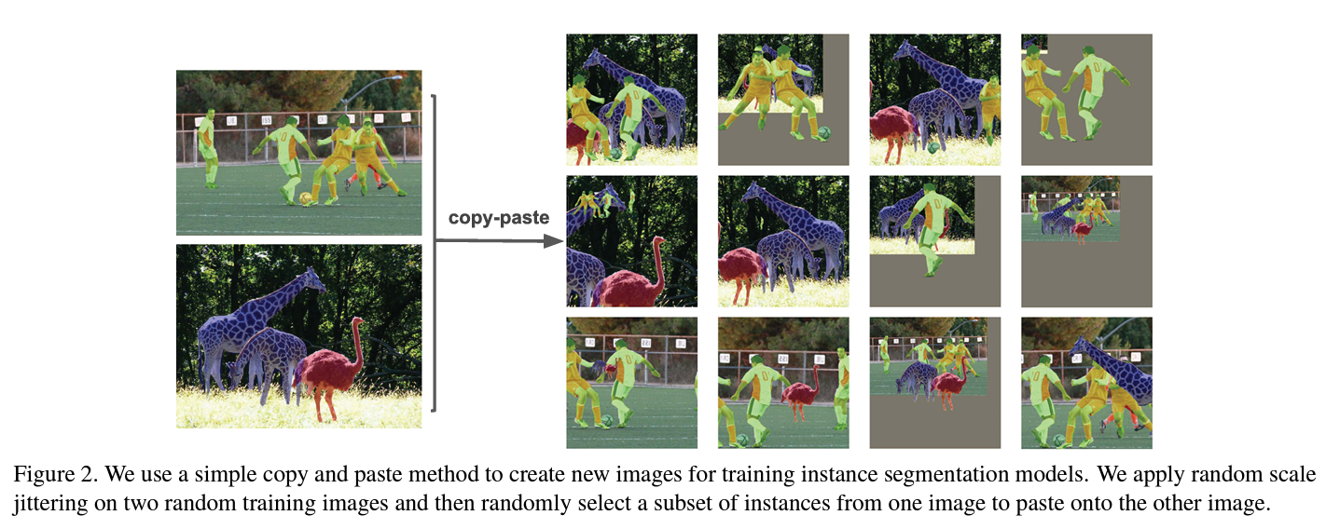
Method
Notes:
It’s just object copy and paste. It’s very simple

Slide 4
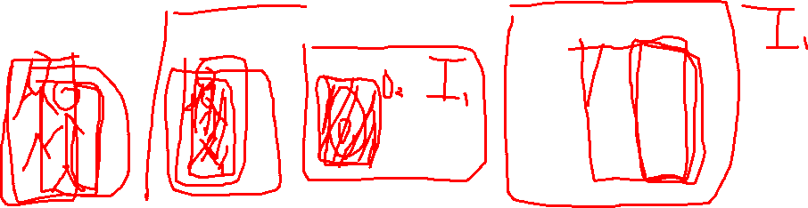
Method
They approach for generating new data using Copy-Paste is very simple.
They randomly select two images and apply random scale jittering and random horizontal flipping on each of them.
Then they select a random subset of objects from one of the images and paste them onto the other image. Lastly, we adjust the ground-truth annotations accordingly they remove fully occluded objects and update the masks and bounding boxes of partially occluded objects.
Notes:
Okay, now we should know copy-paste augmentation.
Copy paste is very simple, They just randomly select two images and then apply random scale jittering and random horizontal flipping on each of them.
Then we select a random subset of objects from one of the images and paste them onto the other image. That’s very simple

Slide 5
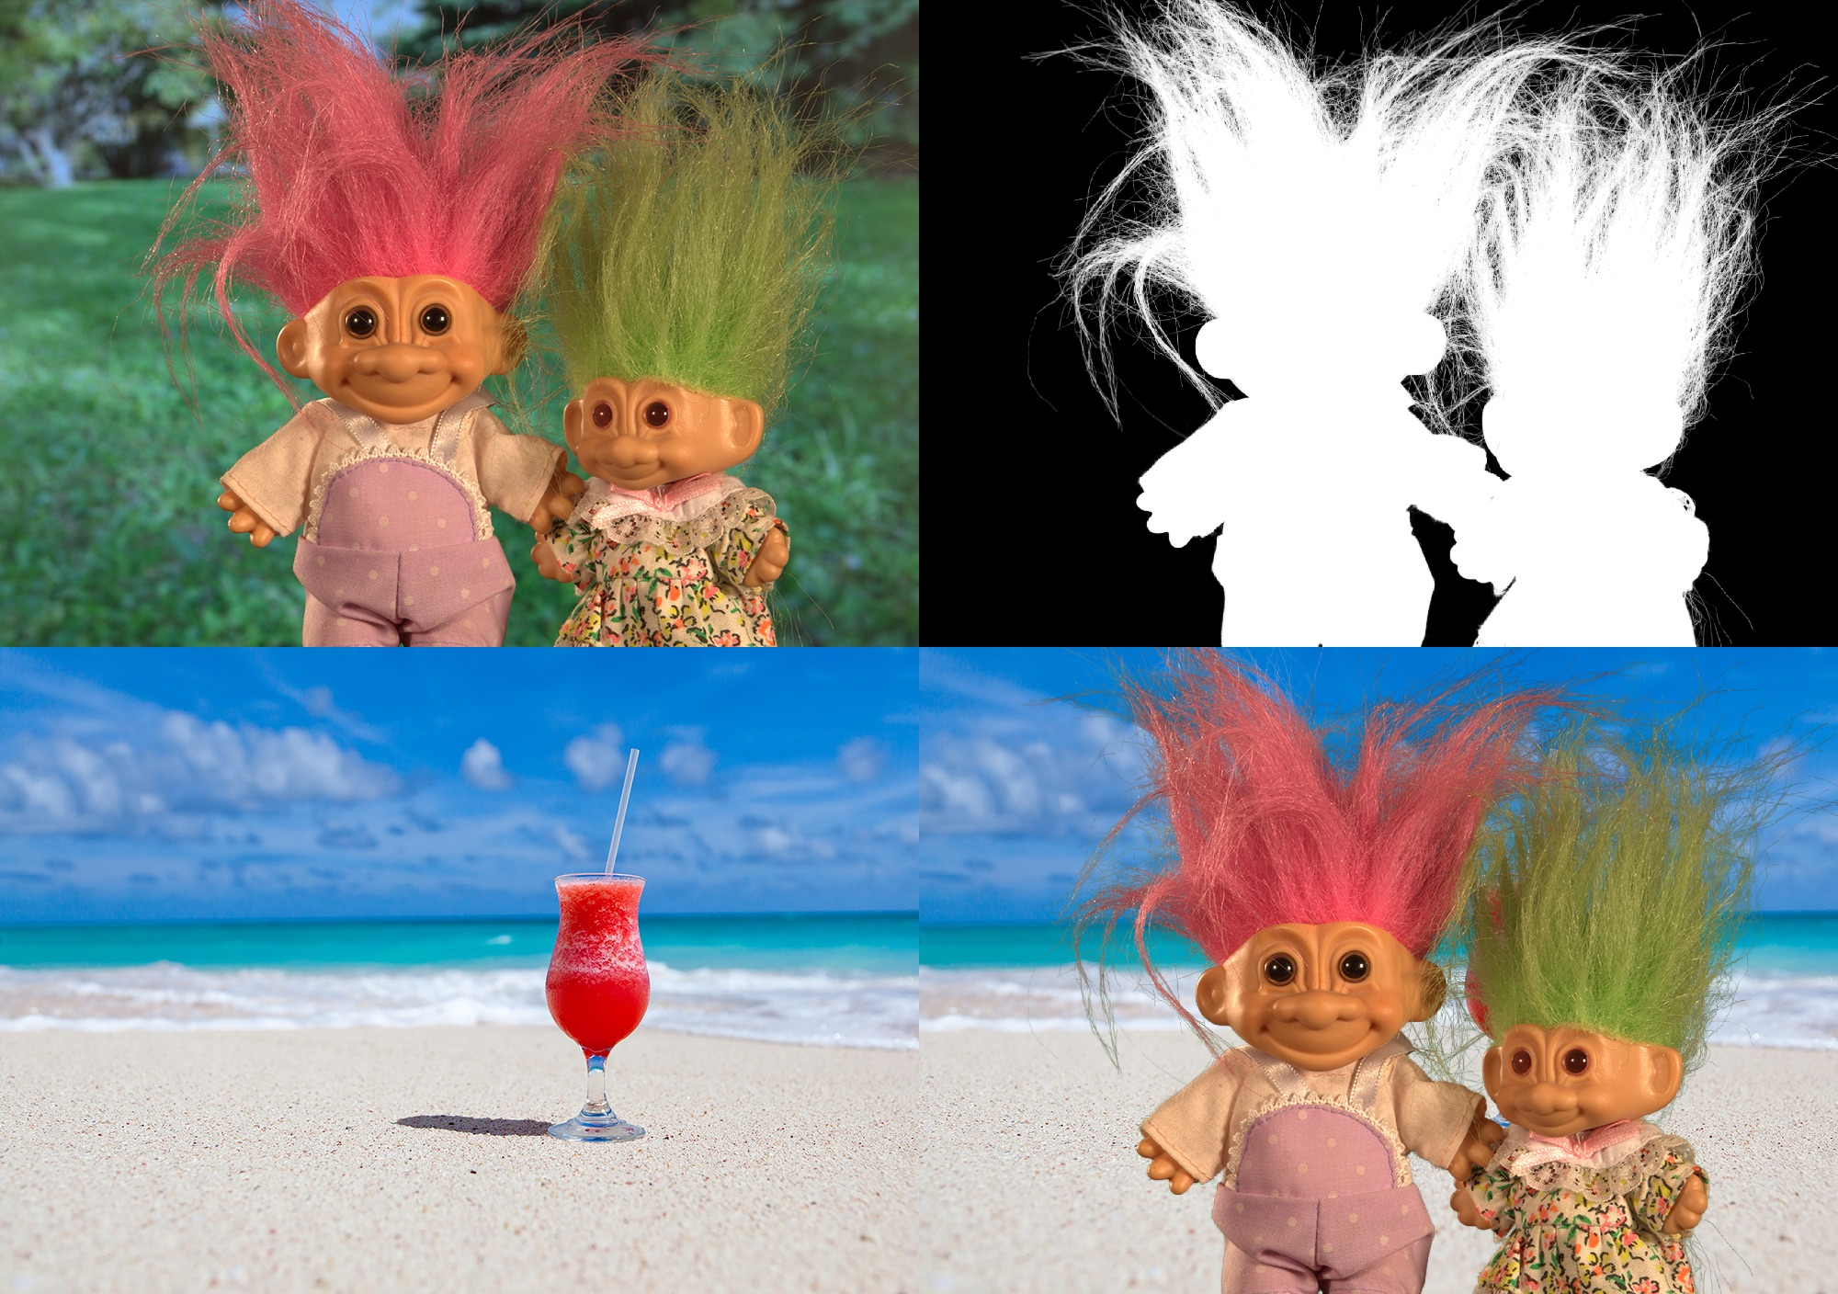
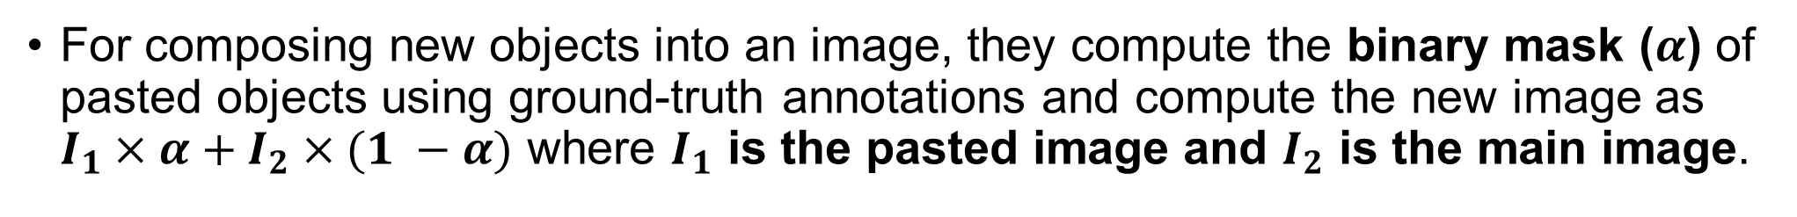
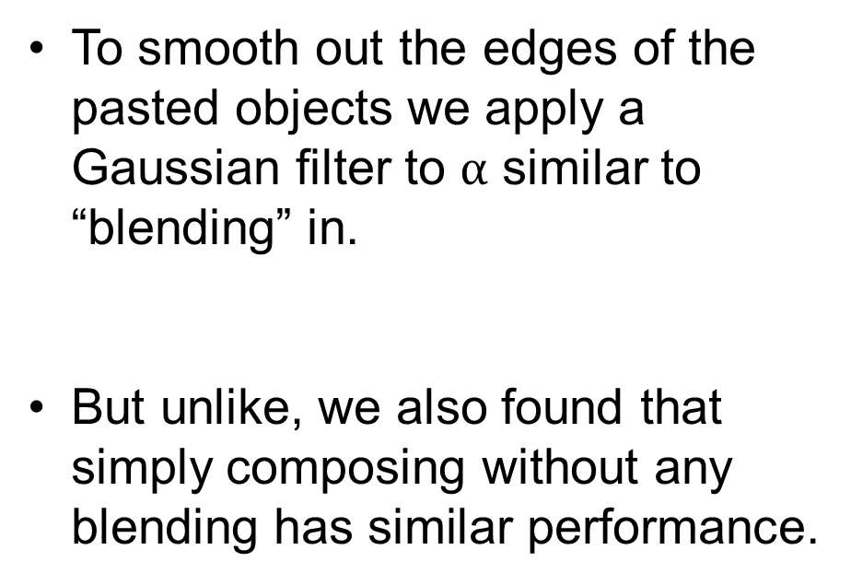
Method – Blending Pasted Objects
For composing new objects into an image, they compute the binary mask ($α$) of pasted objects using ground-truth annotations and compute the new image as $I_{1}×α+I_{2}×(1 −α)$ where $I_{1}$ is the pasted image and $I_{2}$ is the main image.
To smooth out the edges of the pasted objects we apply a Gaussian filter to $α$ similar to “blending” in.
But unlike, we also found that simply composing without any blending has similar performance.
Notes:
They use alpha blending for Copy-Paste.
The Alpha Blending can copy-paste with 2 rgb images and 1 gray scale mask image.
We can calculate with simple equation

Slide 6
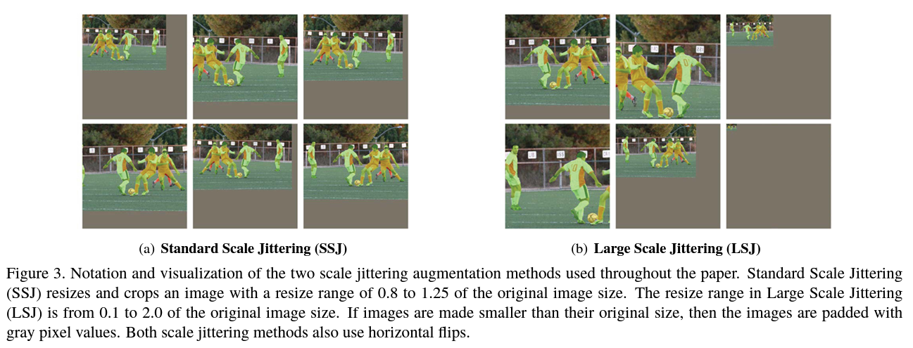
Method – Large Scale Jittering
We use two different types of augmentation methods in conjunction with Copy-Paste throughout the text: standard scale jittering (SSJ) and large scale jittering (LSJ).
These methods randomly resize and crop images.
Notes:
They make a two different type of augmentation methods SSJ and LSJ
SSJ mean standard scale jittering and LSJ mean large scale jittering
Standard scale jittering mean augmentation method with resizes and crops an image with a resize range of 0.8 to 1.25 of the original image size.
Large Scale Jittering mean augmentation method with resizes and crops an image with a resize range of 0.1 to 2.0 of the original image size.

Slide 7
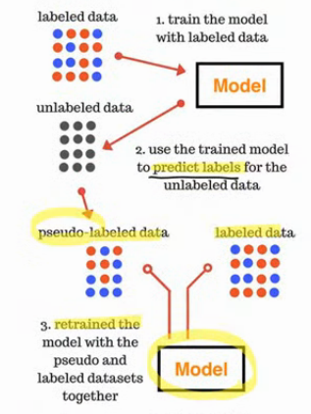
Method – Self-training Copy-Paste
In addition to studying Copy-Paste on supervised data, we also experiment with it as a way of incorporating additional unlabeled images.
Our self-training Copy-Paste procedure is as follows:
train a supervised model with Copy-Paste augmentation on labeled data
generate pseudo labels on unlabeled data
paste ground-truth instance into pseudo labeled and supervised labeled images and train a model on this new data
Notes:
In addition, they experiment with Copy-Paste for self-training as well.
The self-training is according to 3 step process.
First train a supervised model with Copy-Paste augmentation on labeled data
Second generate pseudo labels on unlabeled data
Third paste ground-truth instance into pseudo labeled and supervised labeled images and train a model on this new data

Slide 8
Experiments - Experimental Settings
Architecture
They use Mask R-CNN with Efficient-Net or ResNet as the backbone architecture.
Dataset
They use the COCO dataset which has 118k training images.
For self-training experiments, they use the unlabeled COCO dataset (120k images) and the Objects365 dataset (610k images) as unlabeled images.
For transfer learning experiments, they pre-train our models on the COCO dataset and then fine-tune on the Pascal VOC dataset.
For semantic segmentation, they train our models on the train set (1.5k images) of the PASCAL VOC 2012 segmentation dataset.
For detection, they train on the trainval set of PASCAL VOC 2007 and PASCAL VOC 2007 and PASCAL VOC 2012.
Notes:
Architecture
This Is about Model architecture
They use Mask-R-CNN with Efficient Net or ResNet as the backbone architecture
We also employ feature pyramid networks for multi-scale feature fusion.
We use pyramid levels from $P_{2}$ to $P_{0}$, with an anchor size of $8×2^{l}$ and 3 anchors per pixel.
Our strongest model uses Cascade R-CNN, EfficientNet-B7 as the backbone and NAS-FPN as the feature pyramid with levels from $P_{3}$ to $P_{7}.$
The anchor size is $4×2^{l}$ and we have 9 anchors per pixel.
Our NAS-FPN model uses 5 repeats and we replace convolution layers with ResNet bottleneck blocks.

Slide 9
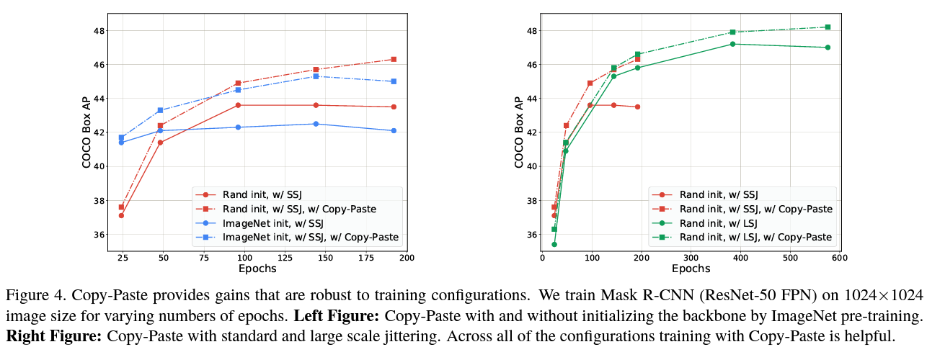
Experiments
Rand init : backbone by Random initialization
ImageNet init : backbone ImageNet pre-training initialization
Notes:
This left graph show mask average precision between Rand init and ImageNet init.
This right graph show mask average precision between SSJ and LSJ.
Random initialization is better than ImageNet initialization.
LSJ is better than SSJ

Slide 10
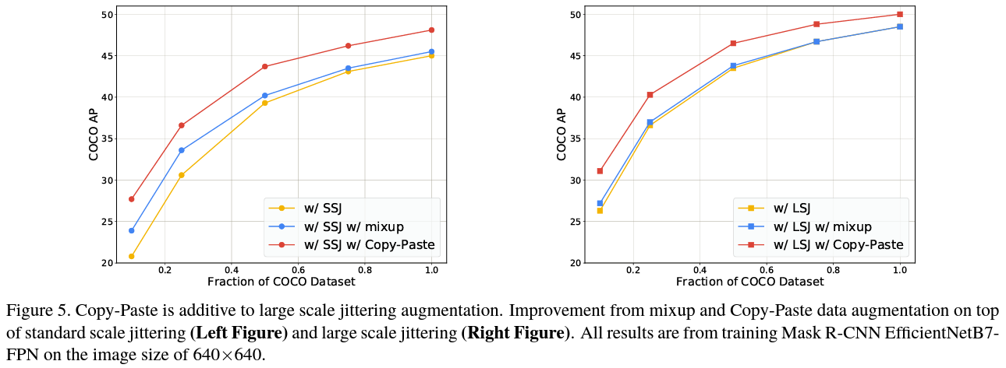
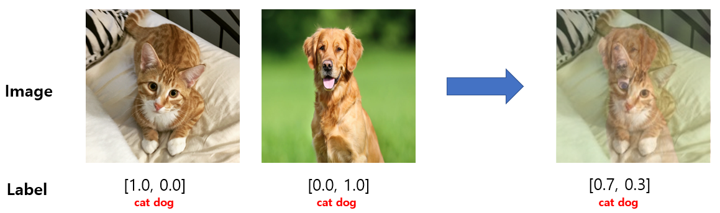
Experiments
Notes:
These graph show COCO average precision between mixup and Copy-Paste.
Copy Paste is better than mixup

Slide 11
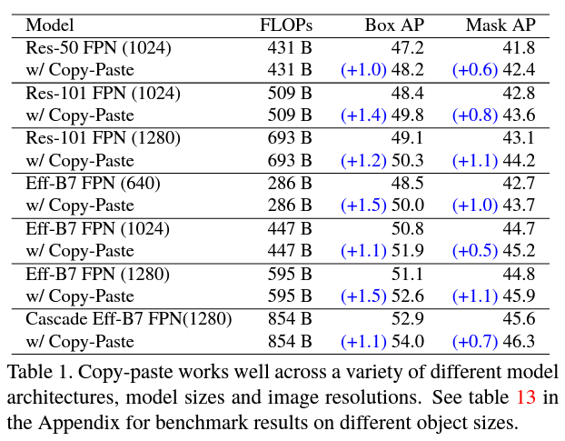
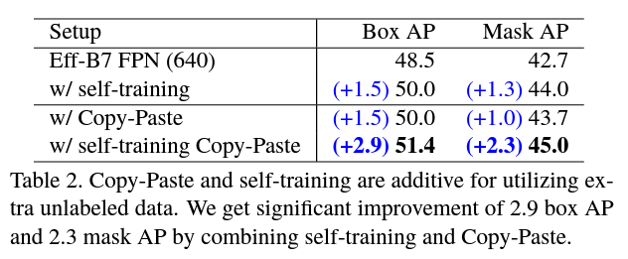
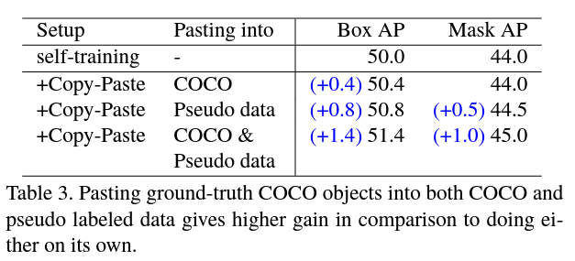
Experiments
Notes:
Copy-paste works well across a variety of different model architectures, model sizes and image resolutions.
And Copy-Paste with self-training works well especially when used together

Slide 12
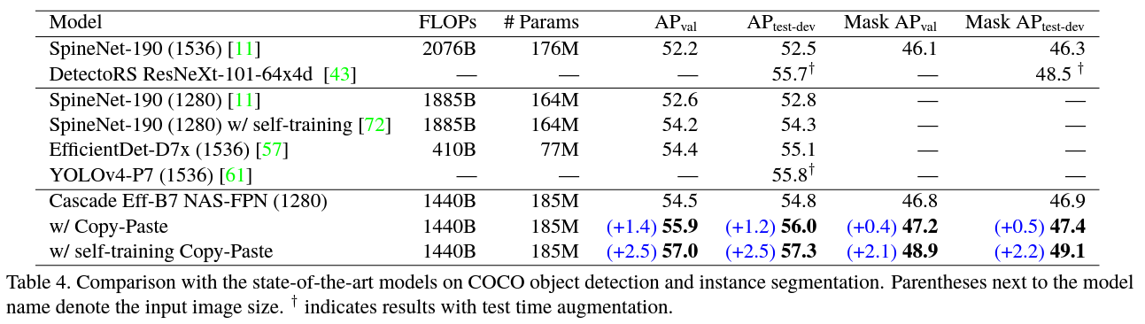
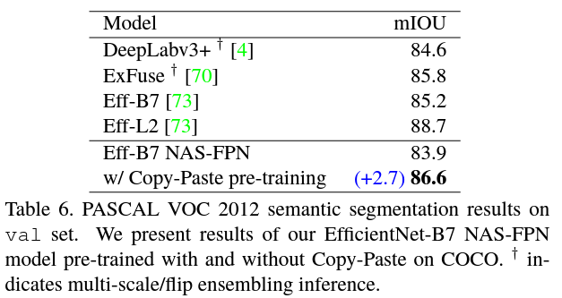
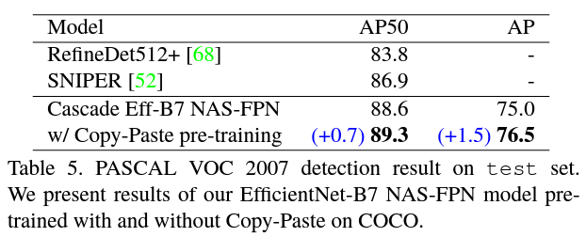
Experiments
Notes:
This table shows the average precision improvement in semantic segmentation and object detection and instance segmentation when applied to SOTA with COCO and PASCAL VOC 2007, 2012 dataset.

Slide 13
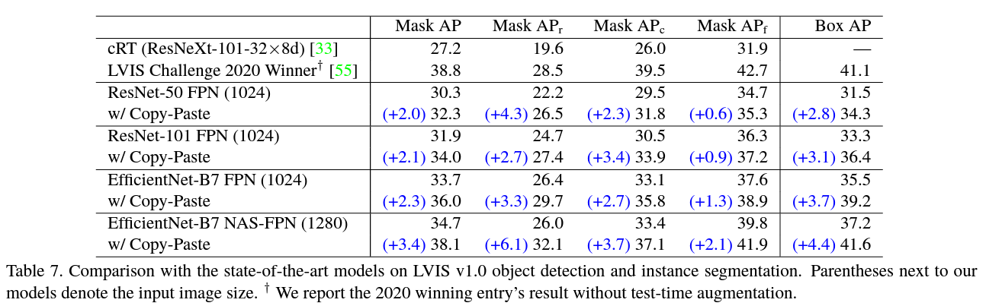
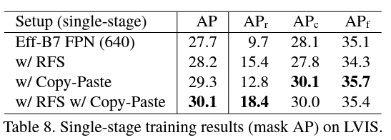
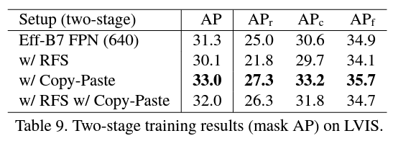
Experiments
RFS: Repeat Factor Sampling
We also benchmark Copy-Paste on LVIS v1.0 (100k training images) and report results on LVIS v1.0 val (20k images).
LVIS has 1203 classes to simulate the long-tail distribution of classes in natural images
Notes:
Finally, they shows the average precision improvement in object detection and instance segmentation when applied to various model with LVIS dataset.
And they compared the performance using RFS together. However, there was no significant performance improvement.

Slide 14
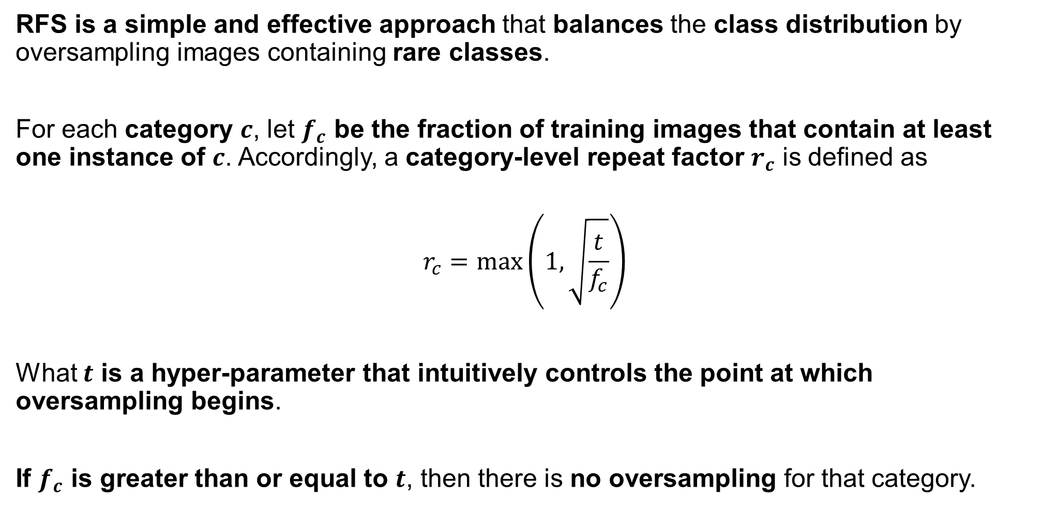
Repeat Factor Sampling
RFS is a simple and effective approach that balances the class distribution by oversampling images containing rare classes.
For each category $c$, let $f_{c}$ be the fraction of training images that contain at least one instance of $c$. Accordingly, a category-level repeat factor $r_{c}$ is defined as
$$r_{c}=\max\left(1,\sqrt{\frac{t}{f_{c}}}\right)$$
What $t$ is a hyper-parameter that intuitively controls the point at which oversampling begins.
If $f_{c}$ is greater than or equal to $t$, then there is no oversampling for that category.
Notes:
What is

Slide 15
Conclusion
Copy-Paste performs well across multiple experimental settings and provides significant improvements on top of strong baselines, both on the COCO and LVIS instance segmentation benchmarks.
The Copy-Paste augmentation strategy is simple, easy to plug into any instance segmentation codebase, and does not increase the training cost or inference time.
We also showed that Copy-Paste is useful for incorporating extra unlabeled images during training and is additive on top of successful self-training techniques.

