Slide 1

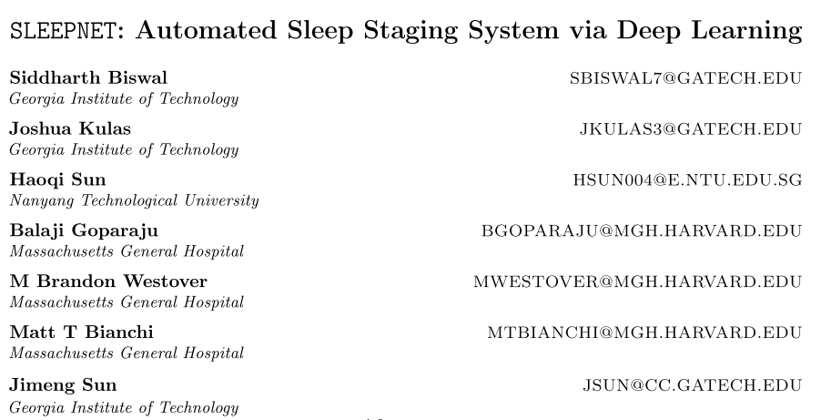
SLEEPNET

Slide 2
Voca
Sleep Disorders : 수면 장애
Sleep Apnea : 수면 무호흡증
Parasomnias : 수면 장애
Hypersomnia : 수면 과다
Polysomnography(PSG) : 수면 다원 검사
Electroencephalography(EEG) : 뇌파 검사
Hypnogram : 수면 단계 시퀀스

Slide 3
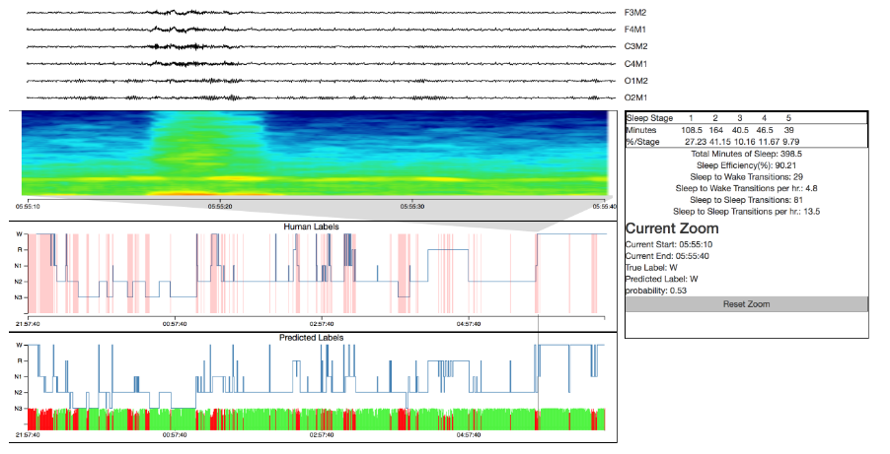
SLEEPNET

Slide 4
SLEEPNET
We propose a specialized clinical decision support tool, SLEEPNET.
SleepNet uses expert-defined features to represent each 30-sec interval and learns to annotate EEG using a RNN
PSGs containing about eight hours of data per patient (9000 for training and 1000 for testing).
Schaltenbrand et al. have applied neural networks. (1996)
+ http://citeseerx.ist.psu.edu/viewdoc/download?doi=10.1.1.325.4283&rep=rep1&type=pdf

Slide 5
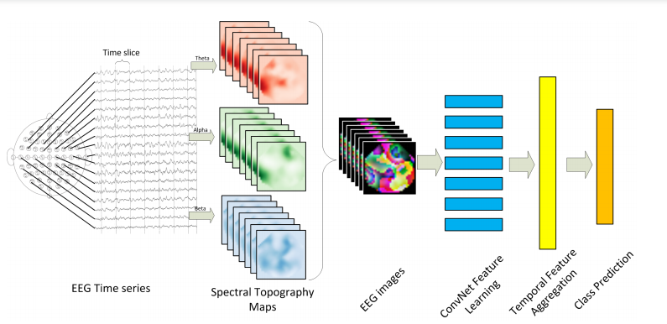
Signal to Image
Recently, a method was proposed to learn an EEG representation by converting the signal into an image using the location of electrodes and applying deep a CNN to the image (Bashivan et al., 2015).
+ https://arxiv.org/pdf/1511.06448.pdf

Slide 6
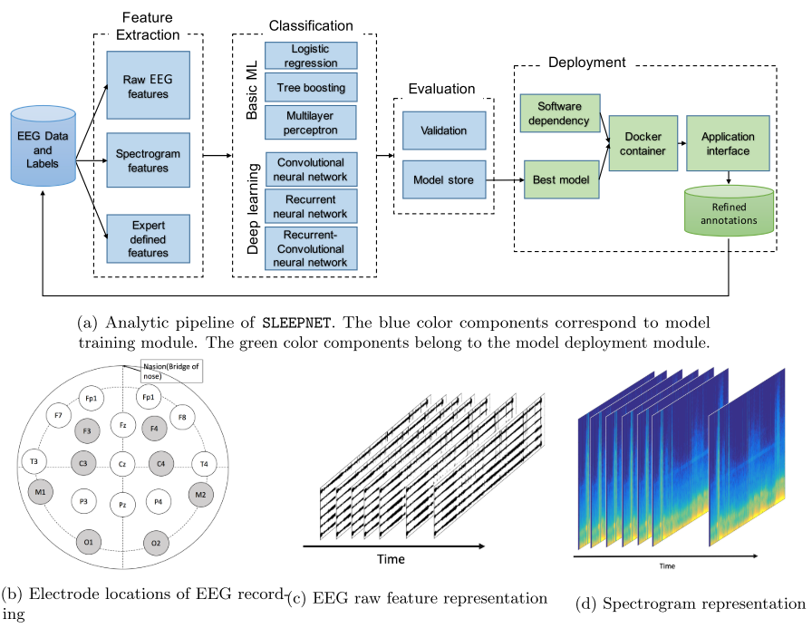
SLEEPNET

Slide 7
Training Module

Slide 8
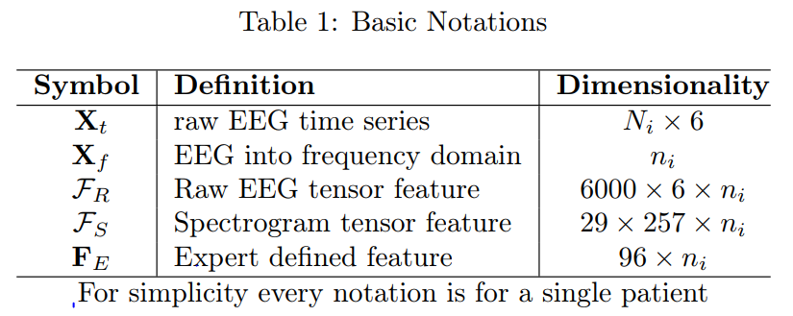

EEG Data and Notations
6 channels : F3, F4, C3, C4, O1, O2
5 stages : Wake, N1, N2, N3, REM
Epoch : 30 second
$n_{i}(\frac{N_{i}}{200×30})$ is the number of 30 seconds windows in the entire recording.(number of windows)

Slide 9
Feature Extraction

Slide 10
SPECTROGRAM
frequency domain is obtained by Fast Fourier Transform(FFT)
sepectrogram is obtained by multitaper spectral analysis(MTSA)
Each 30-second epoch was segmented into 20 sub-epochs of that are 2 seconds long with 1-second overlap.
we used MTSA to estimate power spectral density in 257 frequency bins from 0-100Hz.

Slide 11
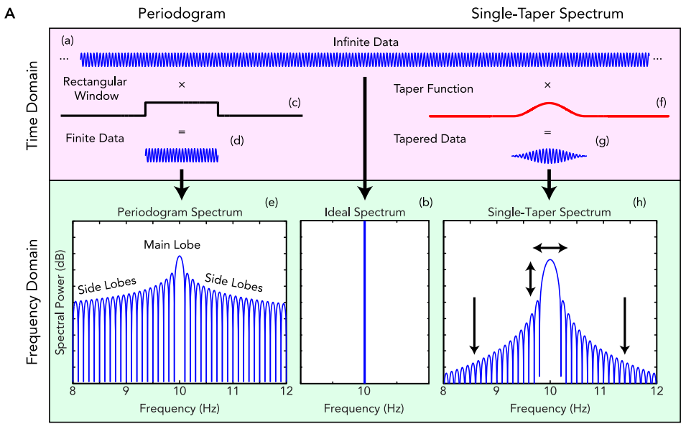
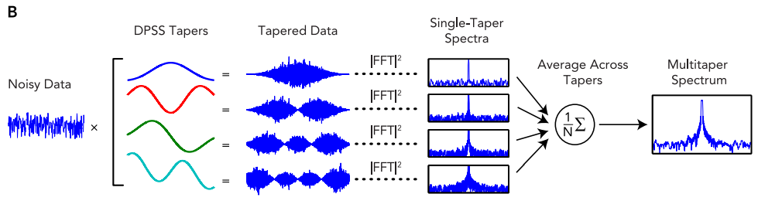
SPECTROGRAM - MTSA
스펙트럼 - 임의파형을 구성하고 있는 주파수들의 분포를 그림으로 나타낸 것
Sleep Neurophysiological Dynamics Through the Lens of Multitaper Spectral Analysis
https://journals.physiology.org/doi/full/10.1152/physiol.00062.2015
Discrete prolate spheroidal(타원체) sequences (DPSSs)
- 개별 타원체 시퀀스

Slide 12
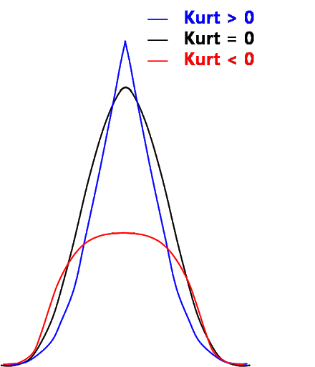
EXPERT DEFINED FEATURES
Line length is included as a measure of amplitude and frequency oscillations in the EEG.
+ Line length: An efficient feature for seizure(발작) onset detection
Kurtosis is included to measure the presence of extreme values.
+ Feature selection for sleep/wake stages classification using data driven methods
To reduce noise in spectral features we averaged spectrograms from contralateral channels, (i.e. F3-M2 and F4-M1, C3-M2, C4-M1, O1-M2, O2-M1)
Then we find indices for each of three frequency bands delta (0.5-4Hz), theta (4-8Hz), alpha (8-12Hz) in the spectrogram matrix.
We normalize these power estimates by the total power from 0-20Hz.
From the resulting matrix, we obtain 95th percentile (rubust version of maximum), minimum, mean and standard deviation.
We also include features reflecting relative power such as i.e. delta/theta, delta/alpha, theta/alpha ratios.
The kurtosis of the spectrogram in the delta, theta, alpha and sigma (12-20Hz) bands were also extracted to capture transient bursts such as sleep spindles.

Slide 13
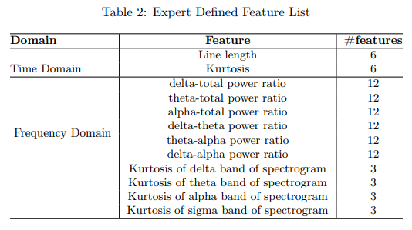
EXPERT DEFINED FEATURES

Slide 14
Classification in SLEEPNET
Logistic Regression
Tree Boosting
Multilayer Perceptrons
Deep Leanning Methods
+ CNN - SPECTROGRAMS
+ RNN – RAW EEG
+ CRNN - SPECTROGRAMS

Slide 15
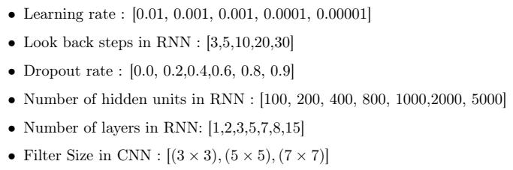
Evaluation
9000 : training (300 validation)
1000 : testing
each patient corresponds to 8 hours data about 950-1000 labels
50 iterations of random search

Slide 16
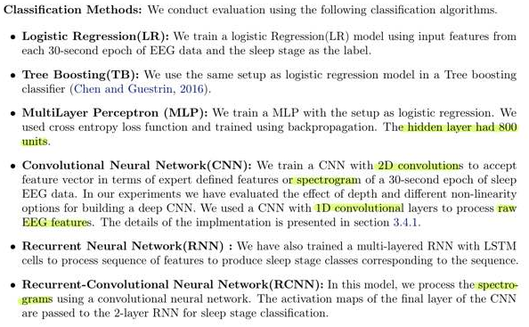
Classification Methods

Slide 17
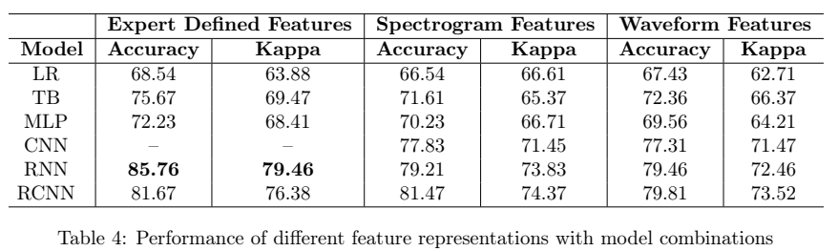
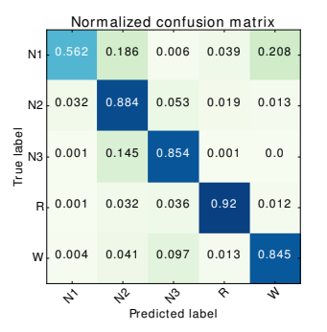
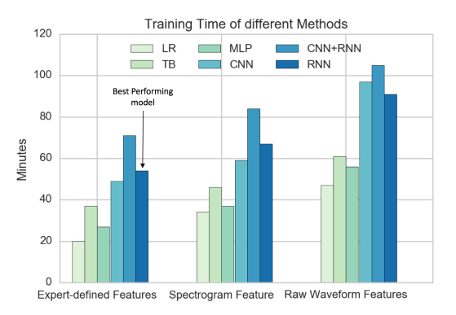
Perfomance

Slide 18
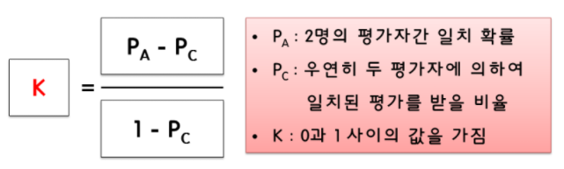
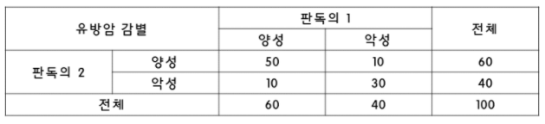

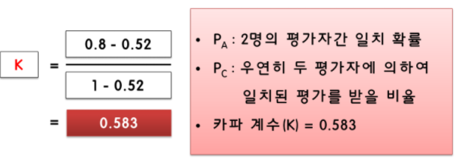
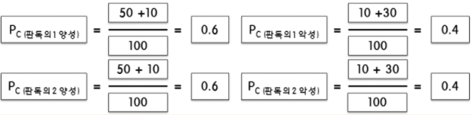
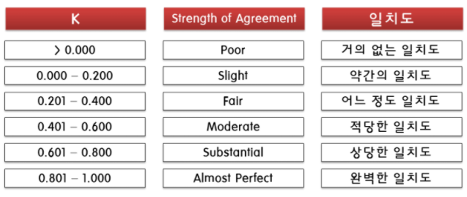
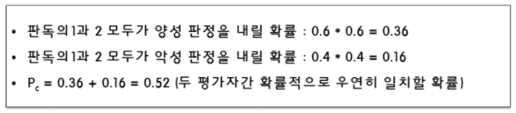
Cohen's Kappa
두 관찰자 간의 측정 범주 값에 대한 일치도를 측정하는 방법

Slide 19
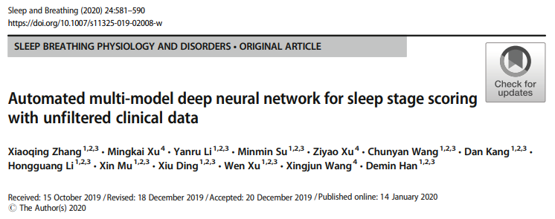
Automated multi-model deep neural network for sleep stage scoring with unfiltered clinical data

Slide 20
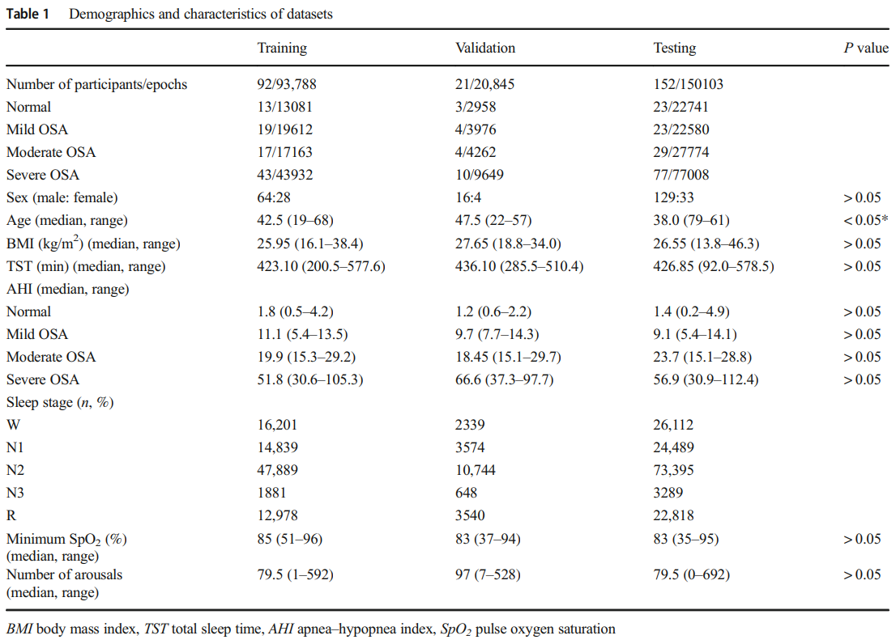
Datasets

Slide 21
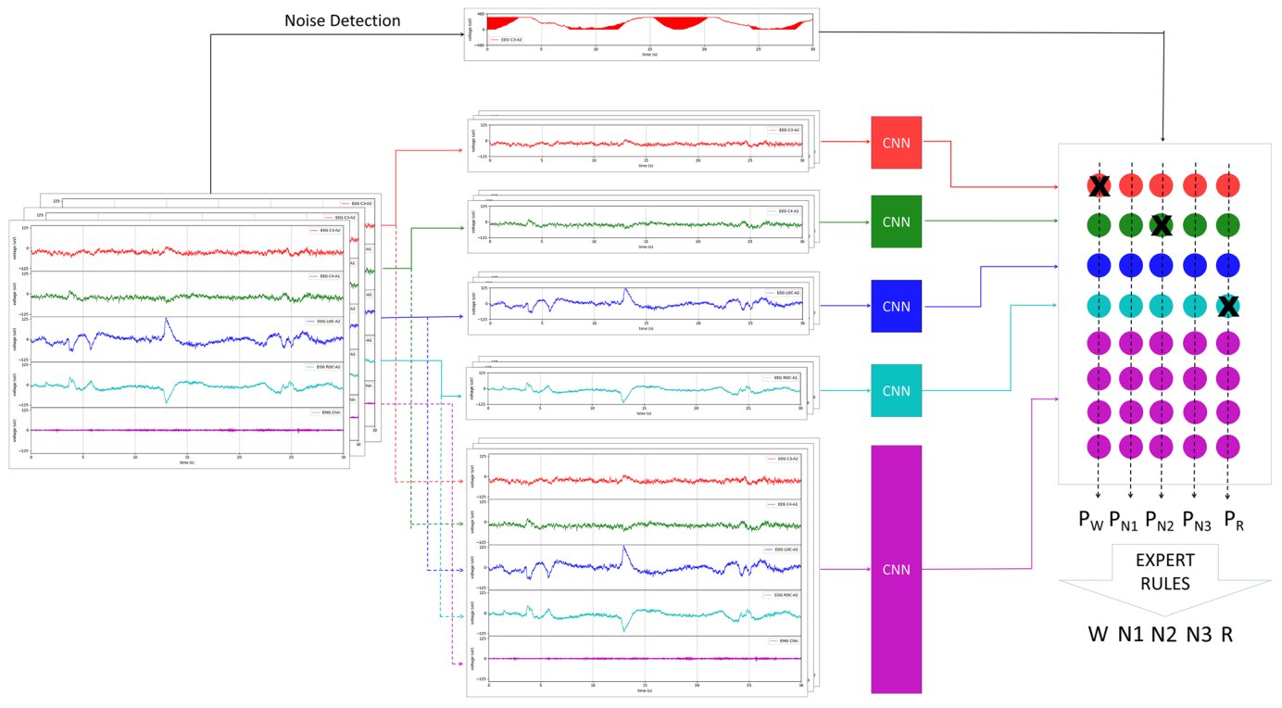
Model

Slide 22
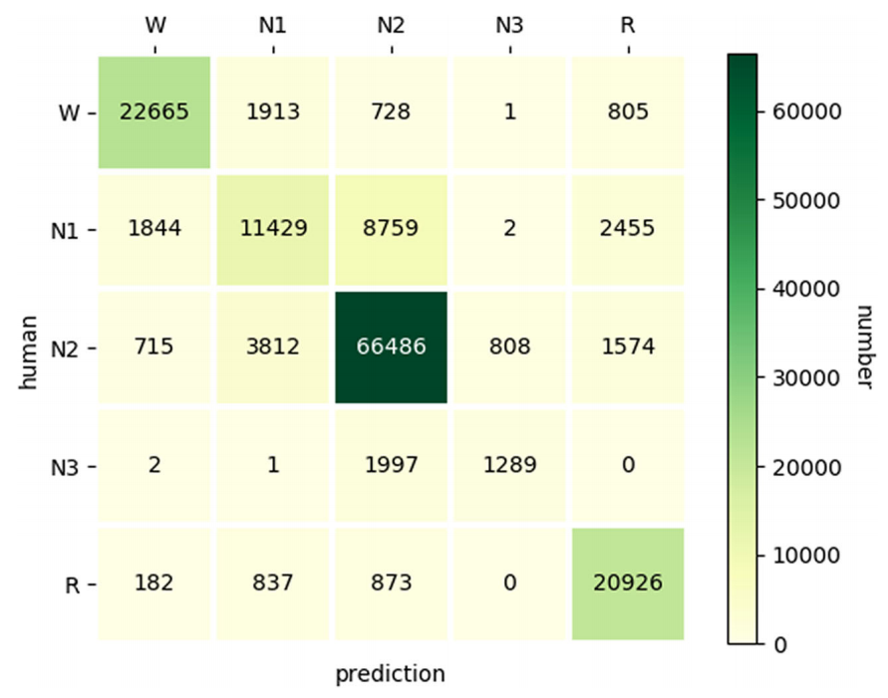
Result

Slide 23
Dicussion
As the AHI increased, the accuracy and F1 values gradually decreased.
In patients with severe OSA, the lowest value is considered to be related to fragmented sleep, and the EEG is relatively complicated. Cohen’s Kappa was to evaluate the inter-rater variability between the model and the technician’s scoring.
The literature suggests that there is inter-rater variability between different human technicians, and both N1 and N3 are relatively low, ranging from 20% to 70% [9–12].
The average Cohen’s Kappa of this study was 0.7276, indicating a substantial agreement with human technicians. Similar to the previous pieces of literature, the model displayed a low consistency in the N1 and N3 stages.
Such a result considers that the waveform characteristics of the low amplitude in the N1 stage are not prominent, and the model may confuse N1 with N2 during scoring (like when the EEG is not typical and thus a technician confuses N1 and N2).
However, the agreement of N3 is weak due to the high proportion of OSA patients in the training dataset, which may lead to the number of N3 periods being inadequate, accounting for only 2% of the total number of epochs.
In clinical practice, the number of sleep stages in clinical data is imbalanced.
Compared with healthy people, sleep fragmentation in OSA patients has more W and N1 stages and fewer N3 stages.
In this study, because the unfiltered data was closer to the clinical situation, the imbalanced sample categories will result in too few features and too diminutive a sample size to extract the data pattern, or in over-fitting problems because of limited samples.

Slide 24
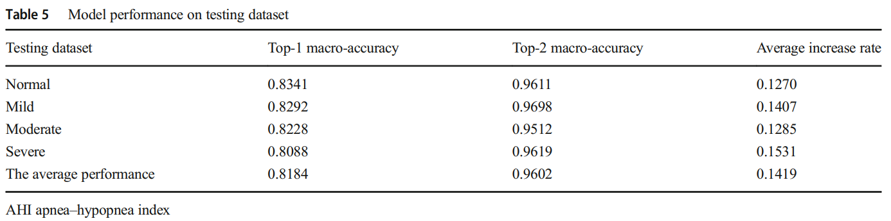
Dicussion
Through the analysis of the predicted value of the second probability of the model, this study finds that the model will have a certain degree of confusion when distinguishing between the W and N1 stages, between the N1 and N2 stages, and between N2 and N3 stages; this is consistent with the most common differences in sleep scoring by human experts.
K complex wave lacks specificity and is related to the existence of spindle wave identification.
This study found that arousal affects the accuracy of sleep staging; this may be due to the number of arousals being positively correlated with the number of N1 stages.
First, the clinical data of this study is imbalanced, and the number of N3 stages in this study is small. Compared with other studies, the recognition of N3 is lower.
Second, the clinical dataset used in this study was derived from retrospective data of a single center, lacking analysis of homogeneity with the published dataset sleep-EDF.
Additionally, the study applied independent and homogeneous training sets and testing sets without cross-validation, and thus there may be deficiencies in the assessment of the generalization capabilities of the model.

Slide 25
Conclusion
In conclusion, this research provides a robust and reliable model in which the inter-rater agreement nears that of human experts.
In future research, it is essential to address the abovementioned limitations, explore the evaluation criteria for neural network models, and develop a lightweight version of the model to make it work in wearable devices and smart devices.
Eventually, this work can have a positive impact on population health and healthcare expenditures.

Slide 26
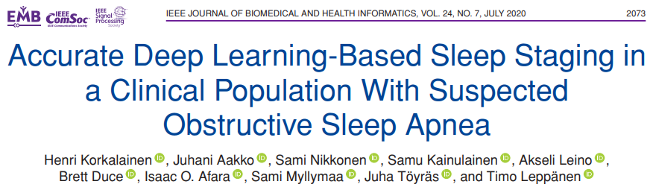
Accurate Deep Learning-Based Sleep Staging in a Clinical Population With Suspected Obstructive Sleep Apnea

Slide 27
Abstract
we aimed to develop an accurate deep learning approach for automatic classification of sleep stages and to study the effect of OSA severity on the classification accuracy.
Overnight polysomnographic recordings from a public dataset of healthy individuals (Sleep-EDF, n = 153) and from a clinical dataset (n = 891) of patients with suspected OSA were used to develop a combined convolutional and long short-term memory neural network.
On the public dataset, the model achieved sleep staging accuracy of 83.7% (κ = 0.77) with a single frontal EEG channel and 83.9% (κ = 0.78) when supplemented with EOG.
For the clinical dataset, the model achieved accuracies of 82.9% (κ = 0.77) and 83.8% (κ = 0.78) with a single EEG channel and two channels (EEG+EOG), respectively. The sleep staging accuracy decreased with increasing OSA severity.
The single-channel accuracy ranged from 84.5% (κ = 0.79) for individuals without OSA diagnosis to 76.5% (κ = 0.68) for patients with severe OSA.
the accuracy decreased with increasing OSA severity.

Slide 28
Intro
We aimed to develop an accurate deep learning-based automatic method for the classification of sleep stages in patients with suspected OSA.
We further aimed to achieve this by utilizing the raw signals without conducting heavy preprocessing.
We hypothesize that deep learning methods enable accurate sleep staging based on a single EEG channel for patients with suspected OSA and that the sleep staging accuracy decreases with increasing OSA severity.
10-fold cross-validation was chosen over a single split to training, validation, and test set due to relatively small dataset and to enable comparison with the previous studies.
AASM rules

Slide 29
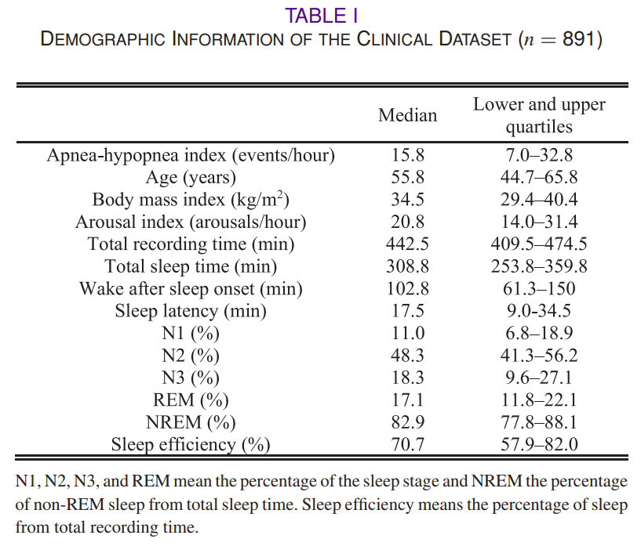
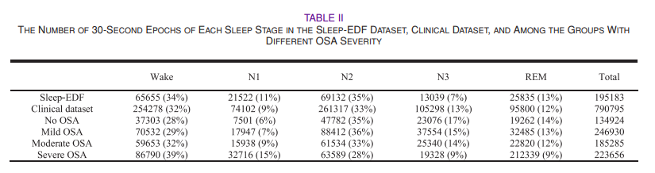
Dataset
Sleep EDF
Clinical Dataset
OSA Severity

Slide 30
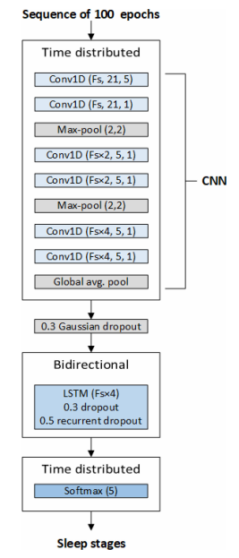
Model

Slide 31
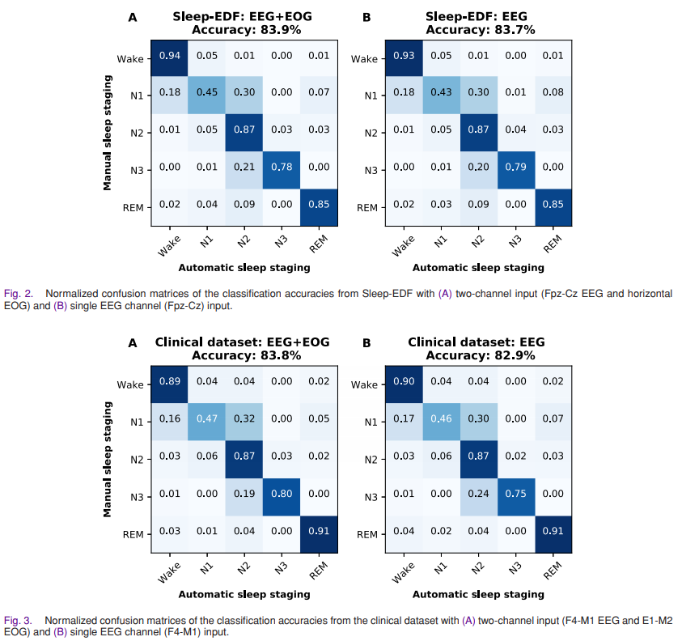
Result

Slide 32
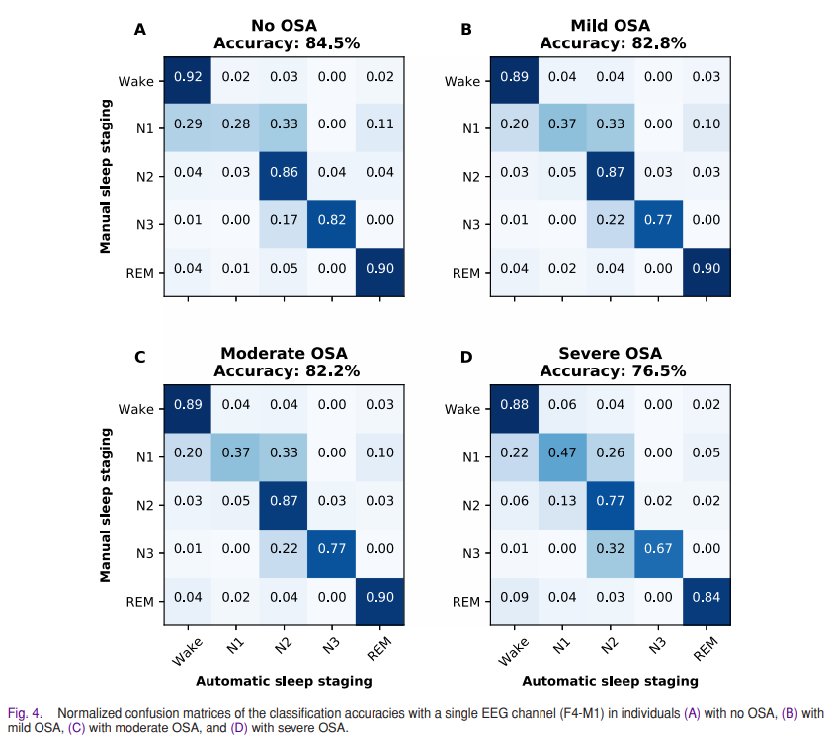
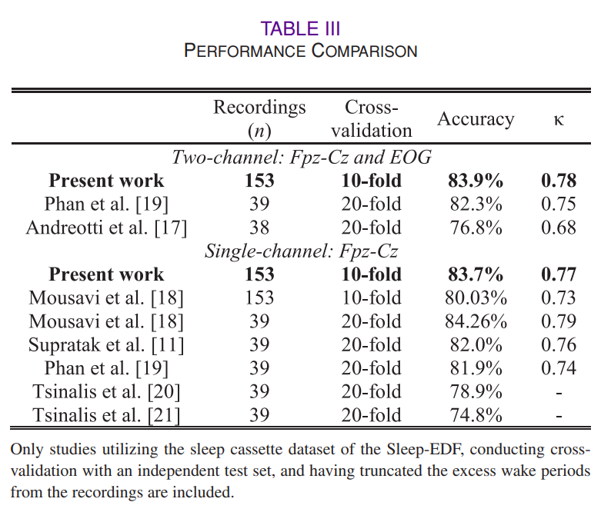
Result
The accuracy of the sleep staging decreased with increasing OSA severity with the accuracy being the highest for individuals without OSA and lowest with individuals having severe OSA.

Slide 33
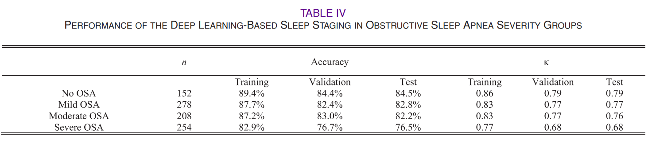
Result

Slide 34
Conclusion
The proposed deep learning-based automatic method enables reliable, fast, and accurate sleep staging for suspected OSA patients.
The accuracy of the sleep staging decreases with increasing OSA severity but with the utilized large clinical dataset, the sleep staging can be conducted for patients suffering from OSA with almost comparable accuracy to individuals without OSA.
Practically, automatic sleep staging can be performed as accurately using either a combination of single EEG and EOG signals or using a single frontal EEG channel.
The single channel approach could enable a cost-efficient, simple, and accurate sleep staging in OSA diagnostics.

