Slide 1
Automated sleep stage scoring of the Sleep Heart Health Study using deep neural networks

Slide 2

Abstract
Study Objectives :
Automated PSG scoring has the potential to reduce the human labor costs and the variability inherent to this task.
Methods :
Sleep Heart Health Study (SHHS)
Train = 5213 patients : 42,560 hours
Test = 580 patients
Accuracy : F1-score, per-stage accuracy, Cohen's kappa
Results:
CNN + LSTM
F1-score : 0.87
K : 0.82

Slide 3
Keypoints
PSGs are well suited for convolutional and recurrent processing methodologies as they consist of spatially and temporally related signal data.
For example, a k-complex may signal onset of N2 sleep, even though subsequent electromyogram (EEG) data may be low-amplitude mixed-frequency data visually identical to N1.

Slide 4
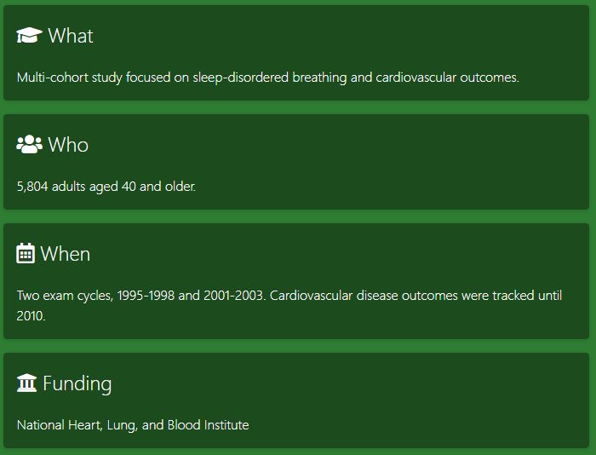
SHHS

Slide 5
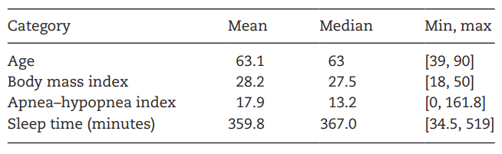
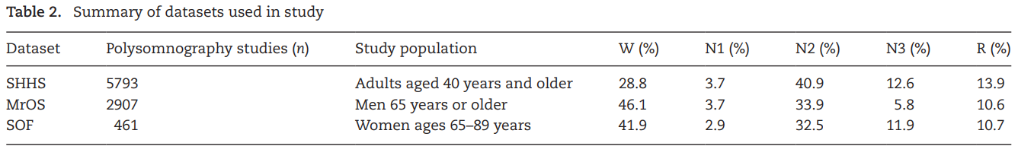
SHHS statistics
체지방

Slide 6
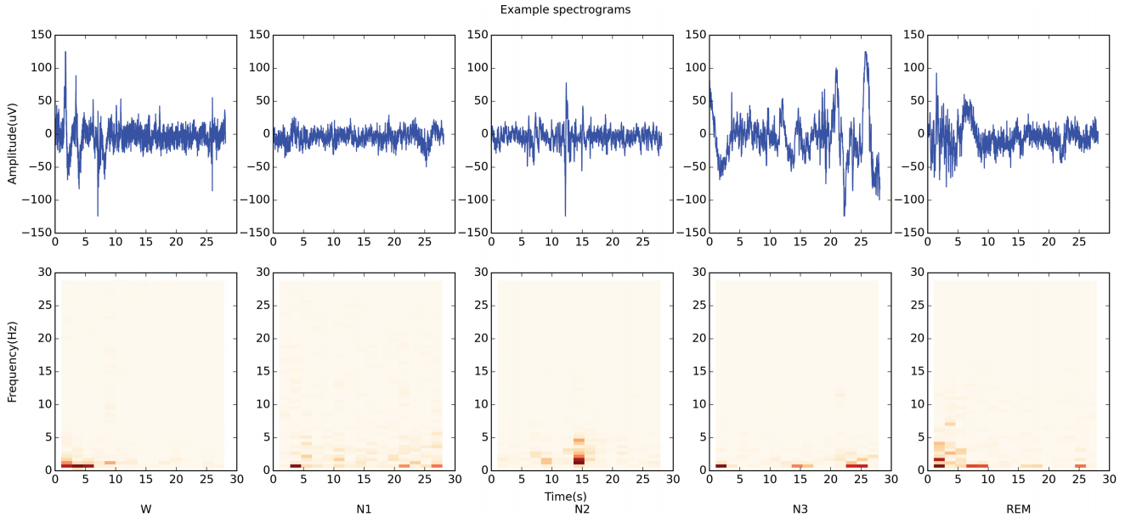
Spectrogram
Spectrograms were generated using 2-second sub-epochs formed by a Tukey window with 25% of the window inside the tapered cosine region.

Slide 7
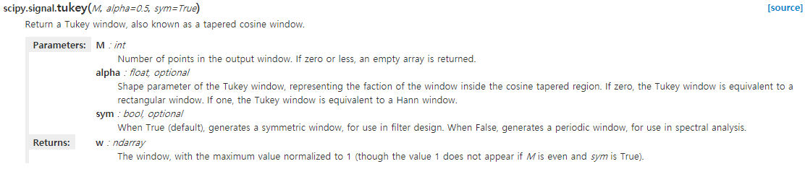
Spectrogram
Spectrograms were generated using 2-second sub-epochs formed by a Tukey window with 25% of the window inside the tapered cosine region.

Slide 8
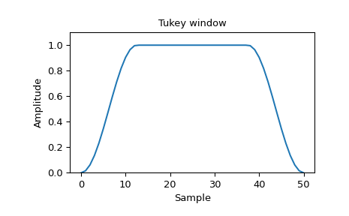
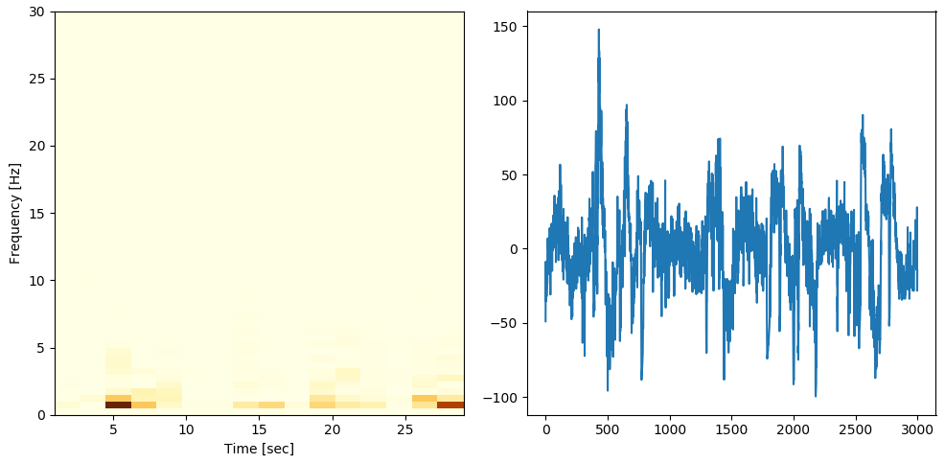
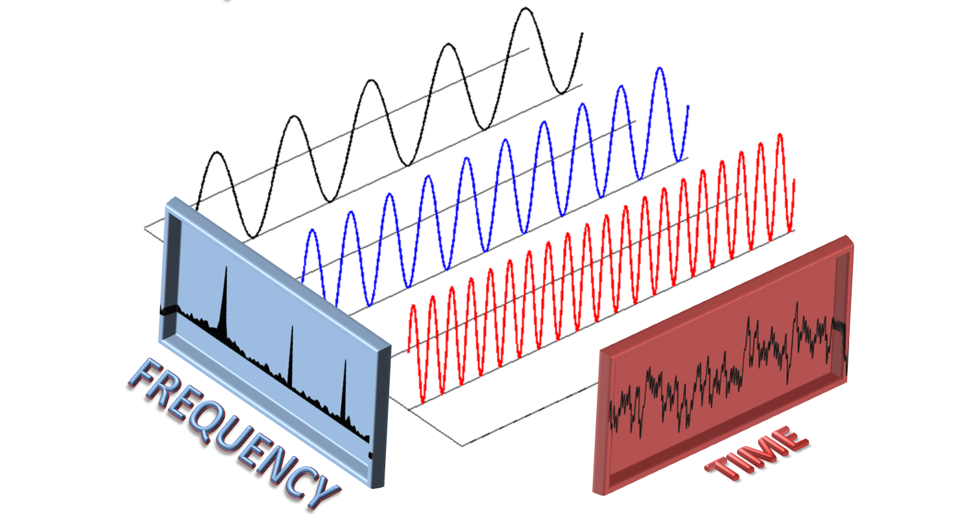
Spectrogram
곡선의 정도
f, t, Sxx = signal.spectrogram(sample, fs=100, window=('tukey', .25), nperseg=200)
noverlap = nperseg // 8

Slide 9
Spectrogram
Segment
Segment
Segment
FFT
Segment가 작을수록 폭이 좁아짐

Slide 10
Model evaluation
Accuracy
F1-score
Cohen's kappa
Weighted accuracy
Unweighted accuracy
Transition epoch F1-score were caculated as a scoring agreement that is known to degrade during the transition from one stage of sleep to another.
Transition stages account for approximately 0.5 % of the data but were evaluated as they potentially convey physiologically relevant information.

Slide 11
Transfer learning
Generalizability was assessed using the SOF and MrOS datasets.
These studies were conducted in different environments with various types of acquisition hardware and on different patient populations than SHHS.
Model performance was additionally evaluated on subsets of the SHHS population with mild, moderate, and severe obstructive sleep apnea(OSA) to demonstrate model transferability between patients with different degrees of sleep-disordered breathing.
A separate model was also trained and tested on only severe patients to demonstrate validity even when restricted to a subset of studied patients.

Slide 12
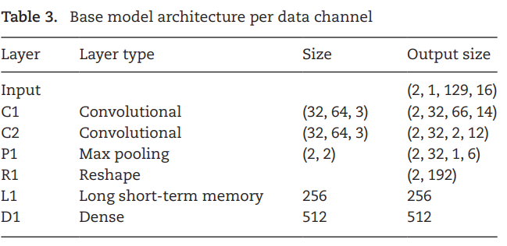
Results
The optimal sleep staging model's architecture consisted of a combination of separate networks for each signal channel.
Spectrograms of each channel were fed into convolutional layers that examined the proximal relationships of the frequencies in time as well as recurrent layers that examined the sequential relationships of epochs.
The subnetworks for each signal channel were combined into two dense layers feeding into a final softmax output layer used to generate discrete stage predictions for each epoch.
(b, c, h, w)

Slide 13
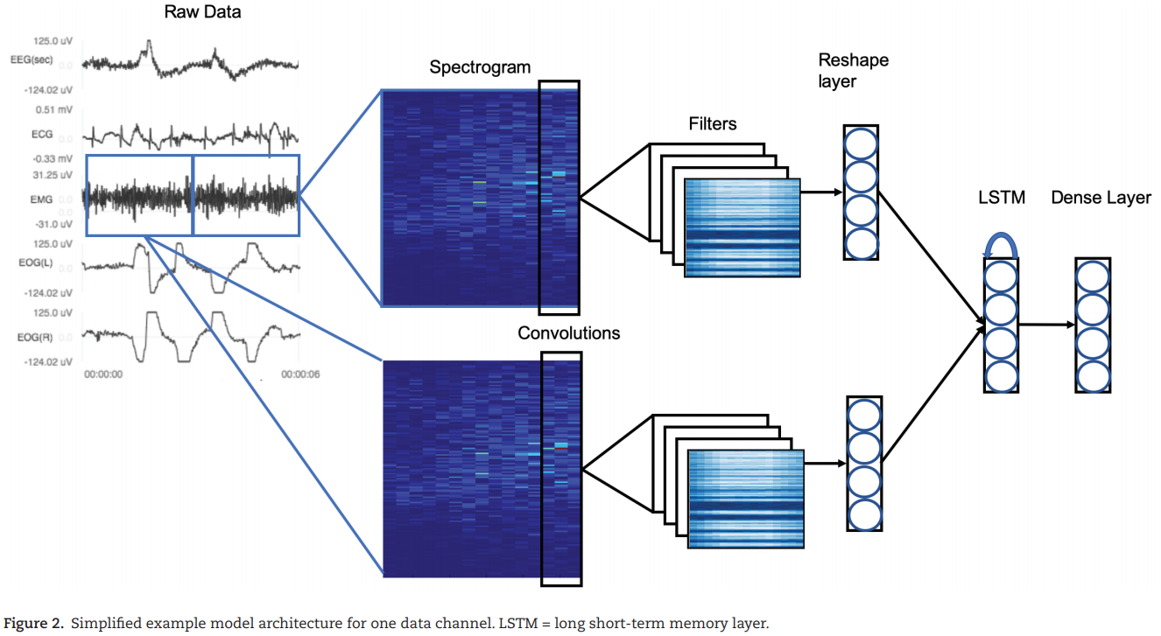
Model architecture

Slide 14
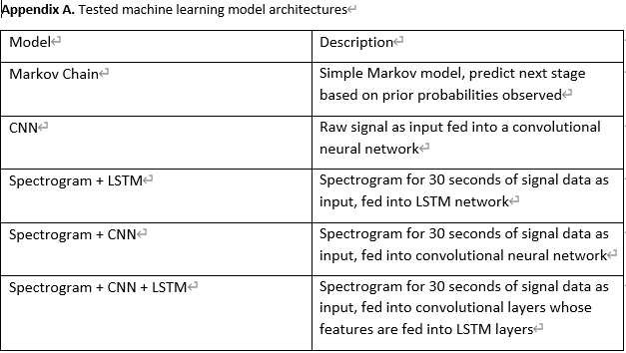
Model - Appendix

Slide 15
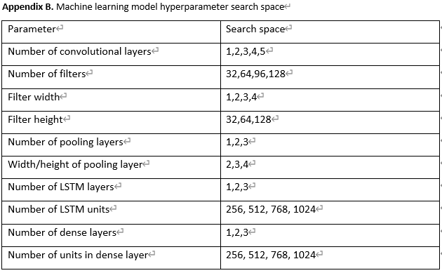
Model tuning

Slide 16
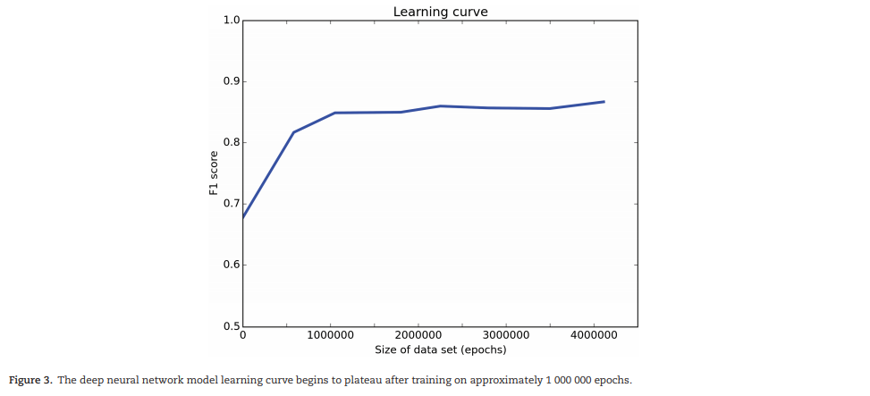
Learning curve
90% : 10%
Model training required approximately 48 hours on an Nvidia GTX Titan X GPU.
A learning curve plateauing around 1,000,000 training epochs demonstrated that the dataset was sufficiently large

Slide 17
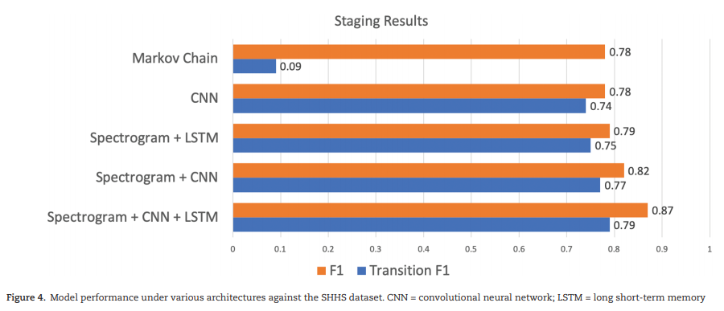
Results
The optimal neural network model was composed of spectrograms in the input layer feeding into CNN layers and an LSTM layer to achieve a weighted F1-score of 0.87 and Cohen's Unweighted kappa of K = 0.82, higher than that of human agreement found in literature (K = 0.76).

Slide 18
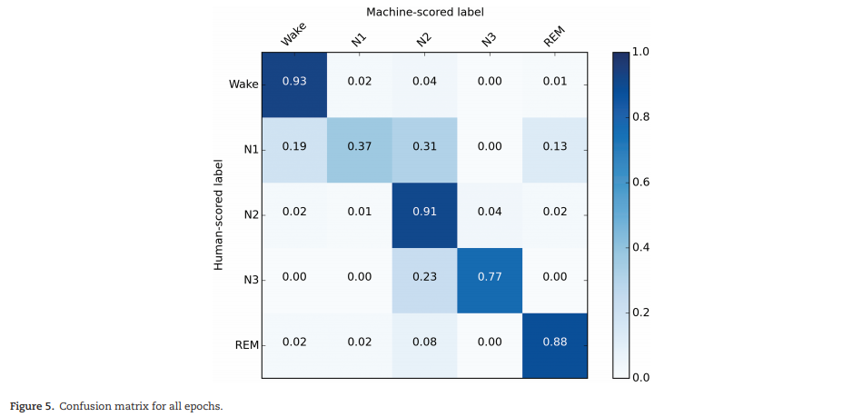
Optimal model confusion matrix

Slide 19
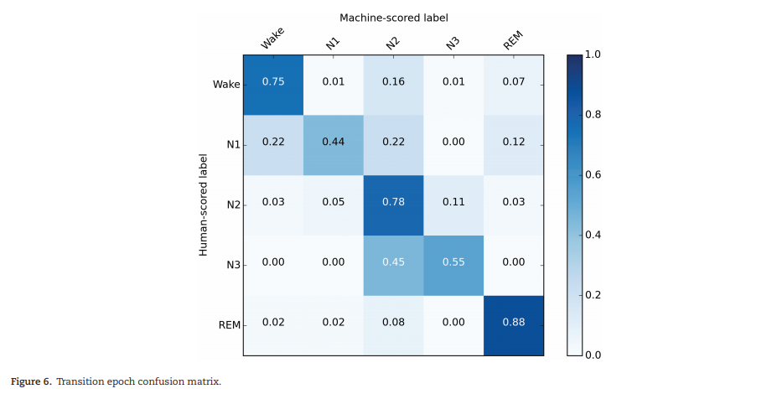
Optimal model confusion matrix

Slide 20
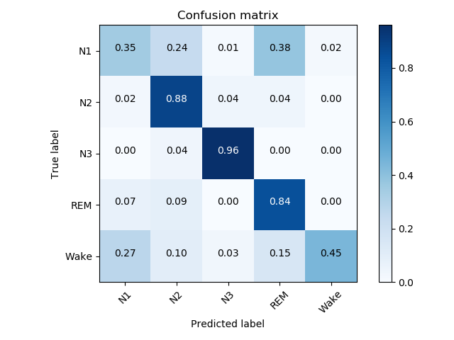
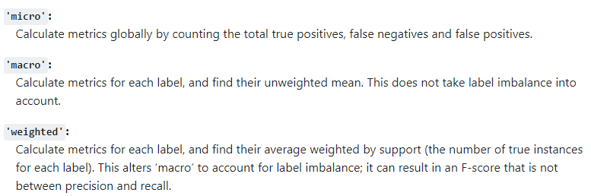
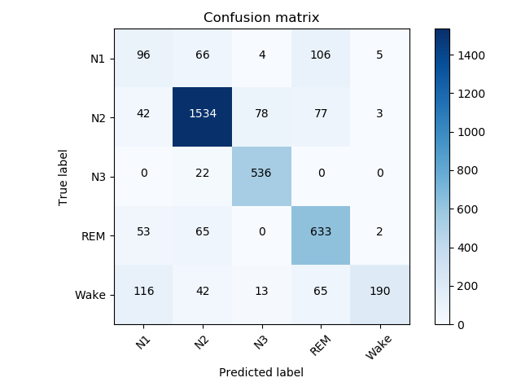
F1 score
precision : 실제값이 true인 것을 false로 예측한것의 비율
recall : 실제값이 false인 것을 true로 예측한것의 비율
batch 64
Total F1 score를 계산해서 평균
각 라벨의 F1 score를 계산해서 평균
각 라벨의 F1 score를 계산해서 weighted 평균
F1 socre macro : 0.6996233418587082
F1 socre micro : 0.7974919957310566
F1 socre weighted : 0.7930584224492141
N1 N2 N3 REM Wake
0.32876712 0.88593705 0.90159798 0.7747858 0.60702875

Slide 21
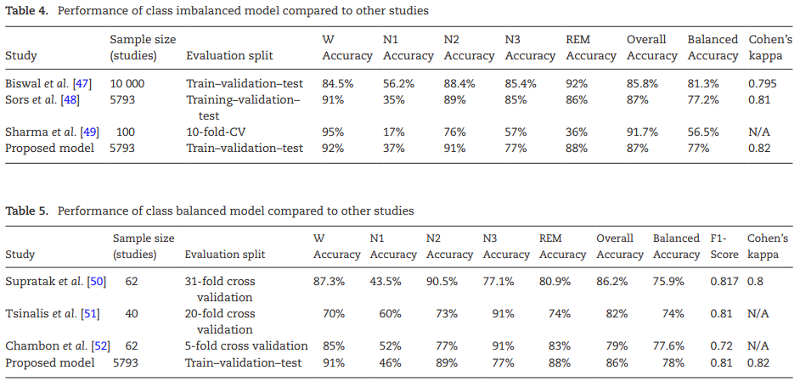

Slide 22
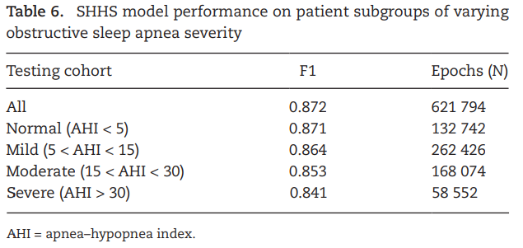
Permance on cohorts with and without sleep disordered breathing
The model performs similarly on subsets of the holdout set with different apnea severity (Table 6).
A model trained and tested on severe OSA patients only achieved an unweighted F1-score of 0.846, similar to the model trained on heterogeneous data.

Slide 23
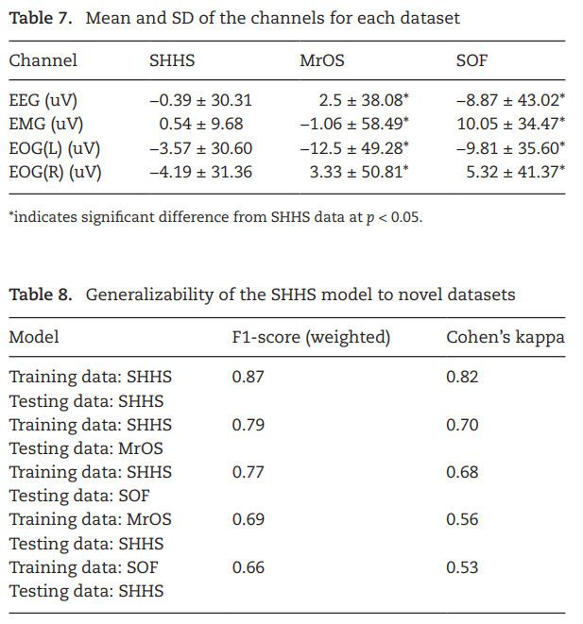

Slide 24
Discussion
Noise가 있는게 더 좋더라
전처리 작업이 성능을 크게 향상시키진 않는다. 오히려 떨어질수도..
데이터 균형을 맞추는 건 오히려 안좋더라
결국은 실생활에 데이터가 불균형하기 때문
N1이 안좋은건 데이터가 깔끔하지 않아서 그럴 수도 있다.
결국은 스티커 부착해서 하는 거라 환자 움직임 그런게 많이 발생하는 부분
결국 N1을 잘 학습하거나 잘못 학습해도 전문가와 모델의 일치도는 낮다라는 것
이 논문의 장점
일반화에 대한 실험
각 데이터셋에 사용된 장비의 마이크로 볼트의 차이에도 불구하고 좋거나 중간 수준의 정확도
데이터를 늘리면(채널) 성능이 향상될 가능성이 존재
현재 인간 수준임을 암시
향후 작업 : 일반화가 가능하도록 모델을 구축하고 대규모 라이브러리 구축

