Slide 1
Bag of Tricks

Slide 2

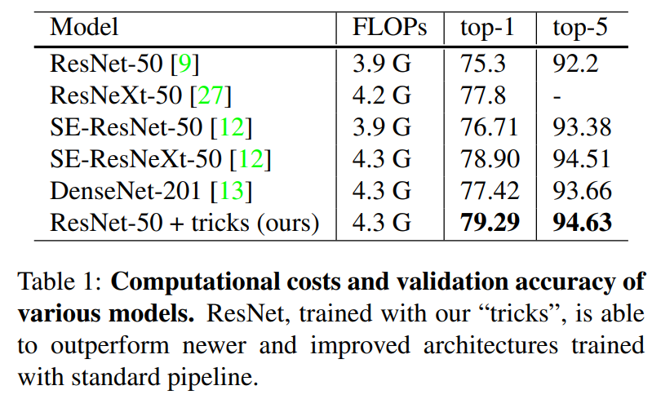
Introduction
Collection of training procedure
Model architecture refinements
Better transfer learning performance

Slide 3
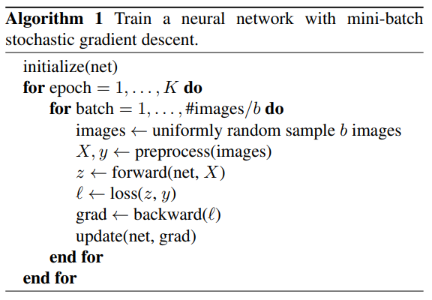
Training Procedures

Slide 4
Baseline Training Procedures
1. Randomly sample an image and decode it into 32-bit floating point raw pixel values in [0, 255].
2. Randomly crop a rectangular region whose aspect ratio is randomly sampled in [3/4, 4/3] and area randomly sampled in [8%, 100%], then resize the cropped region into a 224-by-224 square image.
3. Flip horizontally with 0.5 probability.
4. Scale hue, saturation, and brightness with coefficients uniformly drawn from [0.6, 1.4].
5. Add PCA noise with a coefficient sampled from a normal distribution N (0, 0.1).
6. Normalize RGB channels by subtracting 123.68, 116.779, 103.939 and dividing by 58.393, 57.12, 57.375, respectively.

Slide 5
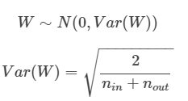
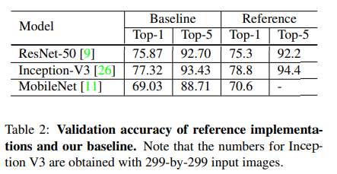

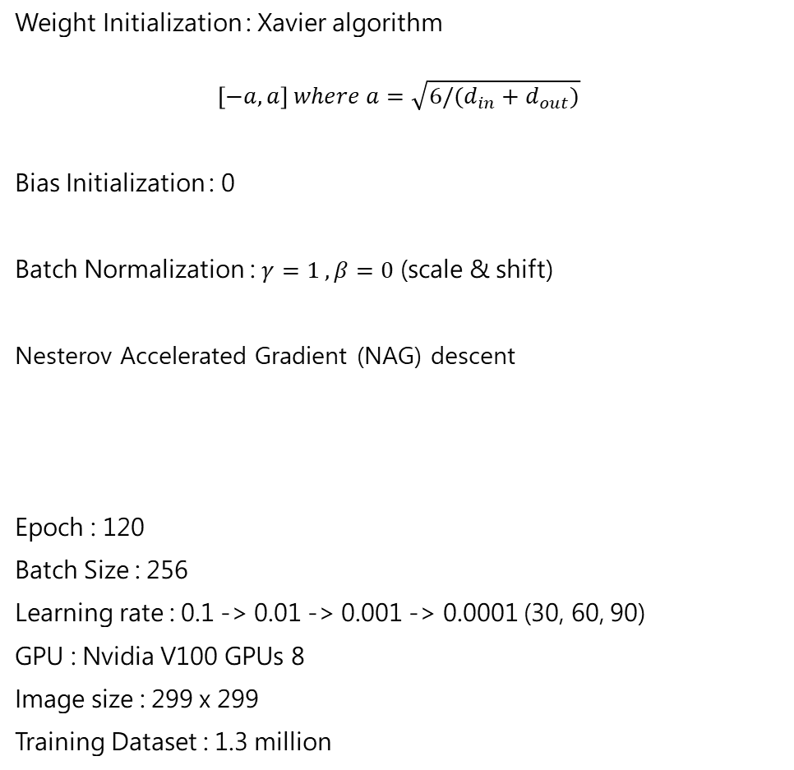
Baseline Training Procedures
Weight Initialization : Xavier algorithm
$$\left[−a, a\right] where a=\sqrt{6/(d_{in}+d_{out})}$$
Bias Initialization : 0
Batch Normalization : $γ=1 , β=0$ (scale & shift)
Nesterov Accelerated Gradient (NAG) descent
Epoch : 120
Batch Size : 256
Learning rate : 0.1 -> 0.01 -> 0.001 -> 0.0001 (30, 60, 90)
GPU : Nvidia V100 GPUs 8
Image size : 299 x 299
Training Dataset : 1.3 million

Slide 6
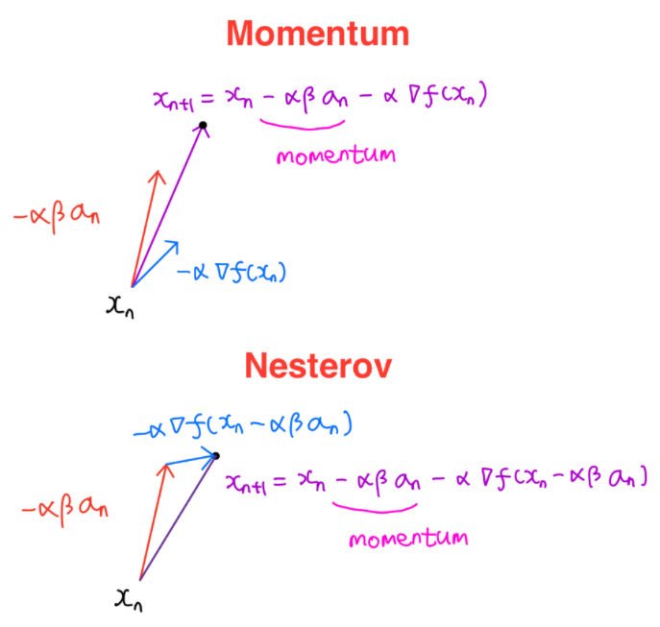
Nesterov Accelerated Gradient (NAG)

Slide 7
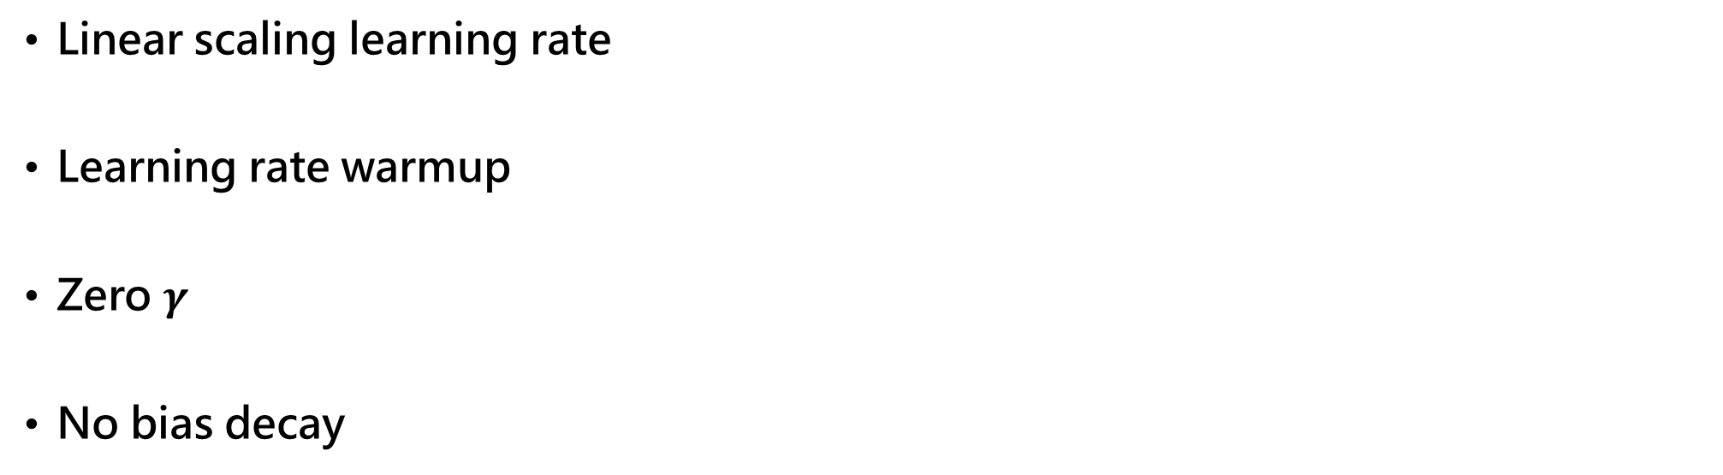
Large-batch training
Mini-batch SGD groups multiple samples to a minibatch to increase parallelism and decrease communication costs.
Using large batch size, however, may slow down the training progress.
For convex problems, convergence rate decreases as batch size increases.
Similar empirical results have been reported for neural networks [25].
In other words, for the same number of epochs, training with a large batch size results in a model with degraded validation accuracy compared to the ones trained with smaller batch sizes.
Multiple works [7, 14] have proposed heuristics to solve this issue.
In the following paragraphs, we will examine four heuristics that help scale the batch size up for single machine training.
Linear scaling learning rate
Learning rate warmup
Zero $γ$
No bias decay

Slide 8
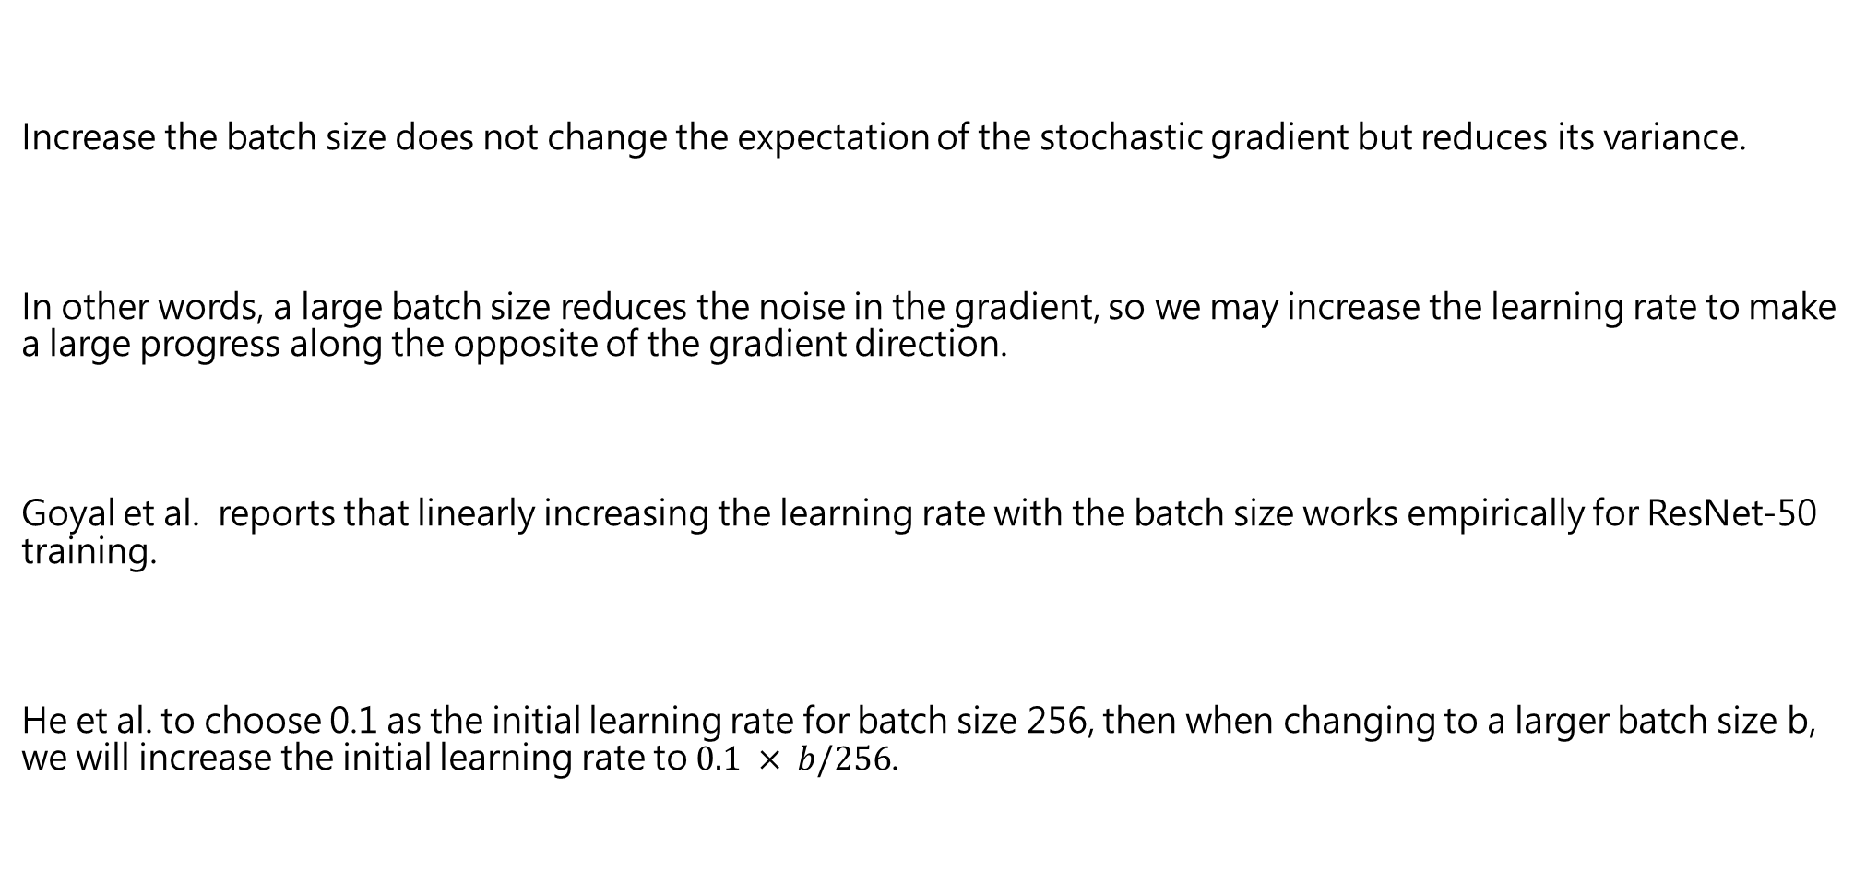
Linear scaling learning rate
Increase the batch size does not change the expectation of the stochastic gradient but reduces its variance.
In other words, a large batch size reduces the noise in the gradient, so we may increase the learning rate to make a large progress along the opposite of the gradient direction.
Goyal et al. reports that linearly increasing the learning rate with the batch size works empirically for ResNet-50 training.
He et al. to choose 0.1 as the initial learning rate for batch size 256, then when changing to a larger batch size b, we will increase the initial learning rate to $0.1 × b/256$.

Slide 9
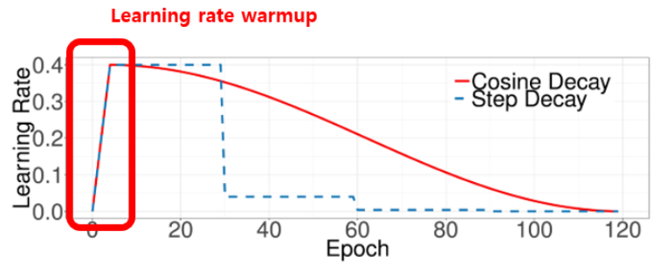

Learning rate warmup
Goyal et al. proposes a gradual warmup strategy that increases the learning rate from 0 to the initial learning rate linearly.
In other words, assume we will use the first $m$ batches (e.g. 5 data epochs) to warm up, and the initial learning rate is $η$, then at batch $i$, $1 ≤ i ≤ m$, we will set the learning rate to be $iη/m$

Slide 10
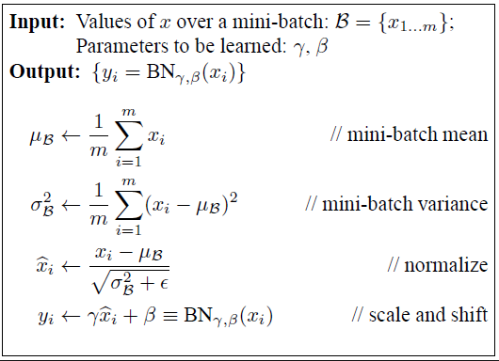
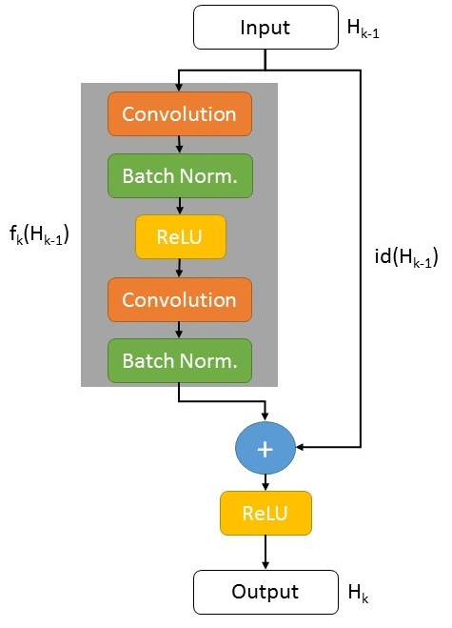
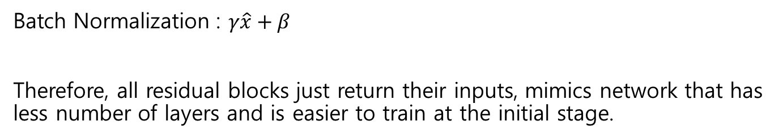
Zero $γ$
Batch Normalization : $γ\hat{x}+β$
Therefore, all residual blocks just return their inputs, mimics network that has less number of layers and is easier to train at the initial stage.

Slide 11
No bias Decay
The weight decay is often applied to all learnable parameters including both weights and bias.
As pointed out by Jia et al. , however, it’s recommended to only apply the regularization to weights to avoid overfitting.
The no bias decay heuristic follows this recommendation, it only applies the weight decay to the weights in convolution and fullyconnected layers.
Other parameters, including the biases and γ and β in BN layers, are left unregularized.

Slide 12
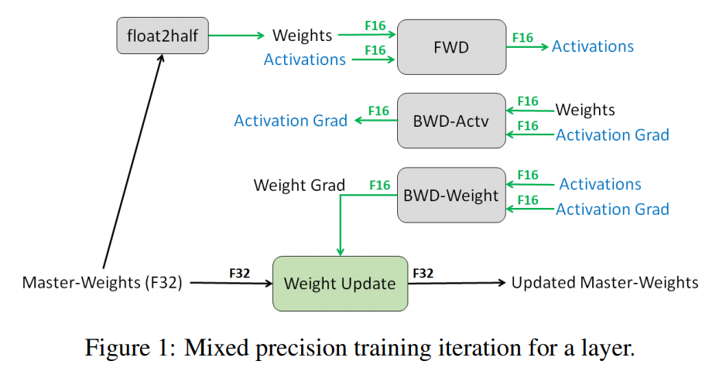
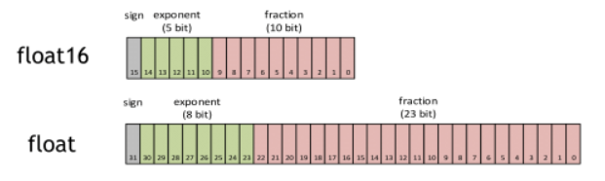
Low precision training
FP16 : all parameters and activations
FP32 : parameter updating

Slide 13
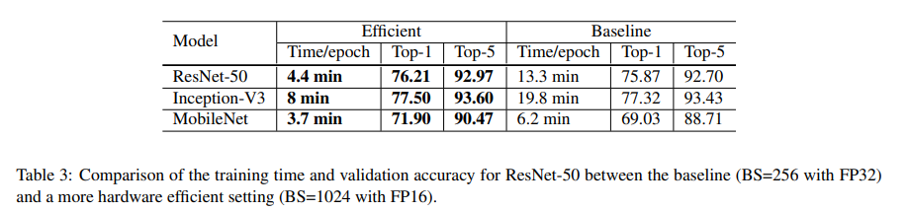
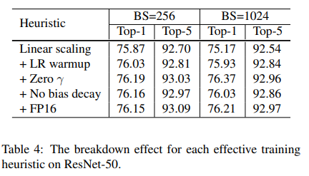
Experiment Results - Efficient

Slide 14
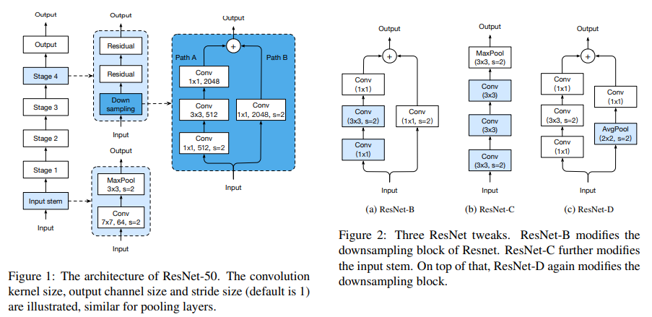
Model Tweaks

Slide 15
ResNet Tweaks
ResNet B
- The observation is that the convolution in path A ignores three-quarters of the input feature map because it uses a kernel size 1×1 with a stride of 2.
- ResNet-B switches the strides size of the first two convolutions in path A, as shown in Figure 2a, so no information is ignored.
- Because the second convolution has a kernel size 3 × 3, the output shape of path A remains unchanged.
ResNet C
- The observation is that the computational cost of a convolution is quadratic to the kernel width or height.
- A 7 × 7 convolution is 5.4 times more expensive than a 3 × 3 convolution.
- So this tweak replacing the 7 × 7 convolution in the input stem with three conservative 3 × 3 convolutions, which is shown in Figure 2b, with the first and second convolutions have their output channel of 32 and a stride of 2, while the last convolution uses a 64 output channel.
ResNet D
- Inspired by ResNet-B, we note that the 1 × 1 convolution in the path B of the downsampling block also ignores 3/4 of input feature maps, we would like to modify it so no information will be ignored.
- Empirically, we found adding a 2×2 average pooling layer with a stride of 2 before the convolution, whose stride is changed to 1, works well in practice and impacts the computational cost little. This tweak is illustrated in Figure 2c.

Slide 16
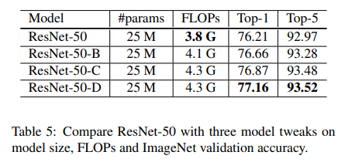
Experiment Results

Slide 17
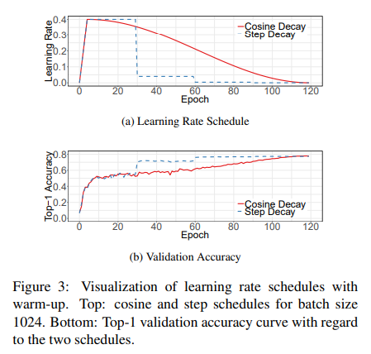

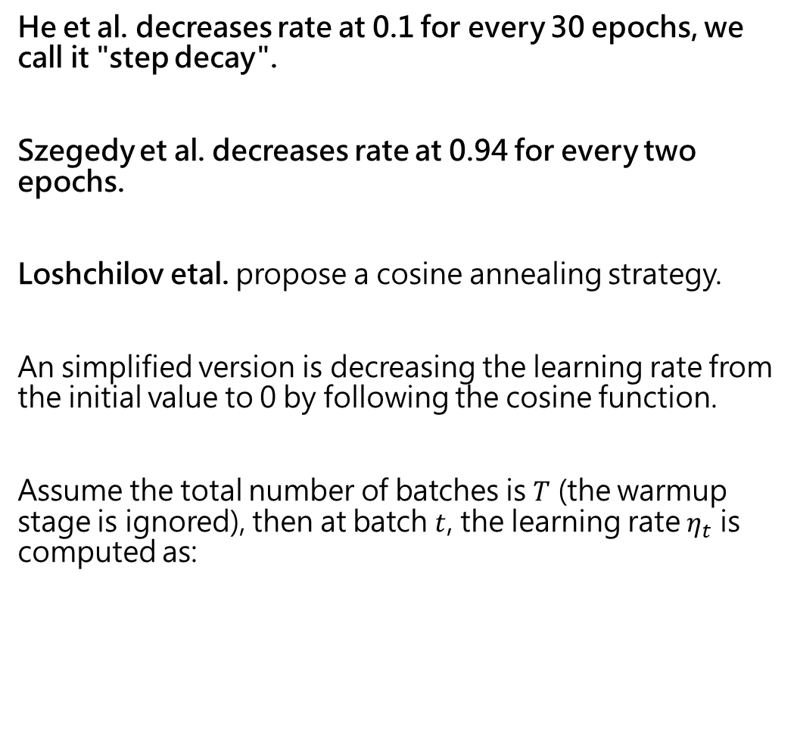
Cosine Learning Rate Decay
He et al. decreases rate at 0.1 for every 30 epochs, we call it "step decay".
Szegedy et al. decreases rate at 0.94 for every two epochs.
Loshchilov etal. propose a cosine annealing strategy.
An simplified version is decreasing the learning rate from the initial value to 0 by following the cosine function.
Assume the total number of batches is $T$ (the warmup stage is ignored), then at batch $t$, the learning rate $η_{t}$ is computed as:

Slide 18

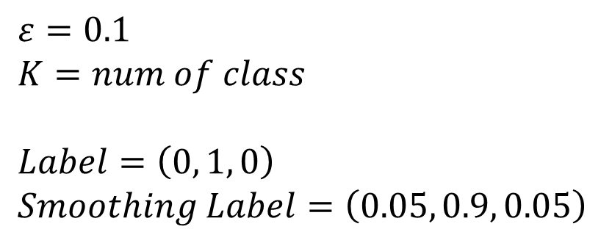
Label Smoothing
$ε=0.1$
$K=num of class$
$Label=\left(0, 1, 0\right)$
$Smoothing Label=\left(0.05, 0.9, 0.05\right)$

Slide 19
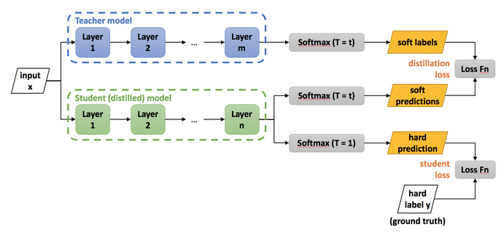
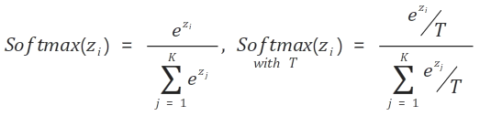
Knowledge Distillation

Slide 20
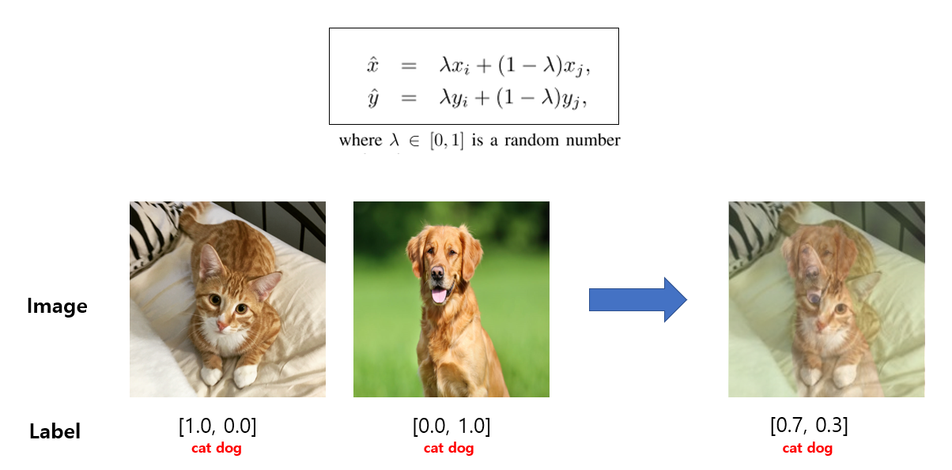
Mixup

Slide 21
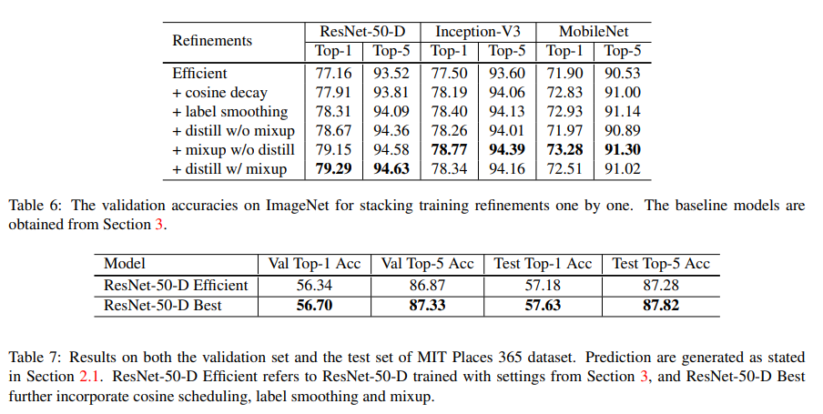

Experiment Results
label smoothing : $ε=0.1$
Distillation : $T=20$ , Teacher : ResNet-152-D
Mixup : $α=0.2$
Epoch : 200

Slide 22
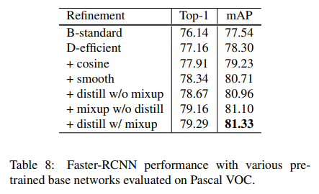
Object Detection

Slide 23
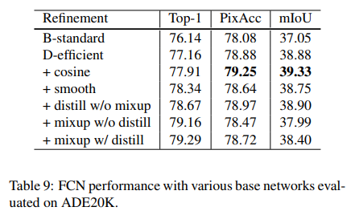
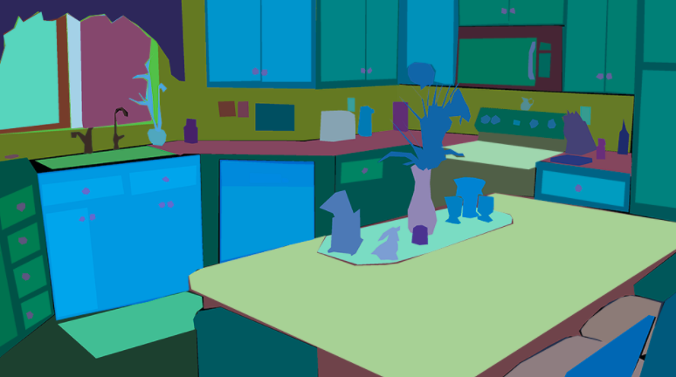
Semantic Segmentation
A potential explanation to the phenomenon is that semantic segmentation predicts in the pixel level.
While models trained with label smoothing, distillation and mixup favor soften labels, blurred pixel-level information may be blurred and degrade overall pixel-level accuracy.

