Slide 1
Optimizer Function
Jaemin Jeong

Slide 2

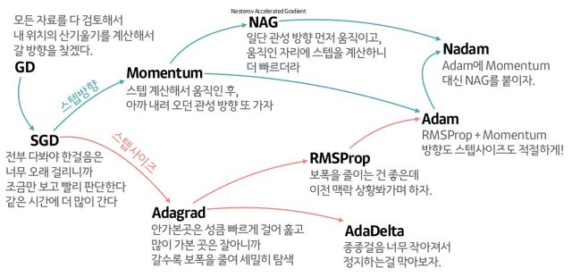
Optimizer

Slide 3
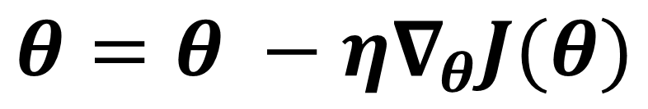
Optimizer
$$θ=θ −η∇_{θ}J(θ)$$

Slide 4
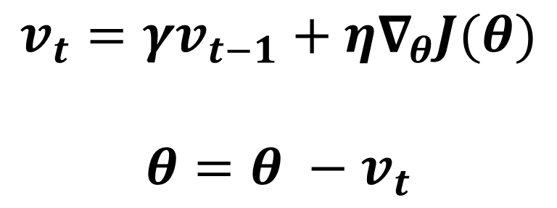
Momentum
1. local minimum에 빠지는 것을 방지
$$v_{t}=γv_{t−1}+η∇_{θ}J(θ)$$
$$θ=θ −v_{t}$$

Slide 5
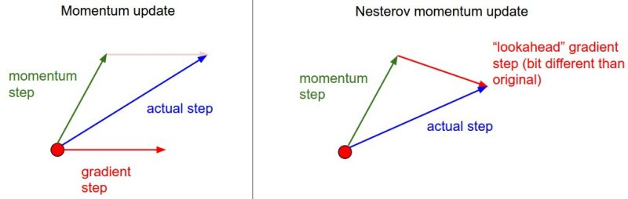
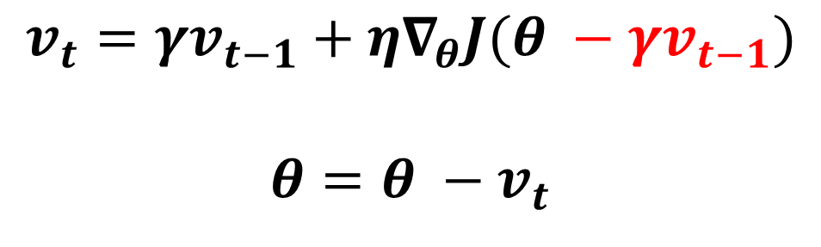
Nesterov Accelerated Gradient (NAG)
1. global minimum에 안정적이고 빠르게 들어가게 하기 위함
$$v_{t}=γv_{t−1}+η∇_{θ}J(θ −γv_{t−1})$$
$$θ=θ −v_{t}$$

Slide 6
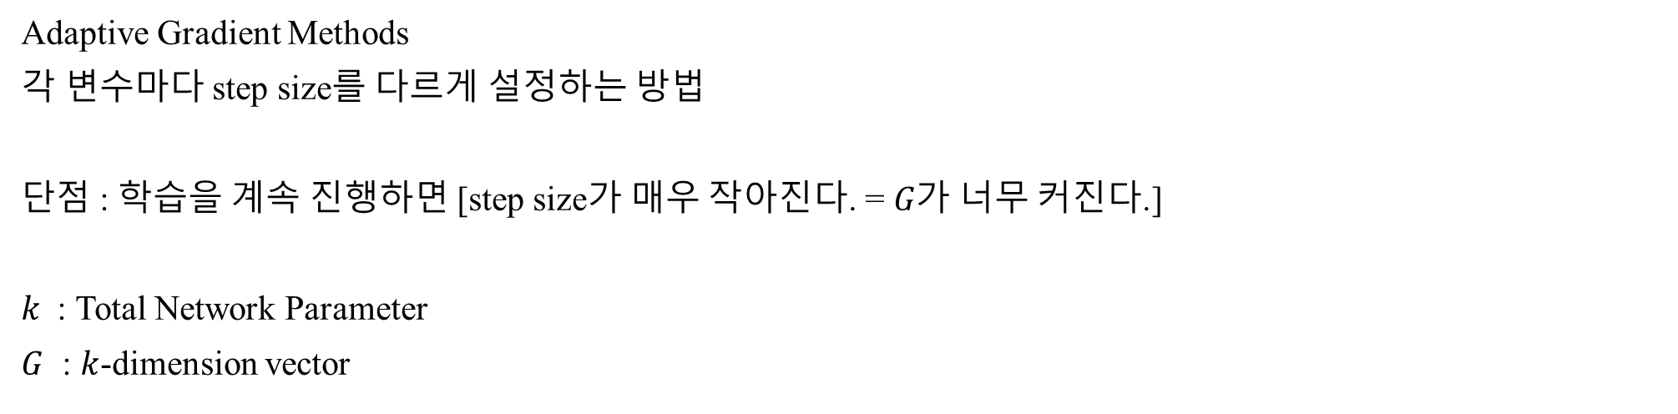
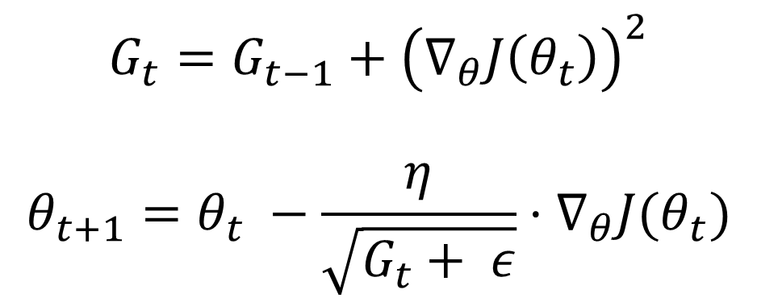
Adagrad
Adaptive Gradient Methods
각 변수마다 step size를 다르게 설정하는 방법
단점 : 학습을 계속 진행하면 [step size가 매우 작아진다. = $G가$ 너무 커진다.]
$k$ : Total Network Parameter
$G$ : $k$-dimension vector
$$G_{t}=G_{t−1}+{\left(∇_{θ}J\left(θ_{t}\right)\right)}^{2}$$
$$θ_{t+1}=θ_{t} −\frac{η}{\sqrt{G_{t}+ ε}}⋅∇_{θ}J(θ_{t})$$

Slide 7
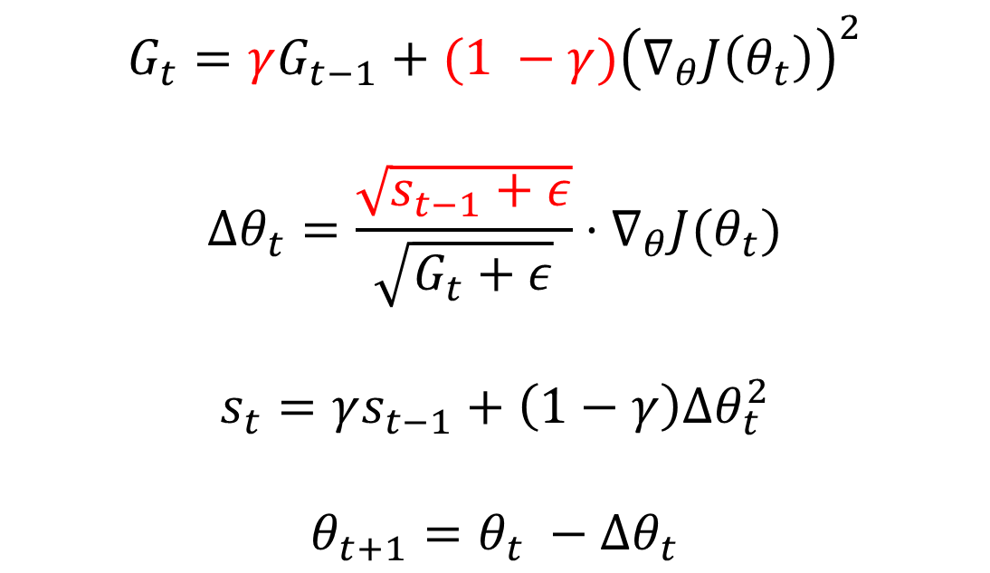
AdaDelta
1. learning rate가 작아지는 문제를 해결한다.
2. learning rate 설정이 필요없다.
$$G_{t}=γG_{t−1}+{(1 −γ)\left(∇_{θ}J\left(θ_{t}\right)\right)}^{2}$$
$$∆θ_{t}=\frac{\sqrt{s_{t−1}+ε}}{\sqrt{G_{t}+ε}}⋅∇_{θ}J(θ_{t})$$
$$s_{t}=γs_{t−1}+\left(1−γ\right)∆θ_{t}^{2}$$
$$θ_{t+1}=θ_{t} −∆θ_{t}$$
현재
최근

Slide 8
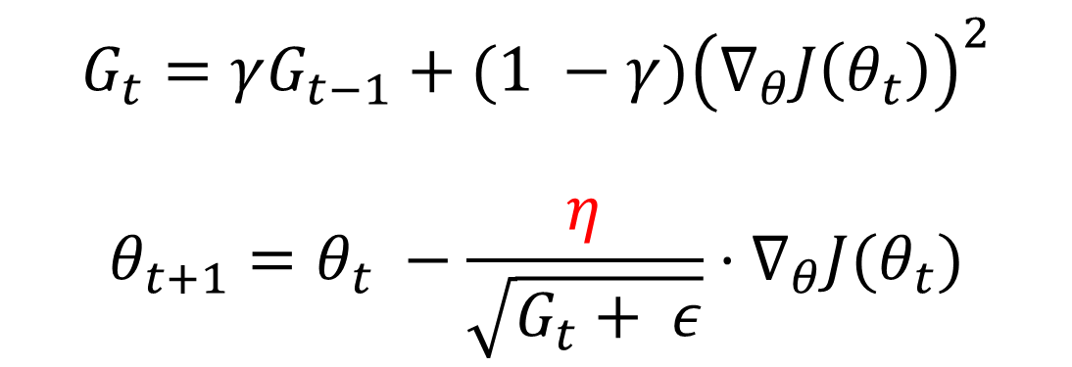
RMSProp
$G$가 커지는 것을 방지하는 이동 지수 평균 term을 추가
$$G_{t}=γG_{t−1}+{(1 −γ)\left(∇_{θ}J\left(θ_{t}\right)\right)}^{2}$$
$$θ_{t+1}=θ_{t} −\frac{η}{\sqrt{G_{t}+ ε}}⋅∇_{θ}J(θ_{t})$$

Slide 9

Adam : RMSProp + Momentum
$$m_{t}=β_{1}m_{t−1}+\left(1−β_{1}\right)∇_{θ}J(θ)$$
$$v_{t}=β_{2}v_{t−1}+\left(1−β_{2}\right){\left(∇_{θ}J\left(θ\right)\right)}^{2}$$
$$\hat{m_{t}}=\frac{m_{t}}{1 −β_{1}^{t}}$$
$$\hat{v_{t}}=\frac{v_{t}}{1 −β_{2}^{t}}$$
$$θ_{t+1}=θ_{t} −\frac{η}{\sqrt{\hat{v_{t}}+ε}} \hat{m_{t}}$$
모평균 : 1차 moment
모분산 : 2차 moment
m과 v가 0으로 편향되는 걸 방지

Slide 10
Decoupled Weight Decay Regulatization (AdamW) ICLR 2019
Jaemin Jeong

Slide 11
Introduction
L2 regularization and weight decay are not identical.
L2 regularization is not effective in Adam.
Weight decay is equally effective in both SGD and Adam.
Optimal weight decay depends on the total number of batch passes/weight updates.
Adam can substantially benefit from a scheduled learning rate multiplier.

Slide 12
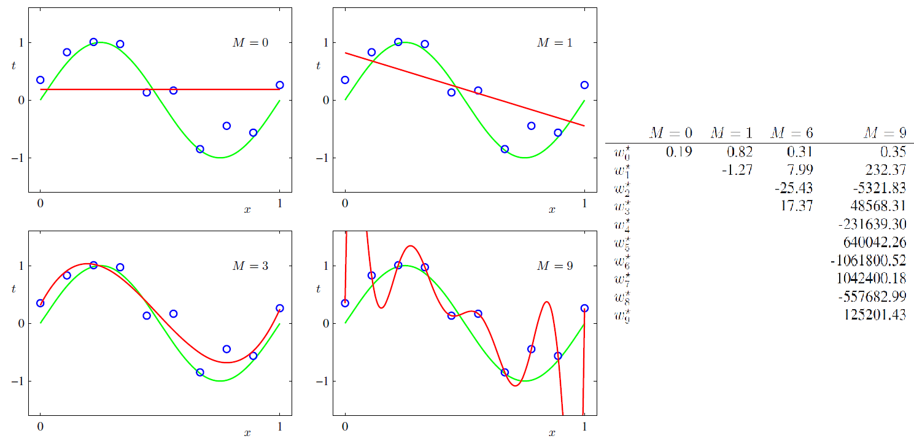
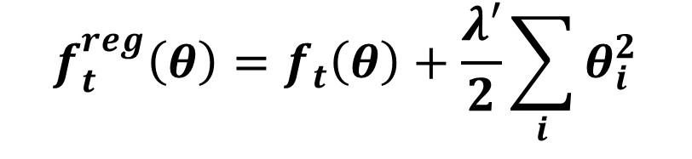
L2 regularization
$$f_{t}^{reg}\left(θ\right)=f_{t}\left(θ\right)+\frac{λ′}{2}\sum_{i}{θ_{i}^{2}}$$

Slide 13
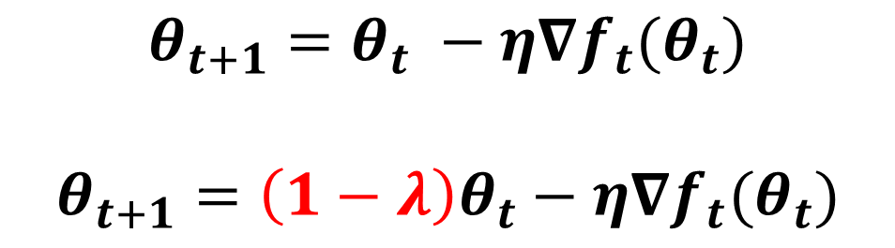
Weight Decay
$$θ_{t+1}=θ_{t} −η∇f_{t}(θ_{t})$$
$$θ_{t+1}=\left(1−λ\right)θ_{t}−η∇f_{t}(θ_{t})$$

Slide 14
L2 regularization == Weight Decay ??
SGD
Adam

Slide 15
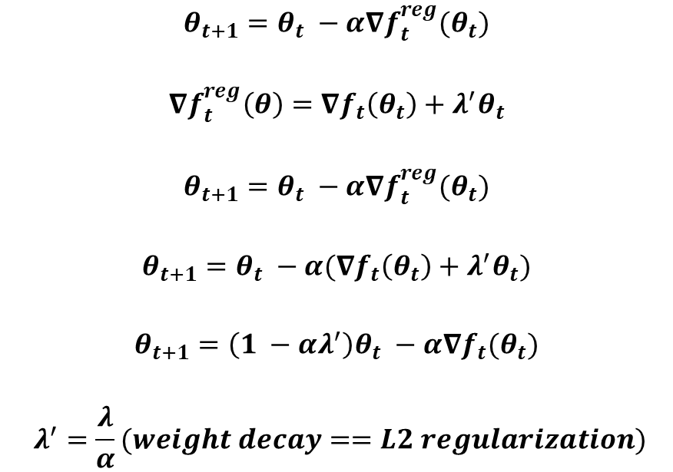
SGD
$$θ_{t+1}=θ_{t} −α∇f_{t}^{reg}(θ_{t})$$
$$∇f_{t}^{reg}\left(θ\right)=∇f_{t}\left(θ_{t}\right)+λ^{′}θ_{t}$$
$$θ_{t+1}=θ_{t} −α∇f_{t}^{reg}(θ_{t})$$
$$θ_{t+1}=θ_{t} −α(∇f_{t}\left(θ_{t}\right)+λ^{′}θ_{t})$$
$$θ_{t+1}=\left(1 −αλ^{′}\right)θ_{t} −α∇f_{t}(θ_{t})$$
$$λ^{′}=\frac{λ}{α}(weight decay==L2 regularization)$$

Slide 16
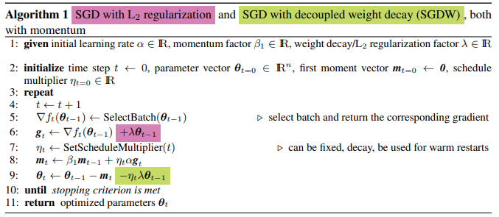
SGD

Slide 17
Adam
$$m_{t}=β_{1}m_{t−1}+\left(1−β_{1}\right)∇_{θ}J(θ)$$
$$v_{t}=β_{2}v_{t−1}+\left(1−β_{2}\right){\left(∇_{θ}J\left(θ\right)\right)}^{2}$$
$$\hat{m_{t}}=\frac{m_{t}}{1 −β_{1}^{t}}$$
$$\hat{v_{t}}=\frac{v_{t}}{1 −β_{2}^{t}}$$
$$θ_{t+1}=θ_{t} −\frac{η}{\sqrt{\hat{v_{t}}+ε}} \hat{m_{t}}$$
모평균 : 1차 moment
모분산 : 2차 moment
m과 v가 0으로 편향되는 걸 방지

Slide 18
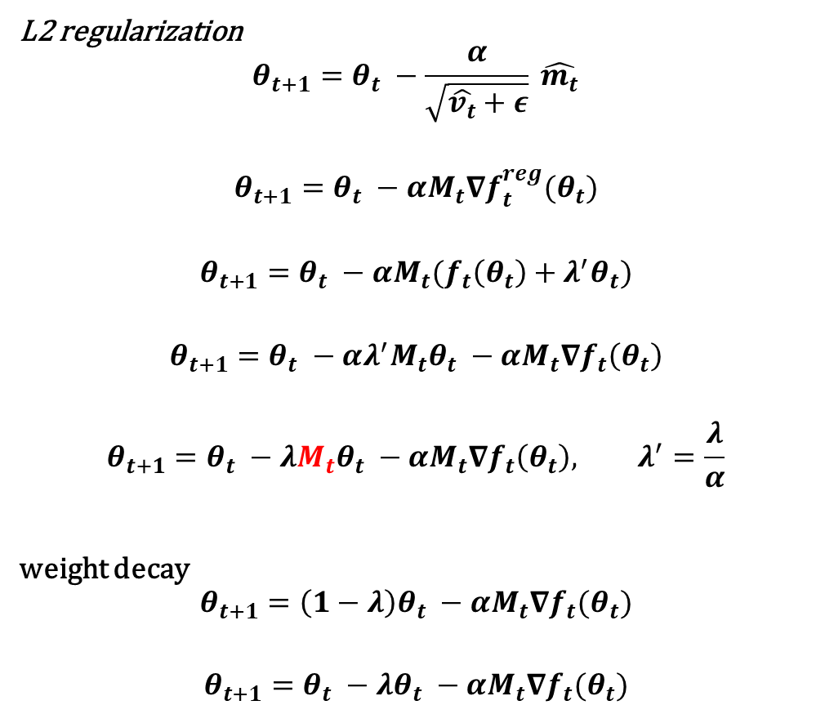
Adam
L2 regularization
$$θ_{t+1}=θ_{t} −\frac{α}{\sqrt{\hat{v_{t}}+ε}} \hat{m_{t}}$$
$$θ_{t+1}=θ_{t} −αM_{t}∇f_{t}^{reg}(θ_{t})$$
$$θ_{t+1}=θ_{t} −αM_{t}(f_{t}\left(θ_{t}\right)+λ^{′}θ_{t})$$
$$θ_{t+1}=θ_{t} −αλ^{′}M_{t}θ_{t} −αM_{t}∇f_{t}\left(θ_{t}\right)$$
$$θ_{t+1}=θ_{t} −λM_{t}θ_{t} −αM_{t}∇f_{t}\left(θ_{t}\right), λ^{′}=\frac{λ}{α}$$
weight decay
$$θ_{t+1}=\left(1−λ\right)θ_{t} −αM_{t}∇f_{t}(θ_{t})$$
$$θ_{t+1}=θ_{t} −λθ_{t} −αM_{t}∇f_{t}(θ_{t})$$

Slide 19
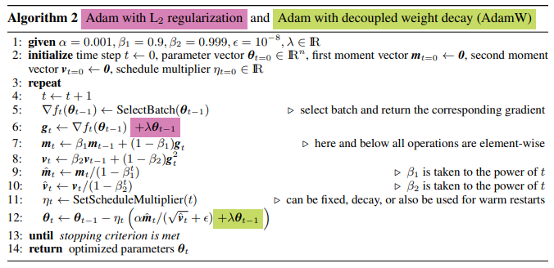
Adam

Slide 20
Experimental validation
shake shake regularization : cnn 중간에 나오는 feature map을 augmentation 하는 방법
Batch size : 128
26 2x64d ResNet : depth = 26, residual branch = 2, width of first residual branch = 64
26 2x96d ResNet : depth = 26, residual branch = 2, width of first residual branch = 96
Cifar10, Imagenet

Slide 21
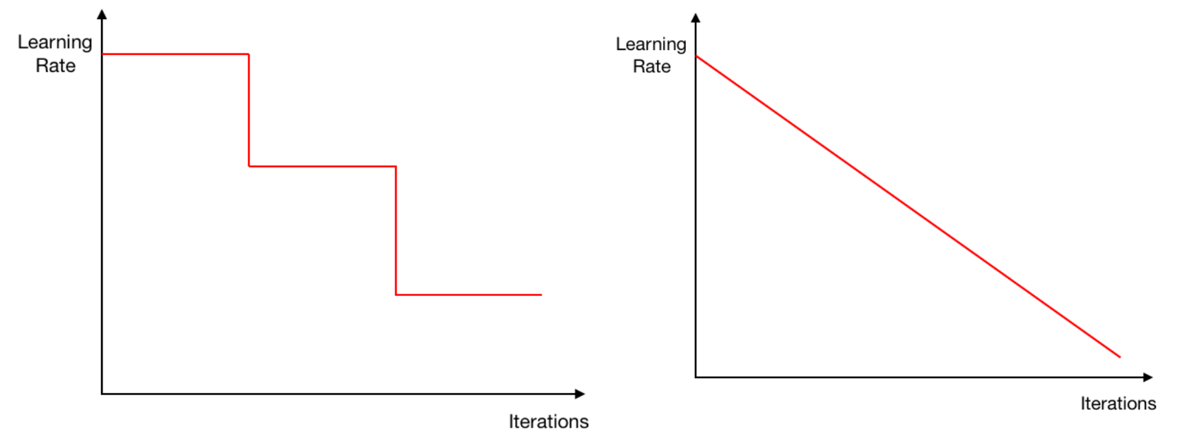
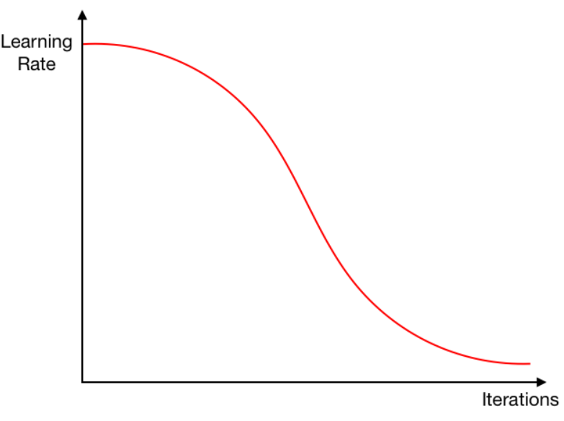
Learning rate scheduler
a fixed learning rate
a drop-step scheduler
a cosine annealing scheduler

Slide 22
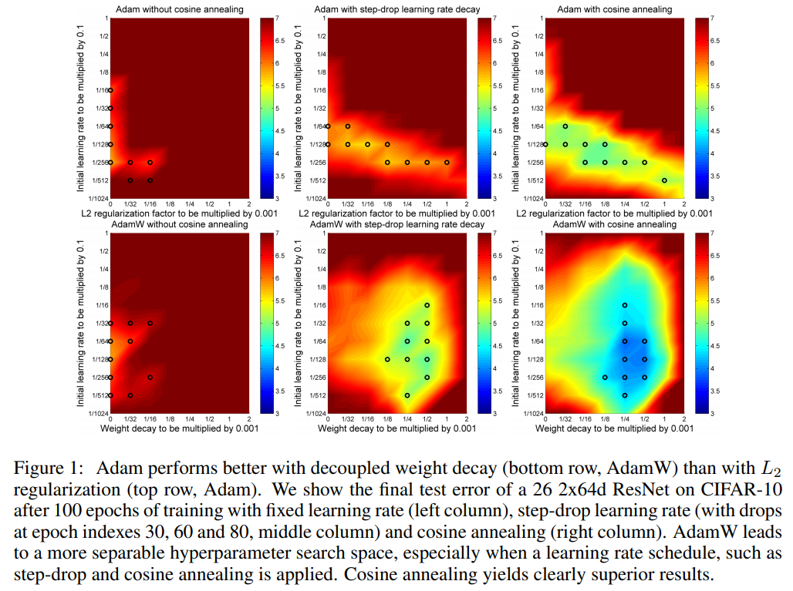

Slide 23
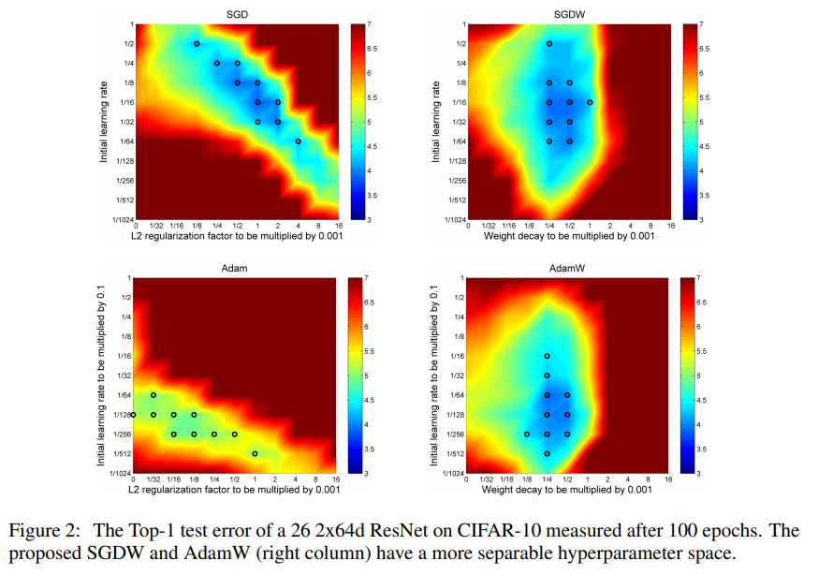

Slide 26
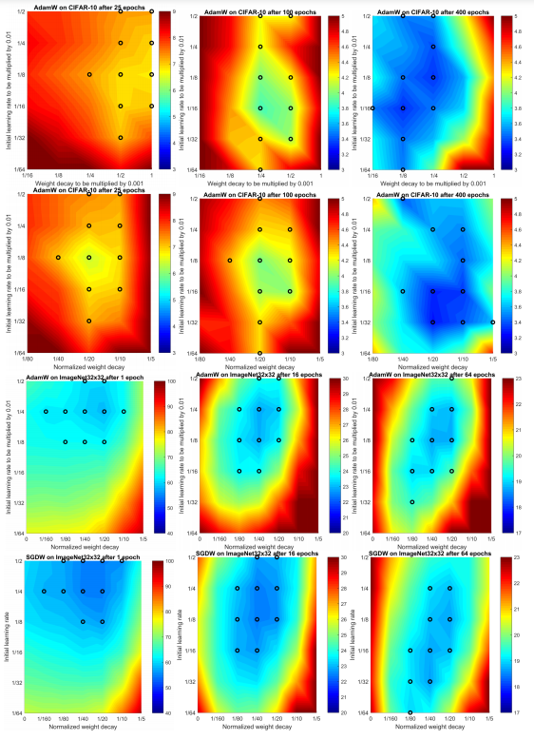
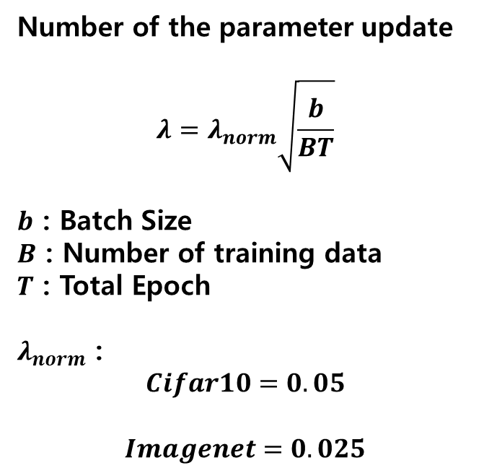
Normalized Weight Decay
Number of the parameter update
$$λ=λ_{norm}\sqrt{\frac{b}{BT}}$$
$b$ : Batch Size
$B$ : Number of training data
$T$ : Total Epoch
$λ_{norm}$ :
$$Cifar10=0.05$$
$$Imagenet=0.025$$

Slide 27
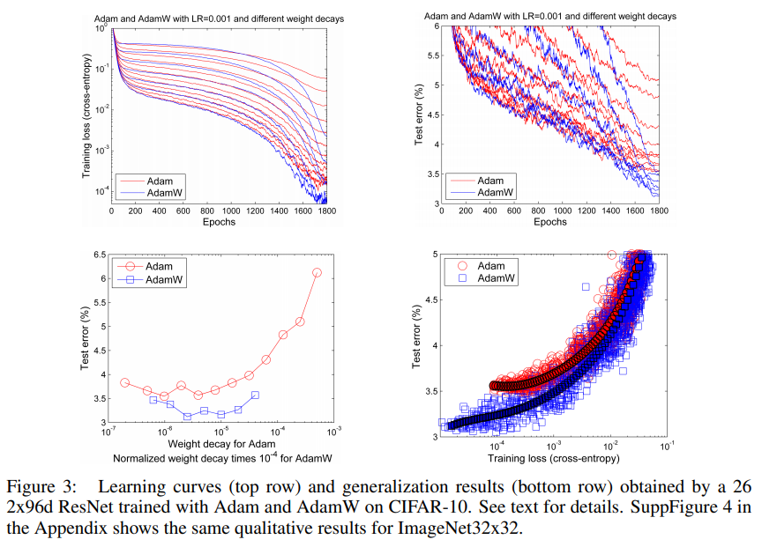

Slide 28
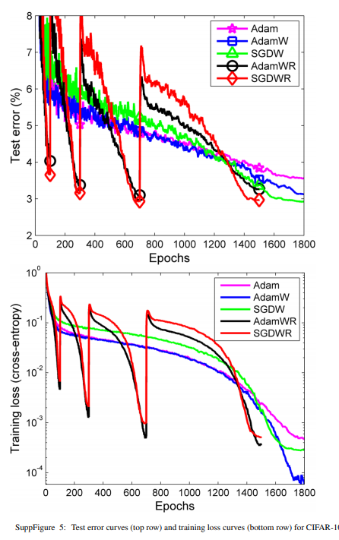
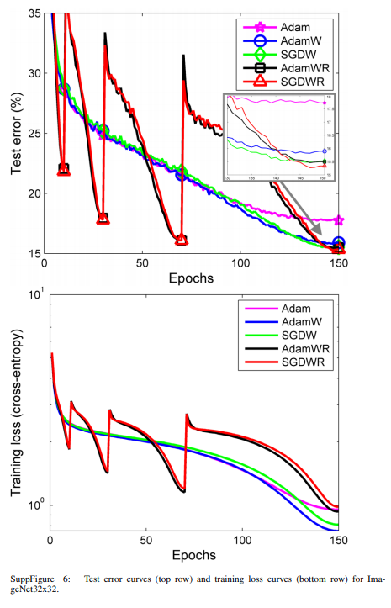

Slide 29
Use of AdamW on other datasets and architectures
-WiderFace
- EEG
- NLP
- etc...

Slide 30
Conclusion
Identified and exposed the inequivalence of L2 regularization and weight decay for Adam.
Adam + Decopuled weight decay > Adam + L2 regularization
Proposed to use warm starts for Adam to improve its anytime performance.

