Slide 1
Shake-Shake Regularization
Xavier Gastaldi
ICLR 2017 Workshop

Slide 2
Introduction
ResNet
Depth : ResNet-v2, DenseNet
Width : Wide ResNet
Cardinality : ResNeXt, Inception-ResNet-v2, Multi-ResNet
Data Augmentation
Improve the generalization ability of multi-branch networks by replacing the standard summation of parallel branches with a stochastic affine combination.

Slide 3
Motivation
Apply data augmentation techniques to internal representations.
Stochastically "blending" 2 viable tensors.

Slide 4
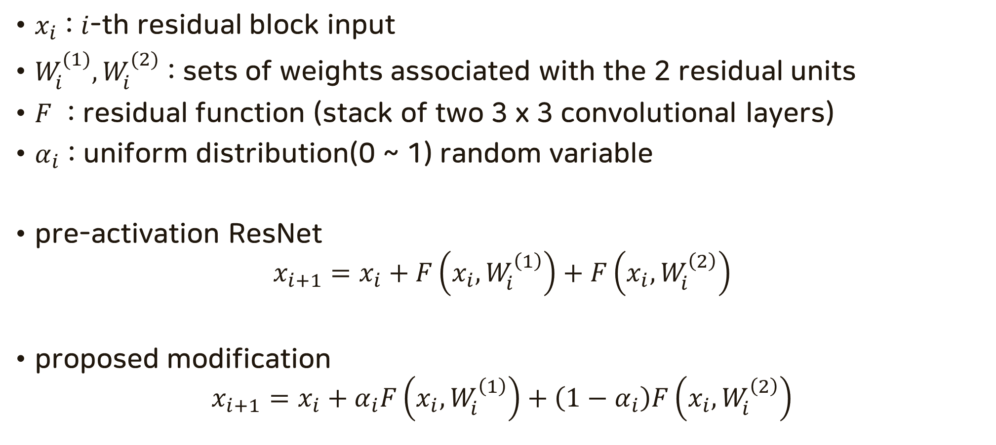
Model description on 3-branch ResNets
$x_{i}$ : $i$-th residual block input
$W_{i}^{(1)}, W_{i}^{(2)}$ : sets of weights associated with the 2 residual units
$F$ : residual function (stack of two 3 x 3 convolutional layers)
$α_{i}$ : uniform distribution(0 ~ 1) random variable
pre-activation ResNet
$$x_{i+1}=x_{i}+F\left(x_{i}, W_{i}^{\left(1\right)}\right)+F\left(x_{i}, W_{i}^{\left(2\right)}\right)$$
proposed modification
$$x_{i+1}=x_{i}+α_{i}F\left(x_{i}, W_{i}^{\left(1\right)}\right)+\left(1−α_{i}\right)F\left(x_{i},W_{i}^{\left(2\right)}\right)$$

Slide 5
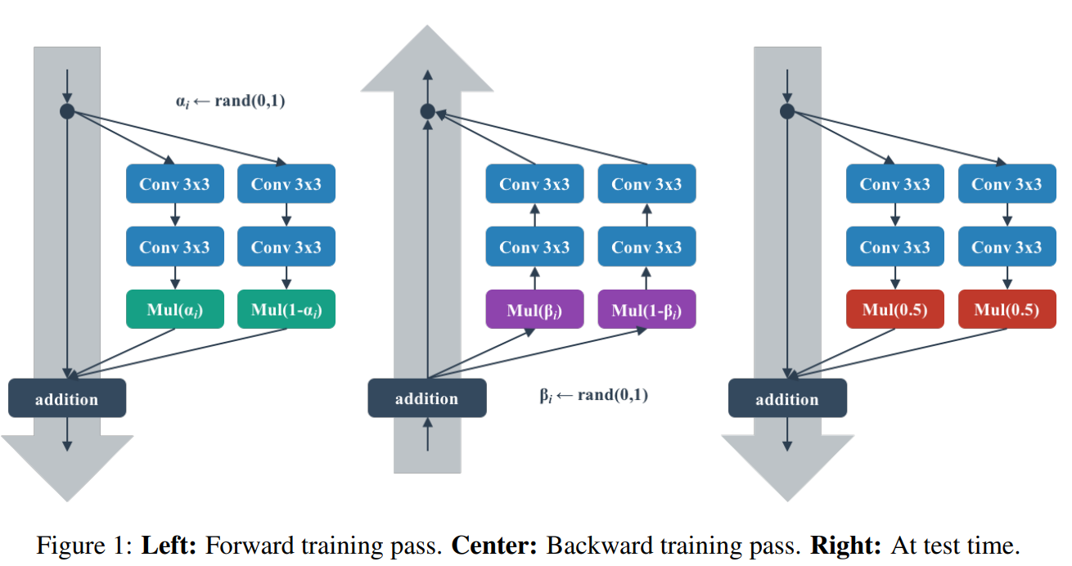
Shake-Shake

Slide 6


Shake-Shake Network
Block 1
1 pixel right, down shift
1 x 1 Avgpool
ReLU
ReLU
3 x 3 Conv 3->16
Block 2
3 x 3 Conv
3 x 3 Conv
Stage 1 16 -> 32
Block 3
BN
BN
Stage 2 32 -> 64
Block 4
1 x 1 Avgpool
ReLU
ReLU
Stage 3 64 -> 128
3 x 3 Conv
3 x 3 Conv
8 x 8 Avgpool
1 x 1 conv
16 -> 32
1 x 1 conv
16 -> 32
BN
BN
Fc
Concat
$$×α_{i}$$
$$×(1−α_{i})$$

Slide 7
Shake-Shake Experiments Setting
CIFAR 10 - 50k training set, 10k evaluation set
Epochs : 1800
Learning rate : 0.2
Cosine anneling without restart
2 GPU
Batch size : 128

Slide 8
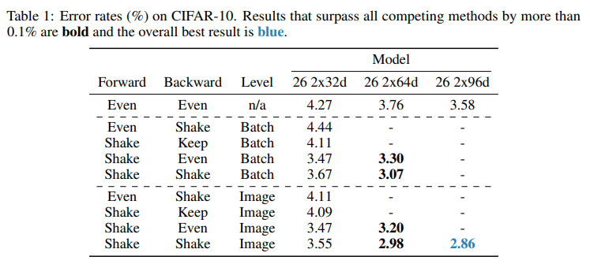
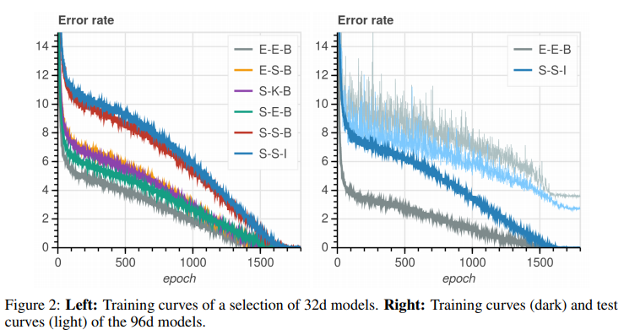
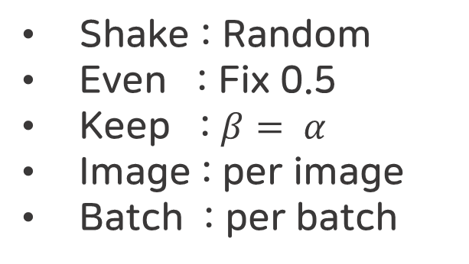
Experiments : Cifar10
Base : 26 2x32d ResNet
depth : 26
2 residual branches
32 resnet block width
Shake : Random
Even : Fix 0.5
Keep : $β= α$
Image : per image
Batch : per batch

Slide 9
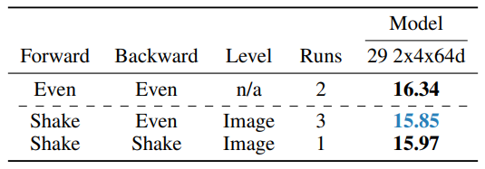
Experiments : Cifar100
ResNeXt without pre-activation
ResNeXt-29 2x4x64d
depth : 29
2 residual branches
4 grouped convolutions
64 channels
Batch size : 128 -> 32

Slide 10
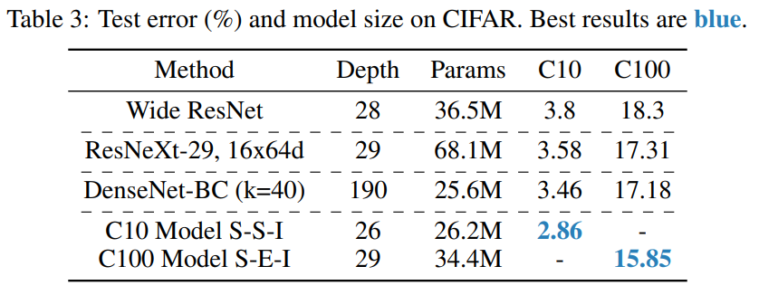
Experiments : Coparisons with SOTA

Slide 11
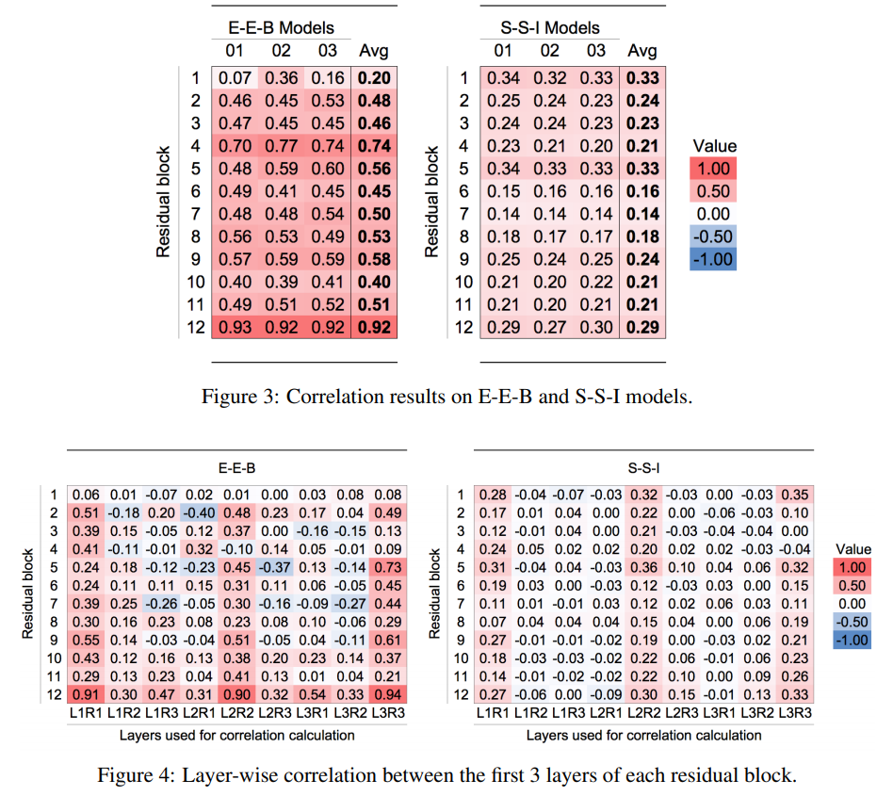



Experiments : Correlation between residual branches
BN
BN
$$×α_{i}$$
$$×(1−α_{i})$$
Flatten
$$\text{Flatten}$$
Correlation
Low Correlation = Good Regularization
High Correlation = Bad Regulartization

Slide 12
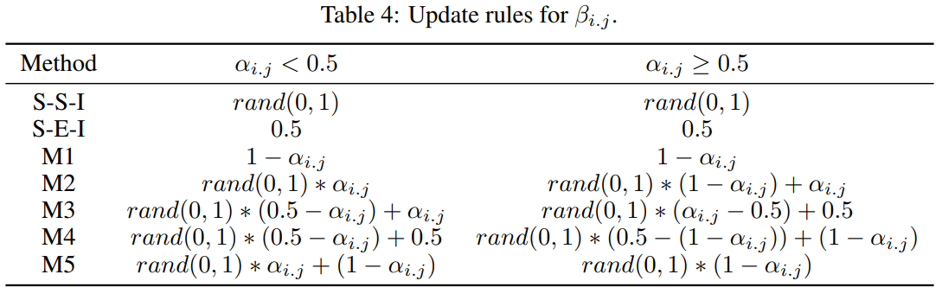
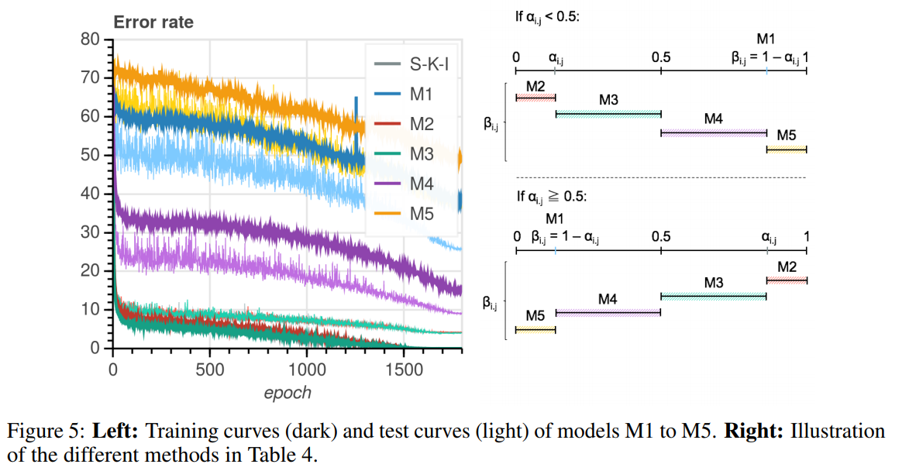
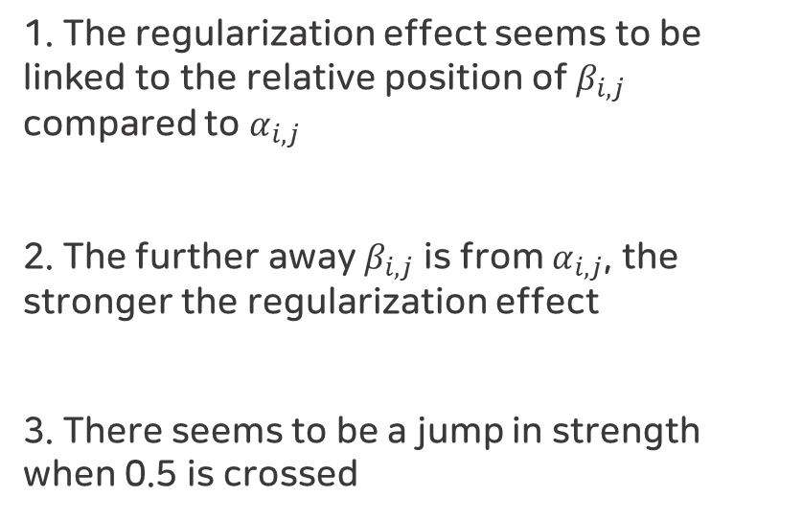
Regularization strength
1. The regularization effect seems to be linked to the relative position of $β_{i,j}$ compared to $α_{i,j}$
2. The further away $β_{i,j}$ is from $α_{i,j}$, the stronger the regularization effect
3. There seems to be a jump in strength when 0.5 is crossed

Slide 13
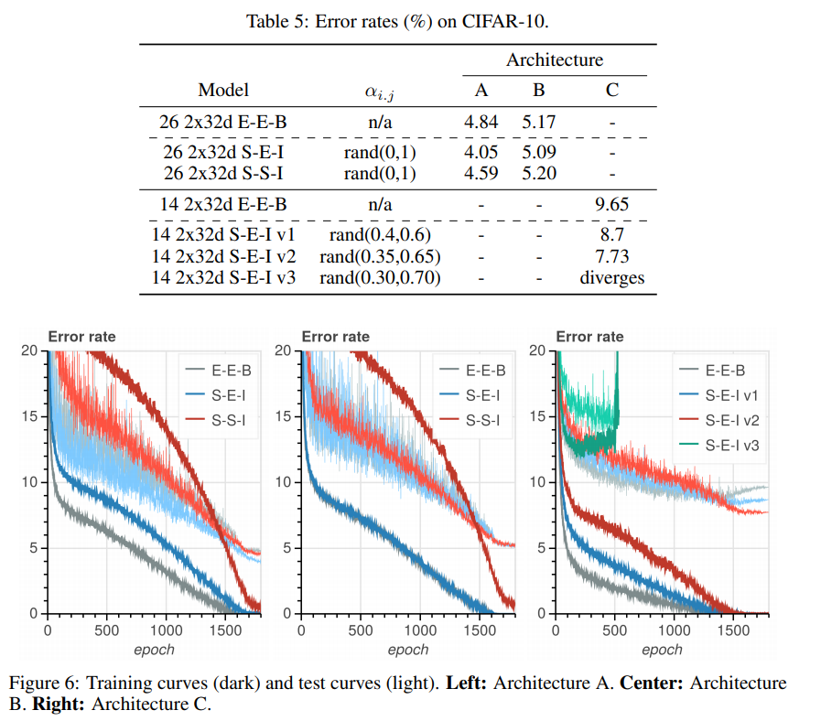
Removing Skip Connection / Batch Normalization
A
Remove skip connection
ReLU - Conv - BN - ReLU - Conv - BN - Mul
2 branches
S-S-I underfit
B
Remove skip connection
ReLU - Conv - BN - Mul
2 branches
twice the number of blocks
No regularization
C
Same as architecture A
Remove Batch Normalization
Sensitive

Slide 14
Conclusion
A series of experiments seem to indicate an ability to combat overfit by decorrelating the branches of multi-branch networks.

