Slide 1
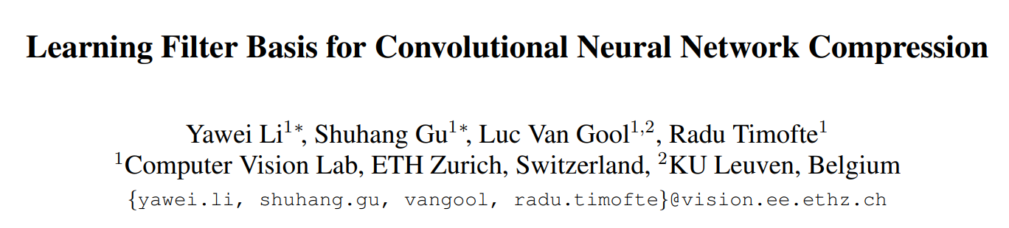

Slide 2
Introduction
In this paper, we try to reduce the number of parameters of CNNs by learning a basis of the filters in convolutional layers.
We focus on Filter Decomposition.
Filter decomposition approximates the original filter with a lightweight convolution and a linear projection.

Slide 3
Filter Decomposition
2D : w x h -> 3 x 3 kernel size
3D : c x w x h -> narrow networks
in_c
h
h
w
w

Slide 4
Introduction
The aforementioned methods are "hard" decomposition.
we propose a novel filter basis learning method that circumvents the limitation of the "hard" filter decomposition methods.
we split the 3D filters along the input channel dimension and each spilt is considered as a basic element.
we assume that the ensemble of those basic elements within one convolutional layer can a be represented by the linear combinations of a basis.

Slide 5
Contribution of this paper
1. we propose a novel basis learning method that can reduce the input channel, making it eligible for narrow networks. our method can be applied to convolutional layers with different kernel sizes and even 1 x 1 convolutions.
2. our method achieves state-of-the-art compression performance.
3. our method generalizes easily to prior work just by changing the number of splits, thus leading to a unified formulation of different filter decomposition methods.
4. we validate our method on both high level(Classification) and low level(Super Resolution) vision tasks.

Slide 6

Filter Decomposition for Network Compression
input image : $x∈X$
label : $y∈Y$
$$\hat{y}=f_{θ}(x)$$
$W≈B⋅A$ ($B∈ℜ^{cwh×m}, A∈ℜ^{m×n}$)
$W≈ ℜ^{cwh×n}=\left[W_{1}, ⋯, W_{n}\right]$ : filter wise
$W≈ℜ^{wh×cn}$ : channel wise
$m<n$

Slide 7
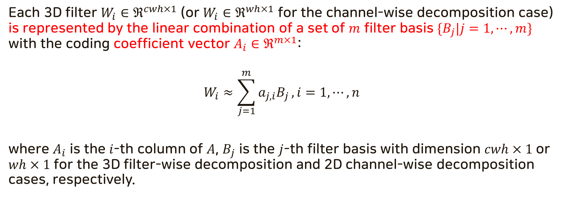
Decomposing convolution layer with filter basis
Each 3D filter $W_{i}∈ℜ^{cwh×1}$ (or $W_{i}∈ℜ^{wh×1}$ for the channel-wise decomposition case) is represented by the linear combination of a set of $m$ filter basis $\{B_{j}|j=1, ⋯,m\}$ with the coding coefficient vector $A_{i}∈ℜ^{m×1}$:
$$W_{i}≈\sum_{j=1}^{m}{a_{j,i}B_{j}}, i=1, ⋯, n$$
where $A_{i}$ is the $i$-th column of $A$, $B_{j}$ is the $j$-th filter basis with dimension $cwh×1$ or $wh×1$ for the 3D filter-wise decomposition and 2D channel-wise decomposition cases, respectively.

Slide 8
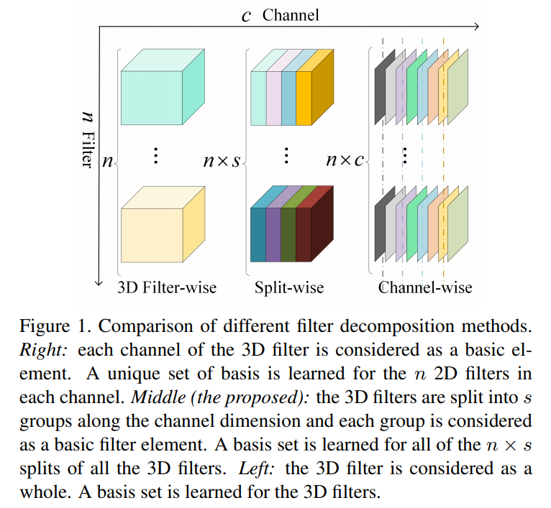
Decomposing convolution layer with filter basis

Slide 9

Compression rate with different filter basis
filter-wise
$$Γ_{filter}=\frac{m⋅c⋅w⋅h+m⋅n}{n⋅c⋅w⋅h}=\frac{m}{n}+\frac{m}{c⋅w⋅h}$$
channel-wise
$$Γ_{channel}=\frac{m⋅w⋅h+c⋅m⋅n}{n⋅c⋅w⋅h}=\frac{m}{n⋅c}+\frac{m}{w⋅h}$$
split-wise
$$Γ_{split}=\frac{m⋅p⋅w⋅h+m⋅n⋅s}{n⋅c⋅w⋅h}=\frac{m}{n×s}+\frac{m}{p⋅w⋅h}$$

Slide 10
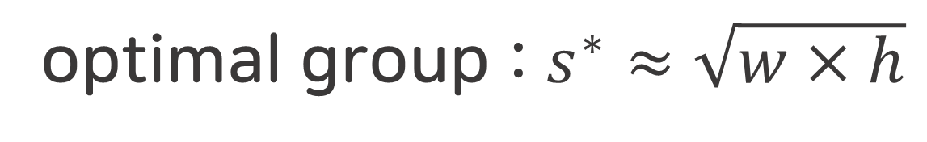

Compression rate with different filter basis
$$\left\{s^{∗}, p^{∗}\right\}=argmin_{\left\{s, p\right\}}\left\{\frac{m}{n×s}+\frac{m}{p⋅w⋅h}\right\}$$
$$=\left\{\sqrt{\frac{c⋅w⋅h}{n}},\sqrt{\frac{n⋅c}{w⋅h}}\right\}$$
optimal group : $s^{∗}≈\sqrt{w×h}$

Slide 11
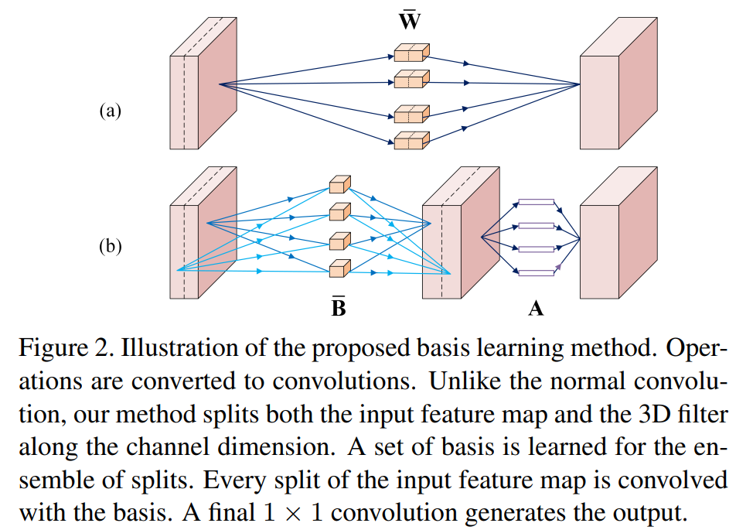
Implementing with convolution

Slide 12
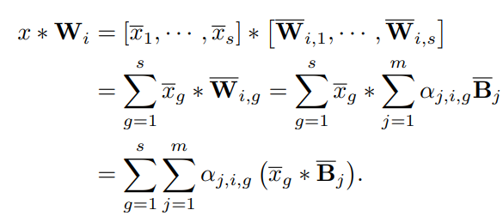
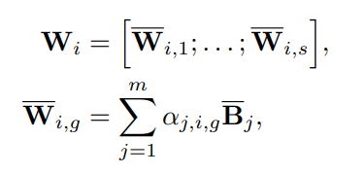

Implementing with convolution
$$W_{i}, B_{j}∈ ℜ^{c×w×h}$$
$$x ∗W_{i}=x∗\left(\sum_{j=1}^{m}{a_{j,i}B_{j}}\right)= \sum_{j=1}^{m}{a_{j,i}(x∗B_{j})}$$

Slide 13
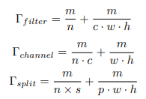
Filter basis decomposition for special filter sizes
1 x 1 convolution case
When the input/output channels are quite large, considerable parameters and computation are consumed by 1 x 1 convolution.
c >> n > m convolution case
output channel < input channel

Slide 14
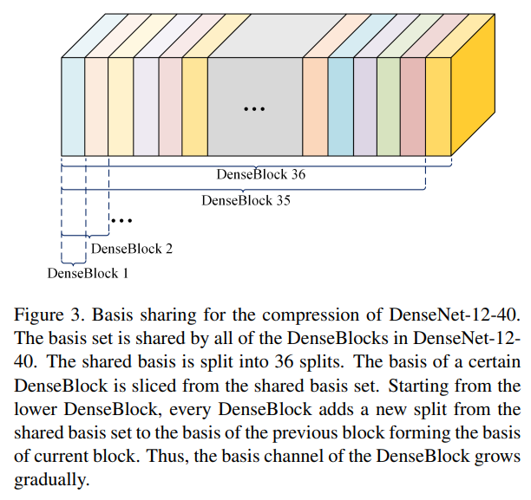
Learning Filter Basis

Slide 15
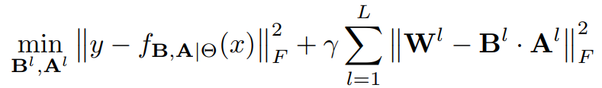
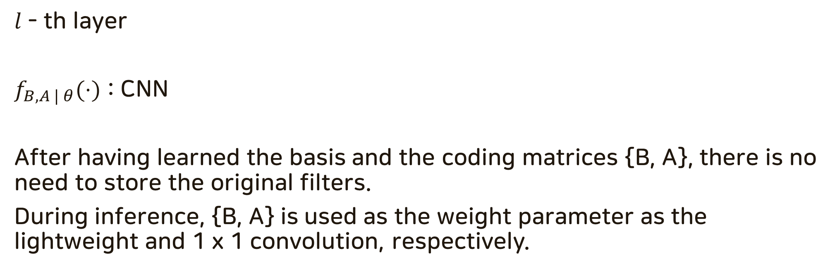
General filter basis learning approach
$l$ - th layer
$f_{B, A | θ}(⋅)$ : CNN
After having learned the basis and the coding matrices {B, A}, there is no need to store the original filters.
During inference, {B, A} is used as the weight parameter as the lightweight and 1 x 1 convolution, respectively.

Slide 16
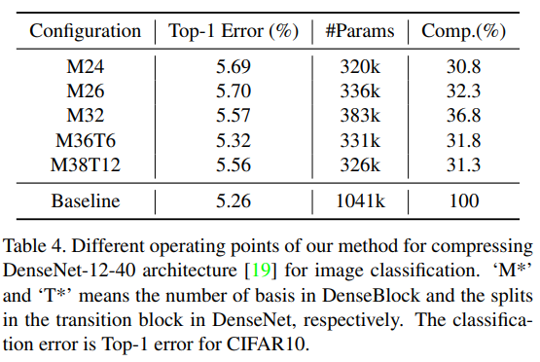
CIFAR10

Slide 17
Task - Image Classification
M : number of basis
T : number of transition layer
Interestingly, although our ‘M38T12’ model uses two more basis than ‘M36T6’, the error rate rises a little bit.
This is because ‘M38T12’ uses an aggressive compression, i.e., s = 12 in the transition block.
Therefore, the compression degree of the DenseBlock and the transition block should be balanced to obtain the best trade-off between compression ratio and accuracy.

Slide 18
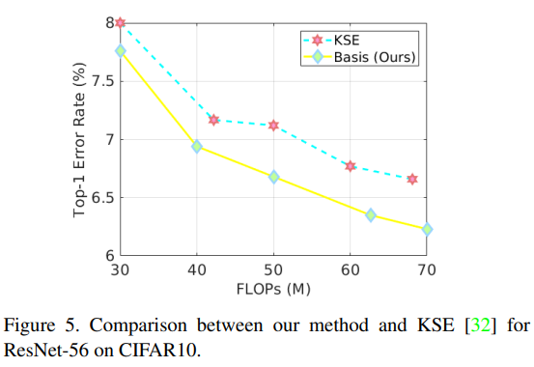
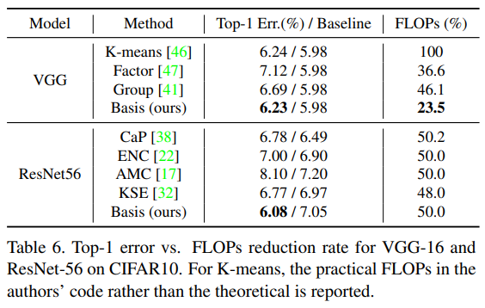
CIFAR10

