Slide 1
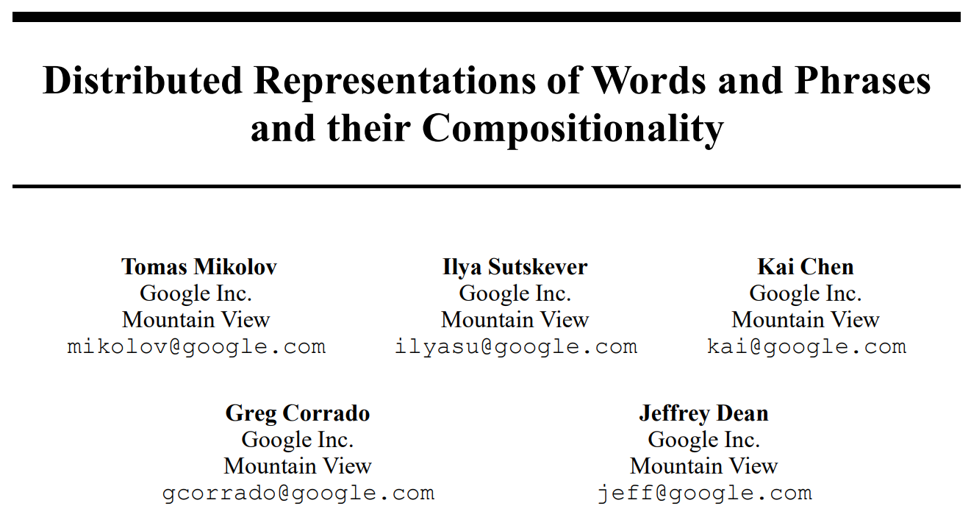

Slide 2
How to upgrade
the skip-gram model?
(word quality, training speed)

Slide 3
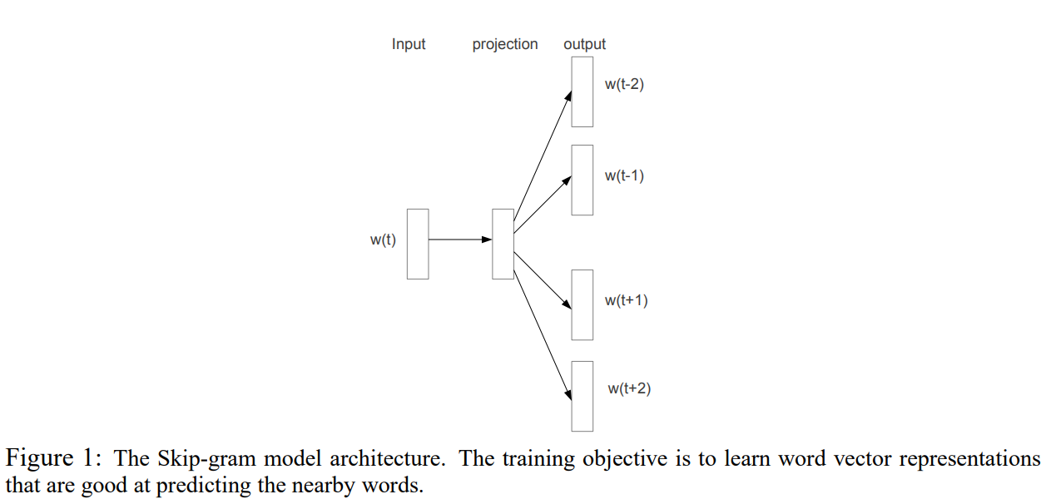
What is the Skip-gram?
An efficient method for learning high-quality distributed vector representations that capture a large number of precise syntactic and semantic word relationships.
Skip gram
Skip gram : 중심단어 -> 주변단어 예측
CBOW : 주변단어 -> 중심단어 예측

Slide 4
Abstract
In this paper we present several extensions that improve both the quality of the vectors and the training speed.
By subsampling of the frequent words we obtain significant speedup and also learn more regular word representations.
We also describe a simple alternative to the hierarchical softmax called negative sampling.

Slide 5

Abstract
An inherent limitation of word representations is their indifference to word order and their inability to represent idiomatic phrases.
For example, the meanings of “Canada” and “Air” cannot be easily combined to obtain “Air Canada”.
Motivated by this example, we present a simple method for finding phrases in text, and show that learning good vector representations for millions of phrases is possible.

Slide 6
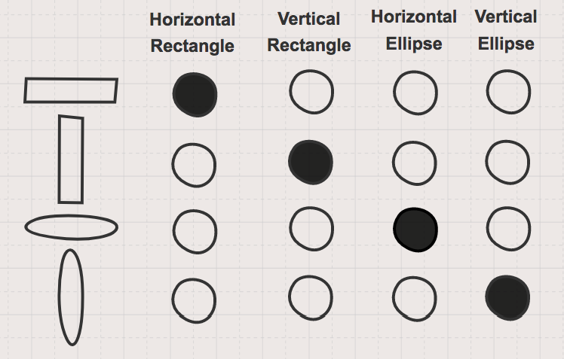
What is the Distributed Representations?
Distributed representations of words in a vector space help learning algorithms to achieve better performance in natural language processing tasks by grouping similar words.

Slide 7
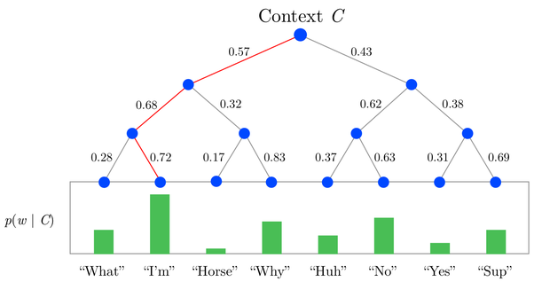
What is the Hierarhical Softmax?

Slide 8

Introduction
Several extensions of the original Skip-gram model !!
Training speedup
-> Hierarchical softmax
-> Noise Contrastive Estimation(NCE)
-> Nagative Sampling
-> Subsampling of frequent words
Word representations are limited by their inability to represent idiomatic phrases that are not compositions of the individual words.
-> The extension from word-based to phrase-based models
vec(“Montreal Canadiens”) - vec(“Montreal”) + vec(“Toronto”)
= vec(“Toronto Maple Leafs”)
idiomatic phrases
-> 관용구
-> 둘 이상 단어가 결합하여 특정한 뜻을 생성

Slide 9
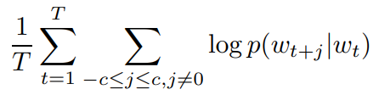
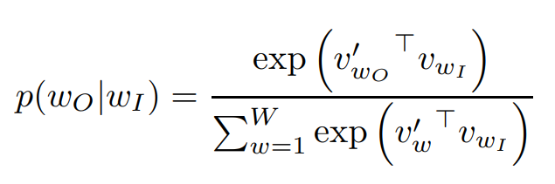

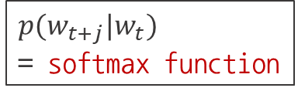
The Skip-gram Model
The training objective of the Skip-gram model is to find word representations that are useful for predicting the surrounding words in a sentence or a document.
Sequence of training words : $w_{1}, w_{2}, w_{3}, …, w_{T}$
Size of training context : $c$ (Large c -> high accuracy, many training time)
"input" and "output" vector representations of $w$ : $v_{w} , v_{w}^{′}$
The number of words in the vocabulary : $W$
the objective of the Skip-gram model is to maximize the average log probability
This formulation is impractical because the cost of computing $∇\log{p(w_{O}|w_{I})}$ is proportional to $W$, which is often large (${10}^{5}–{10}^{7}$ terms).
$p(w_{t+j}|w_{t})$
= softmax function

Slide 10
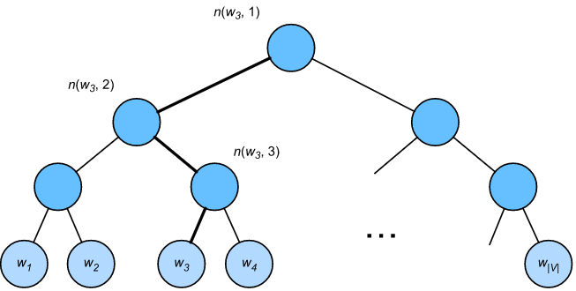
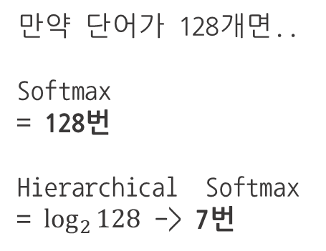

Hierarchical Softmax
The main advantage is that instead of evaluating $W$ output nodes in the neural network to obtain the probability distribution, it is needed to evaluate only about $\log_{2}(W)$nodes.
만약 단어가 128개면..
Softmax
= 128번
Hierarchical Softmax
= $\log_{2}{128}$ -> 7번
$$W$$

Slide 11
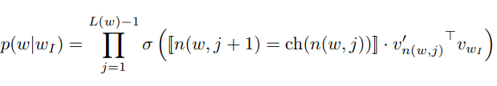
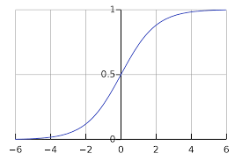
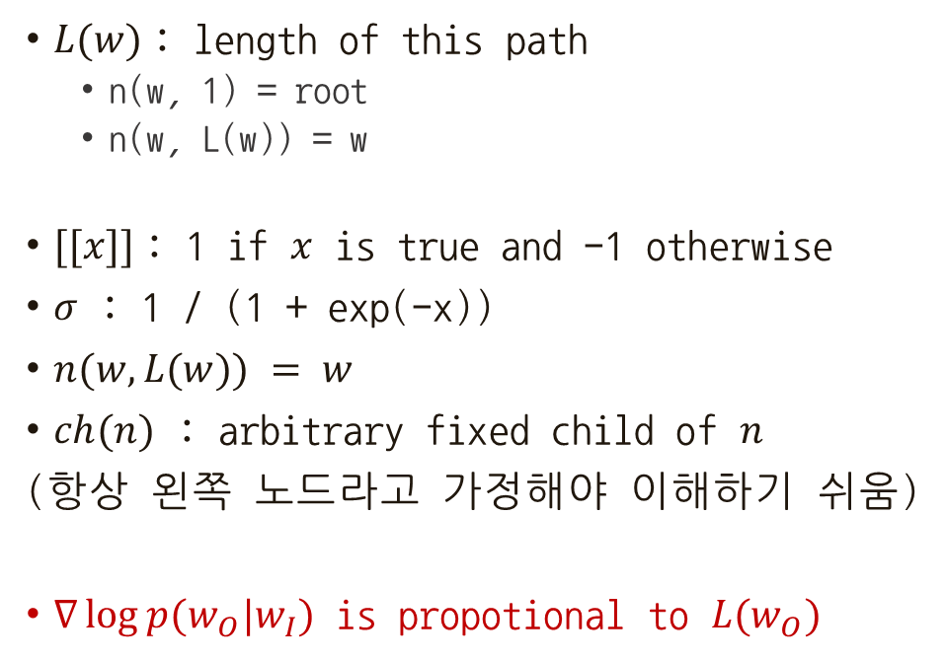

Hierarchical Softmax
$L(w)$: length of this path
n(w, 1) = root
n(w, L(w)) = w
$[[x]]$: 1 if $x$ is true and -1 otherwise
$σ$ : 1 / (1 + exp(-x))
$n(w, L(w)) = w$
$ch(n)$ : arbitrary fixed child of $n$
(항상 왼쪽 노드라고 가정해야 이해하기 쉬움)
$∇\log{p(w_{O}|w_{I})}$ is propotional to $L(w_{O})$
$$W$$
sigmoid(x) + sigmoid(-x) = 1

Slide 12

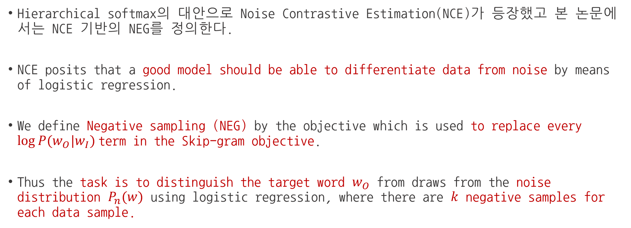
Negative Sampling
Hierarchical softmax의 대안으로 Noise Contrastive Estimation(NCE)가 등장했고 본 논문에서는 NCE 기반의 NEG를 정의한다.
NCE posits that a good model should be able to differentiate data from noise by means of logistic regression.
We define Negative sampling (NEG) by the objective which is used to replace every $log⁡P(w_{O}|w_{I})$term in the Skip-gram objective.
Thus the task is to distinguish the target word $w_{O}$ from draws from the noise distribution $P_{n}(w)$ using logistic regression, where there are $k$ negative samples for each data sample.

Slide 13
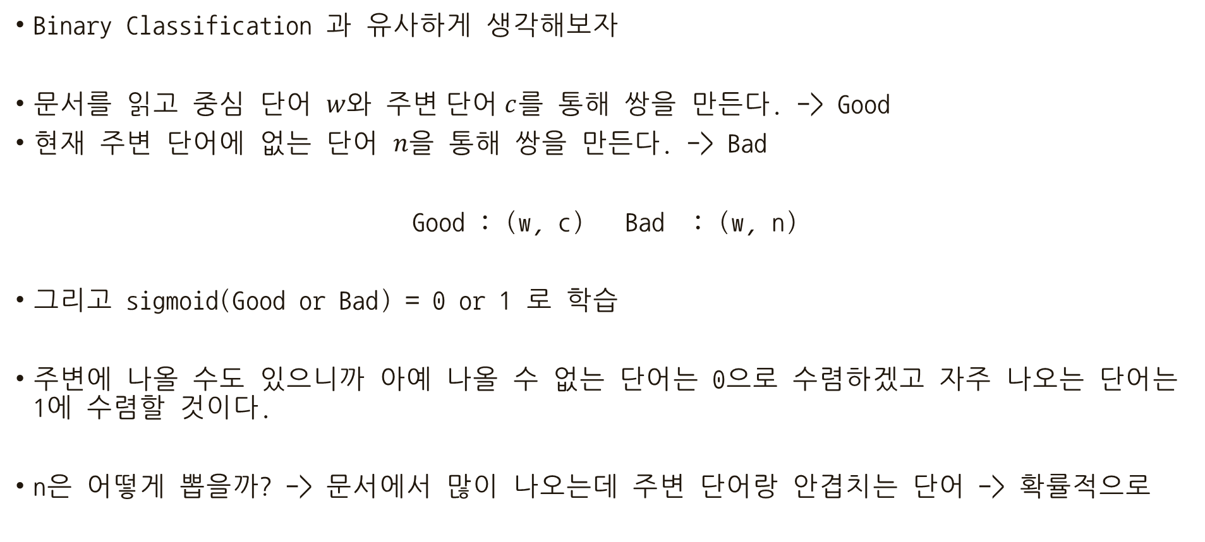
Noise Contrastive Estimation
Binary Classification 과 유사하게 생각해보자
문서를 읽고 중심 단어 $w와$ 주$변 단어 c$를 통해 쌍을 만든다. -> Good
현재 주변 단어에 없는 단어 $n을$ 통해 쌍을 만든다. -> Bad
Good : (w, c) Bad : (w, n)
그리고 sigmoid(Good or Bad) = 0 or 1 로 학습
주변에 나올 수도 있으니까 아예 나올 수 없는 단어는 0으로 수렴하겠고 자주 나오는 단어는 1에 수렴할 것이다.
n은 어떻게 뽑을까? -> 문서에서 많이 나오는데 주변 단어랑 안겹치는 단어 -> 확률적으로
https://ko-kr.facebook.com/groups/TensorFlowKR/permalink/746771665663894/

Slide 14
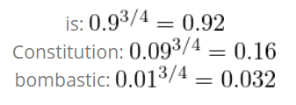
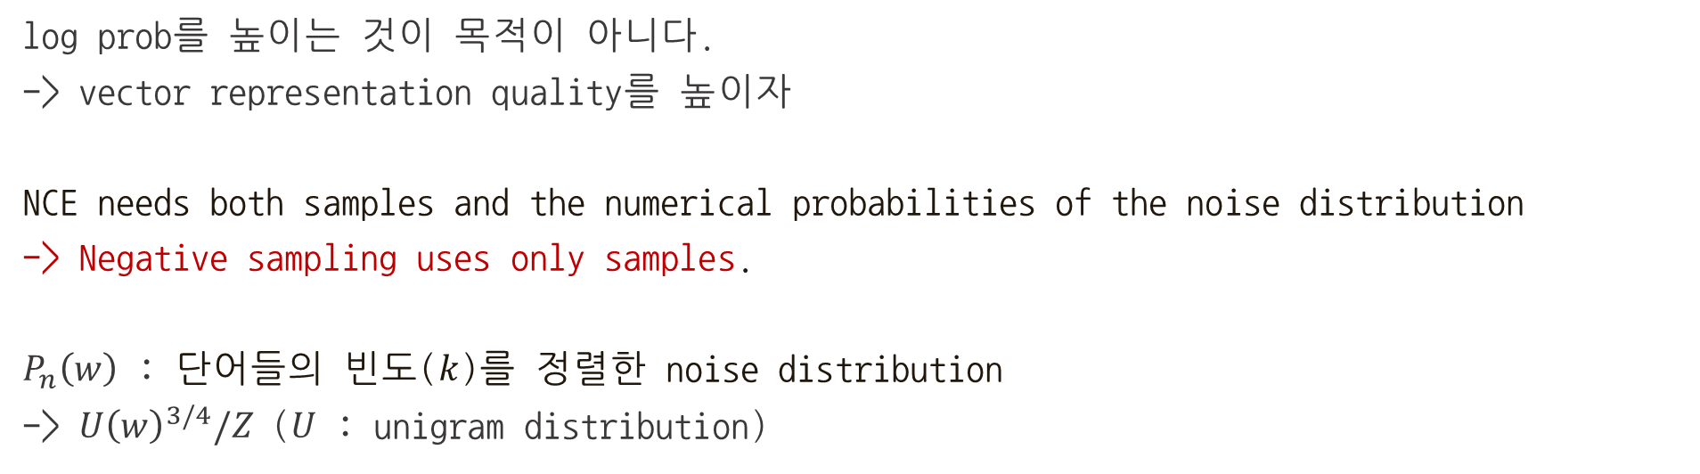
NCS vs NEG
log prob를 높이는 것이 목적이 아니다.
-> vector representation quality를 높이자
NCE needs both samples and the numerical probabilities of the noise distribution
-> Negative sampling uses only samples.
$P_{n}\left(w\right)$ : 단어들의 빈도($k$)를 정렬한 noise distribution
-> $U{\left(w\right)}^{3/4}/Z$ ($U$ : unigram distribution)

Slide 15
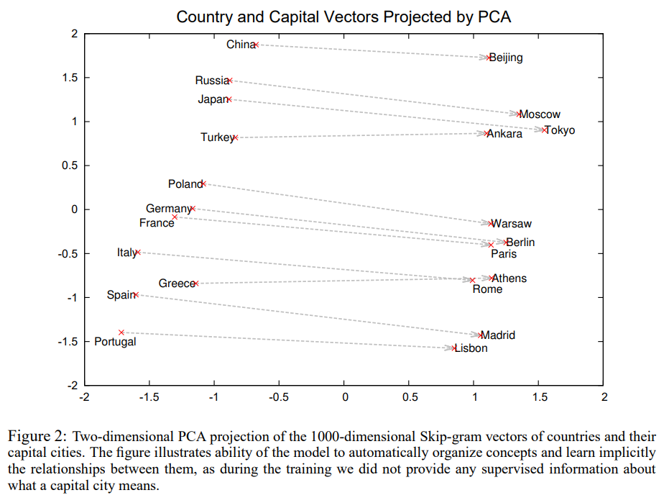

Slide 16
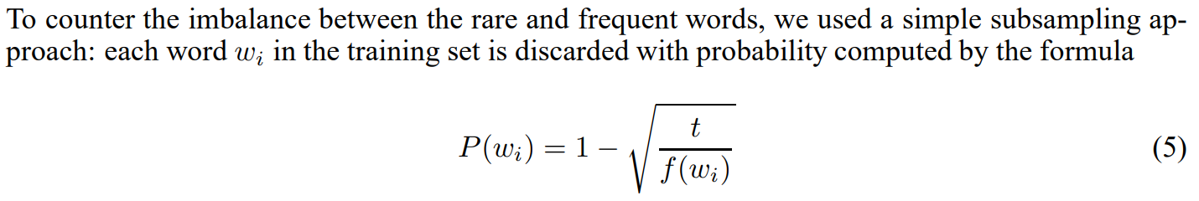
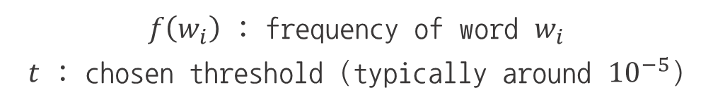
Subsampling of Frequent Words
$f\left(w_{i}\right)$ : frequency of word $w_{i}$
$t$ : chosen threshold (typically around ${10}^{−5}$)

Slide 17
Empirical Results
For training the Skip-gram models, we have used a large dataset consisting of various news articles (an internal Google dataset with one billion words).
We discarded from the vocabulary all words that occurred less than 5 times in the training data, which resulted in a vocabulary of size 692K.

Slide 18
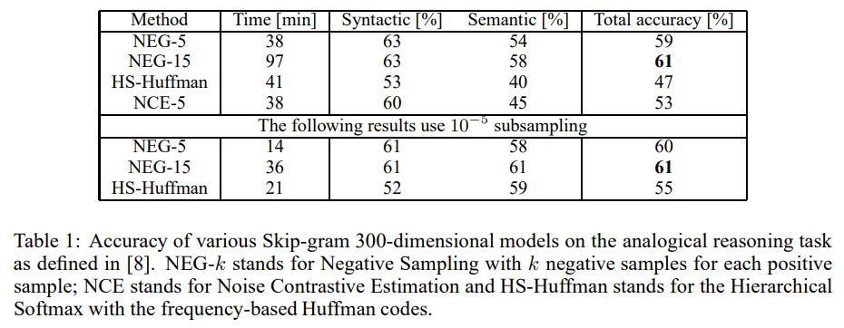

Slide 19

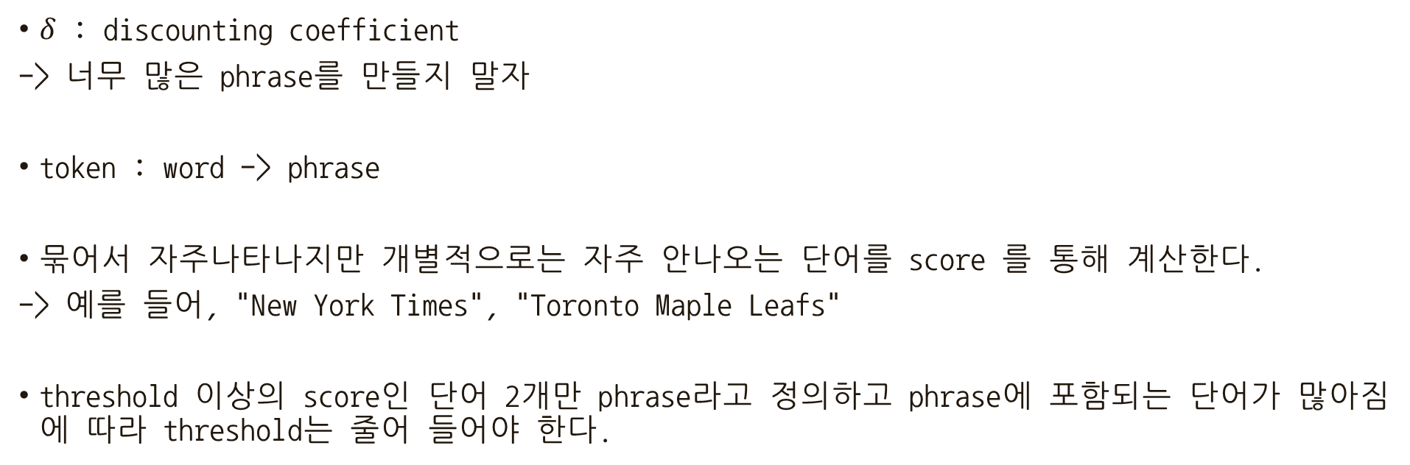
Learning Phrases
$δ$ : discounting coefficient
-> 너무 많은 phrase를 만들지 말자
token : word -> phrase
묶어서 자주나타나지만 개별적으로는 자주 안나오는 단어를 score 를 통해 계산한다.
-> 예를 들어, "New York Times", "Toronto Maple Leafs"
threshold 이상의 score인 단어 2개만 phrase라고 정의하고 phrase에 포함되는 단어가 많아짐에 따라 threshold는 줄어 들어야 한다.

Slide 20
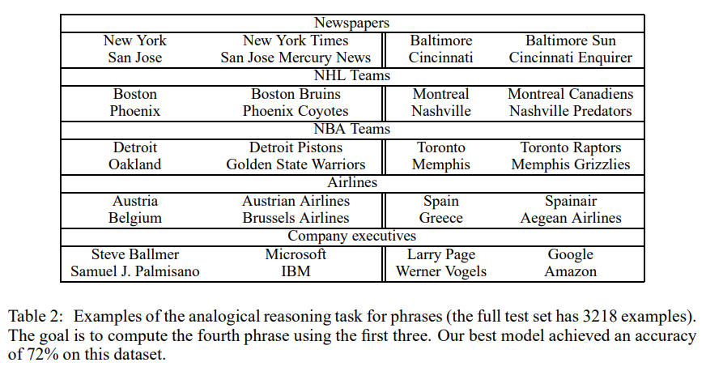
Learning Phrases

Slide 21
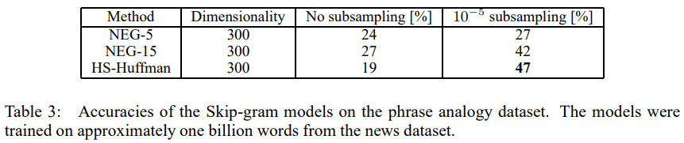
Phrase Skip-Gram Results
Starting with the same news data as in the previous experiments, we first constructed the phrase based training corpus and then we trained several Skip-gram models using different hyperparameters.
vector dimension : 300
context size : 5
Negative Sampling k = 5 에서 정확도가 괜찮은데 k = 15에서 정확도가 좋더라
Subsampling 추가하니 성능이 많이 좋아짐

Slide 22
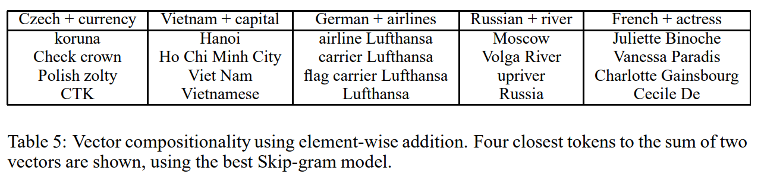
Additive Compositionality
Good word quality

Slide 23
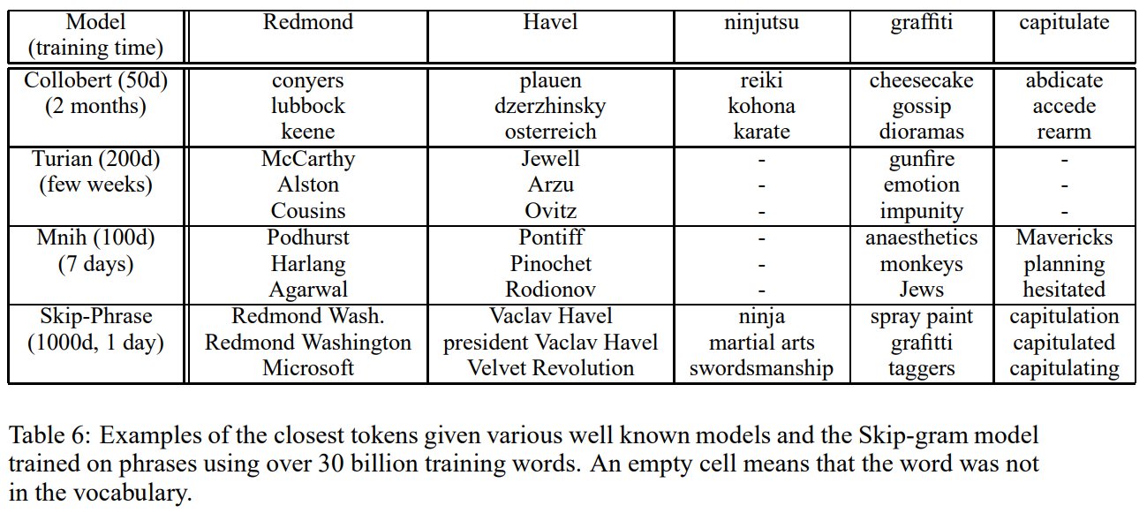
Comparison to Published Word Representations
Better training speed
Better word quality

Slide 24
Conclusion
Upgrade Skip-Gram Model
Negative Sampling
Subsampling
A very interesting result of this work is that the word vectors can be somewhat meaningfully combined using just simple vector addition.

