Slide 1
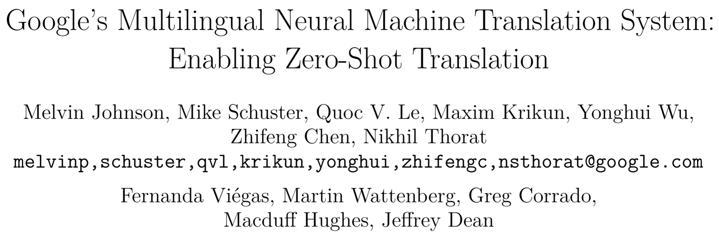

Slide 2
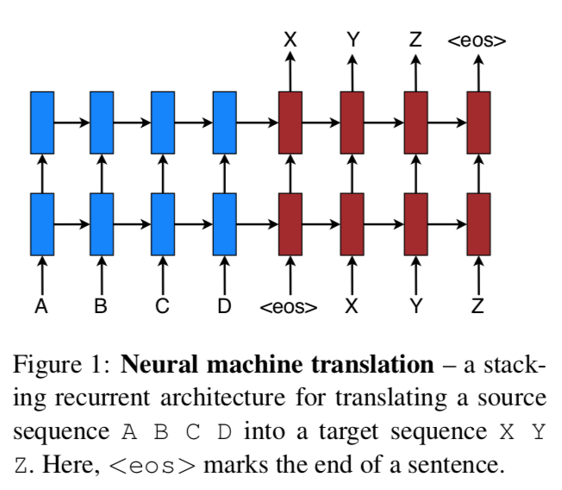
Neural Machine Translation
Luong, Minh-Thang, Hieu Pham, and Christopher D. Manning. "Effective approaches to attention-based neural machine translation." arXiv preprint arXiv:1508.04025 (2015).

Slide 3
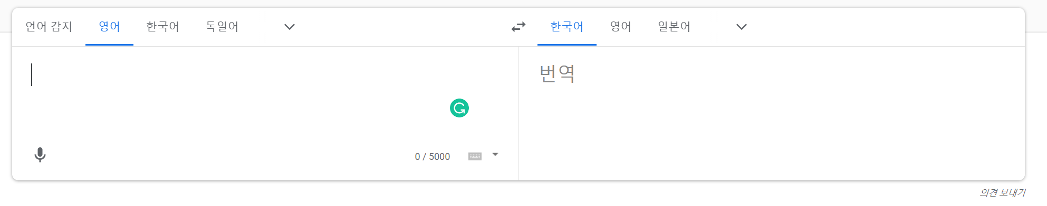
Neural Machine Translation

Slide 4
Our Solution requires no changes to the model architecture from a standard NMT system.
But instead introduces an artificial token at the beginning of the input sentence to specify the required target language.

Slide 5
Abstract
Using a shared wordpiece vocabulary, our approach enables multilingual NMT systems using a single model.
English -> French : comparable performance
English -> German : state-of-the-art
French -> English : state-of-the-art
German -> English : state-of-the-art

Slide 6
Several attractive benefits
Simplicity
Low-resource language improvements
Zero-shot translation

Slide 7
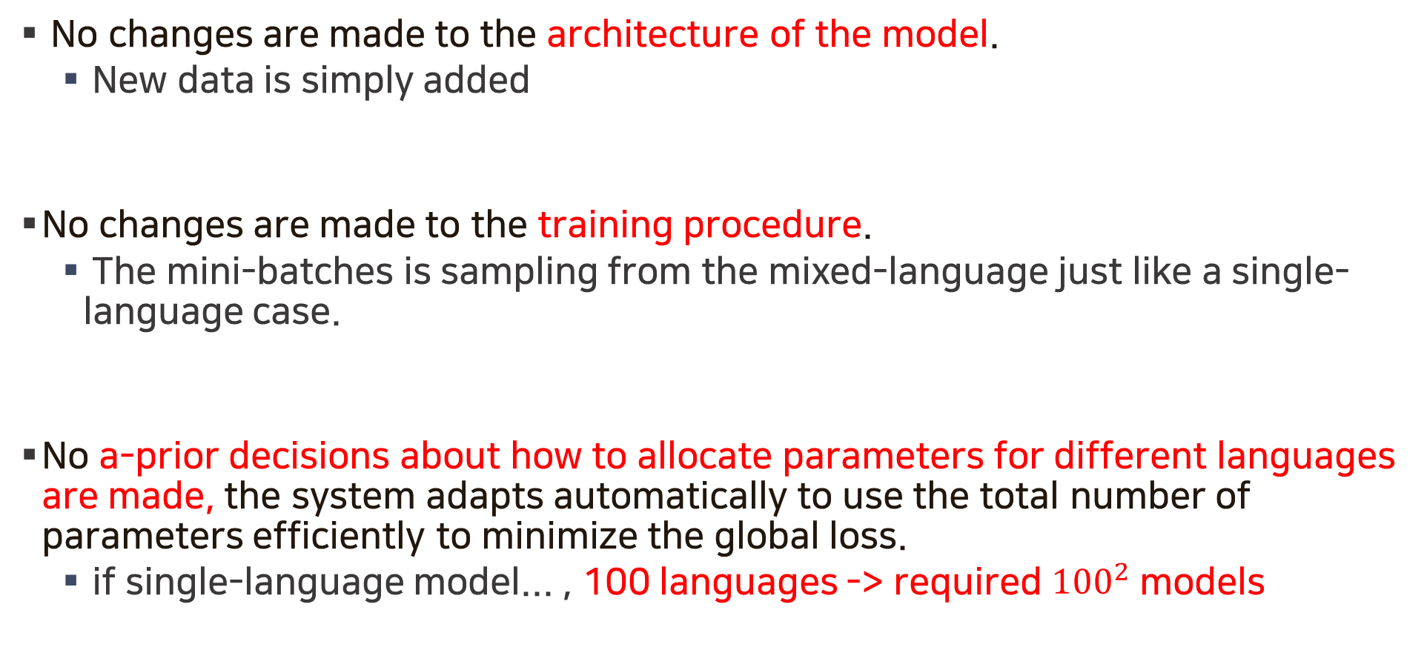
Simplicity
No changes are made to the architecture of the model.
New data is simply added
No changes are made to the training procedure.
The mini-batches is sampling from the mixed-language just like a single-language case.
No a-prior decisions about how to allocate parameters for different languages are made, the system adapts automatically to use the total number of parameters efficiently to minimize the global loss.
if single-language model... , 100 languages -> required $1{00}^{2}$ models

Slide 8
Low-resource language improvements
All parameters are implicitly shared by all the language pairs being modeled.
This forces the model to generalize across language boundaries during training.
It is observed that when language pairs with little available data and language pairs with abundant data are mixed into a single model, translation quality on the low resource language pair is significantly improved.

Slide 9
Zero-shot translation
A surprising benefit of modeling several language pairs in a single model is that the model can learn to translate between language pairs it has never seen in this combination during training.
Main Contribution : Zero shot
Zero resource is the additional fine-tuning step which is required in the latter approach.
Firat, Orhan, et al. "Zero-resource translation with multi-lingual neural machine translation." arXiv preprint arXiv:1606.04164 (2016).

Slide 10
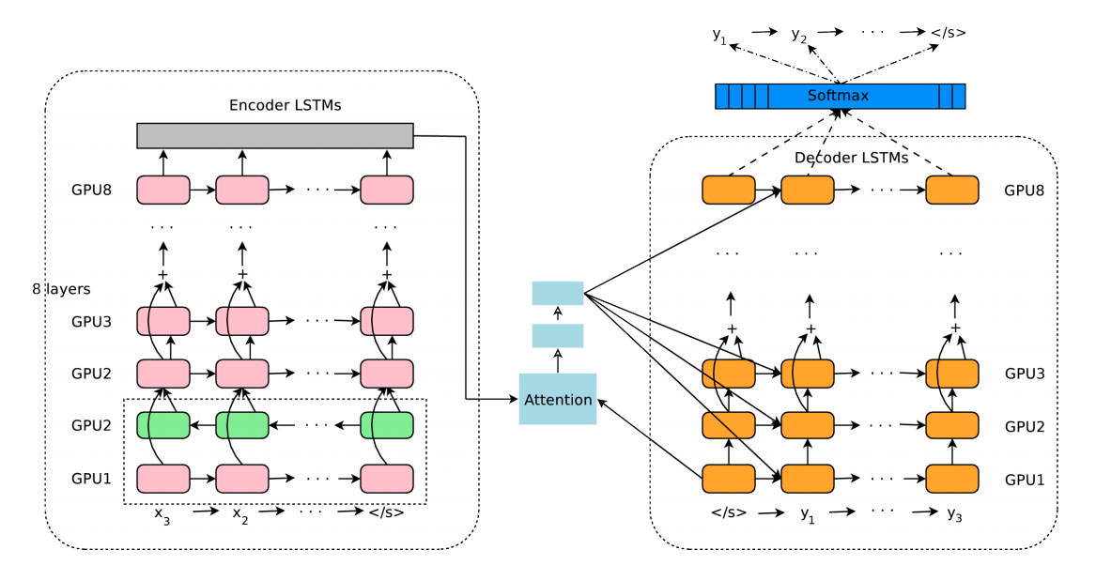
System Architecture
Google’s Neural Machine Translation (GNMT)
Wu, Yonghui, et al. "Google's neural machine translation system: Bridging the gap between human and machine translation." arXiv preprint arXiv:1609.08144 (2016).

Slide 11
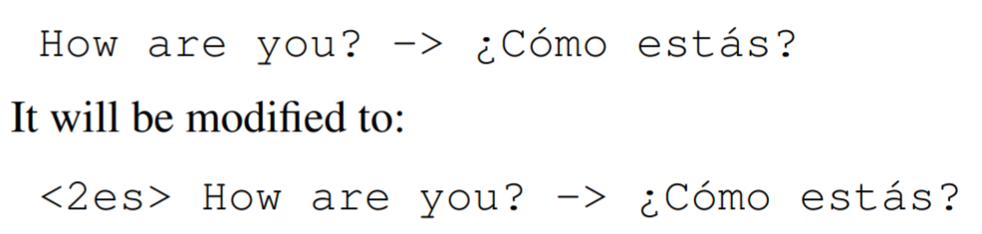
System Architecture
Add artificial token

Slide 12
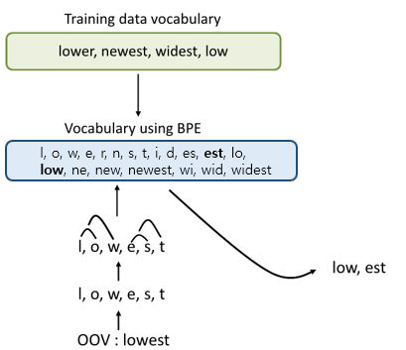
System Architecture
To address the issue of translation of unknown words and to limit the vocabulary for computational efficiency we use a shared word piece model across all the source and target data used for training, usually with 32000 word pieces.
BPE

Slide 13
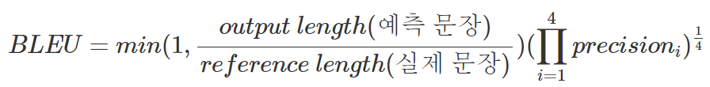
Datasets, Training Protocols and Evaluation Metrics
Train
WMT 14
En -> Fr
En -> De
Train
Google-internal large-scale production datasets
En <-> Ja
En <-> Kr
En <-> Es
En <-> Pt
Test
Newstest2014 and newstest2015
Fr -> En
De -> En
Multilingual models take a little more time to train than single language pair models.
Larger batch size
Higher initial learning rate
Evaluate : BLEU score metric
To test the influence of varying amounts of training data per language pair we explore two strategies
With oversampling vs Without any change
Random sampling

Slide 14
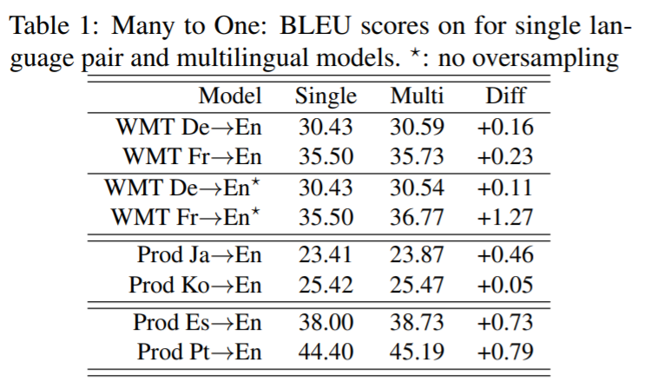
Many to One
Since there is only a single target language no additional source token is required -- Perform three sets of experiments
First set
Single : De -> En, Fr -> En
Multi : De, Fr -> En
With oversampling vs Without any change
Second set
Single : Ja -> En, Ko -> En
Multi : Ja, Ko -> En
Third set
Single : Pt -> En, Es -> En
Multi : Pt, Es -> En

Slide 15
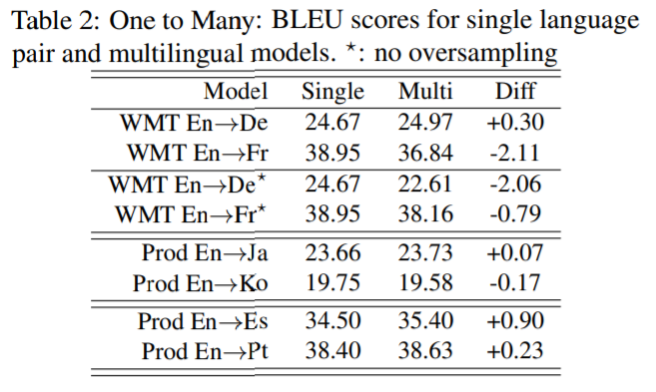
One to Many
smaller language pair (En→De)
larger language pair (En→Fr)

Slide 16
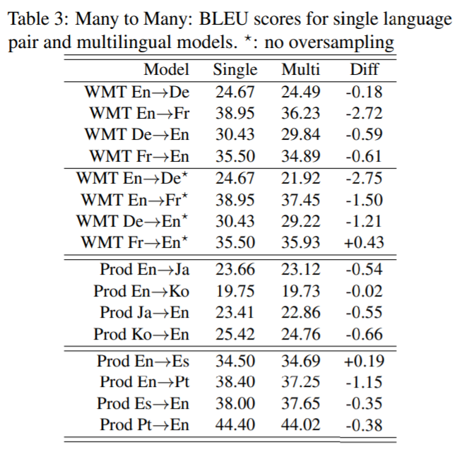
Many to Many

Slide 17
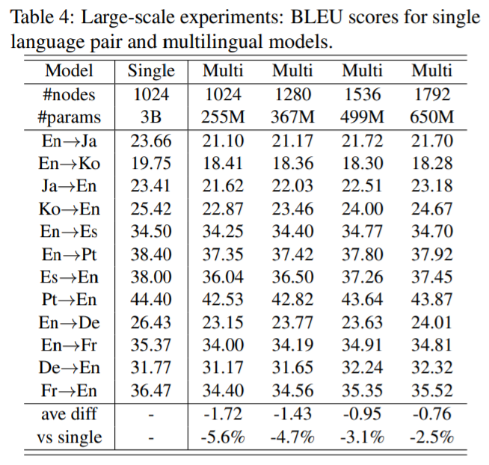
Large-scale Experiments
This section shows the result of combining 12 production language pairs having a total of 3B parameters (255M per single model) into a single multilingual model.
255M * 12 = 3B

Slide 18
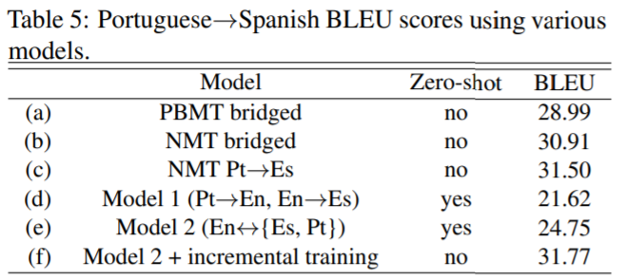
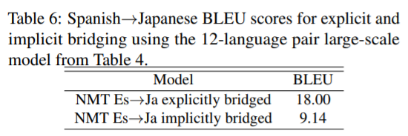
Zero-Shot Translation
The most straight-forward approach of translating between languages where no or little parallel data is available is to use explicit bridging.
xx→En (bridging) En→yy
Disadvantages :
time doubles
loss of quality
Es -> En En -> Ja
Es -> Ja

Slide 19
Effect of Direct Parallel Data
explore two ways of leveraging available parallel data to improve zero-shot translation quality.
Incrementally training the multilingual model on the additional parallel data for the zero-shot directions.
Training a new multilingual model with all available parallel data mixed equally.
1. “Zero-Shot” : English <-> {Belarusian(Be), Russian(Ru), Ukrainian(Uk)}
2. “From-Scratch” : “Zero-Shot” + (additional data) Ru <-> {Be, Uk}
3. “Incremental” : Take the best checkpoint of the “Zero-Shot” model, and run incremental training on a small portion of the data used to train the “From-Scratch” model for a short period of time until convergence. (in this case 3% of “Zero-Shot” model total training time)

Slide 20
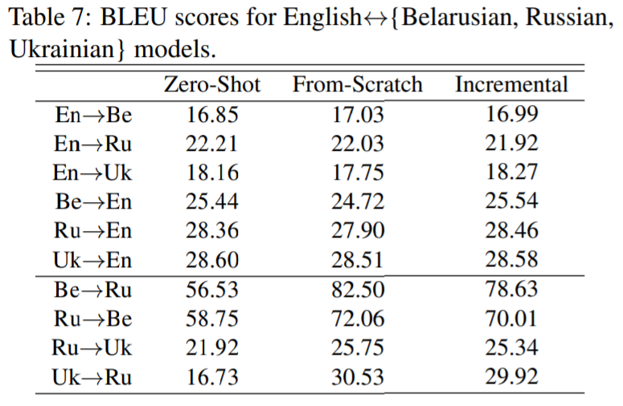
Effect of Direct Parallel Data

Slide 21
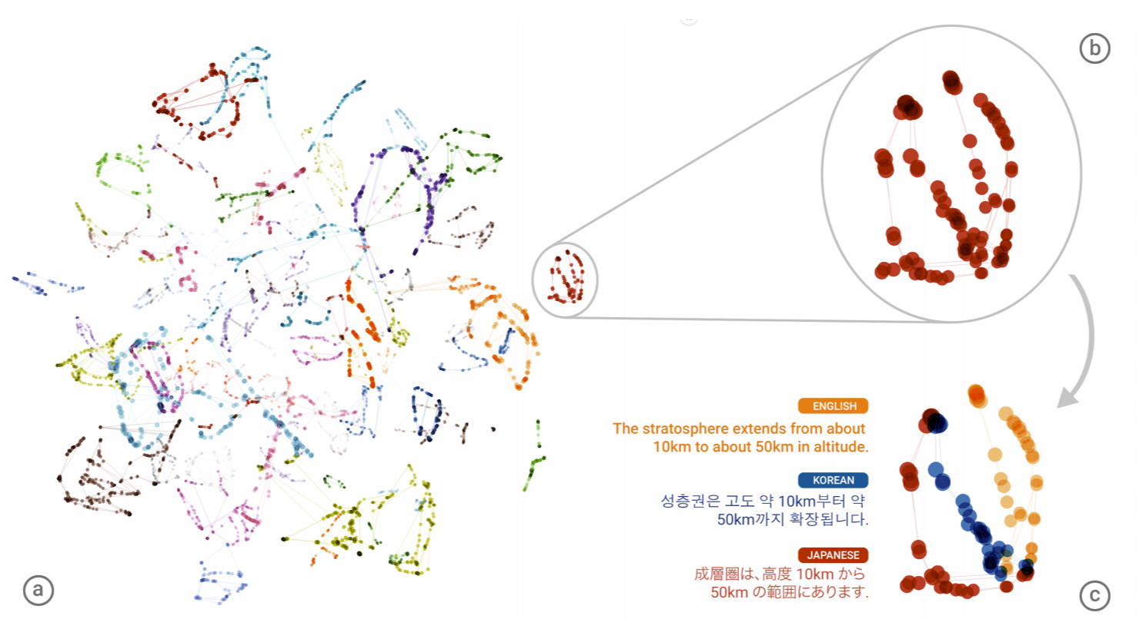
Visual Analysis
Evidence for an Interlingua

Slide 22
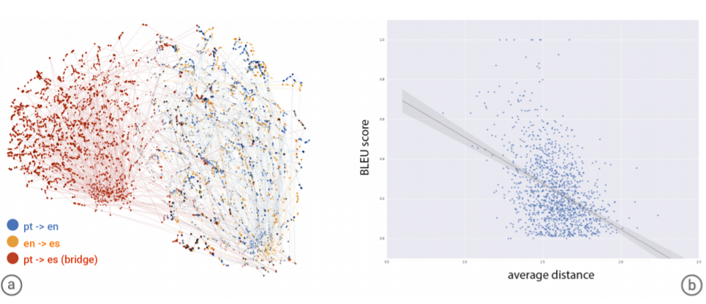
Visual Analysis
Partially Separated Representations

Slide 23
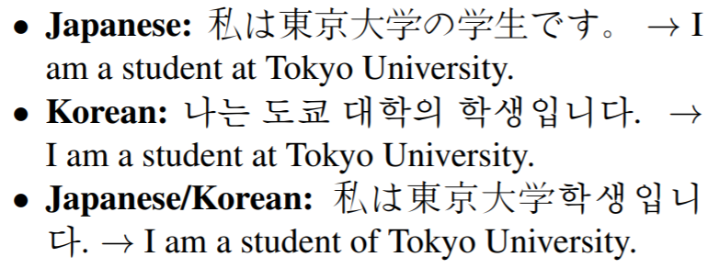
Mixing Languages

Slide 24
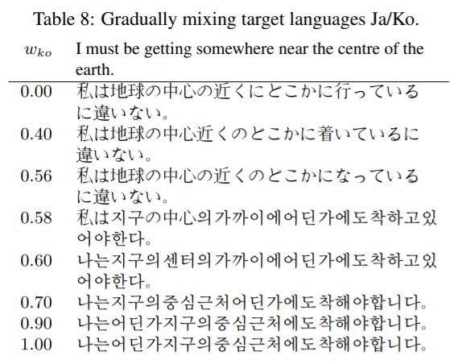
Mixing Languages
$$\left(1 – w\right)<2ja> + w<2ko>$$

Slide 25
Conclusion
We present a simple solution to multilingual NMT.
We show
We can train multilingual NMT models that can be used to translate between a number of different languages using a single model where all parameters are shared. (slightly lower translation quality)
Zero-shot translation without explicit bridging is possible.

