Slide 1
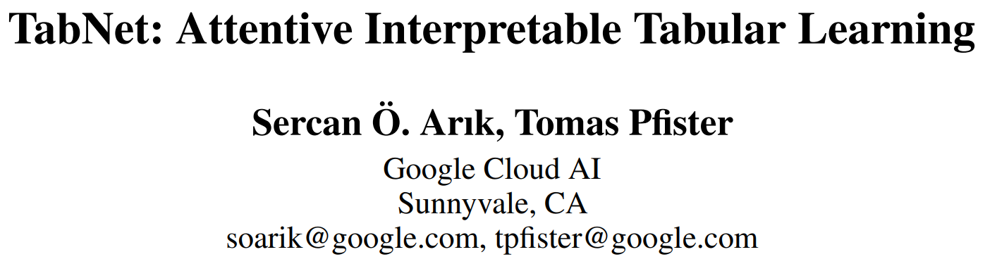

Slide 2
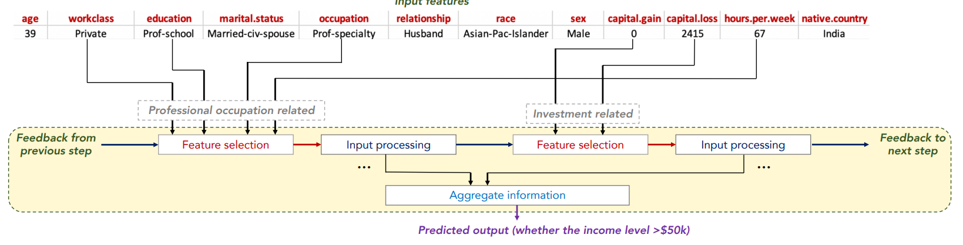

Slide 3
Contribution
1. TabNet inputs raw tabular data without any preprocessing and is trained using gradient descent-based optimization.
2. TabNet uses sequential attention to choose which features to reason from at each decision step.
-> interpretability and better learning as the learning capacity is used for the most salient features.
3. TabNet outperforms or is on par with other tabular learning models on various datasets.
4. We show performance improvements by using unsupervised pre-training to predict masked features.

Slide 4
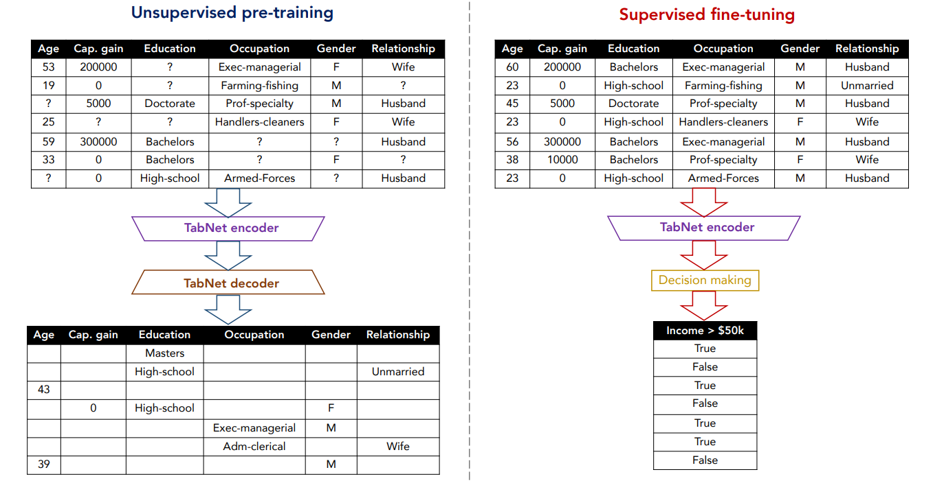

Slide 5
Feature selection & Tree-based learning
Feature selection broadly refers to judiciously picking a subset of features based on their usefulness for prediction.
Their prominent strength is efficient picking of global features with the most statistical information gain.
To improve the performance of standard DTs(Decision Trees), one common approach is ensembling to reduce variance.

Slide 6
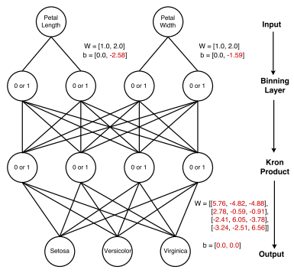
Feature selection & Tree-based learning
Random Forest : random subsets of data with randomly selected features to grow many trees.
XGBoost & LightGBM : tree-based ensemble. (다음 기회에 ..)
Integration of DNNs into DTs ->
Self-supervied learning -> BERT

Slide 7
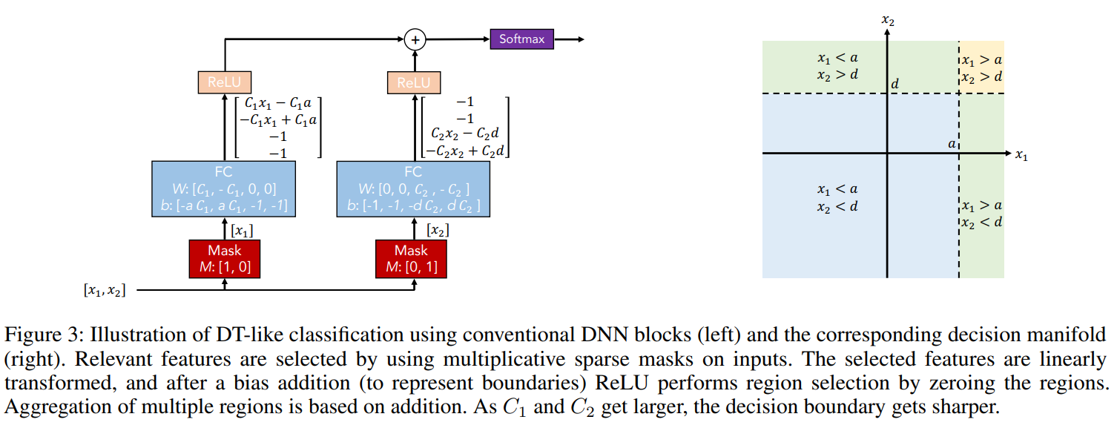
Conventional DNN blocks

Slide 8
TabNet
TabNet is based on such functionality and it outperforms DTs while reaping their benefits by careful design which
(i) uses sparse instance-wise feature selection learned from data
(ii) constructs a sequential multi-step architecture, where each step contributes to a portion of the decision based on the selected features
(iii) improves the learning capacity via nonlinear processing of the selected features
(iv) mimics ensembling via higher dimensions and more steps.

Slide 9
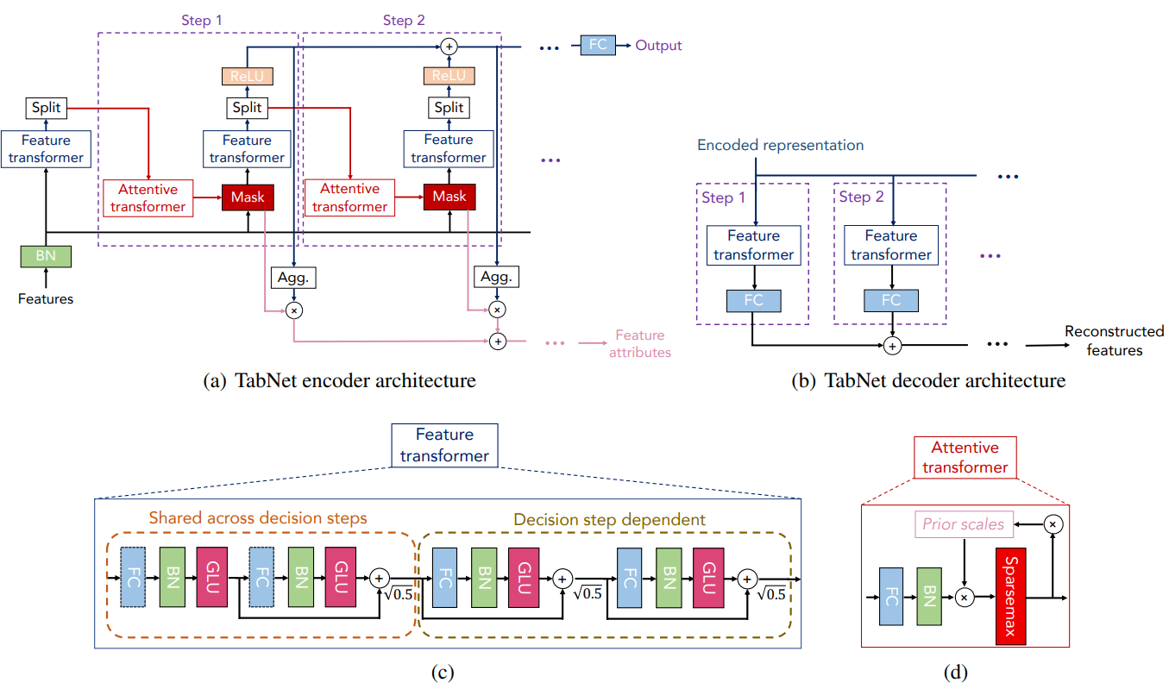







BN : Ghost Batch Normalization
GLU : Gated Linear Unit
$$d\left[i\right]$$
$$a[i]$$
$$M\left[i\right]$$
$$M\left[i\right]⋅f$$
$$η$$
$$P\left[i−1\right]$$
$$a\left[i−1\right]$$
$$M\left[i\right]$$

Slide 10
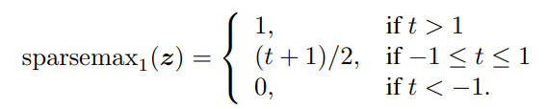
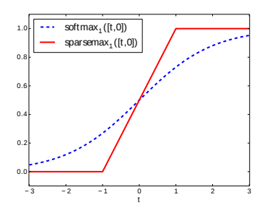
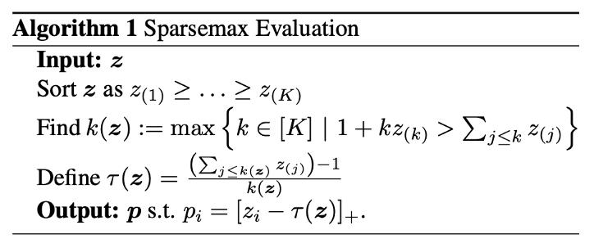
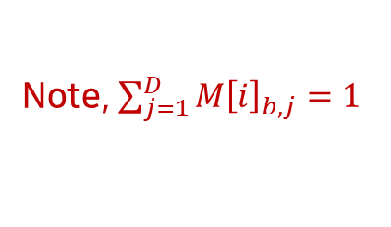
Sparsemax
The idea is to set the probabilities of the smallest values of z to zero and keep only probabilities of the highest values of z, but still keep the function differentiable to ensure successful application of backpropagation algorithm.
$$a\left[i −1\right] :M\left[i\right]=sparsemax\left(P\left[i−1\right]⋅h_{i}\left(a\left[i−1\right]\right)\right)$$
Note, $\sum_{j=1}^{D}{M{\left[i\right]}_{b,j}=1}$
출처 : https://towardsdatascience.com/what-is-sparsemax-f84c136624e4

Slide 11
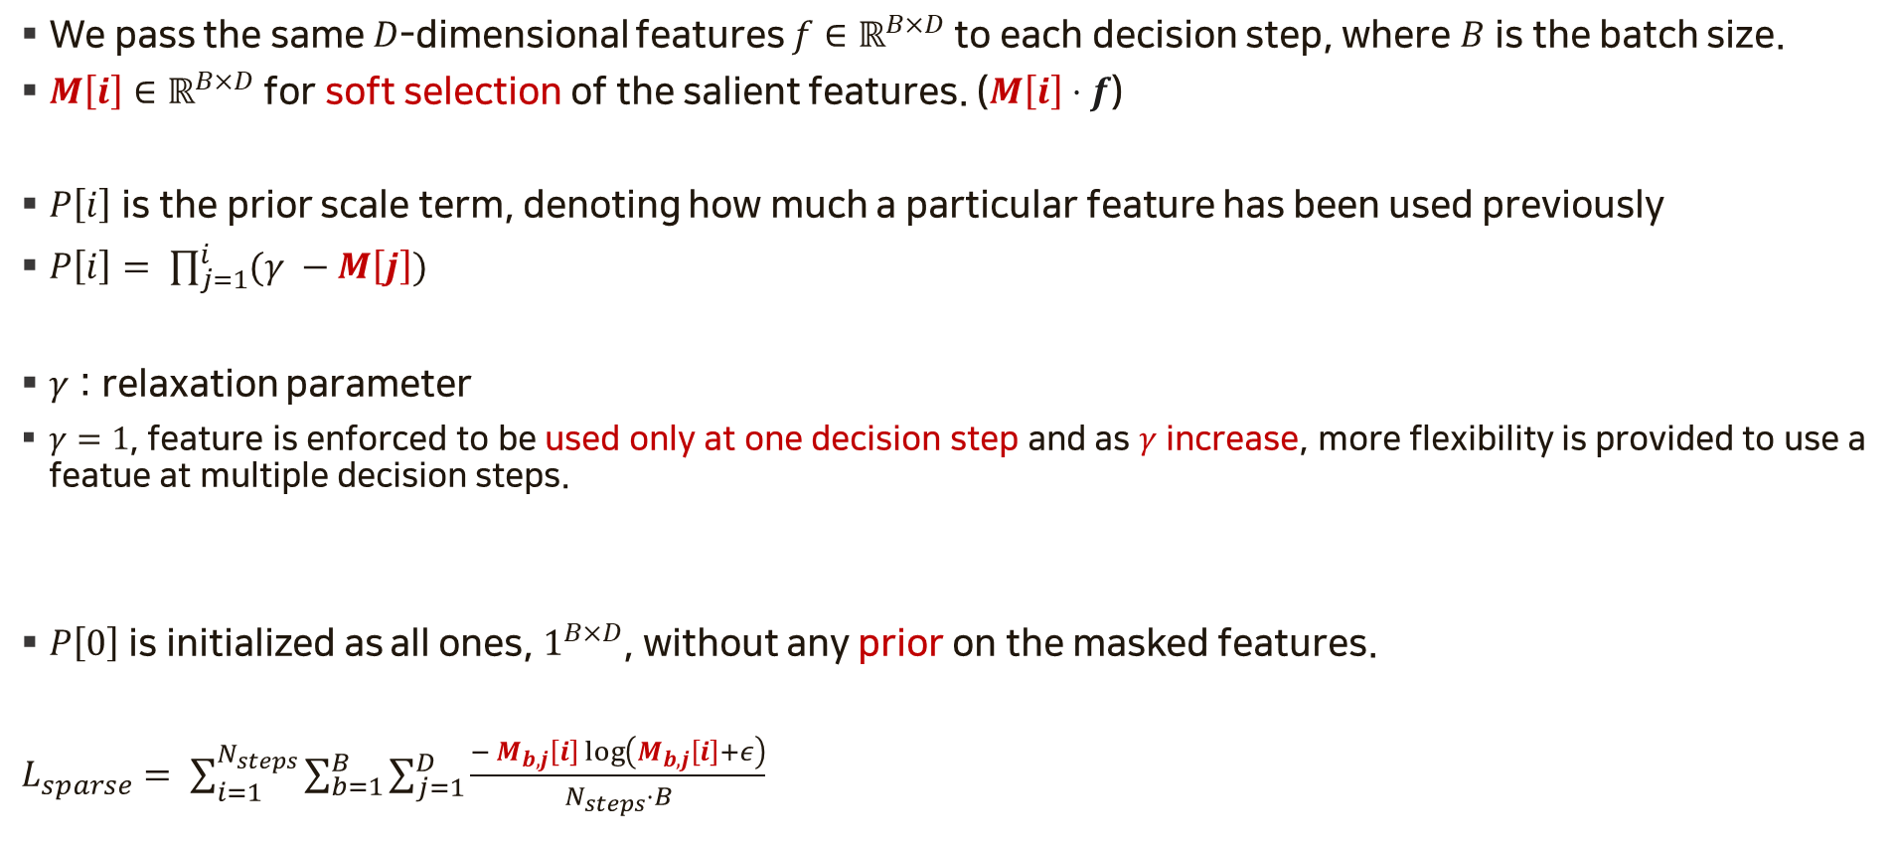
Feature Selection
We pass the same $D$-dimensional features $f∈ℝ^{B×D}$ to each decision step, where $B$ is the batch size.
$M\left[i\right]∈ℝ^{B×D}$ for soft selection of the salient features. ($M\left[i\right]⋅f$)
$P\left[i\right]$ is the prior scale term, denoting how much a particular feature has been used previously
$P\left[i\right]= \prod_{j=1}^{i}{(γ −M\left[j\right])}$
$γ$ : relaxation parameter
$γ=1$, feature is enforced to be used only at one decision step and as $γ$ increase, more flexibility is provided to use a featue at multiple decision steps.
$P\left[0\right]$ is initialized as all ones, $1^{B×D}$, without any prior on the masked features.
$L_{sparse}= \sum_{i=1}^{N_{steps}}{\sum_{b=1}^{B}{\sum_{j=1}^{D}{\frac{− M_{b,j}\left[i\right]\log\left(M_{b,j}\left[i\right]+ε\right)}{N_{steps}⋅B}}}}$

Slide 12
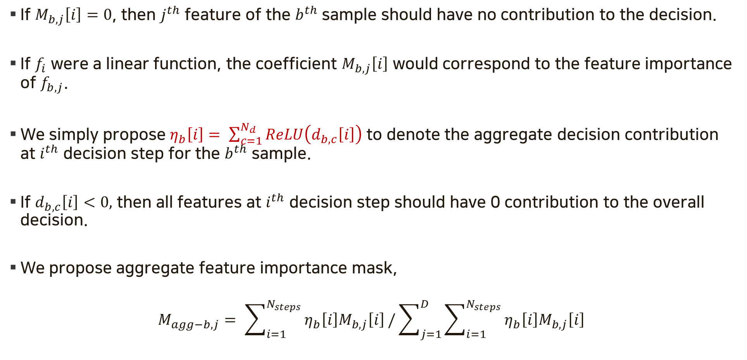
Interpretability
If $M_{b,j}\left[i\right]=0$, then $j^{th}$ feature of the $b^{th}$ sample should have no contribution to the decision.
If $f_{i}$ were a linear function, the coefficient $M_{b,j}\left[i\right]$ would correspond to the feature importance of $f_{b,j}$.
We simply propose $η_{b}\left[i\right]= \sum_{c=1}^{N_{d}}{ReLU\left(d_{b,c}\left[i\right]\right)}$ to denote the aggregate decision contribution at $i^{th}$ decision step for the $b^{th}$ sample.
If $d_{b,c}\left[i\right]<0,$ then all features at $i^{th}$ decision step should have 0 contribution to the overall decision.
We propose aggregate feature importance mask,
$$M_{agg−b,j}= \sum_{i=1}^{N_{steps}}{η_{b}\left[i\right]M_{b,j}\left[i\right]}/\sum_{j=1}^{D}{\sum_{i=1}^{N_{steps}}{η_{b}\left[i\right]M_{b,j}\left[i\right]}}$$

Slide 13
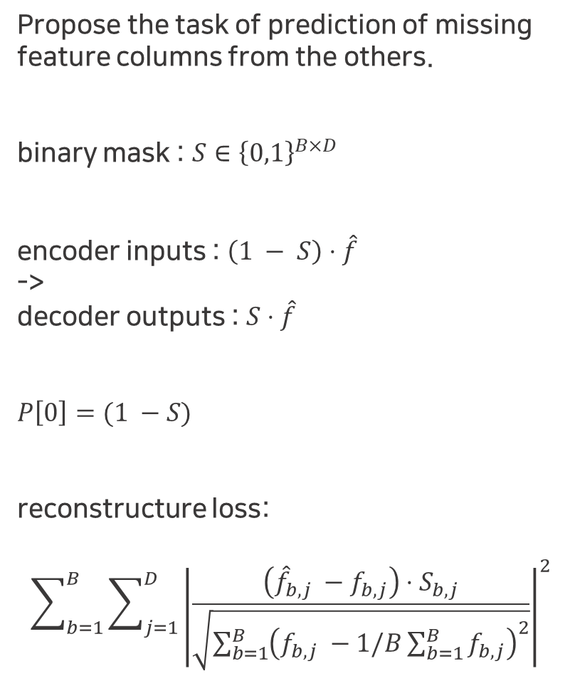
Tabular self-supervised learning
Propose the task of prediction of missing feature columns from the others.
binary mask : $S∈{\left\{0,1\right\}}^{B×D}$
encoder inputs : $\left(1 − S\right)⋅\hat{f}$
->
decoder outputs : $S⋅\hat{f}$
$P\left[0\right]=(1 −S)$
reconstructure loss:
$$\sum_{b=1}^{B}{\sum_{j=1}^{D}{{\left|\frac{\left({\hat{f}}_{b,j} −f_{b,j}\right)⋅S_{b,j}}{\sqrt{\sum_{b=1}^{B}{{\left(f_{b,j} −1/B\sum_{b=1}^{B}{f_{b,j}}\right)}^{2}}}}\right|}^{2}}}$$

Slide 14
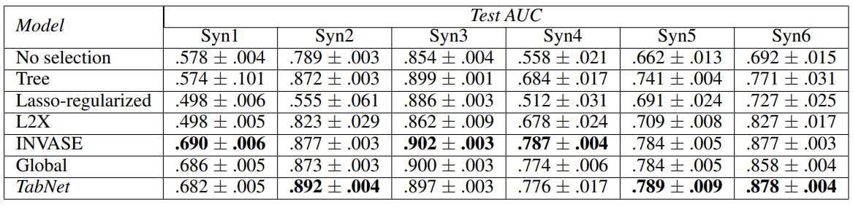
Instant-wise feature selection (AUC)
The datasets are constructed in such a way that only a subset of the features determine the output.

Slide 15
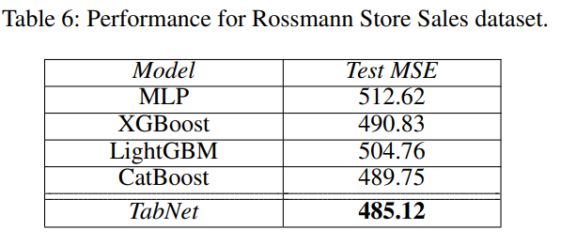
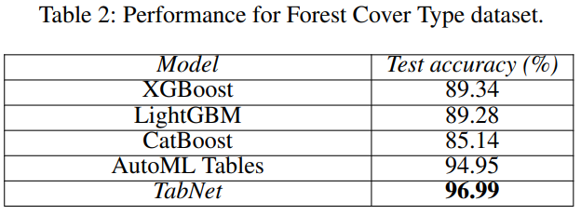
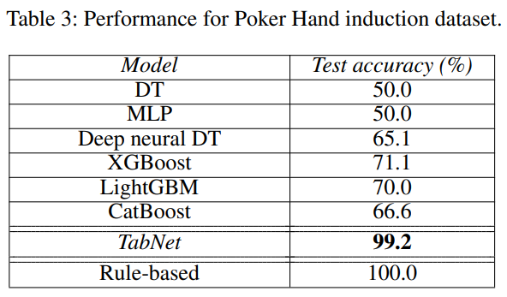
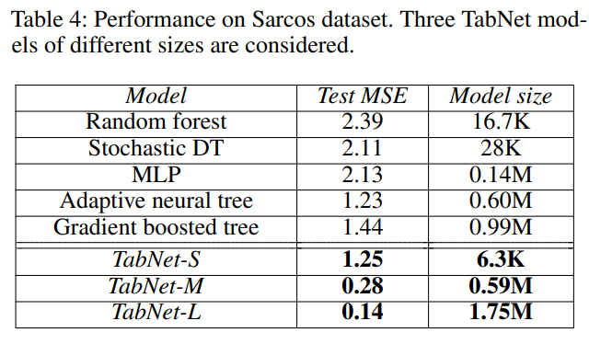
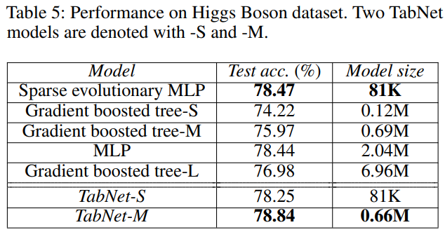
Performance on real-world datasets

Slide 16
-S, -M, -L

Slide 17
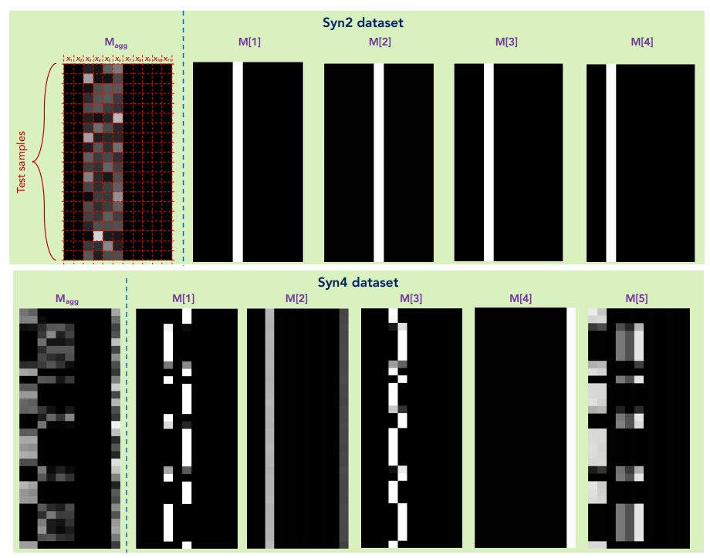
Feature importance

Slide 18
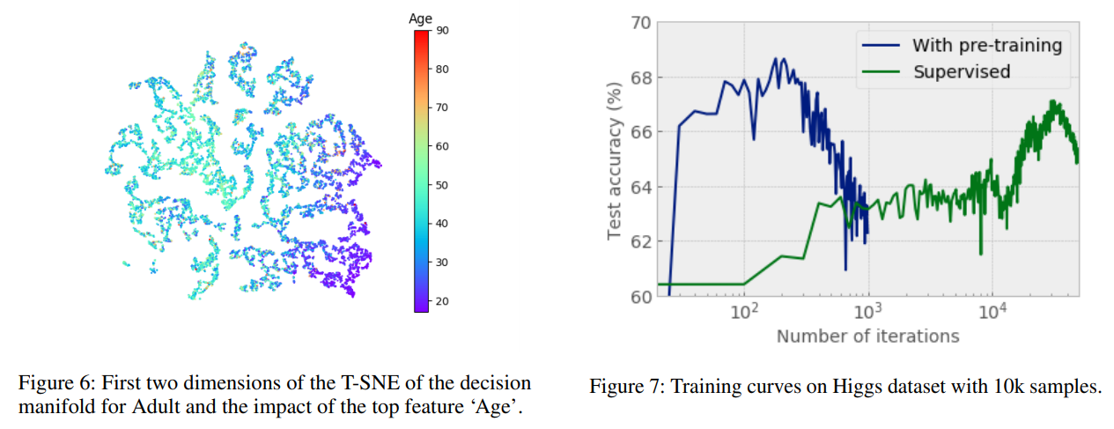
T-SNE & Training curves

