Slide 1
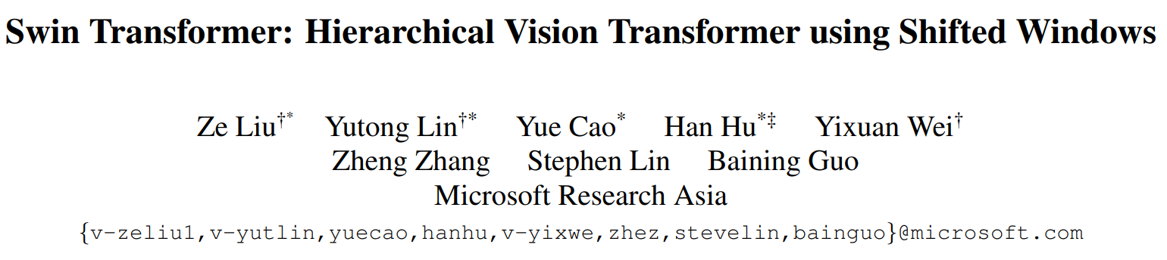

Slide 2
Swin Transformer
General-purpose backbone for computer vision.
Hierachical Transformer whose representation is computed with shifted windows.

Slide 3
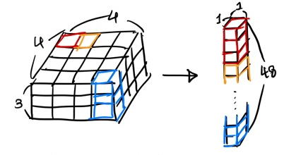
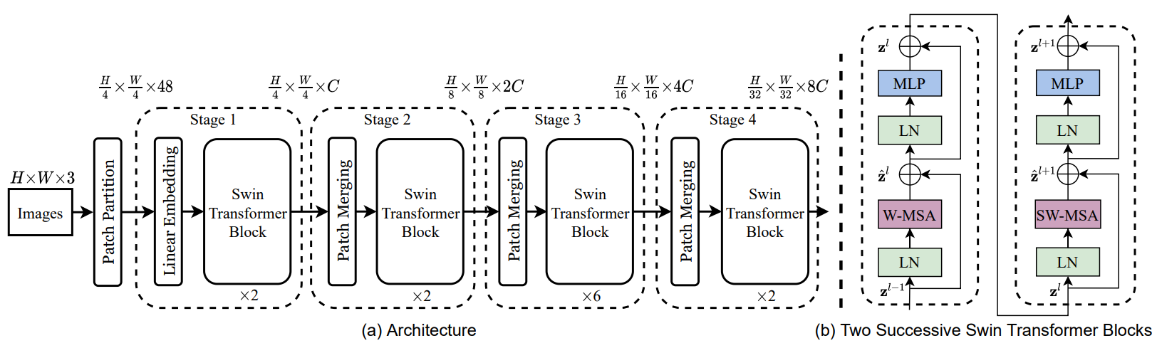
Architecture
https://hangjo-o.tistory.com/69

Slide 4
Patch Merging
1 | 1
1 | 1
2 | 2
2 | 2
1 | 2 | 1 | 2
3 | 4 | 3 | 4
1 | 2 | 1 | 2
3 | 4 | 3 | 4
1 | 1
1 | 1
1 | 1
1 | 1
3 | 3
3 | 3
4 | 4
4 | 4

Slide 5
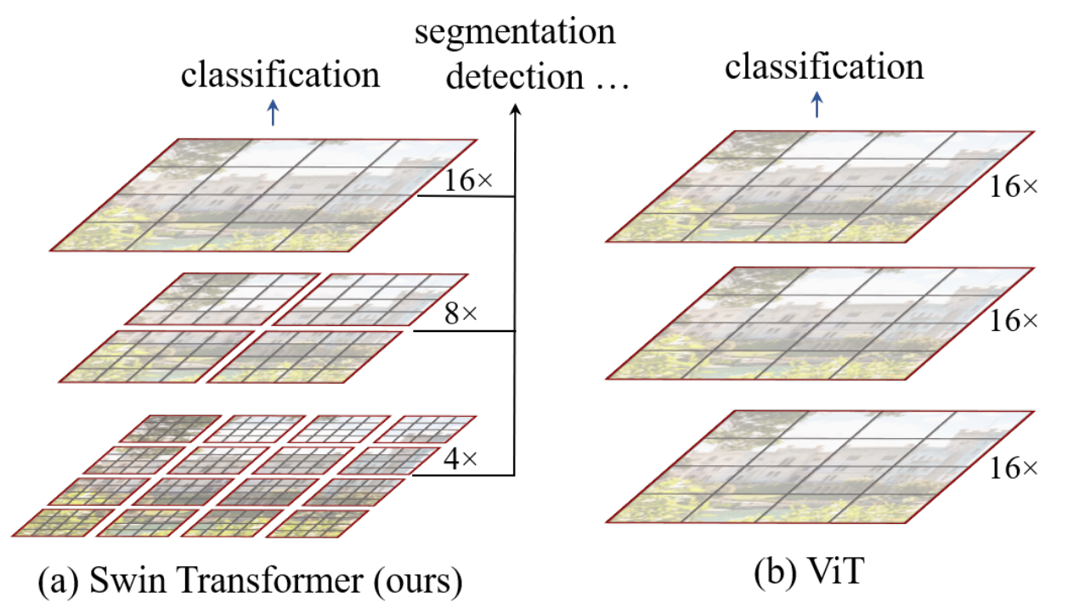
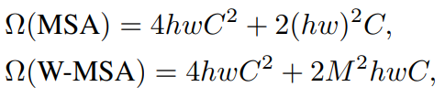

Self-attention in non-overlapped windows
$M×M$ (7 x 7)
Propose to compute self-attention within local windows.

Slide 6
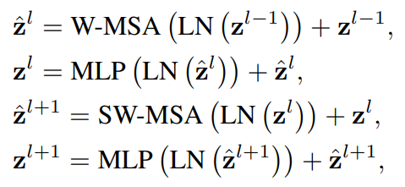
Shifted window partitioning in successive blocks
The window-based self-attention module lacks connections across windows, which limits its modeling power.
W-MSA
SW-MSA

Slide 7
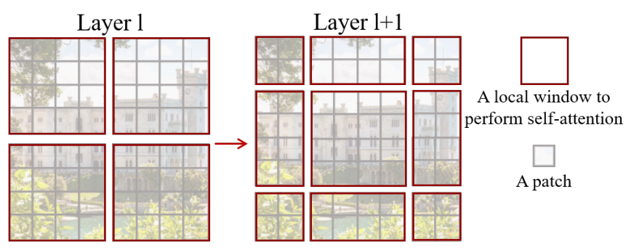
Swin Transformer
Attention
Attention
Attention
Attention

Slide 8
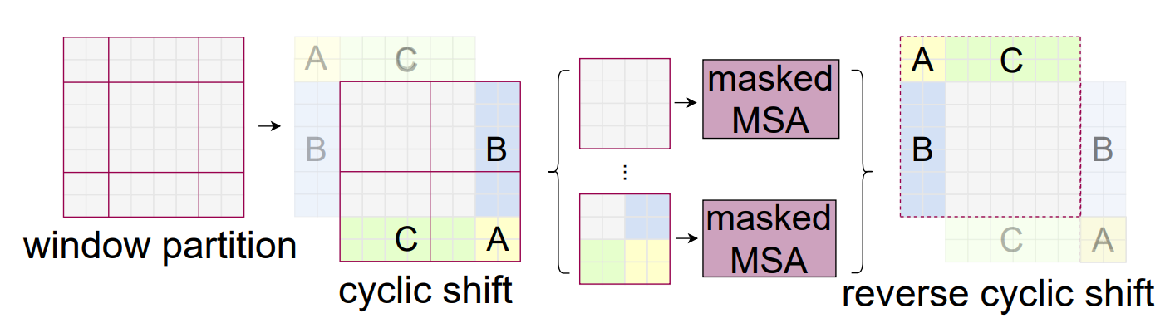
Efficient batch computation for shifted configuration
if.. smaller than M x M ??
Add padding -> increased computation
Cyclic-Shift

Slide 9
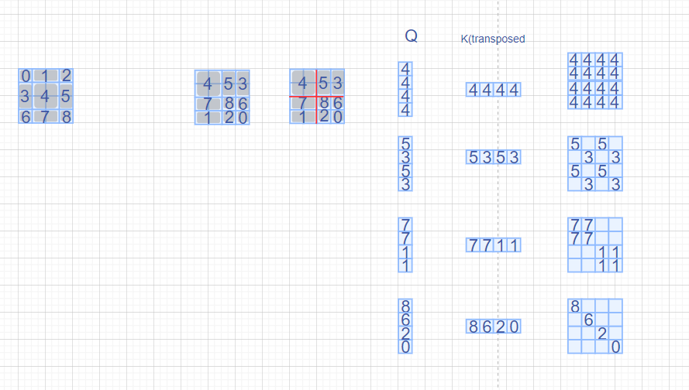

Slide 10

Relative position bias
Including a relative position bias : $B∈ℝ^{M^{2}×M^{2}}$
$$Attention\left(Q,K,V\right)=Softmax\left(\frac{QK^{T}}{\sqrt{d}}+B\right)V$$

Slide 11
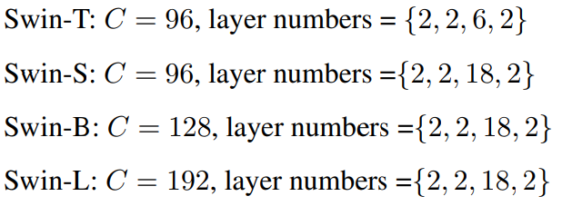
Swin Transformer
We also introduce Swin-T, Swin-S and Swin-L, which are versions of about 0.25×, 0.5× and 2× the model size and computational complexity, respectively.
M = 7 / d = 32

Slide 12
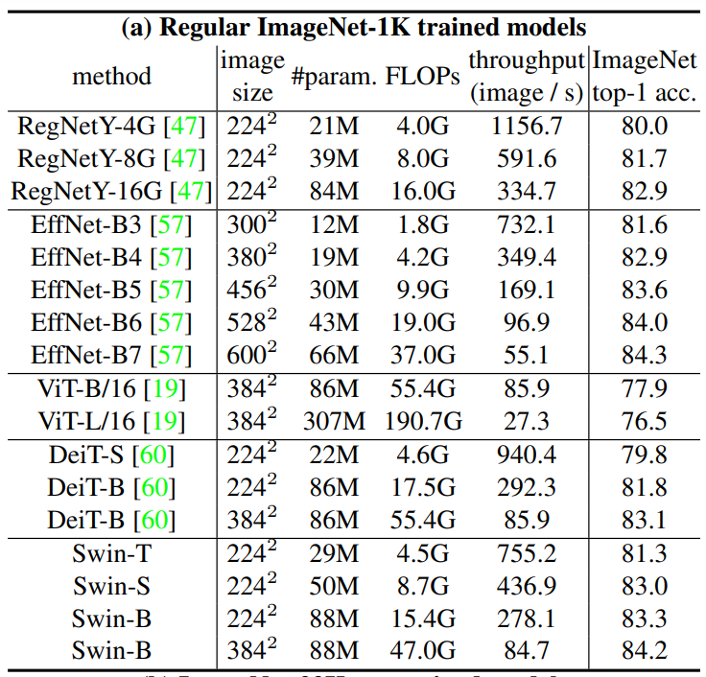
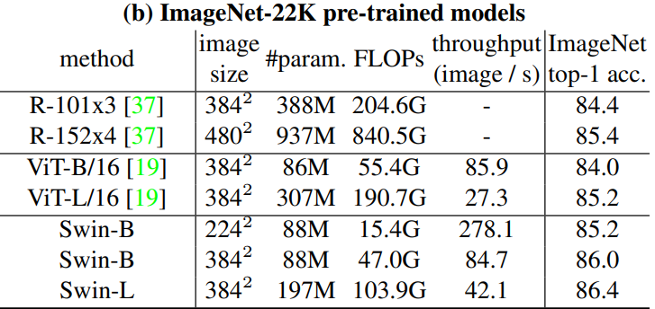
Experiments - ImageNet
14.2 million images and 22K classes.

Slide 13
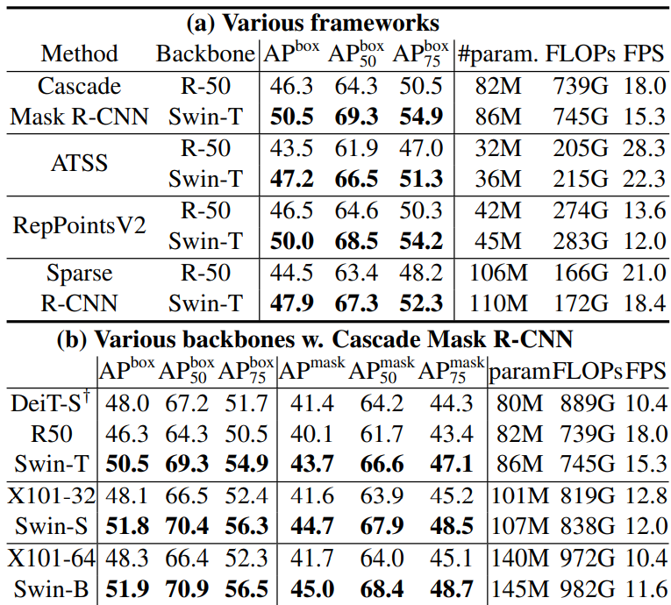
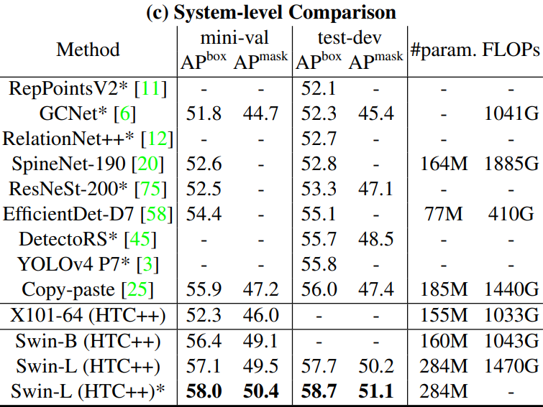
Experiments - Object Detection

Slide 14
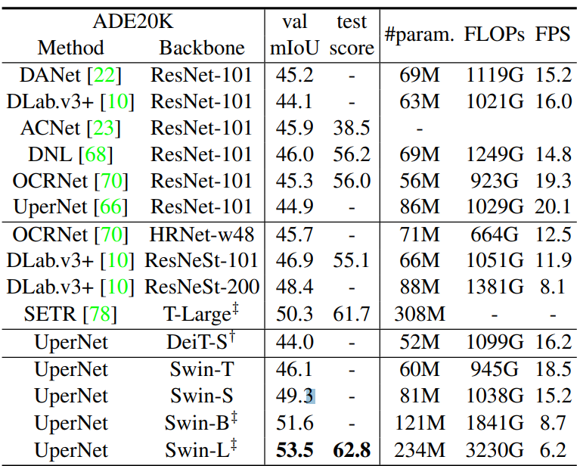
Semantic Segmentation

Slide 15
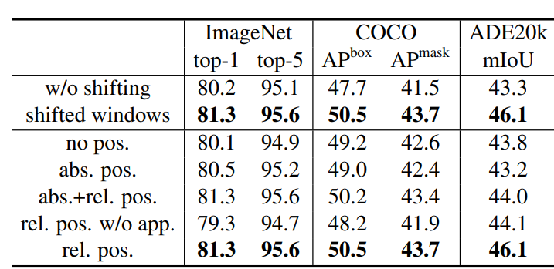
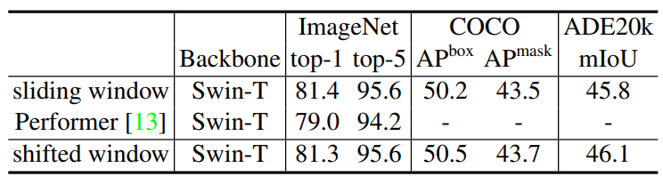
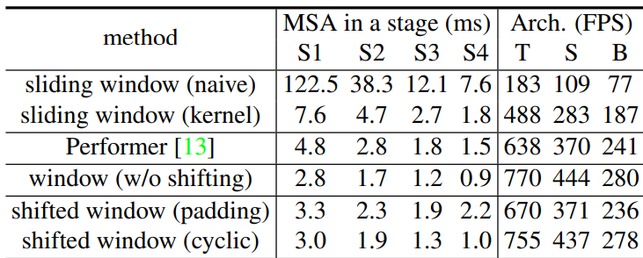
Ablation Study

Slide 16
Conclusion
Proposed Swin Transformer which a new vision Transformer.
Hierarchical feature representation and has linear computational complexity with respect to input image size.
Shifted window based self-attention is shown to be effective and efficient on vision problems.

