Slide 1























<
Provide program feedback to
>
Pending accreditation by
Standards Council of Canada
Taiga Environmental Laboratory
Proficiency Test
Provide ISO 17043 quality feedback
Interlabs Program
Provide technical performance feedback
Notes:
Last but not least, I’d like to acknowledge MECP and PHAC for their ongoing support for this program, and of course, the core labs across the province involved in MECP’s WSI program!

Slide 2
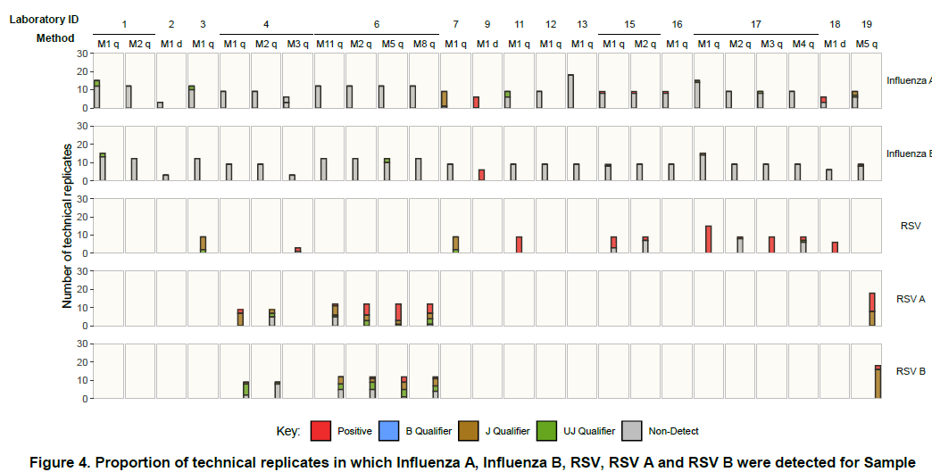

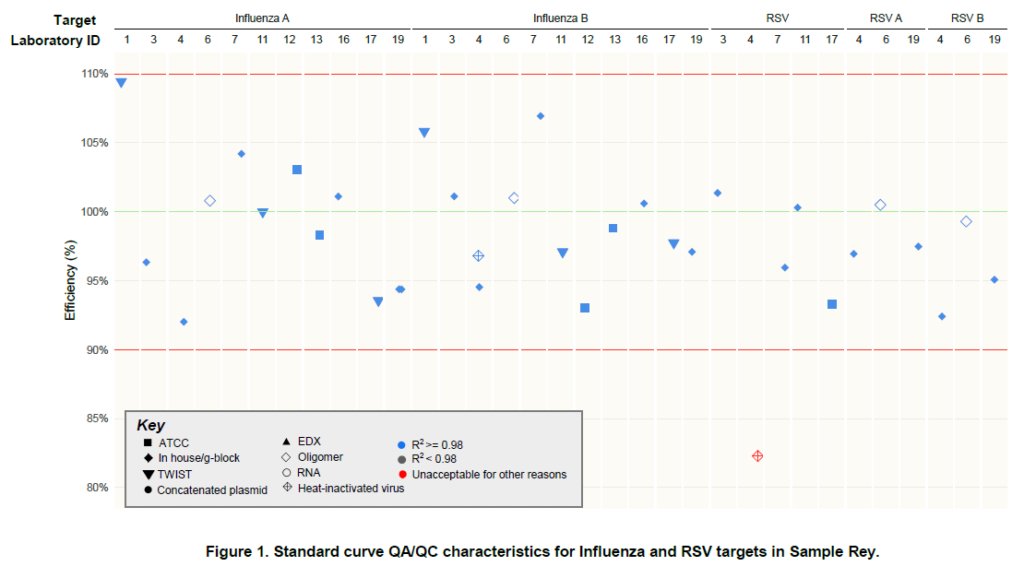
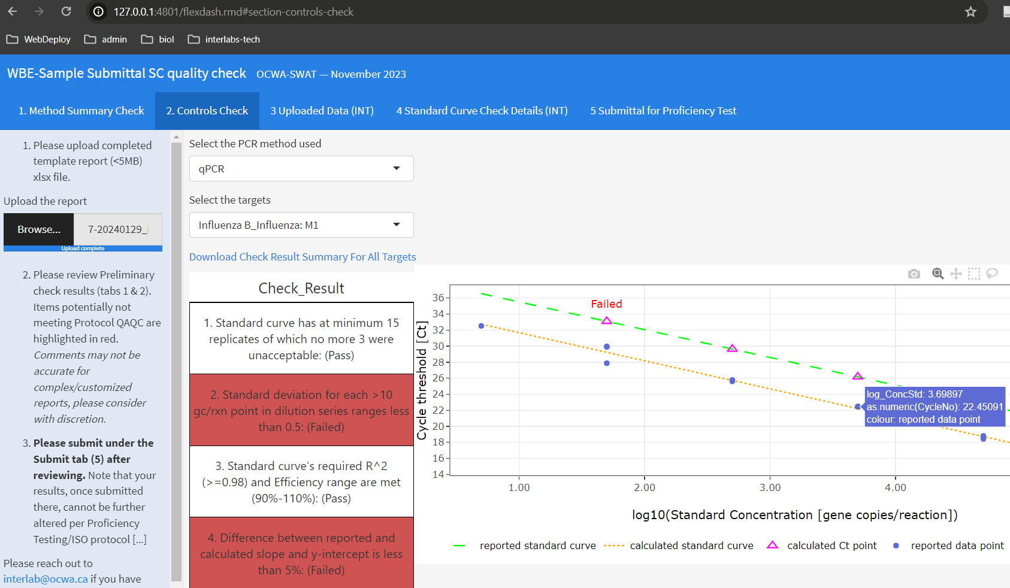
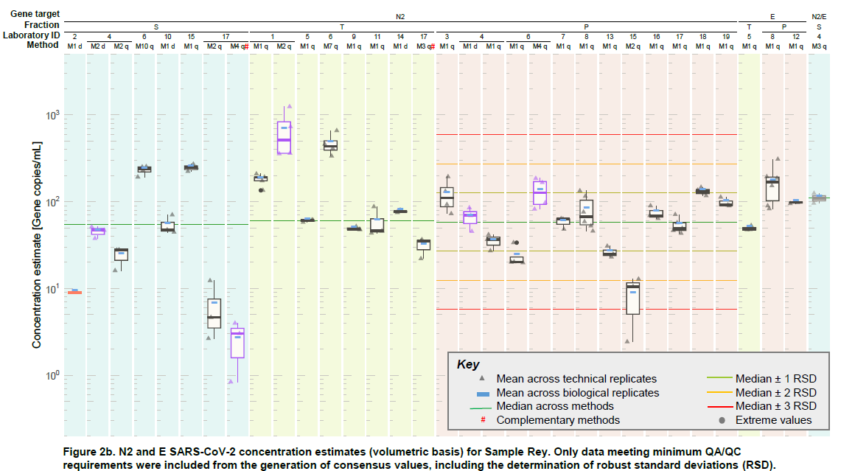

Slide 3
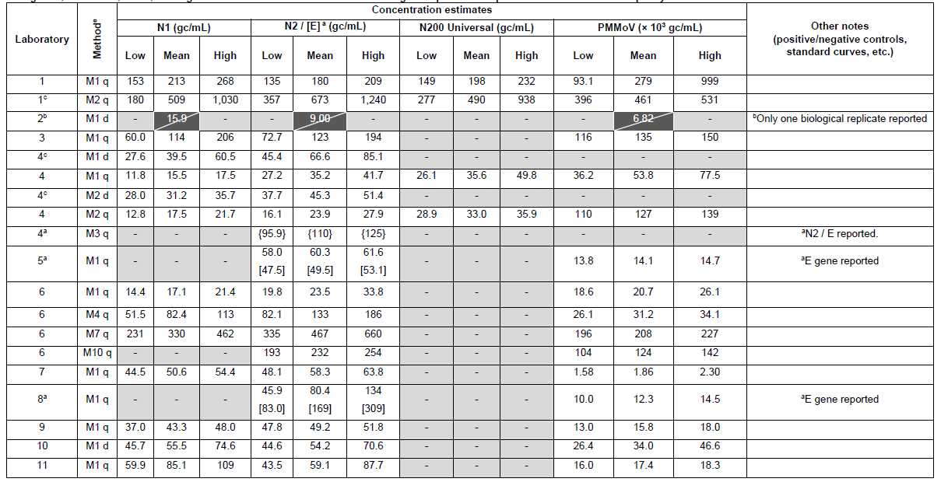
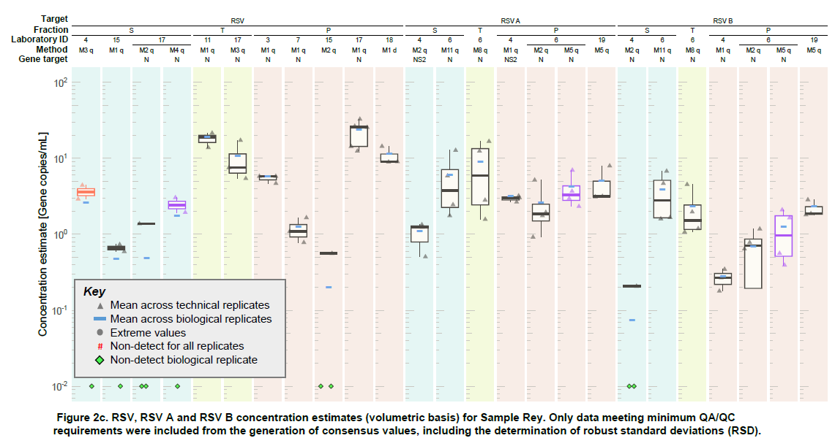

Slide 4
