Slide 1
Module :
Data Science & Machine Learning
Session 4 : Supervised Learning
Taught by-
Ms. Jyoti Kataria
Bioinformatics Analyst, Medgenome Labs Ltd.
M.Sc. Biotechnology, IIT Bombay

Slide 2
Important Information
Quiz week2 - question 7; its print(a)
Week2 and Week3 solutions uploaded for practice questions
Python Reference: https://thepythonguru.com/, datacamp, hacker earth, hacker rank
Linked in : Add today’s project
Class Project Link:
https://www.kaggle.com/c/diabetes-classification/data

Slide 3
Project Rubrics
A .pynb file will be the final submission – 60 Marks
Criteria for assessment (Break - up) :
Problem Statement and choosing the model - 20 M
Data Cleaning & Pre-processing steps - 20 M
Results/Performance Metrics - 20 M
Best Notebook for the project submission : Certified

Slide 4
Quick recap!

Slide 5
Supervised Learning :
Decision Trees : Classification & Regression both
Random Forest : Classification & Regression both
Logistic Regression : Classification

Slide 6
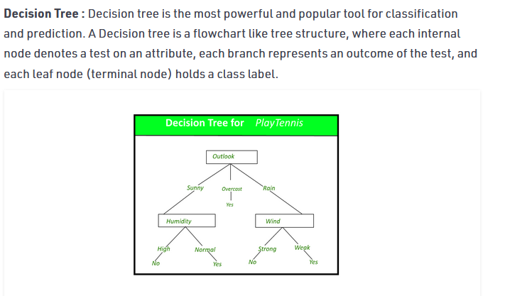

Slide 7
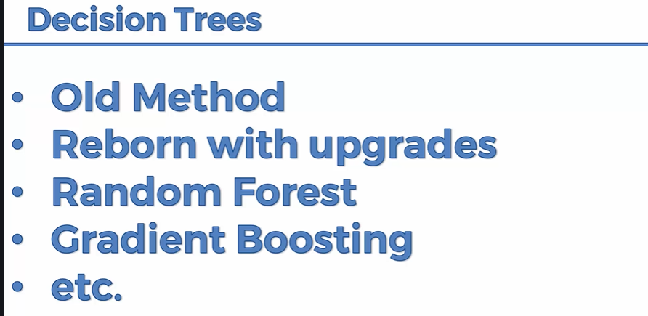
Facial recognition on iphones; Random forest invoke DT

Slide 8
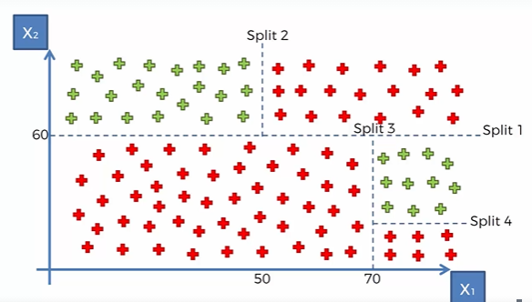
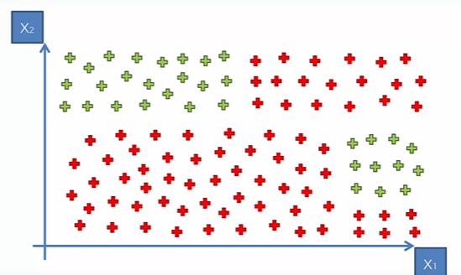
Decision Trees

Slide 9
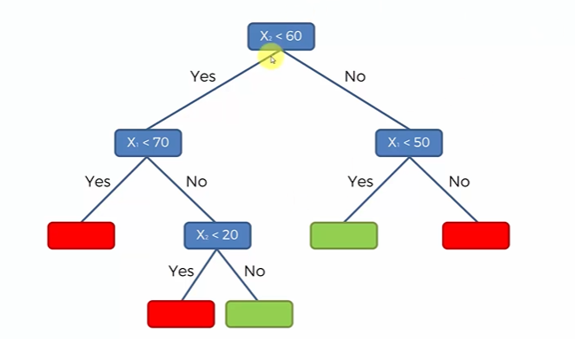
Decision Trees

Slide 10
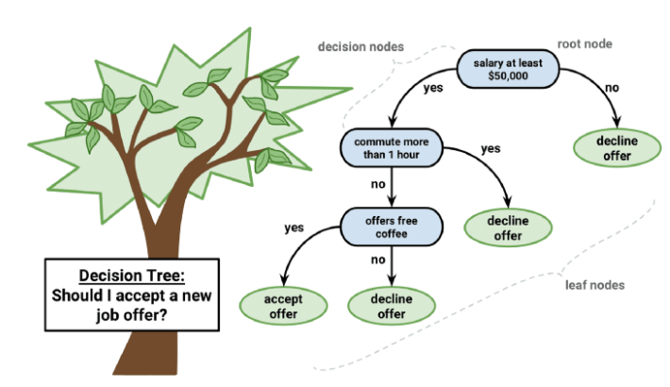
Decision Trees

Slide 11

Random Forest
Ensemble Learning
Running decision trees multiple times

Slide 12
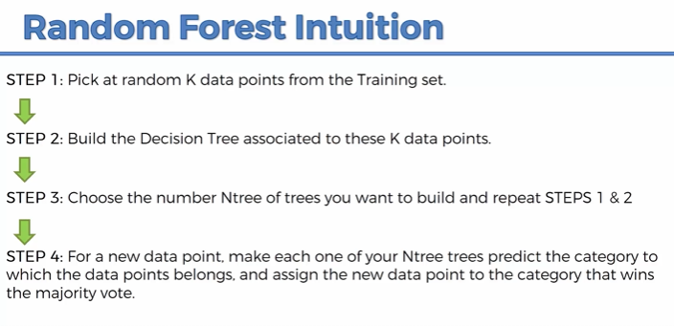

Slide 13
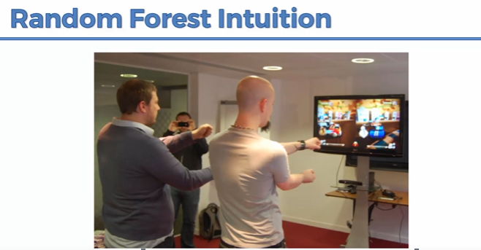
Power of numbers
Leveraging the power of single decision trees
Biologically; gene classification

Slide 14
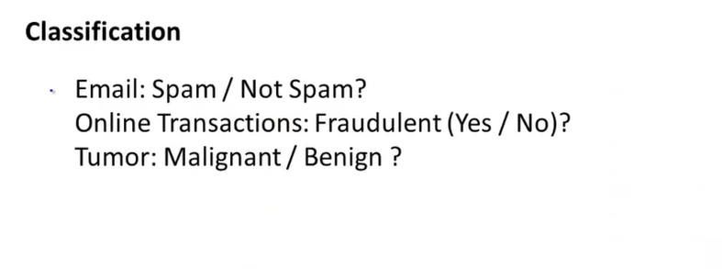
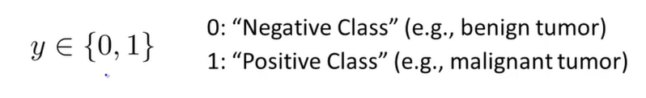
Supervised Learning – Classification Problem
Model Name : Logistic Regression

Slide 15
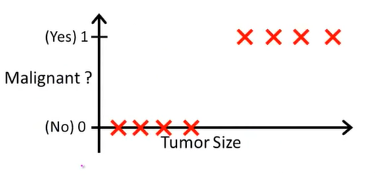
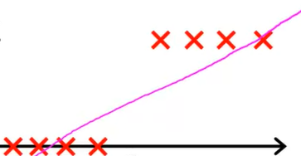
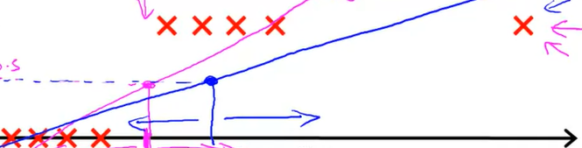
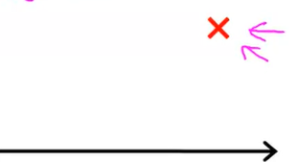
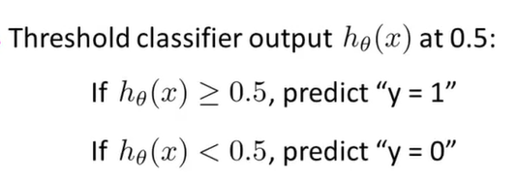
Logistic Regression (contd..)

Slide 16
Logistic Regression (contd..)
Applying linear regression to a classification problem doesn’t look like a good idea
But sometimes, it may get lucky!
Prefer not using it!

Slide 17
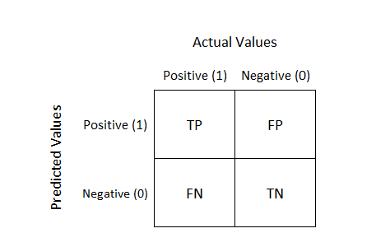
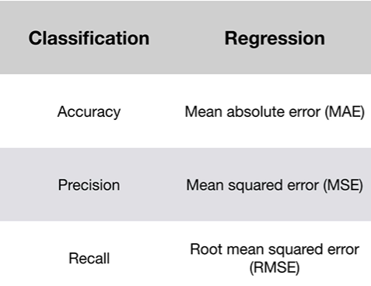
Logistic Regression : Performance Matrix
Confusion Matrix
It is a table with 4 different combinations of predicted and actual values

Slide 18
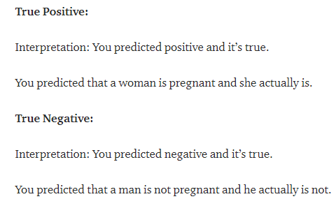
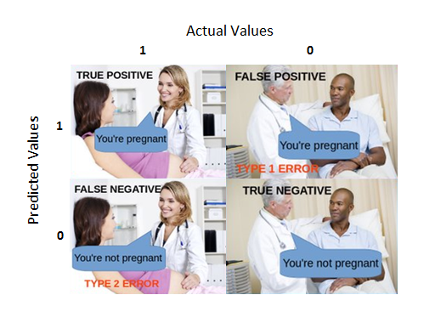
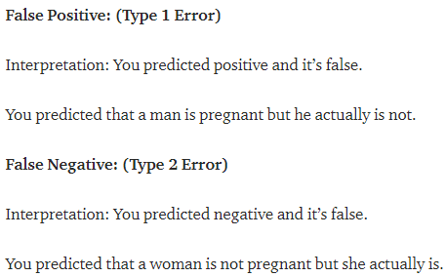
Logistic Regression : Performance Matrix (contd..)
Lets take pregnancy example:
COVID+

Slide 19
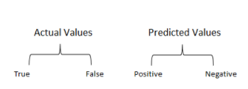
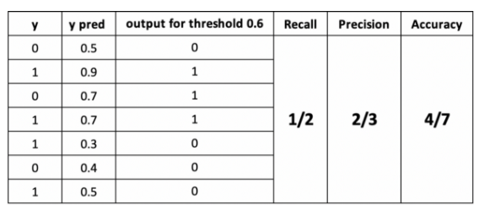
Logistic Regression : Performance Matrix (contd..)

Slide 20
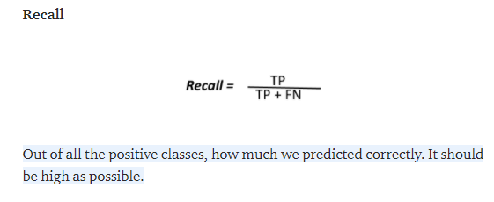
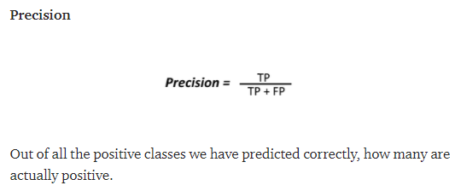
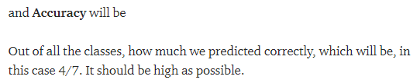
Recall, Precision, Accuracy
= True Positive Rate = Sensitivity

Slide 21
Important points!
We need to reduce False positive and False Negative errors wherever we can!
Example – Spam classifier (FP)
Cancer (FN)

Slide 22
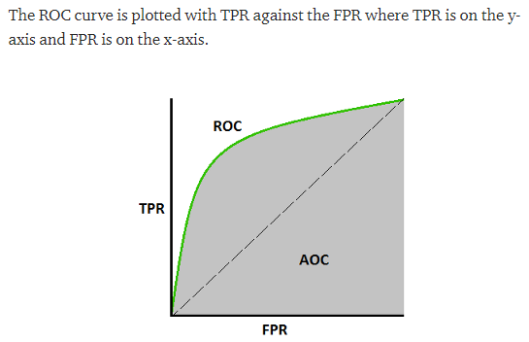
AUC – ROC Curve
AUC - ROC curve is a performance measurement for the classification problems at various threshold settings
ROC is a probability curve and AUC represents the degree or measure of separability

Slide 23
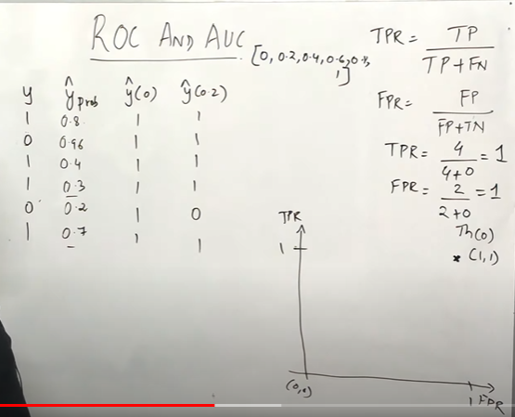

Slide 24
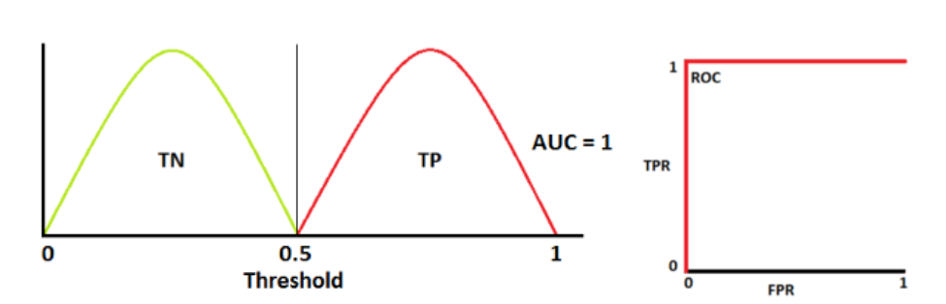

Ideal scenario!

Slide 25
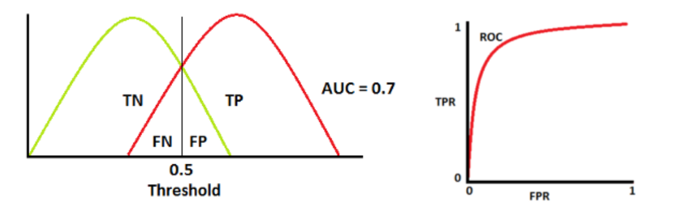
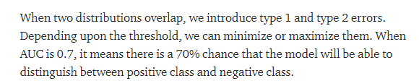
Usual scenario!

Slide 26
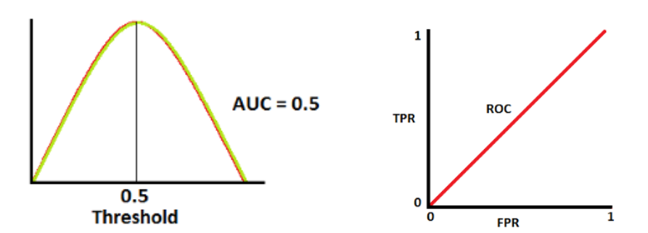

Worst scenario!

Slide 27
Let’s revise!
Decision Tree
Random Forest; Ensemble Learning
Logistic Regression
Recall, Precision, Accuracy, ROC-AUC Curve
Bar plot with pandas
Correlation Plot; multi-collinearity

Slide 29
Thank you ☺

