Slide 1
Module :
Data Science & Machine Learning
Session 2
Taught by-
Ms. Jyoti Kataria
Bioinformatics Analyst, Medgenome Labs Ltd.
M.Sc. Biotechnology, IIT Bombay

Slide 2
Quick recap!

Slide 3
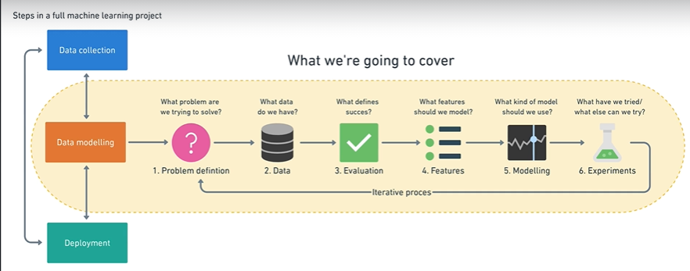

Slide 4
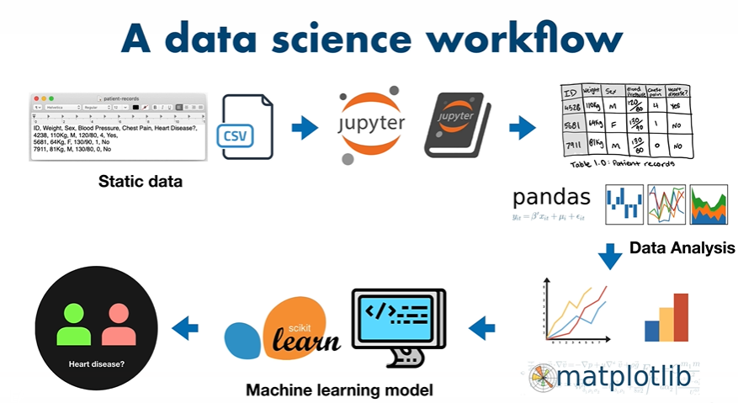

Slide 5
Today’s topics!
How did ML come into picture?
Supervised and Unsupervised Learning again!
Project Rubrics
Why python?
Hands on with python! ( a lot of commands you will learn/run)

Slide 6
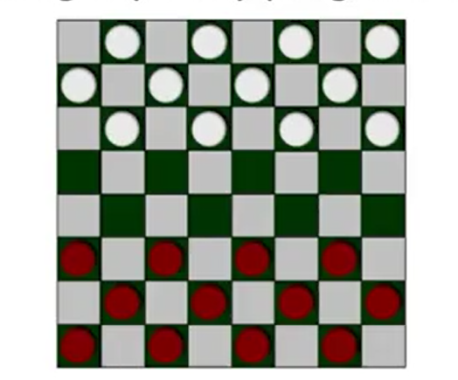
Flashback!
Arthur Samuel described it as: "the field of study that gives computers the ability to learn without being explicitly programmed."

Slide 7
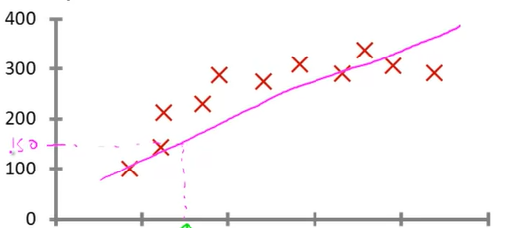
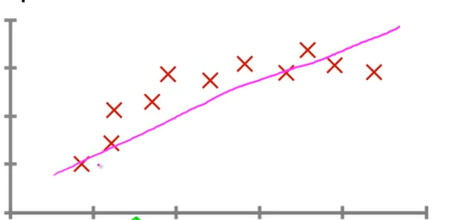
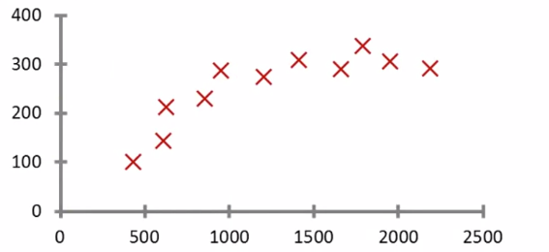
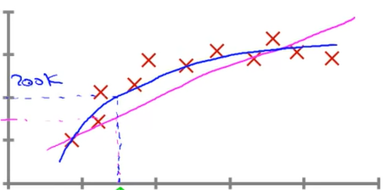
Supervised Learning : Regression
Right answers given!
Blood sugar level
20 30 40 50 60
Age
Regression Problem
Continuous valued output

Slide 8
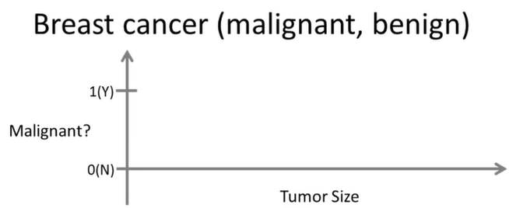
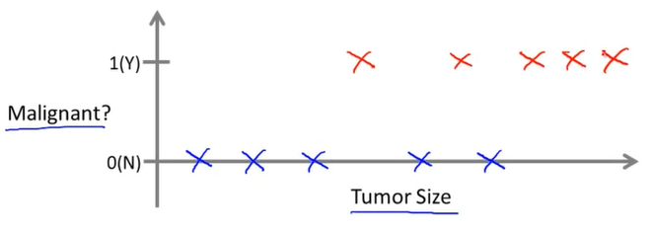
Supervised Learning : Classification
Can you estimate what's the chance of the tumor to be malignant/benign?
Classification Problem
Discrete valued output
0 – Benign
1 – First type
2 – Second type…

Slide 9
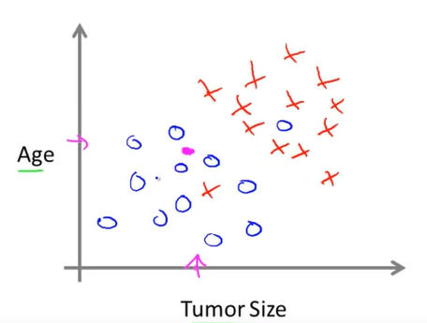
Supervised Learning : Support Vector Machine (SVM)
Clump Thickness
Uniformity of Cell Size
Uniformity of Cell Shape
Etc etc…
SVM

Slide 10
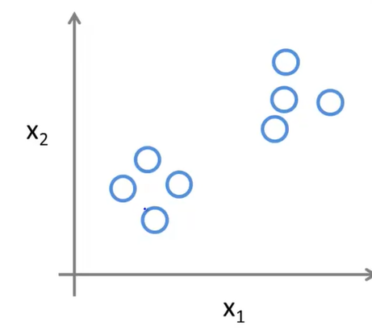
Unsupervised Learning :
Clustering
No labels for the data

Slide 11
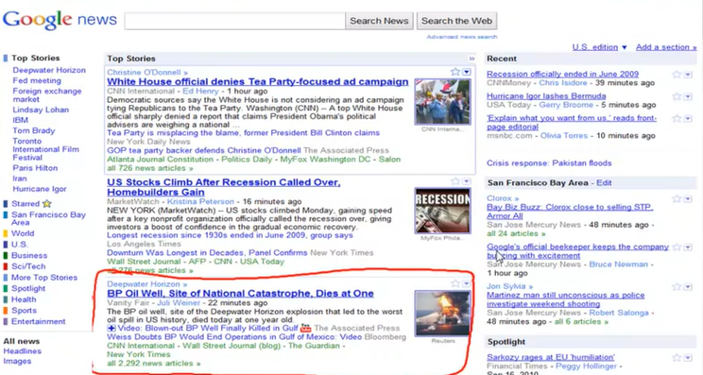

Slide 12
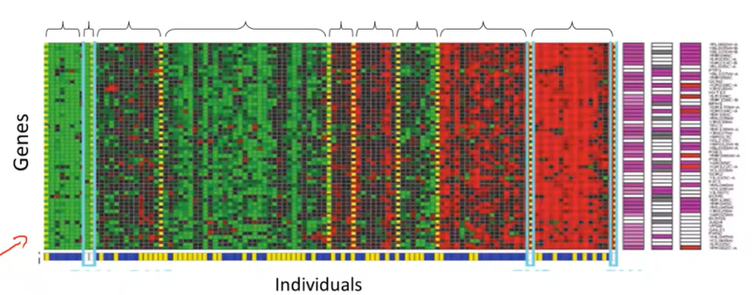
Unsupervised Learning :Clustering

Slide 13
Project Rubrics
A .pynb file will be the final submission – 60 Marks
Criteria for assessment:
Problem Statement
Requirements; libraries
Choosing the model
Data Cleaning & Pre-processing steps
Results/Performance Metrics
Best notebook ?

Slide 14
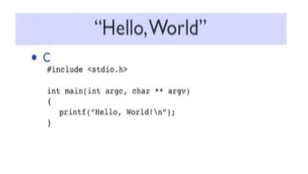
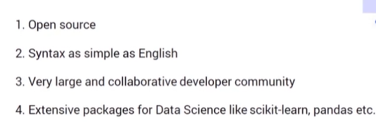
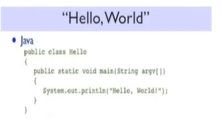
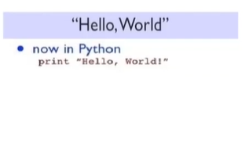
Why Python?

Slide 15
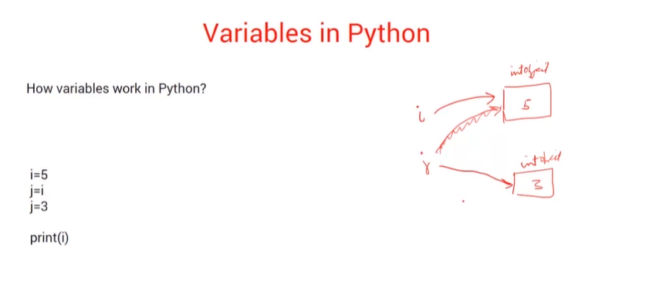

Slide 16
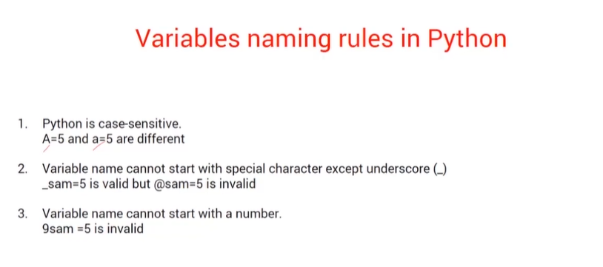

Slide 17
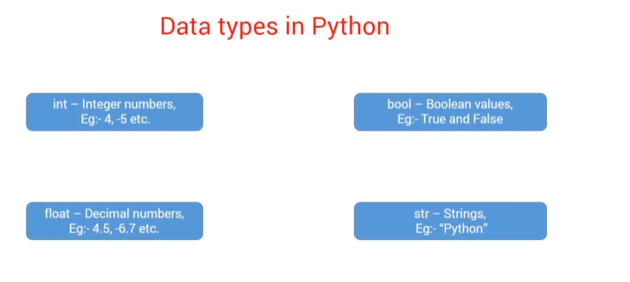

Slide 18
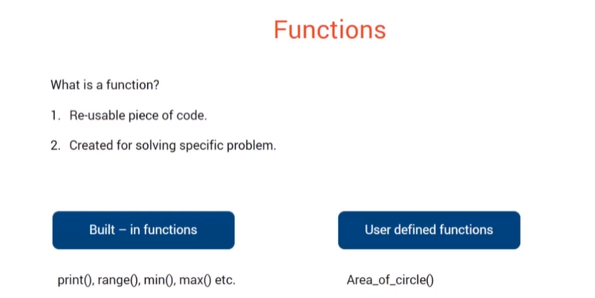

Slide 19
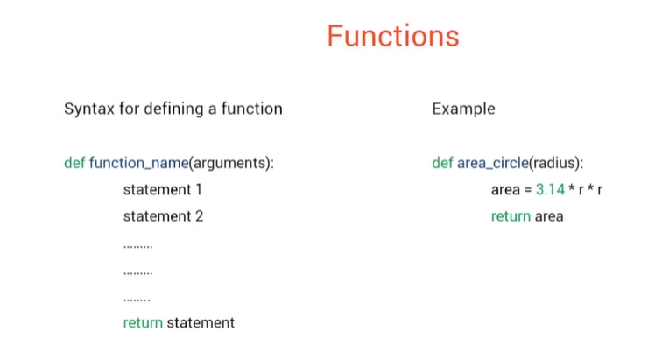

Slide 20
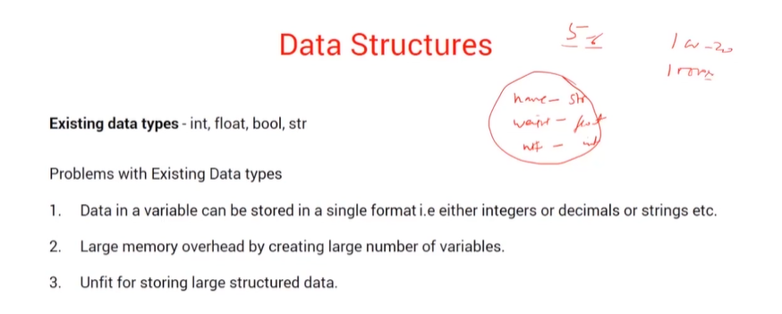

Slide 21
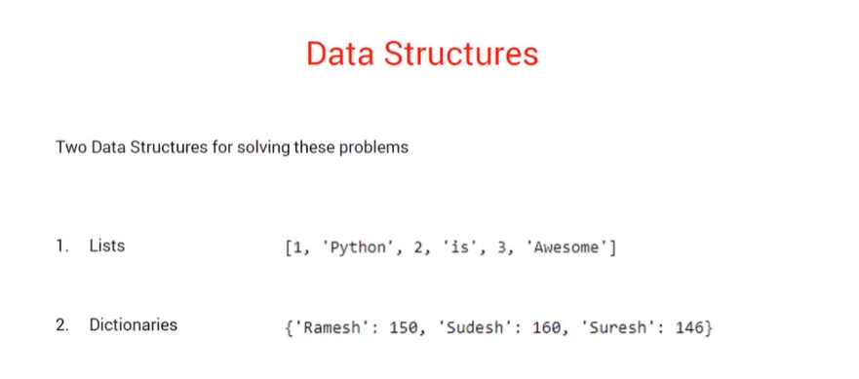

Slide 22
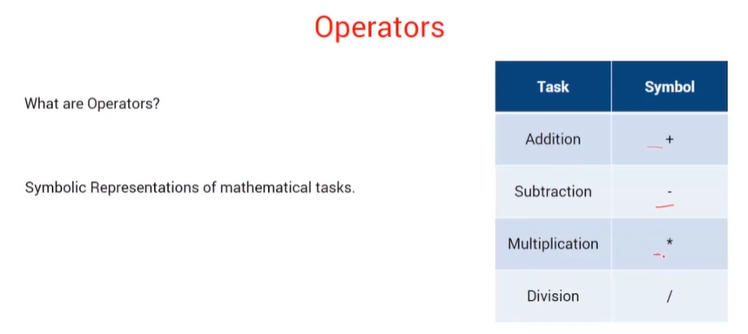

Slide 23
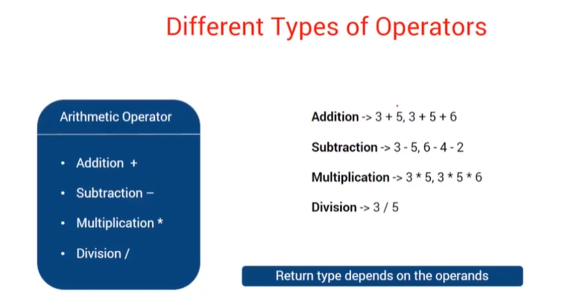

Slide 24
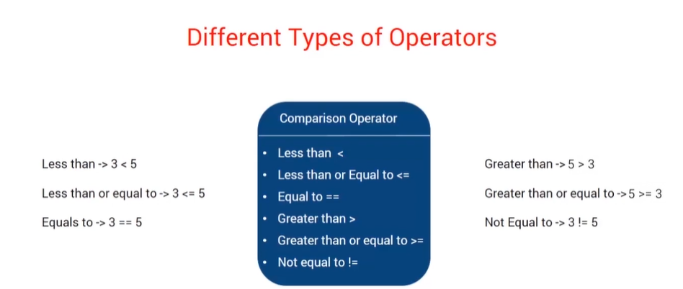

Slide 25
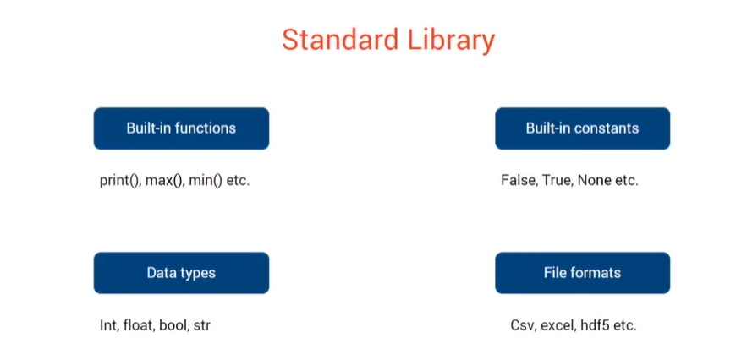

Slide 26
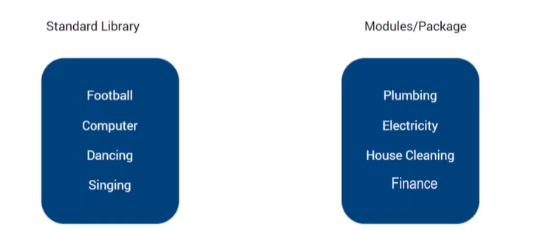
Library & Module & Package
Module : File containing various python functions and variables; basically a .py file.
Package : Collection of modules
Library : Collection of packages

Slide 27
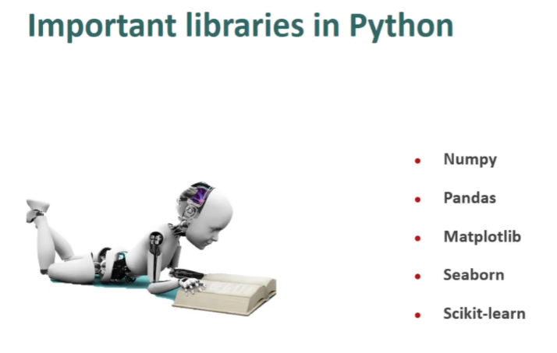

Slide 28
Lets code!

Slide 29
Let’s revise!
Variables : Storage, naming
Datatypes; Data Structures
Functions
Module, library, package
Operator Precedence Rule
String Operations

Slide 30
Thank you ☺

Slide 31


