Slide 1
Module :
Data Science & Machine Learning
Session 3 : EDA & Data Visualization
Taught by-
Ms. Jyoti Kataria
Bioinformatics Analyst, Medgenome Labs Ltd.
M.Sc. Biotechnology, IIT Bombay

Slide 2
Quick recap!

Slide 3
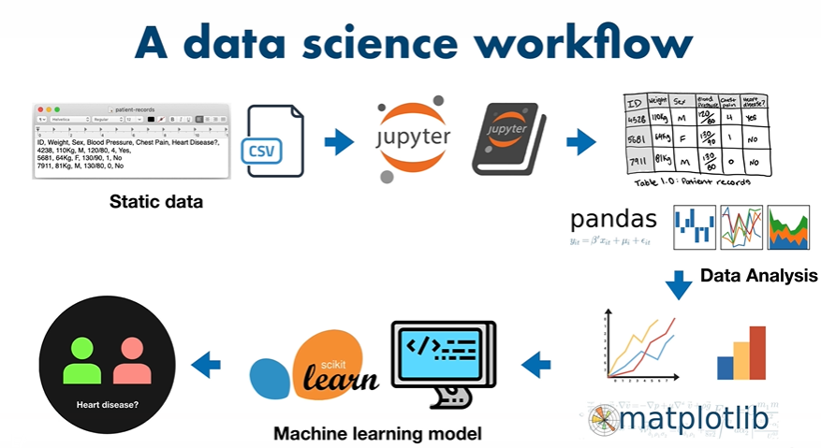

Slide 4
Session 2 Recap
Data types; float, int, string, bool
Data structures; list, dictionary
Numeric operations
String operations; + and *
Loops; Functions
Data frame and its operations

Slide 5

Where we (will code)/(do data analysis)?
Google colaboratory : needs internet
Jupyter notebook : needs internet
Virtual machine : depends
Python IDLE
Other code editors; VS Code, PyCharm etc (big projects)

Slide 6
Today’s Topics
Bar Graph
List comprehension
Some numpy commands; np.arange, len, random.randint,size
Scatter Plot
Line Plot
Histogram
Box Plot
Case Study

Slide 7
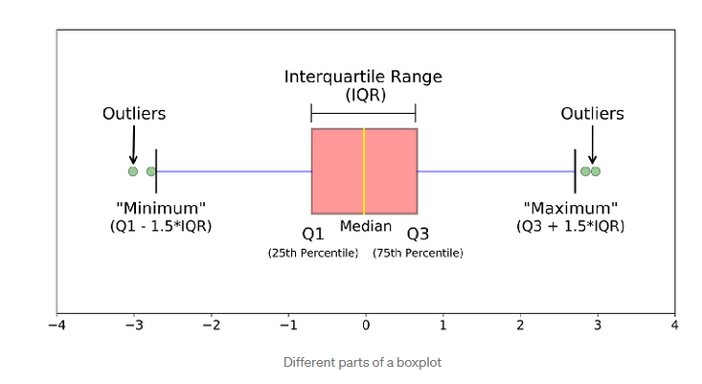
Box Plot

Slide 8
Thank you ☺

