Slide 1
Module :
Data Science & Machine Learning
Session 8 : Deep Learning and Neural Networks

Slide 2
Lets recap!
Deep Learning : History
Why it became a hype after so long?
Artificial Neural Network : Perceptron
Neuron
Two Layered ANN
Back Propagation
Big Data Fundamentals

Slide 3
Today’s Topics
CNN
Keras
RNN
Important terminology and concepts
- Boosting
- Bagging
- Bias & Variance
Python Session with Keras

Slide 4
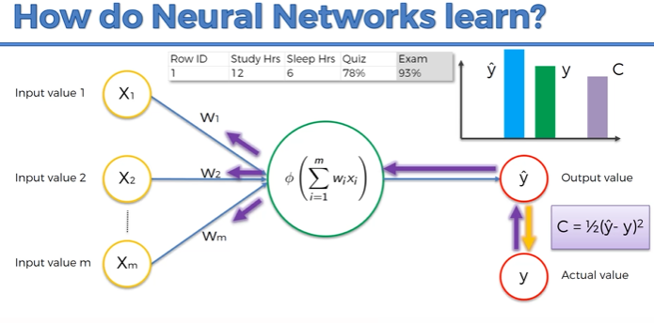


Slide 5
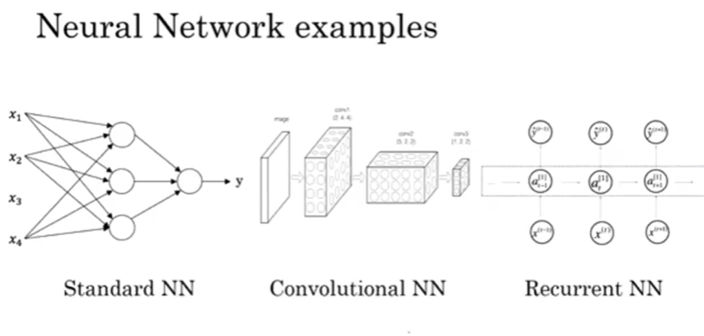

Slide 6
CNN – Convolutional Neural Network
Deep Learning algorithm which can take in an input image, assign importance (learnable weights and biases) to various aspects/objects in the image and be able to differentiate one from the other.
Specialized for 2-D images.
CNN apply filters to create a feature map that summarizes the presence of detected features in the input.
Filters can be handcrafted, such as line detectors but the innovation of convolutional neural networks is to learn the filters during training in the context of a specific prediction problem.
So, ConvNets have the ability to learn these filters/characteristics.

Slide 7
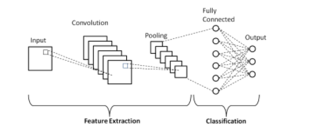
CNN - Intuition

Slide 8
Keras
High Level neural network API, written in python
Easy and fast prototyping
Supports both CNN and RNN and combination also
Runs on both CPU and GPU
Reference
https://keras.io/guides/

Slide 9
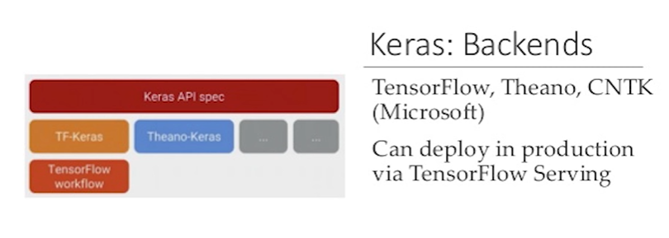

Slide 10
Models in Keras
Two ways of composing models in Keras:-
Sequential Model
Functional Model

Slide 11
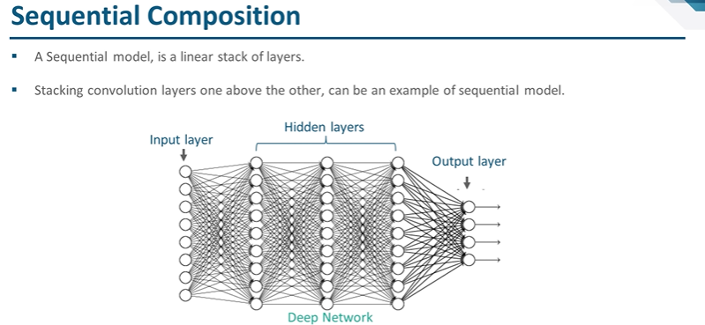

Slide 12
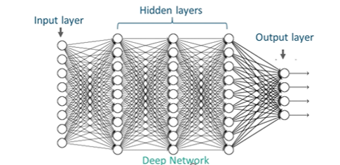
Functional Composition

Slide 13
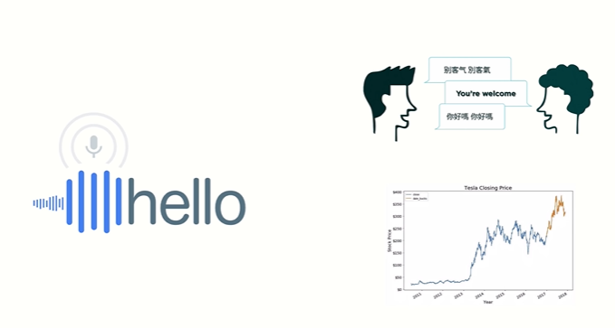
RNN

Slide 14
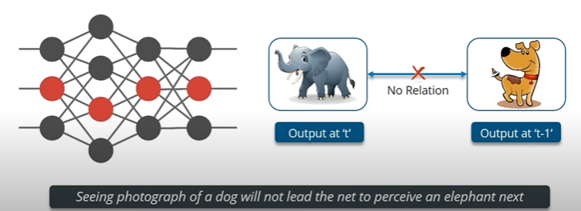
Why RNN used?

Slide 15
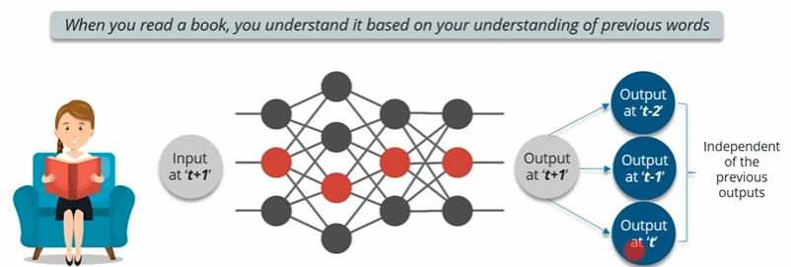
Why RNN used?

Slide 16
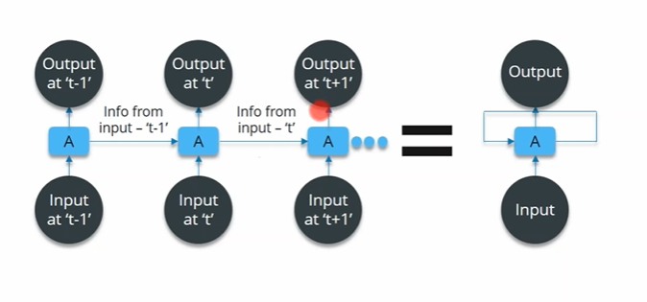
RNN - Intuition

Slide 17
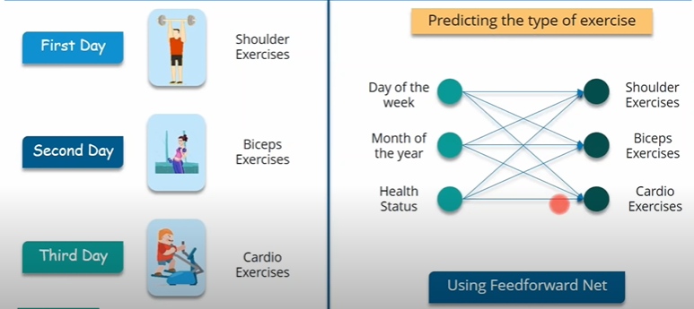
RNN - Intuition

Slide 18
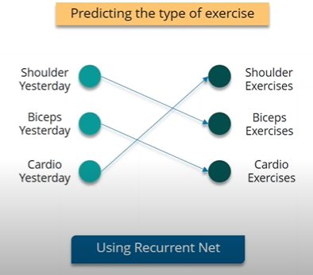
RNN - Intuition

Slide 19
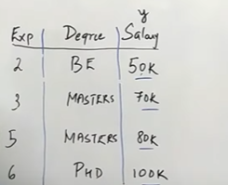

Gradient Boosting
Accuracy enhancement technique used for regression and classification problems
Base Model; Mean = 75
Compute residuals; errors
Decision Tree; Inputs – Degree;Exp
Outputs- Error
Check for errors again and tries to reduce
cost function

Slide 20
Bagging (Bootstrap Aggregation)
Ensemble Technique
Row sampling with replacement
This statistical technique consists in generating samples of size B (called bootstrap samples) from an initial dataset of size N by randomly drawing with replacement B observations.

Slide 21
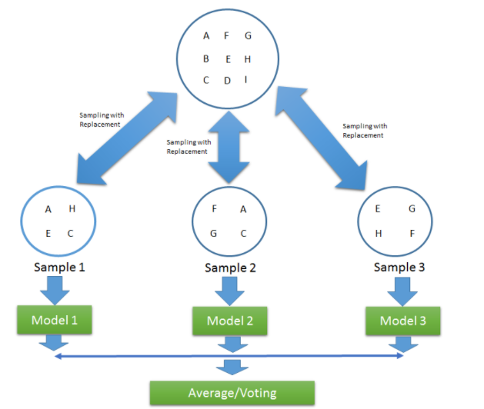
Bagging

Slide 22
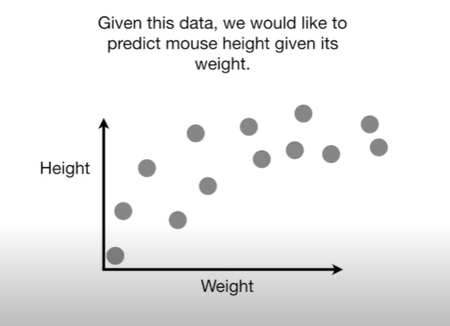
Bias and Variance

Slide 23
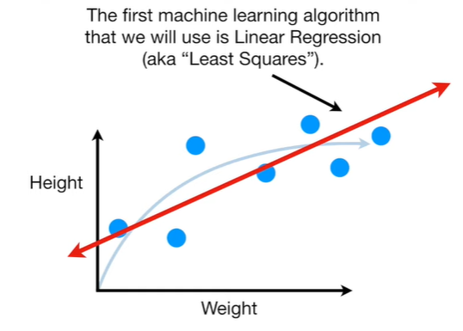
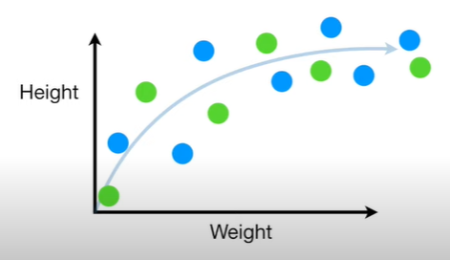
Lets divide the data into training and test data set
Blue = Train Data set
Green = Test Data set

Slide 24
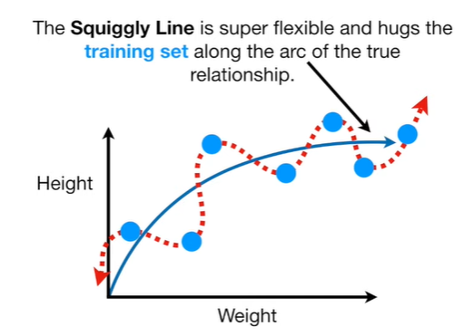
Bias (contd..)
The inability for a machine learning algorithm to capture the true relationship is called Bias.

Slide 25
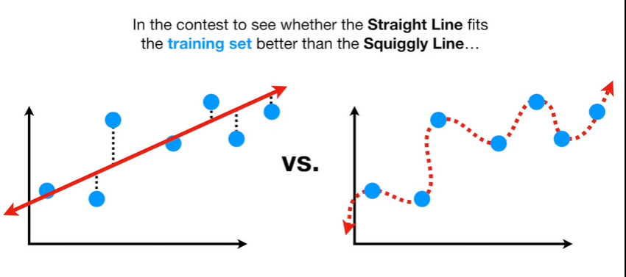
Calculating SSE (Sum of Squared Errors)
Wins!

Slide 26
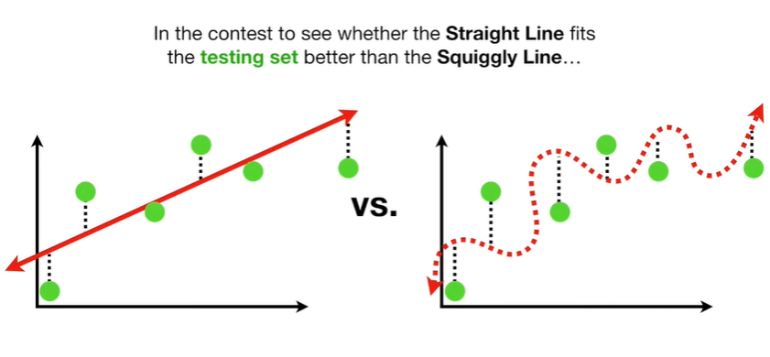
Variance - We also have a testing set!
Wins!
The difference in fits between data sets is called Variance.

Slide 27
Which ML algorithm to use when?
Usecase – Classification/Regression
Dataset
Classification – Logistic Regression, DT, Random Forest, xg boost etc.
Logistic Regression : basic, simple, less time
consuming
Visualization of data : seaborn plots, decide further
Size of the data; imbalanced data set

Slide 28
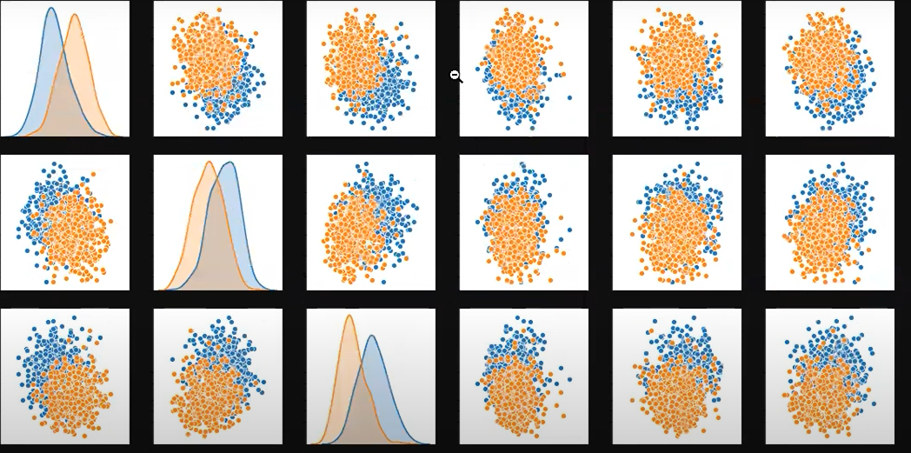
Bi-variate Pairplot

Slide 29
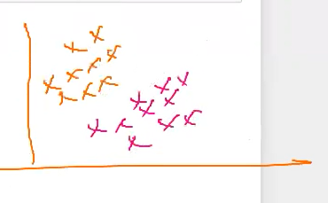
Logistic Regression will work best here!
Why?
No overlapping
Linear classification problem
If overlapping what next?

Slide 30
Can I apply DT, RF and kNN?
DT works good if the datapoints aren’t too overlapping, otherwise kNN
Lets take another dataset!

Slide 31
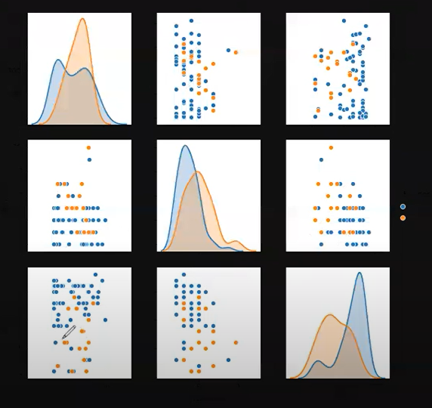
Which model should work best for this?

Slide 32

Imbalanced Data set

Slide 33
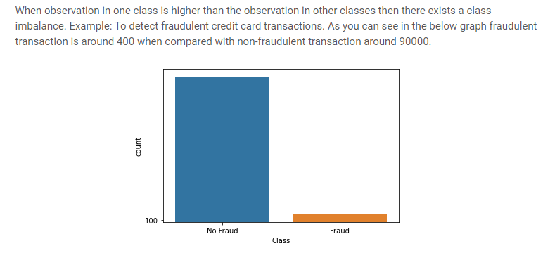
Imbalanced Data set

Slide 34
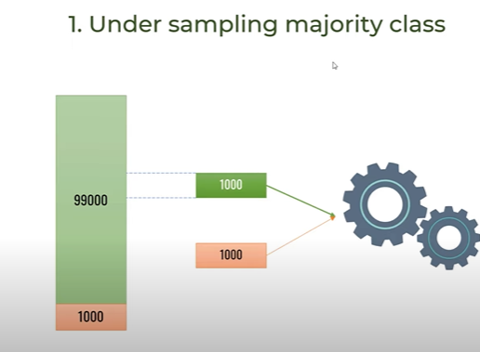
How to proceed with imbalanced dataset?

Slide 35
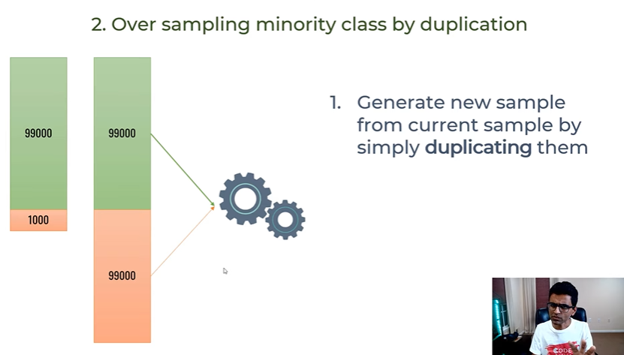
How to proceed with imbalanced dataset?

Slide 36
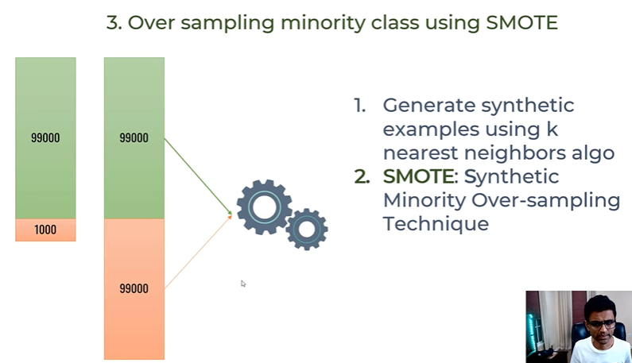
How to proceed with imbalanced dataset?

Slide 37
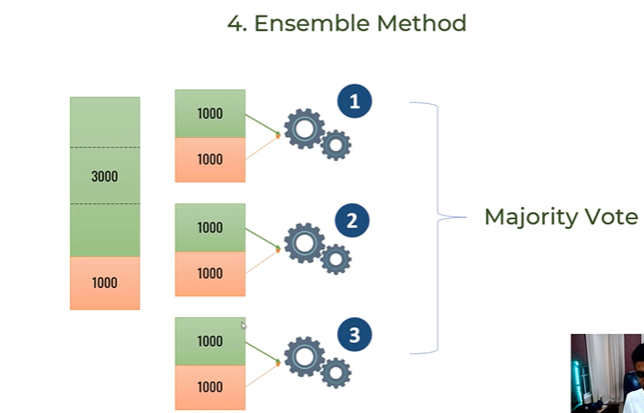
How to proceed with imbalanced dataset?

Slide 38
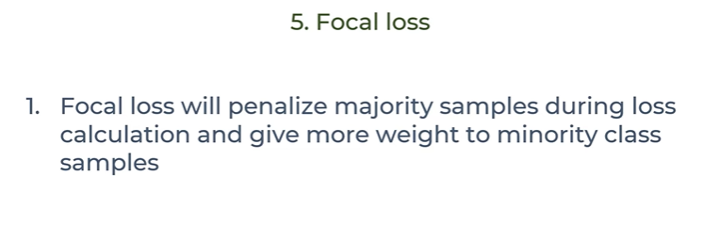
How to proceed with imbalanced dataset?

Slide 39
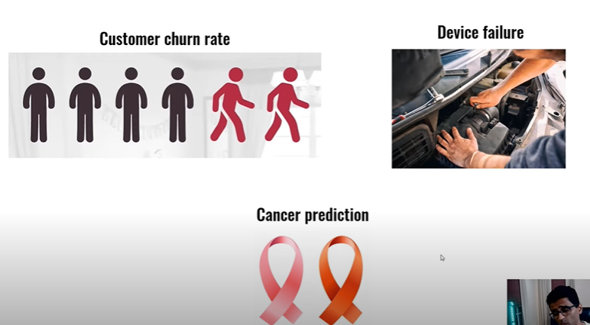
Imbalanced datasets examples

Slide 40
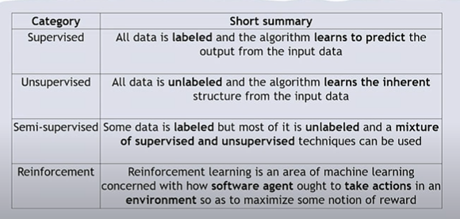
Major ML Techniques

Slide 41
Thankyou ☺

