Slide 1
Module : Data Science & Machine Learning
Session 6 : Un-Supervised Learning (Contd.) + Deep Learning
Taught by-
Ms. Jyoti Kataria
Bioinformatics Analyst, Medgenome Labs Ltd.
M.Sc. Biotechnology, IIT Bombay

Slide 2
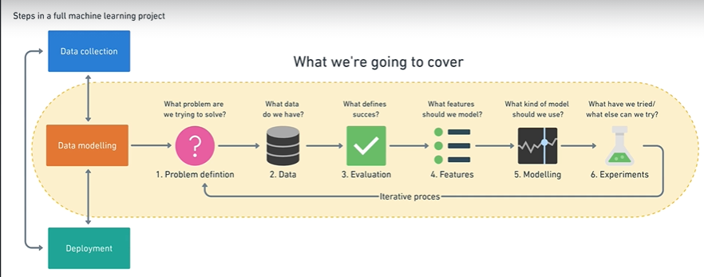
Quick recap!

Slide 3
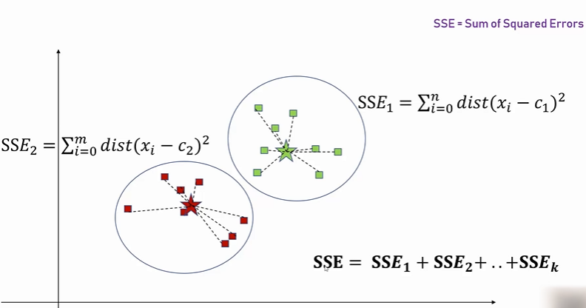
K Means Clustering

Slide 4
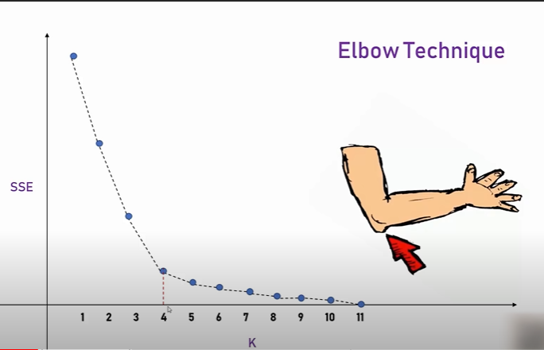
K Means Clustering : Elbow Method

Slide 5
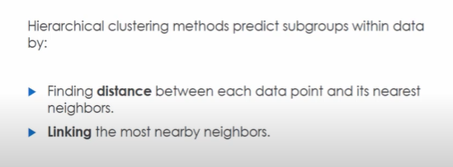
Hierarchical Clustering
Suppose you are a geneticist and you want to differentiate functional groups of genes from many samples. We can do this by seeing expression profile of different genes vs samples.

Slide 6
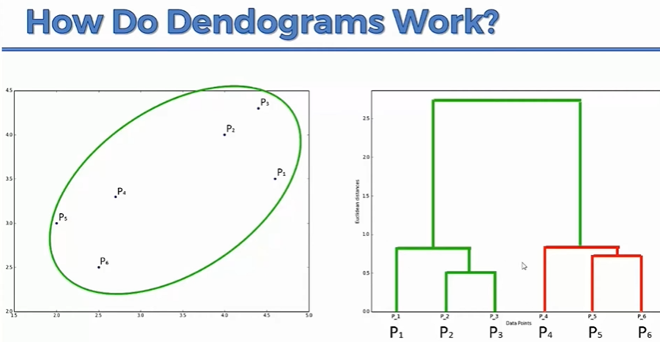

Slide 7
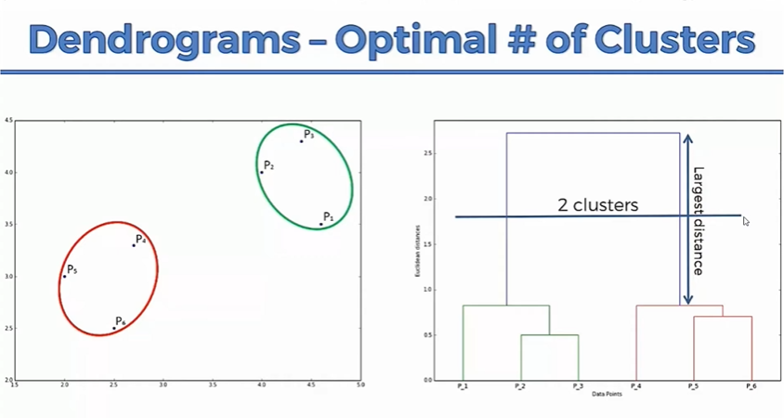

Slide 8
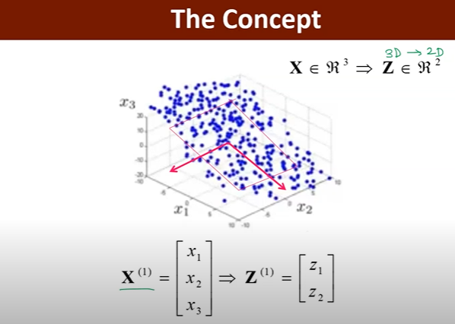
PCA

Slide 9
Python Session
kMeans clustering
Hierarchical Clustering
PCA

Slide 10
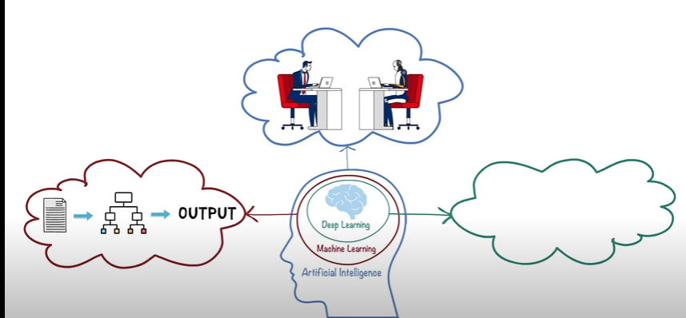
AI, ML and DL
?

Slide 11
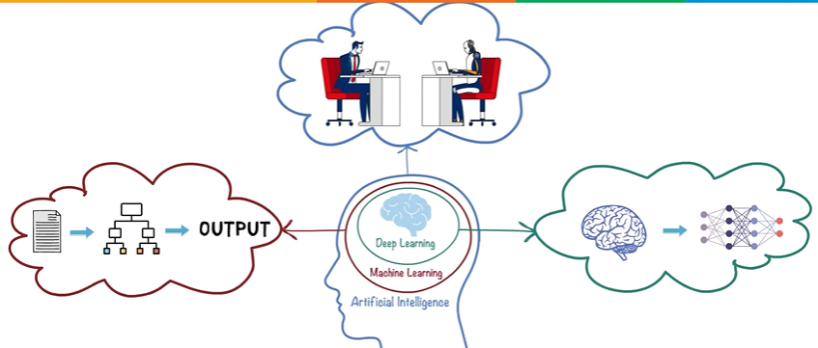
Deep Learning

Slide 12
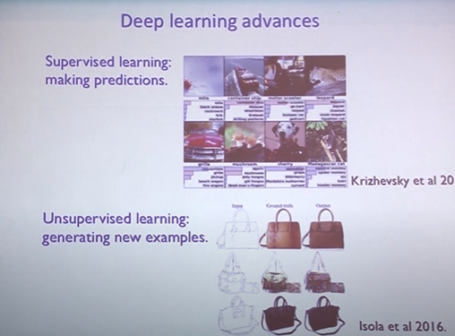

Slide 13
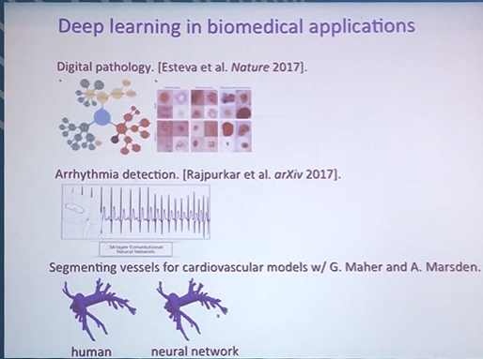

Slide 14
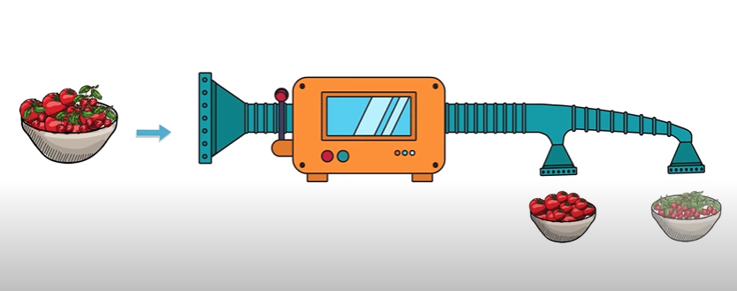
Making an algorithm to differentiate cherries and tomatoes!

Slide 15
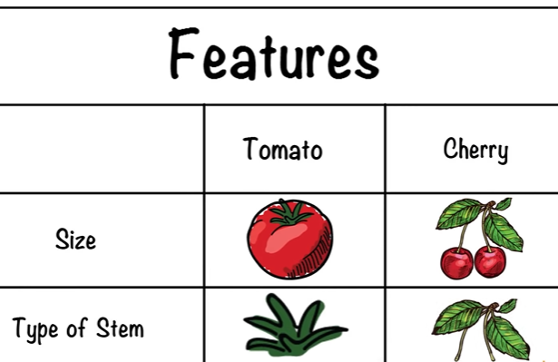

Slide 16
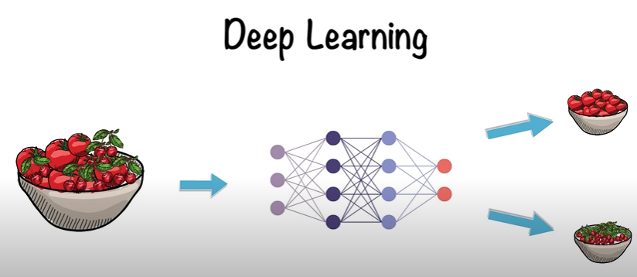

Slide 17
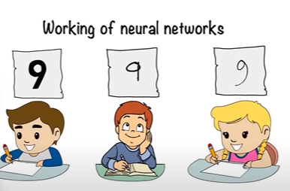
What is an Artificial Neural Network?

Slide 18
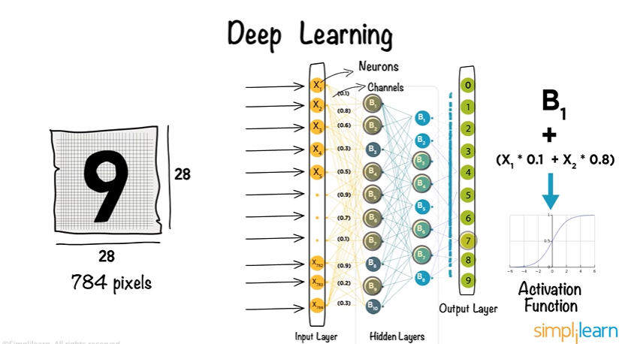

Slide 19
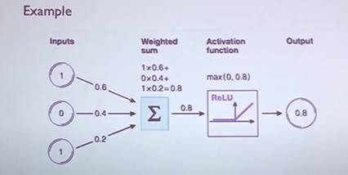

Slide 20
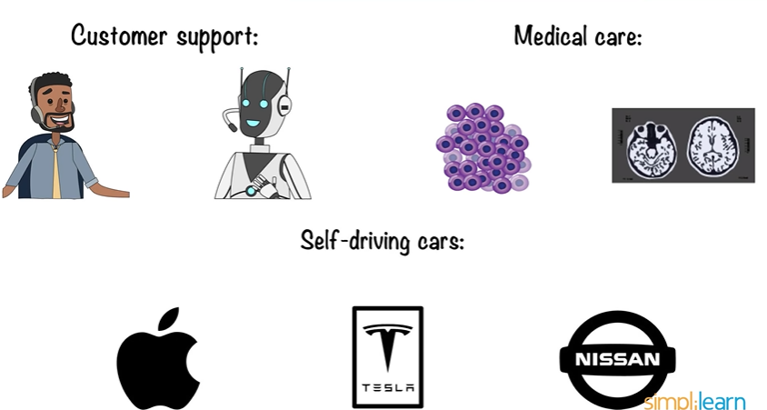
Applications!

Slide 21

Deep learning has a vast scope but has some limitations also!

Slide 22
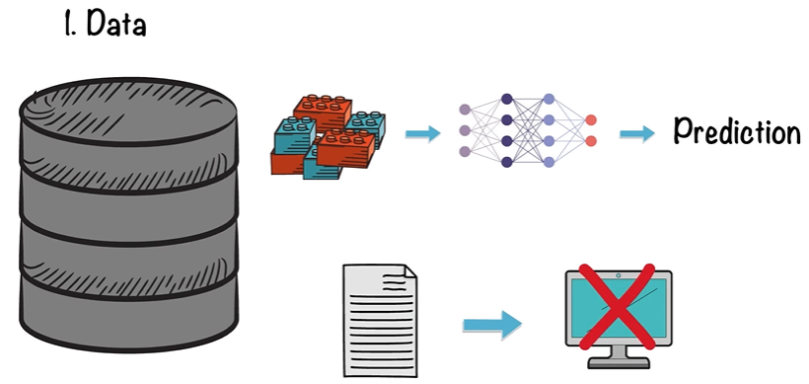

Slide 23
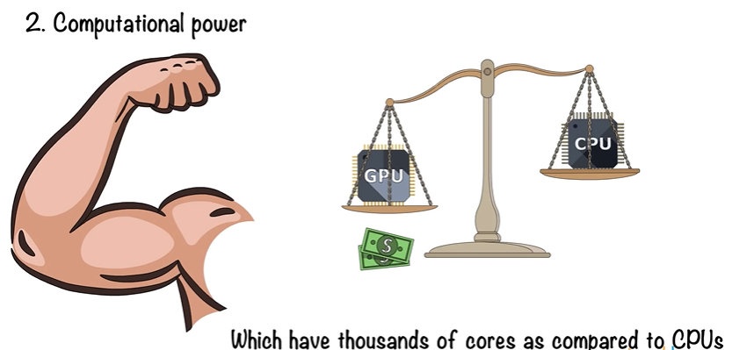

Slide 24
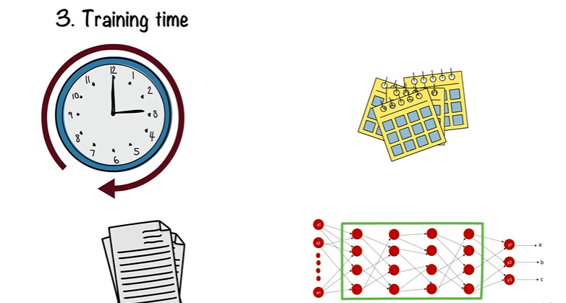

Slide 25
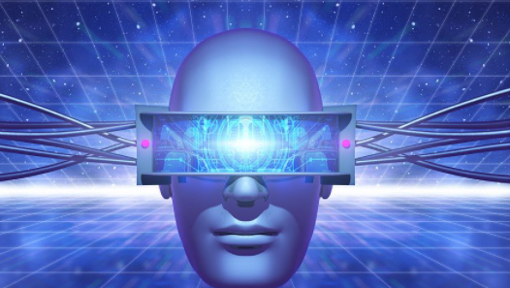
Computer Vision
Computer vision is an interdisciplinary scientific field that deals with how computers can gain high-level understanding from digital images or videos.

Slide 26
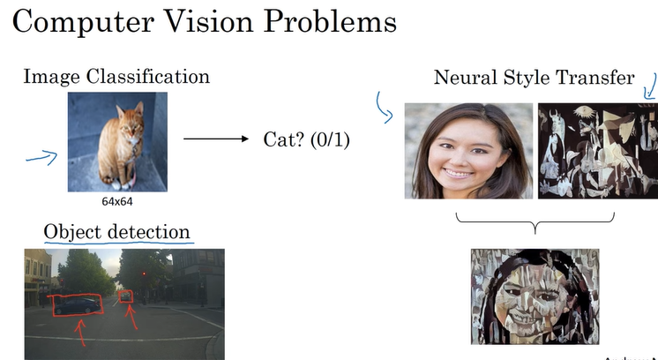

Slide 27
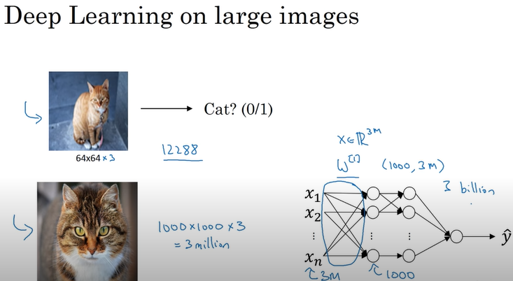

Slide 28
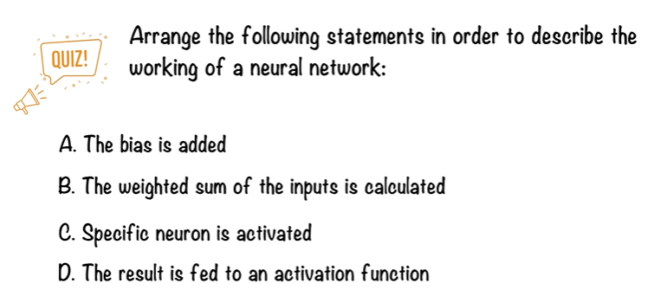

Slide 29
Thankyou ☺

