Slide 1
Module : Data Science & Machine Learning
Session 2
Taught by-
Ms. Jyoti Kataria
Bioinformatics Analyst, Medgenome Labs Ltd.
M.Sc. Biotechnology, IIT Bombay

Slide 2
Quick recap!

Slide 3
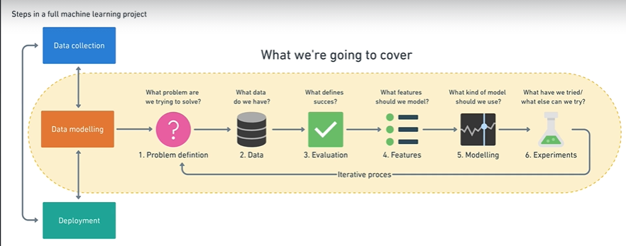

Slide 4
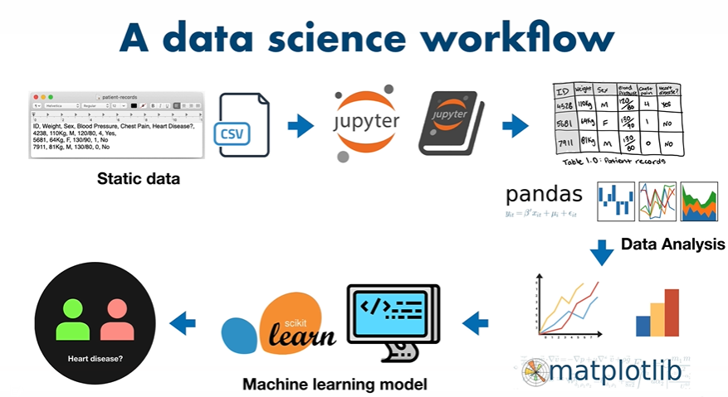

Slide 5
Today’s topics!
How did ML come into picture?
Supervised and Unsupervised Learning again!
Project Rubrics
Why python?
Ready for the challenges?
Hands on with python! ( a lot of commands you will learn/run)

Slide 6
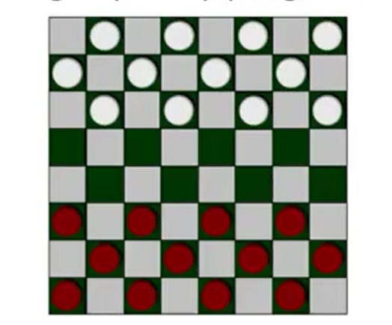
Flashback!
Arthur Samuel described it as: "the field of study that gives computers the ability to learn without being explicitly programmed."

Slide 7
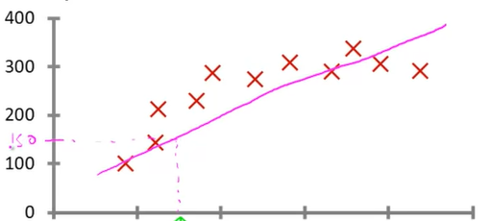
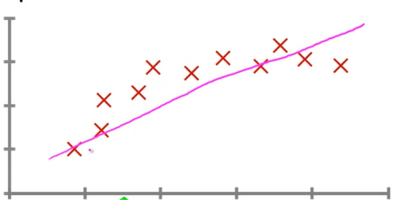
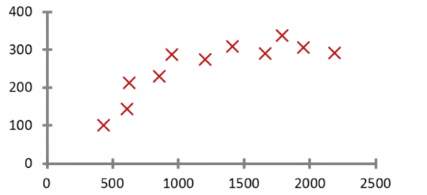
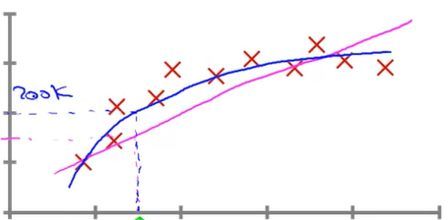
Supervised Learning : Regression
Right answers given!
Blood sugar level
20 30 40 50 60
Age
Regression Problem
Continuous valued output

Slide 8
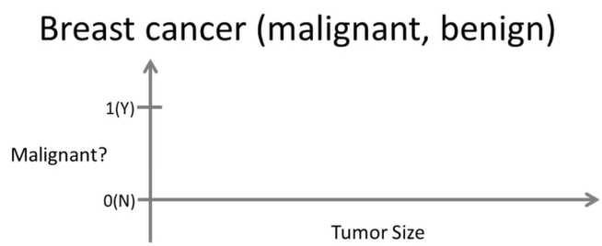
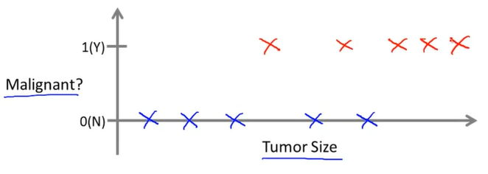
Supervised Learning : Classification
Can you estimate what's the chance of the tumor to be malignant/benign?
Classification Problem
Discrete valued output
0 – Benign
1 – First type
2 – Second type…

Slide 9
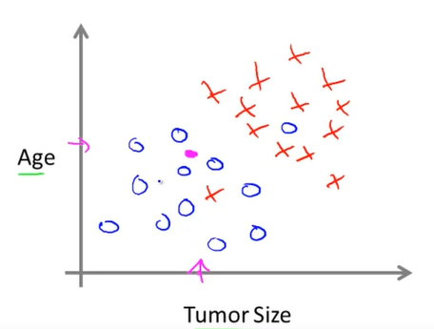
Supervised Learning : Support Vector Machine (SVM)
Clump Thickness
Uniformity of Cell Size
Uniformity of Cell Shape
Etc etc…
SVM

Slide 10
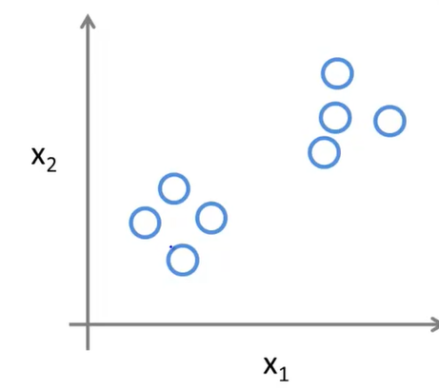
Unsupervised Learning : Clustering
No labels for the data

Slide 11
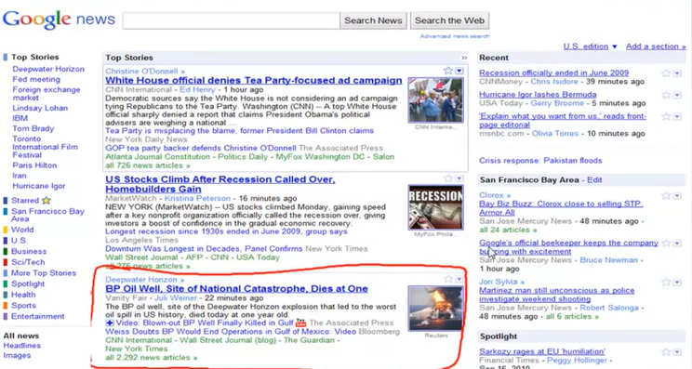

Slide 12
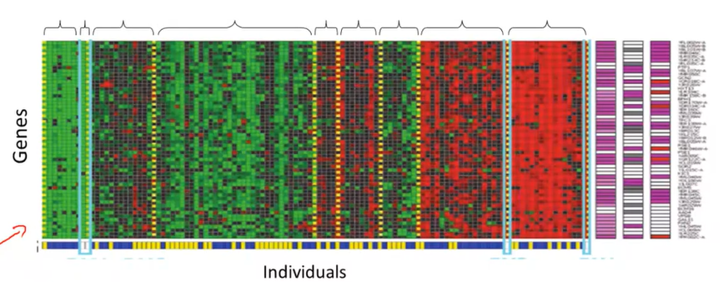
Unsupervised Learning :Clustering

Slide 13
Project Rubrics
A .pynb file will be the final submission
Criteria for assessment:
Submission in time
Accuracy or any other performance metrics

Slide 14
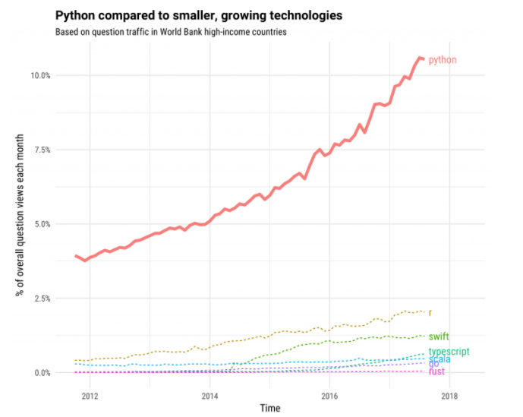
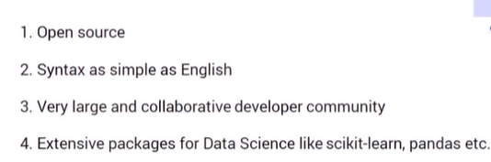
Why Python?
https://stackoverflow.blog/2017/09/06/incredible-growth-python/#:~:text=Python%20is%20an%20unusual%20case,faster%20each%20year%20since%202013).

Slide 15
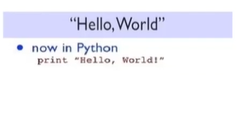
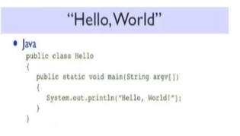
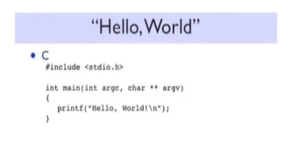
How is python easy?

Slide 16
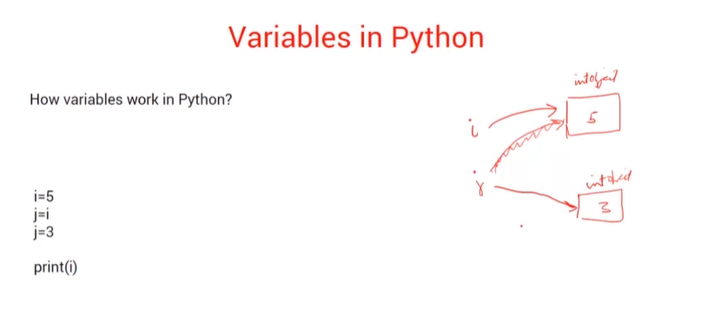

Slide 17
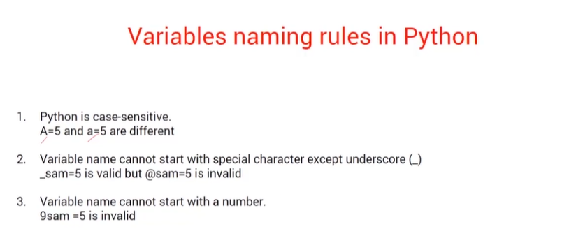

Slide 18
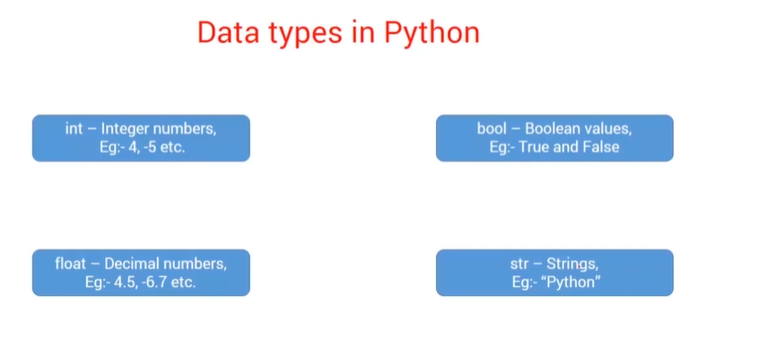

Slide 19
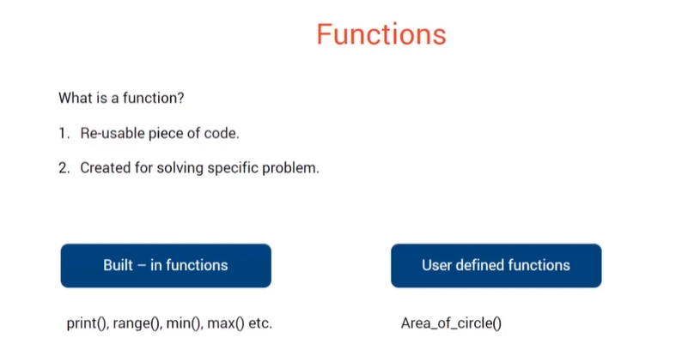

Slide 20
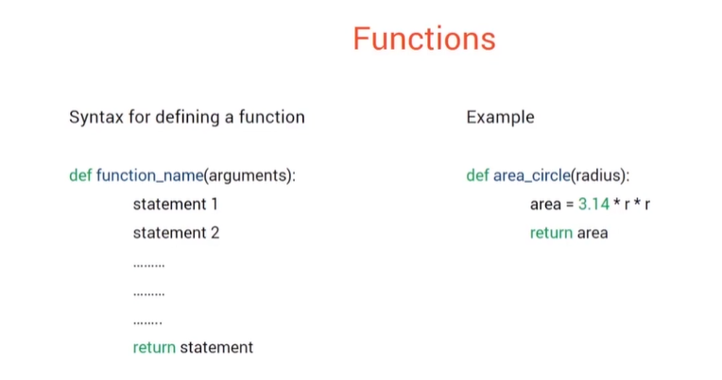

Slide 21
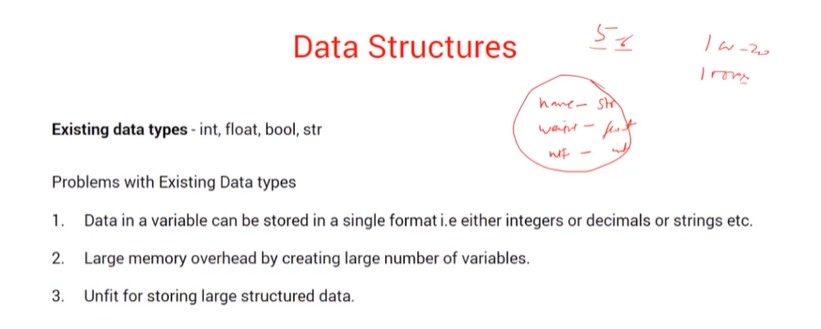

Slide 22
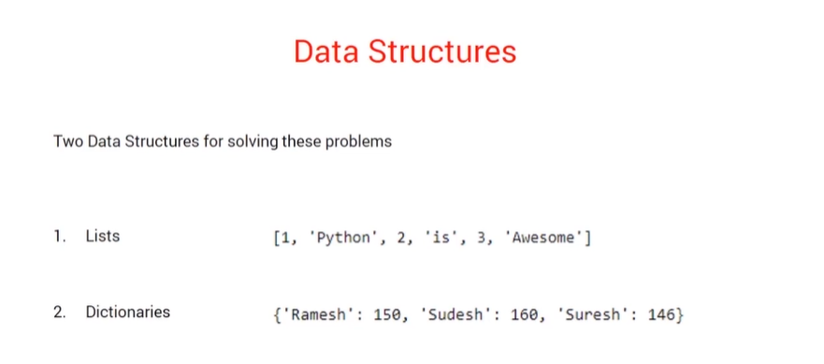

Slide 23
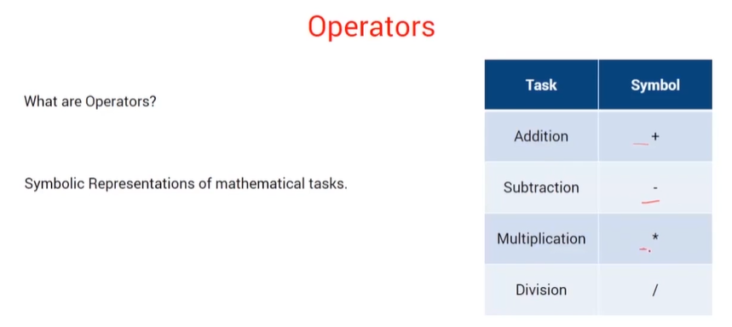

Slide 24
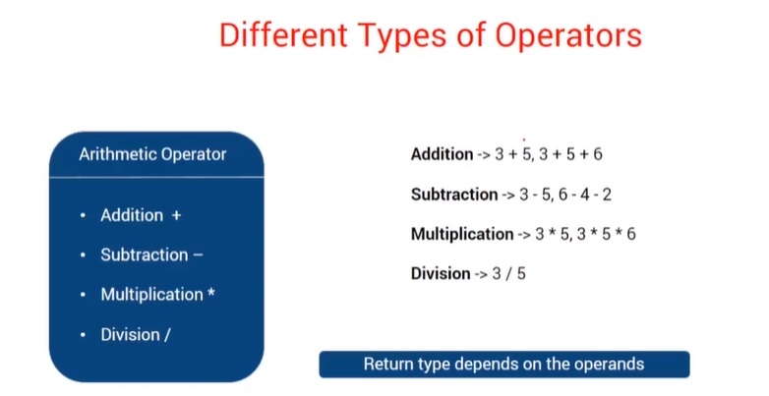

Slide 25
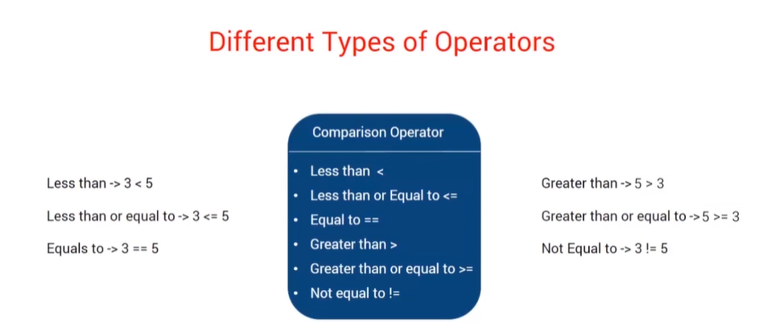

Slide 26
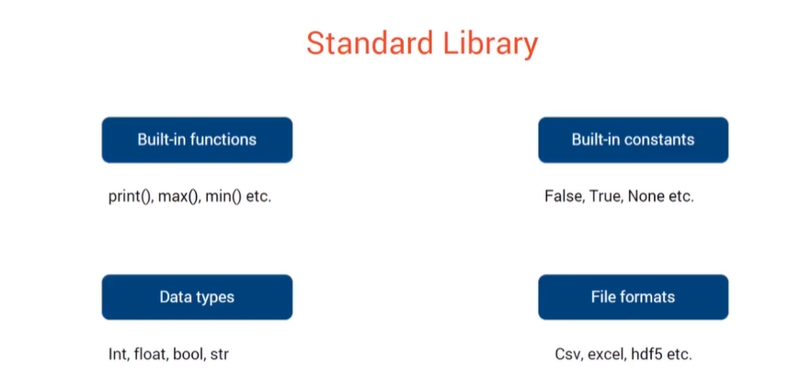

Slide 27
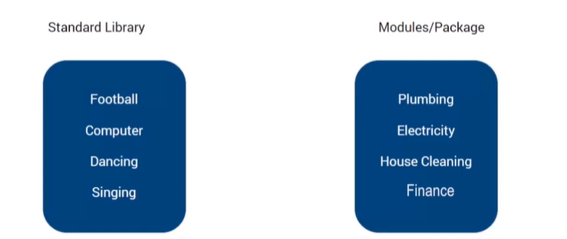
Library & Module & Package
Module : File containing various python functions and variables; basically a .py file.
Package : Collection of modules
Library : Collection of packages

Slide 28
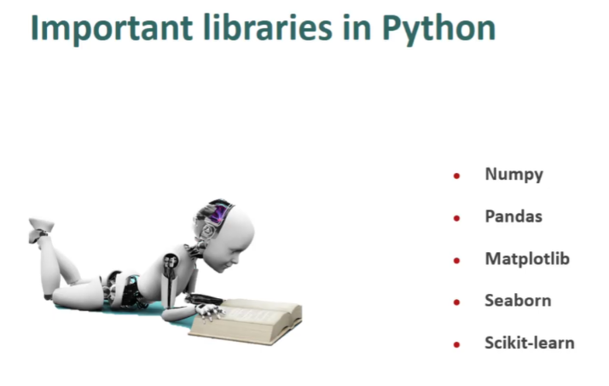

Slide 29
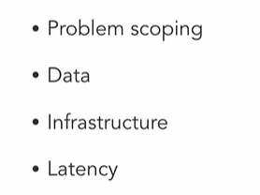
Challenges

Slide 30
Lets code!

Slide 31
Let’s revise!
Variables : Storage, naming
Datatypes; Data Structures
Functions
Module, library, package
Operator Precedence Rule
String Operations

Slide 32
Thank you ☺

