Slide 1
Sequence Alignment using ML
Jyoti Kataria
Bioinformatics Analyst, Medgenome Labs Ltd.
M.Sc. Biotechnology (IIT Bombay)

Slide 2
Lets recap!
DNA & RNA
Central Dogma
Gene
Introns & Exons
Dna replication
Transcription
Translation
Pairwise Alignment
MSA
Indels
SNPs
Codons
Databases

Slide 3
Announcements
ML Assignments:
Sep 3rd: Allotment
Sep 24th: Submission (Group wise)
Internal Assessment:
Full marks (if class participation is there)

Slide 4
ML Techniques
15 techniques for predicting optimal sequence alignment
Based on NW and SW algorithm
Ex: Multilayer perceptron, XG Boost, Support Vector Machine
https://ieeexplore.ieee.org/stamp/stamp.jsp?arnumber=9497110

Slide 5
MLP
Multi-layer perceptron
Type of ANN

Slide 6
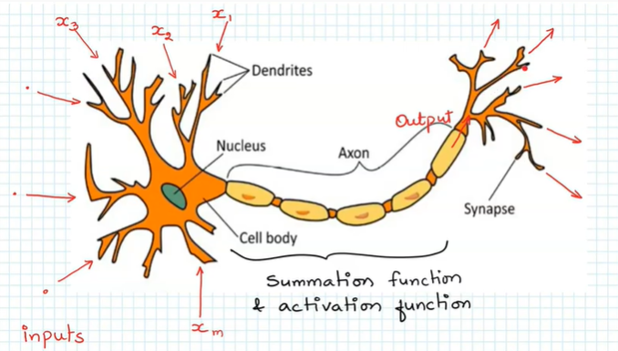
ANN

Slide 7
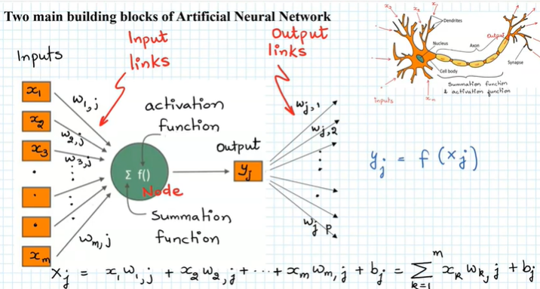
ANN (Contd..)

Slide 8
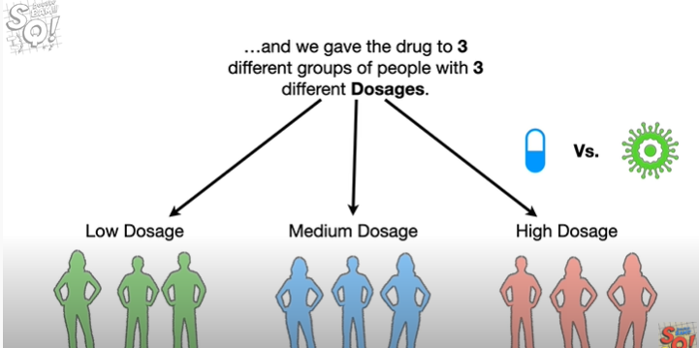
ANN (Contd..)

Slide 9
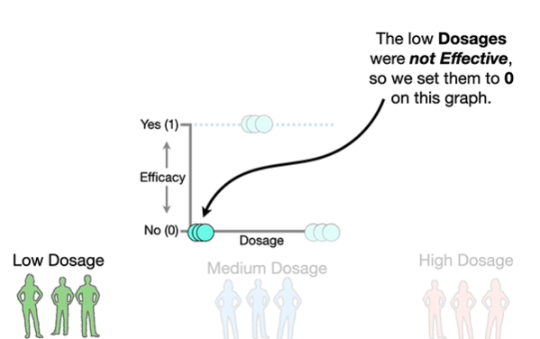
ANN (Contd..)

Slide 10
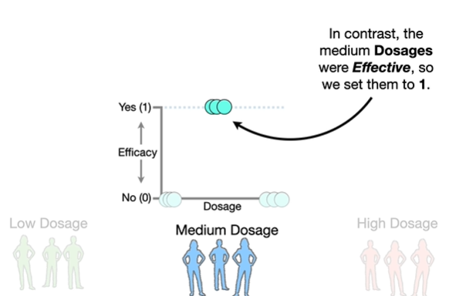
ANN (Contd..)

Slide 11
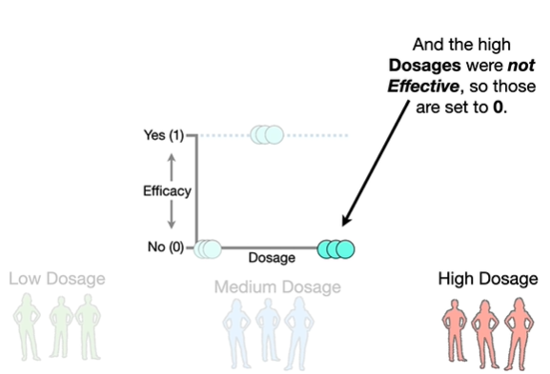
ANN (Contd..)

Slide 12
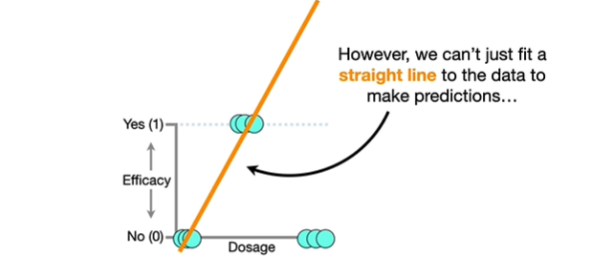
ANN (Contd..)

Slide 13
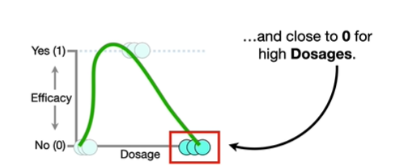
ANN (Contd..)

Slide 14
XGBoost
Extreme Gradient Boosting
Used for supervised learning problems where we use the training data with multiple features(xi) to predict a target variable (yi)
Low accuracy classifiers > high accuracy classifiers
Decision Tree based ensemble machine learning algorithm
Faster than the traditional ML methods

