Slide 1
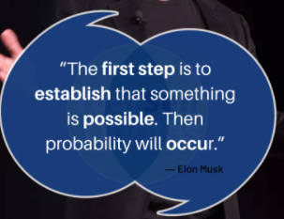
Jyoti Kataria
Bioinformatics Analyst, Medgenome Labs Ltd.
M.Sc. Biotechnology (IIT Bombay)

Slide 2
Evaluation
Continuous
In class presentations/assignments
Group work

Slide 3
Agenda
What is biological data & Where is it coming from?
What does it mean?
Why to analyze?
How to analyze?

Slide 4

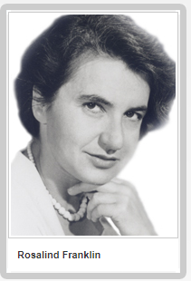

Slide 5
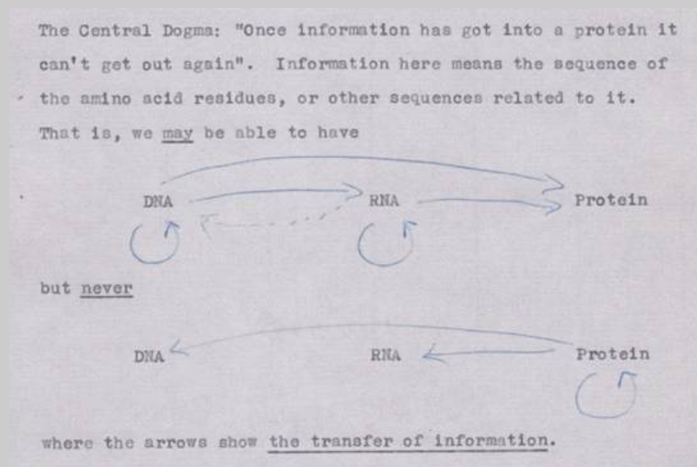
Central Dogma of Life

Slide 6
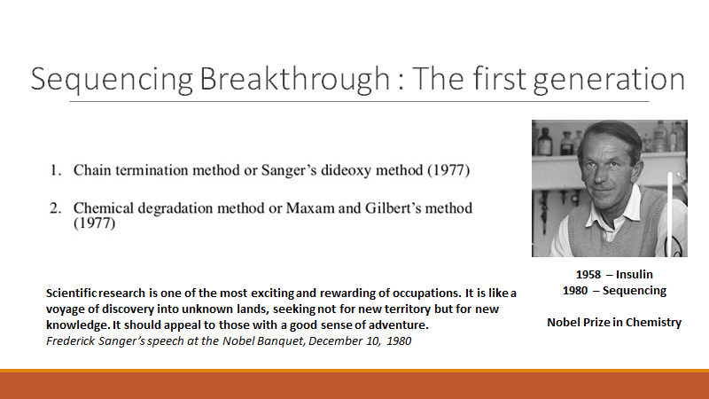

Slide 7
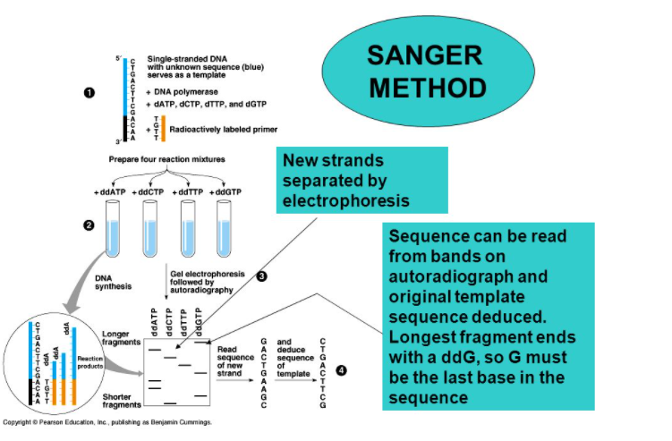

Slide 8
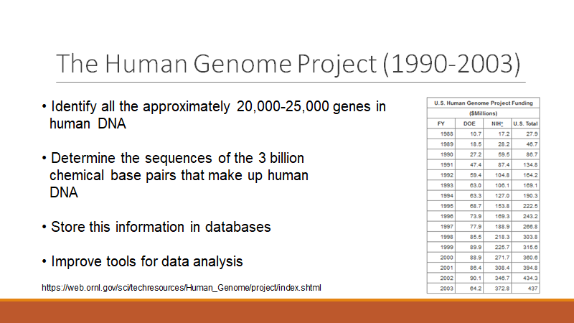

Slide 9
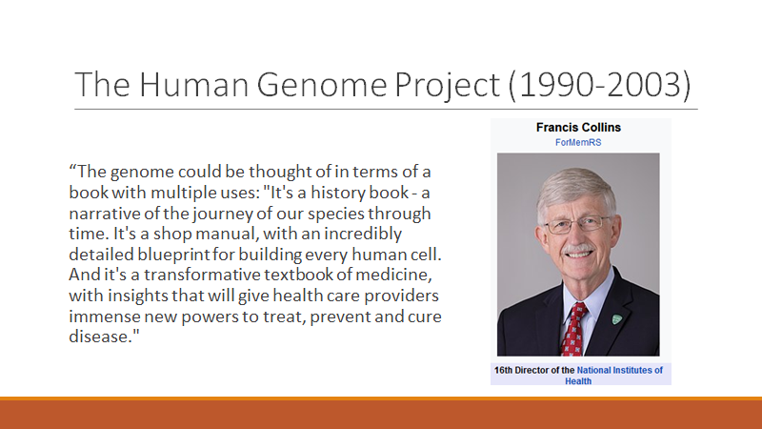

Slide 10
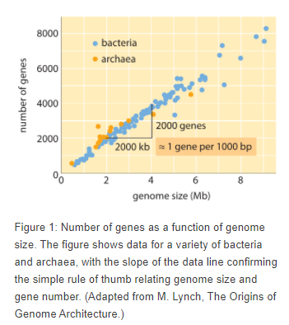
Genome size & no. of genes

Slide 11
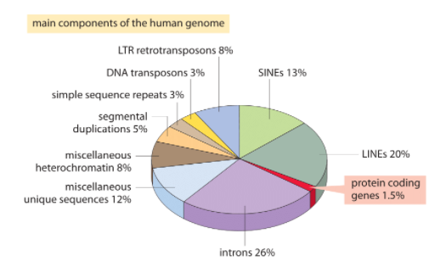
What all is there inside this huge DNA?

Slide 12
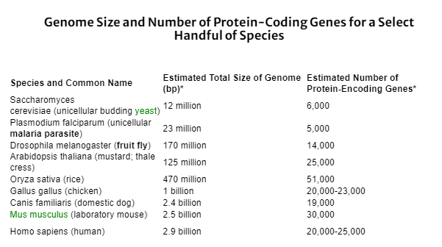
Genome Size for some species

Slide 13
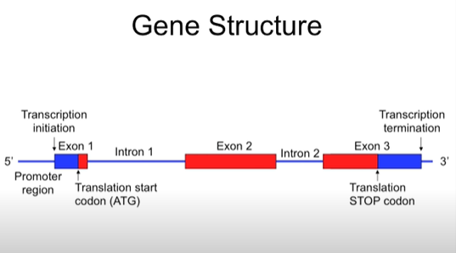

Slide 14
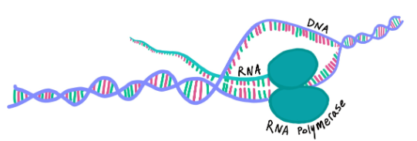
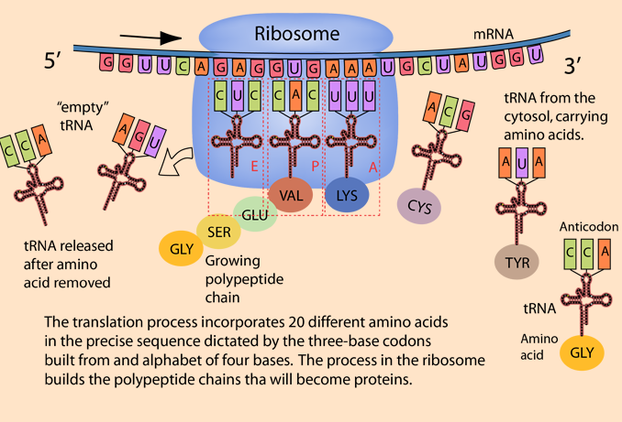
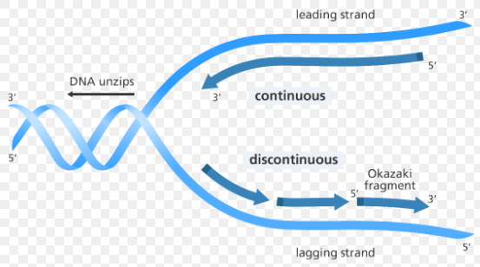
Central dogma again!! DNA > RNA > protein
1
3
2

Slide 15
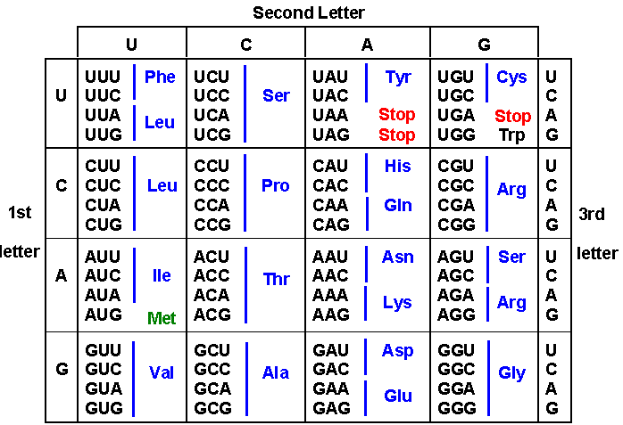

Slide 16
Inclass Activity 1 :
Biological databases trip (10-15 mins)
Take the assigned databases from the google sheet, find out the answers to the following three questions :-
What does it have?
How is the data stored inside it?
Why this database is important or Who all would be the potential users for the same?

Slide 17
Quick Recap
DNA & RNA
Central Dogma
Gene
Introns & Exons
Dna replication
Transcription
Translation
Codons
Databases

