Slide 1
Sequence Alignment
Jyoti Kataria
Bioinformatics Analyst, Medgenome Labs Ltd.
M.Sc. Biotechnology (IIT Bombay)

Slide 2
Inclass Activity 1 :
Biological databases trip (10-15 mins)
Take the assigned databases from the google sheet, find out the answers to the following three questions :-
What does it have?
How is the data stored inside it?
Why this database is important or Who all would be the potential users for the same?

Slide 3
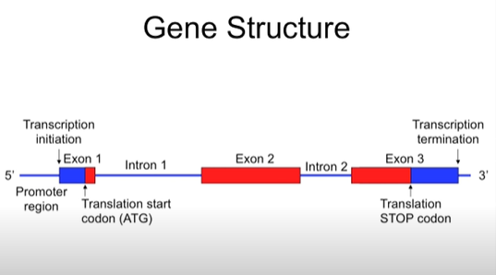

Slide 4
Quick Recap
DNA & RNA
Central Dogma
Gene
Introns & Exons
Databases
Dna replication
Transcription
Translation
Codons

Slide 5
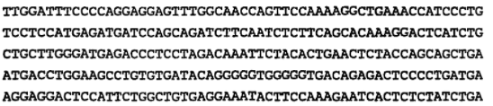
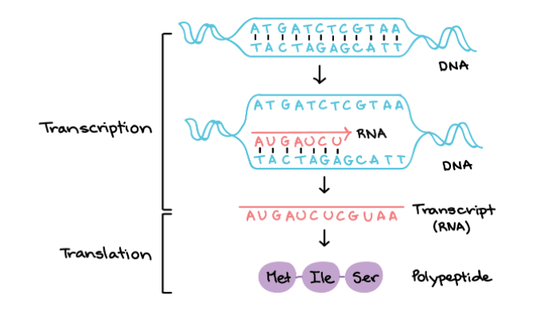

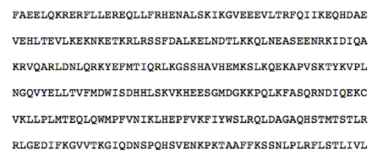
Sequences you should be comfortable with :
1
2
3

Slide 6
Alignment
Arranging sequences of DNA, RNA or protein to dig out some relationships based on their similarity/dissimilarity
Relationships could be functional, structural or evolutionary

Slide 7
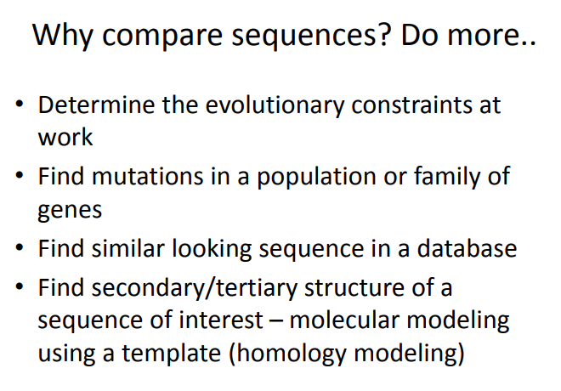

Slide 8
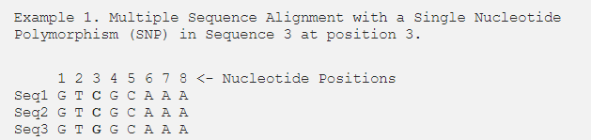
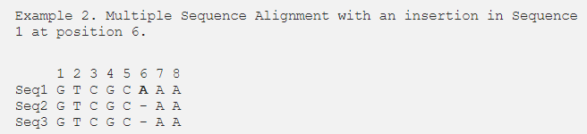
Alignment

Slide 9
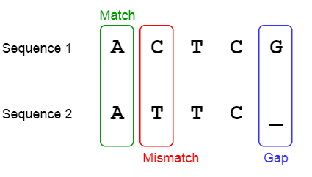
Scoring: Good or bad ?
Match, Mismatch and Gap

Slide 10


Lets align manually (with our brains on)!
Part 1

Slide 11


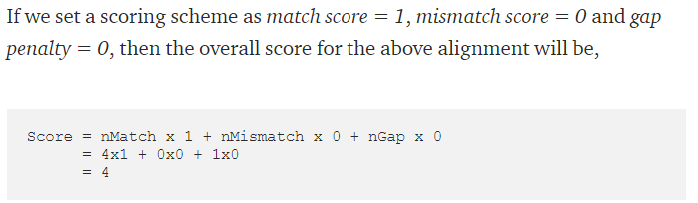
Lets align manually (with our brains on)!
Part 2

Slide 12
Practical Session : Global and Local Alignment

Slide 13
Quick Recap
Pairwise Alignment
MSA
Indels
SNPs

