Slide 1

Next-generation Sequencing (NGS)
Jyoti Kataria
Bioinformatics Analyst

Slide 2
Lets recap!

Slide 3
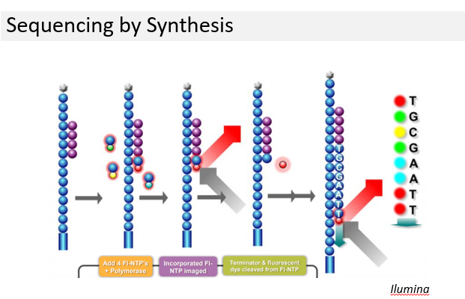

Slide 4
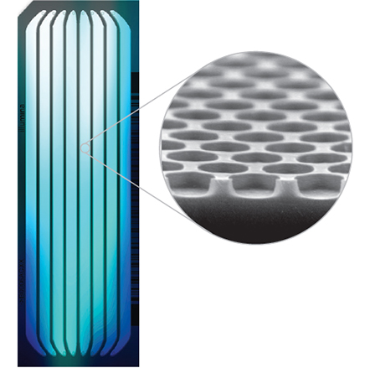
Demultiplexing
Multiple samples pooled together
Bar code (6-12 bp) is added for sample differentiation
Bcl2fastq program is used
Sample sheet preparation
Fastq files containing Phred quality scores
Lane-wise or Sample-wise data

Slide 5
Whole Exome and Whole Genome Sequencing
WES
- Detects coding variants
- Protein coding genes constitute only 1% of the human genome but harbor
85% of the mutations with large effects on disease trait
- Efficient approach to identify genes causing Mendelian disorders
WGS
- Detects large structural variants
- Detects coding and non-coding variants
- Rare Tumor Types

Slide 6
Steps in WGS/WES
Base Trimming
FastQC
- Total reads, Avg. Read length, Total data > Q30, GC %
Adapter Removal
- Fastq-mcf : Filtering and fine quality check
-q 20, -l 30
Alignment
- BWA-MEM : Good balance between performance & accuracy
- Maps low divergent sequences to a larger genome (human)

Slide 7
Steps in WGS/WES (Contd..)
Duplicate Removal :
- Removes optical duplicates and artifacts
- Sentieon
- input is sorted.bam & output is .deduped.bam
Indel realignment : Local realignment around indels
- Reads mapped on the edges of indels often get mapped with
mismatching bases
- -i deduped.bam
- -r reference.fa sequence
- -k Mills Gold standard
- Output is .realigned.bam

Slide 8
Steps in WGS/WES (Contd..)
Base quality score recalibration (BQSR) :
- Modifies the quality scores assigned to individual read bases
of the sequence read data
- Removes experimental biases caused by the sequence
- -r reference.fa
- -i realigned.bam
- -q recal.data.table
- Output is recalled.bam

Slide 9
Steps in WGS/WES (Contd..)
Variant calling :
- Identification of the sites where the data displays variation
relative to the reference
- -r reference.fa
- -q recal_data.table
- -d dbSNP
- -i realigned.bam
- Output is .vcf

Slide 10
Steps in WGS/WES (Contd..)
Variant Annotation :
- VARIMAT annotates each variant with the more than 25
databases
- Ex-dbSNP, HGMD, MedVar, ClinVar, GWAS, ExAC, 1000G, OncoMD

Slide 11
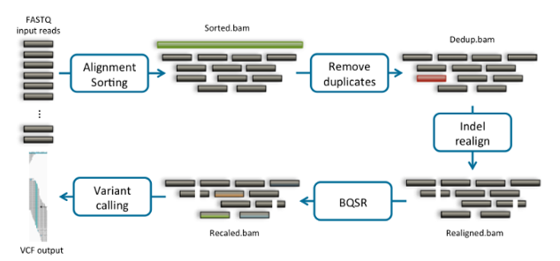
Summary

