Slide 1
Population Genomics

Slide 2
Introduction
The study of change in the allele frequencies and the genotype within a population
Population?
A community of individuals wherein interbreeding can occur

Slide 3
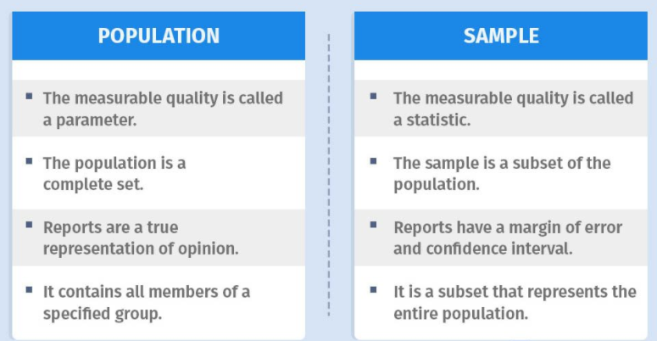
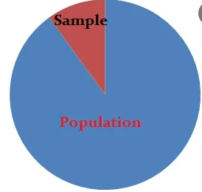
Population and Sample

Slide 4
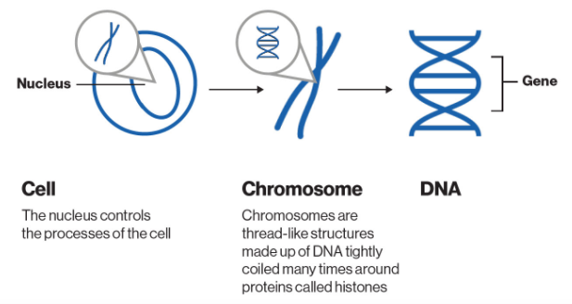
Gene

Slide 5
Allele
An allele is a variant form of a gene.
Some genes have a variety of different forms, which are located at the same position, or genetic locus, on a chromosome.
Humans are called diploid organisms because they have two alleles at each genetic locus, with one allele inherited from each parent.

Slide 6
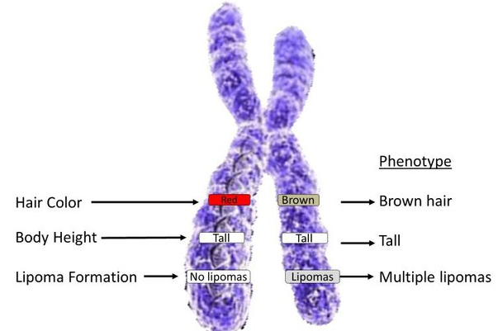
Allele

Slide 7
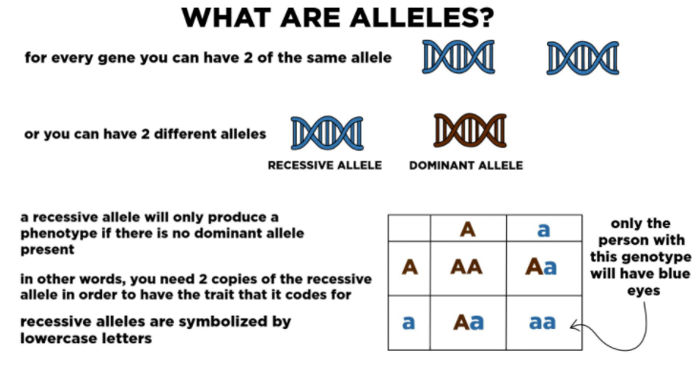

Slide 8
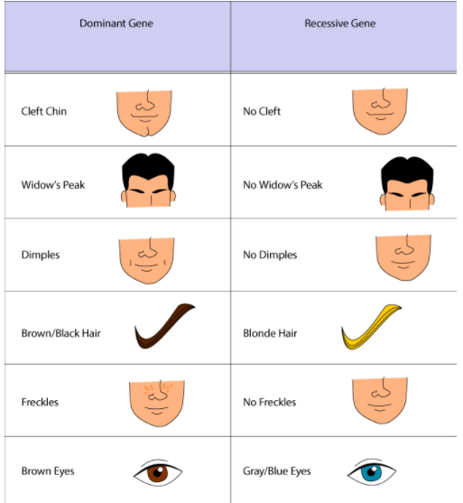

Slide 9
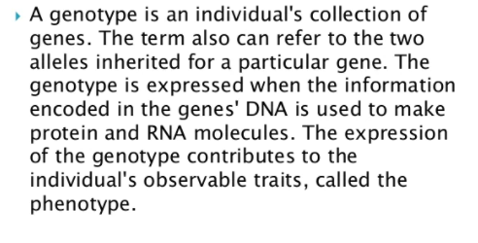
Genotype

Slide 10

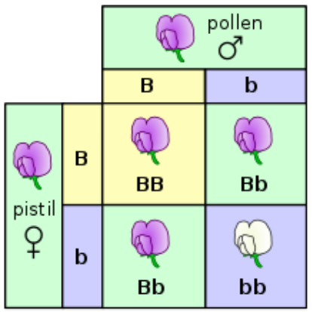



Genotype and phenotype

Slide 11
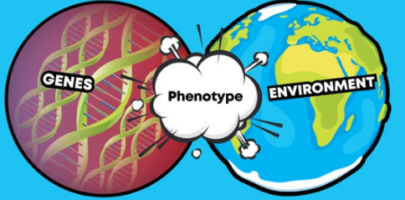
Phenotype
A phenotype is an individual's observable traits, such as height, eye color, and blood type

Slide 12
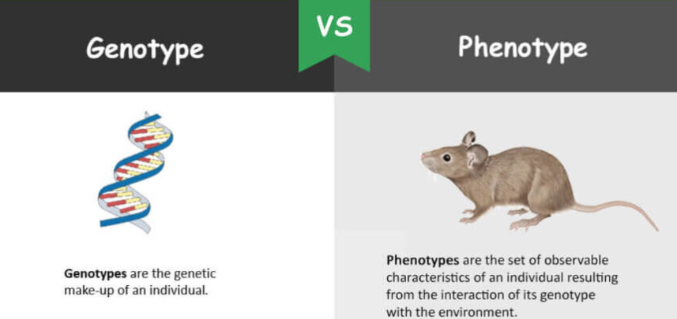

Slide 13
The Hardy-Weinberg Principle

Slide 14
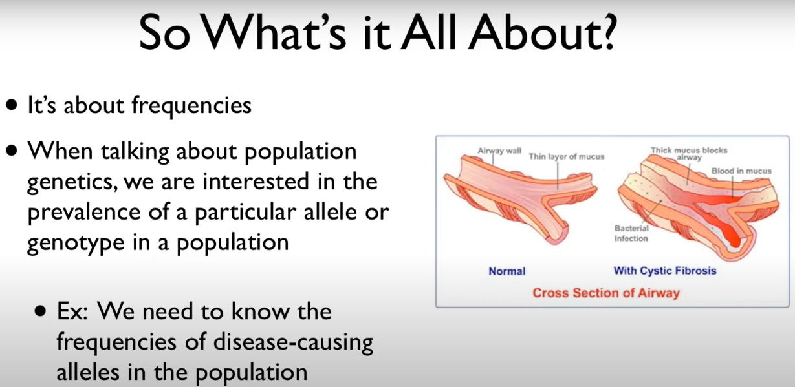

Slide 15
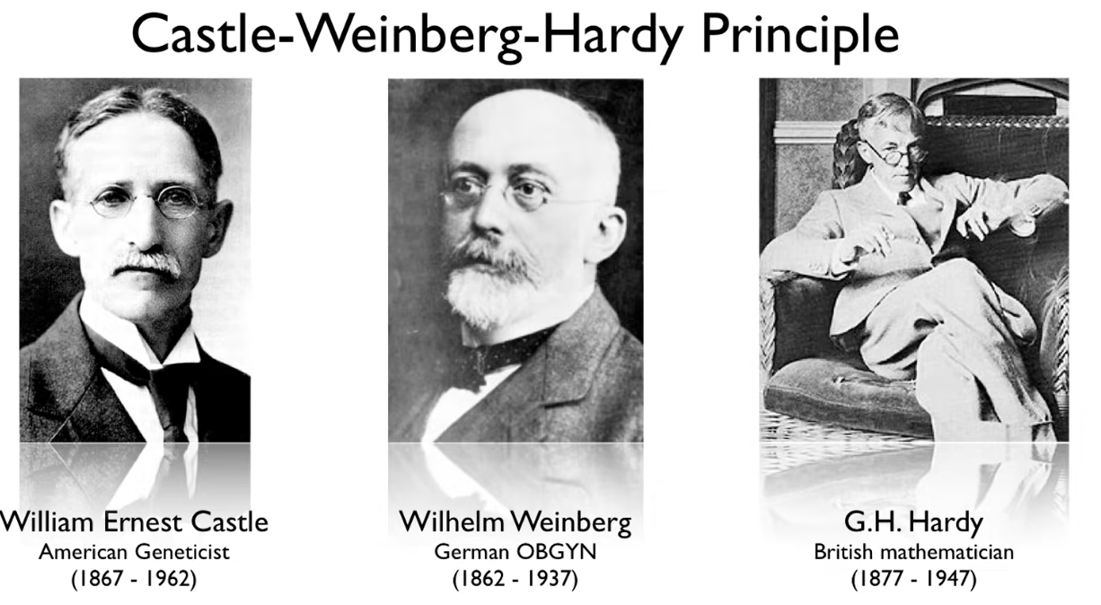

Slide 16
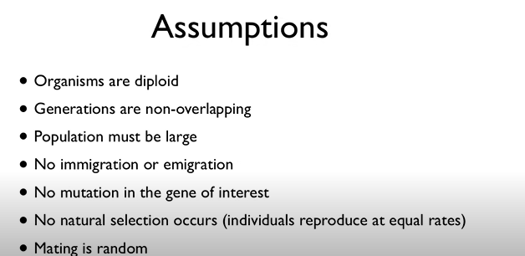

Slide 17
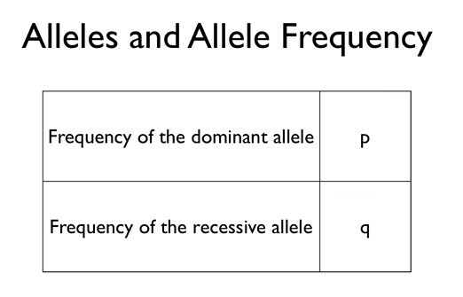

The Hardy-Weinberg Principle

Slide 18
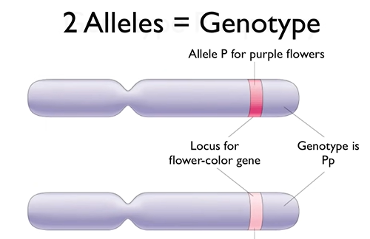
The Hardy-Weinberg Principle

Slide 19
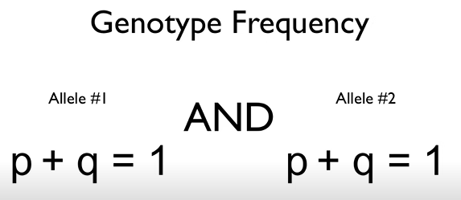
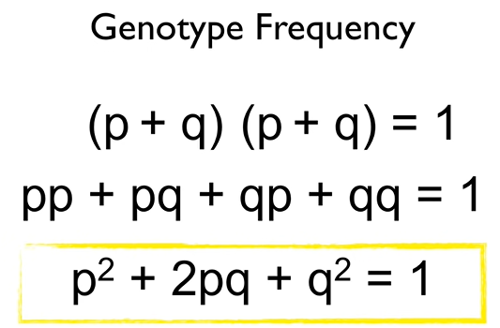
The Hardy-Weinberg Principle

Slide 20
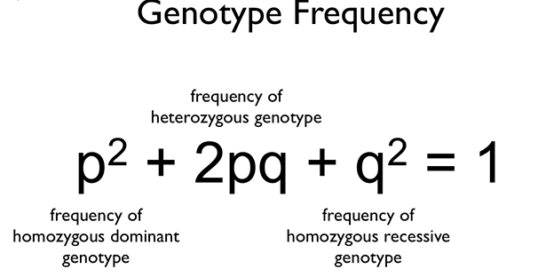
The Hardy-Weinberg Principle

Slide 21
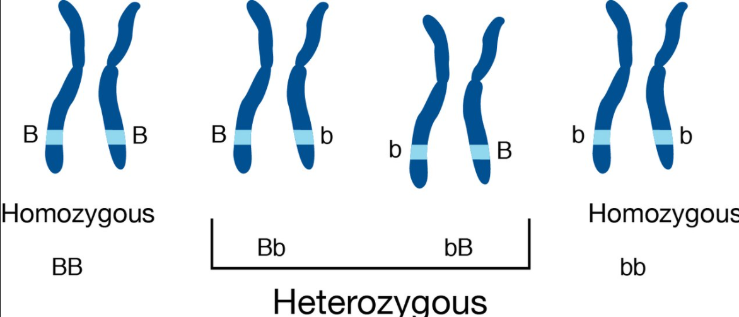
Homozygous and Heterozygous?

Slide 22

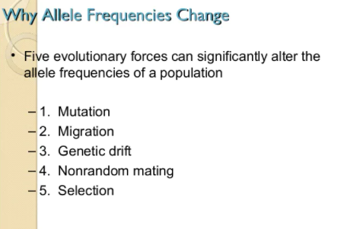

Slide 23
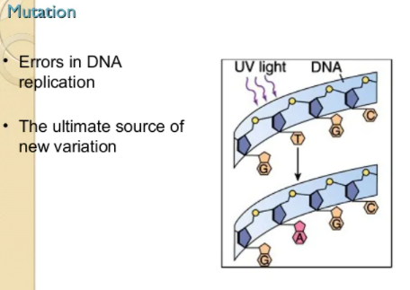

Slide 24
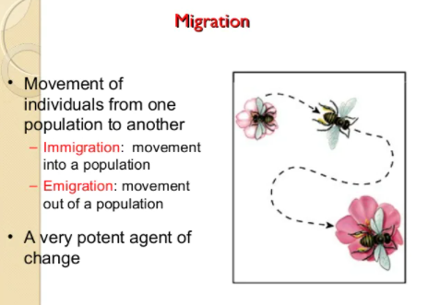

Slide 25
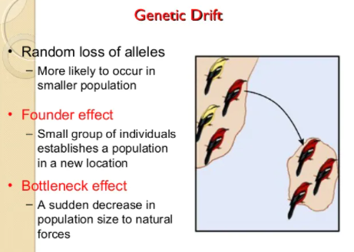

Slide 26
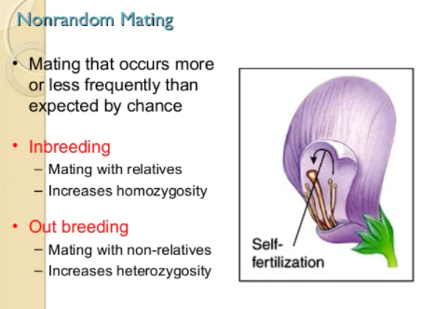

Slide 27
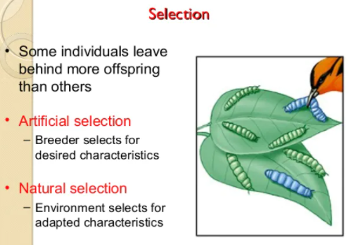

Slide 28
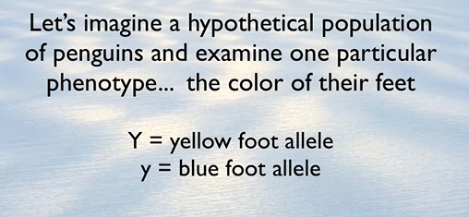

Slide 29
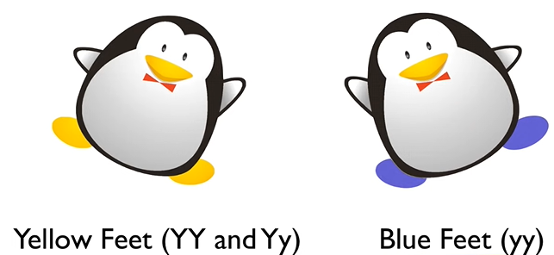
The penguins!

