Slide 1


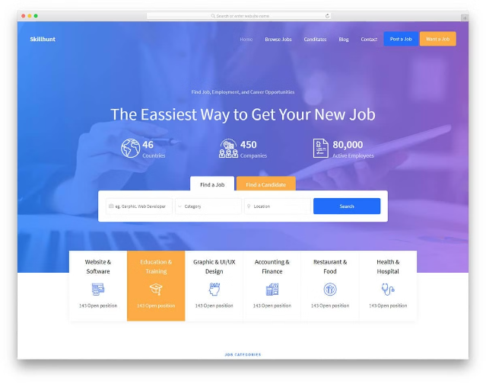
Job Searching Portal

Slide 2
Problem Statement :
Job seekers and employers often struggle with complicated job search websites that are hard to use. These platforms might not meet the specific needs of each user, causing frustration and making job searching and hiring less efficient. We need a simple, easy-to-use, and responsive interface that caters to both Seekers and Employers, with straightforward access to job listings, application forms, and dashboards. Using React will help make the site fast and interactive, improving the overall user experience.

Slide 3
Project Overview:
A job searching portal is a web-based platform that connects job seekers with employers, facilitating the process of finding and applying for job opportunities. It serves as a centralized platform where job seekers can explore job listings, submit applications, and manage their job search process

Slide 4

Project Objective
We have done our project using:
React JS( Front end)
Django ( Framework)
MySQL (Database)
Postman (CRUD Operations)

Slide 5

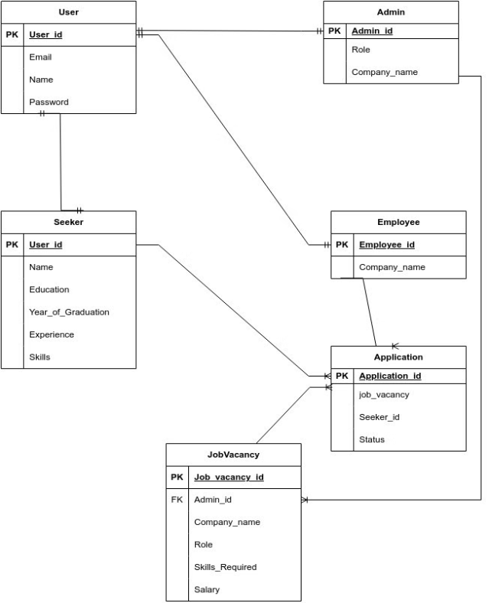
Entity Relationship Diagram

Slide 6
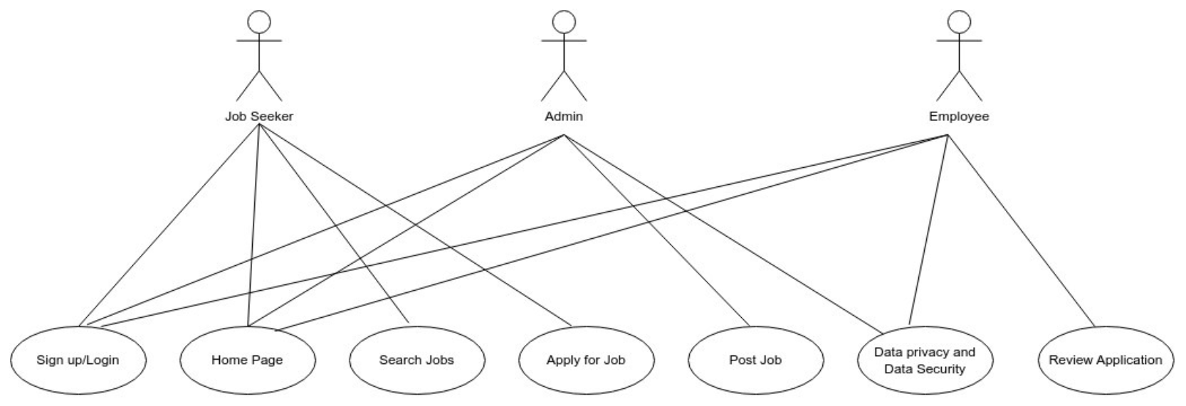
Use Case Diagram

Slide 7
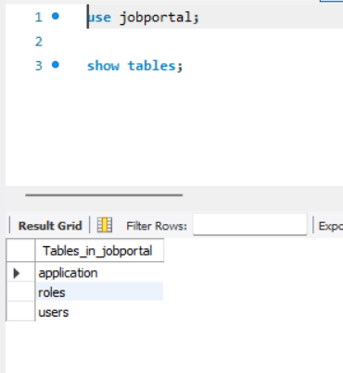
Database Tables:
Users
Roles
Application

Slide 8
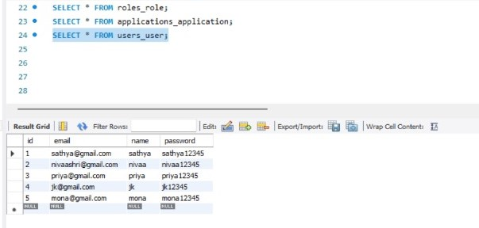
Users :
The fields inside ' Users ' table consists of -
Email
Name
Password

Slide 9
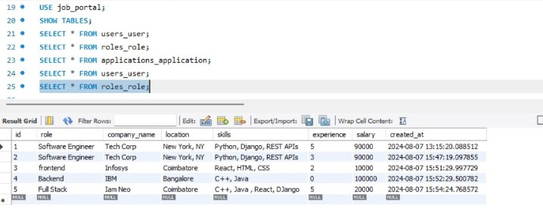
Roles:
The fields inside ' Roles ' table consists of -
Role
Company Name
Location
Skills
Years of Experience
Salary

Slide 10
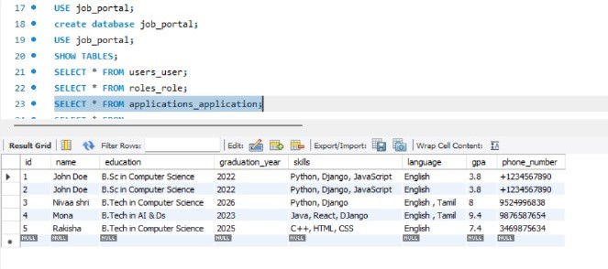
Application:
The fields inside ' Application ' table consists of -
Name
Education
Year of Graduation
Skills
Language
CGPA
Phone Number

