Slide 1
Dogecoin Price Prediction
Research Presentation | Random Forest Regression

Slide 2
Problem Definition
Goal: Predict DOGE close price from market and technical indicators.
Inputs: Open, High, Low, Volume, MA5, MA10, Daily Return, Volatility.
Task type: Supervised regression.

Slide 3
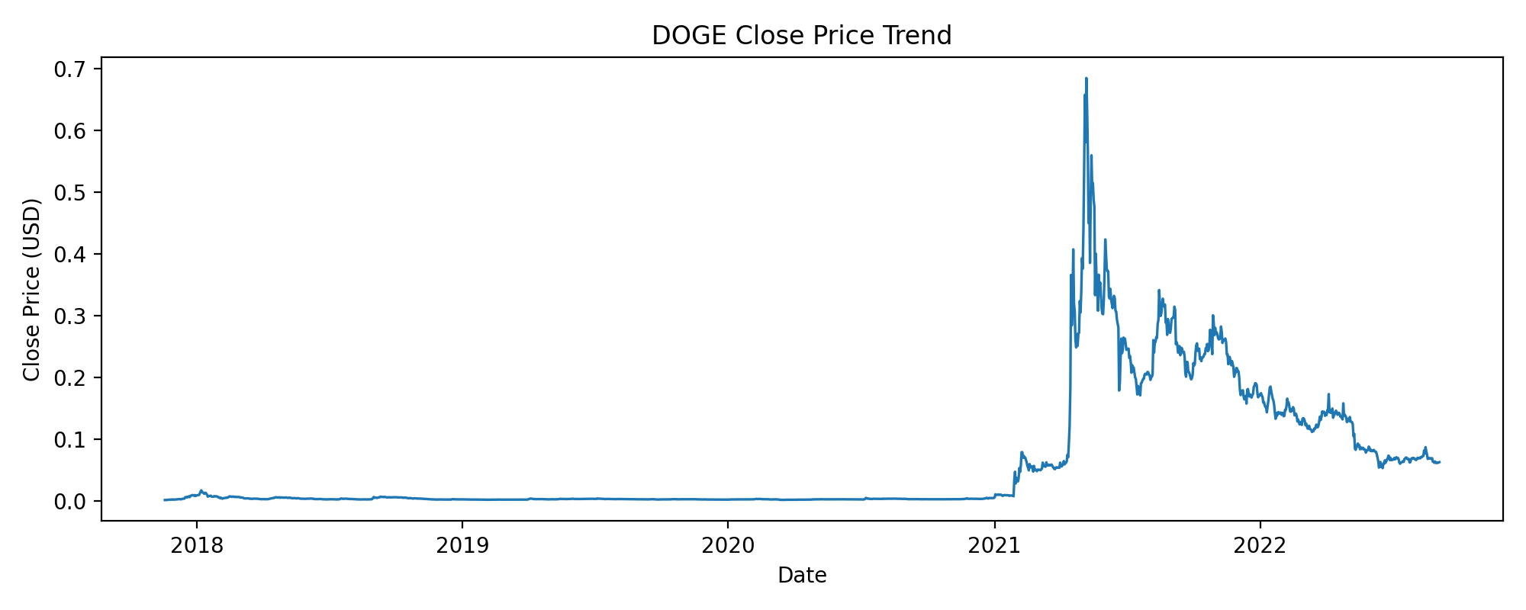
Dataset Used
Rows (raw): 1761
Rows (processed): 1751
Date range: 2017-11-18 to 2022-09-04
Split: 1400 train / 351 test

Slide 4
Model Trained
RandomForestRegressor
n_estimators=100, max_depth=15
min_samples_split=5, min_samples_leaf=2
random_state=42

Slide 5
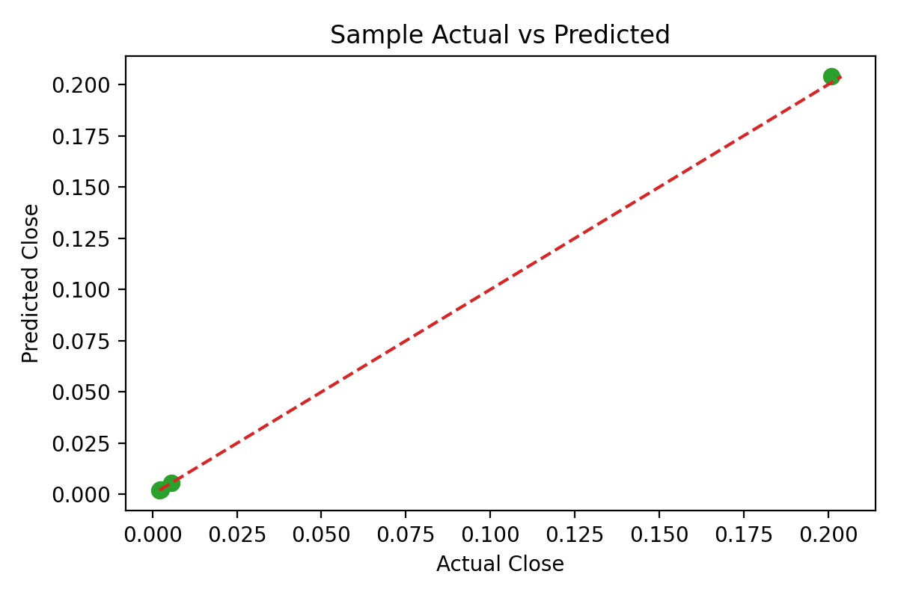
Accuracy Shown
MSE: 0.00001884
RMSE: 0.00434057
MAE: 0.00142236
R2: 0.997776

Slide 6
Output Visible
Sample predictions from test data:
Sample 1: Actual=0.005545 | Predicted=0.005598
Sample 2: Actual=0.002346 | Predicted=0.002346
Sample 3: Actual=0.002434 | Predicted=0.002412
Sample 4: Actual=0.002083 | Predicted=0.002076
Sample 5: Actual=0.200887 | Predicted=0.203924

