Slide 1

AI-Enabled Business Intelligence Internship- Capstone Project
StaySense BI Airbnb Business Intelligence Dashboard
Presented by Juhi Kansal
Intern ID: TBI-26101032

Slide 2
StaySense BI Overview Developed an interactive Business Intelligence dashboard that transforms Airbnb NYC listing data into actionable business insights for property managers and analysts.
Technologies Used:
Workflow
Data Collection
Data Cleaning
EDA
Dashboard Development
Business Insights
PYTHON
SQL
POWER BI
CSV DATASETS

Slide 3
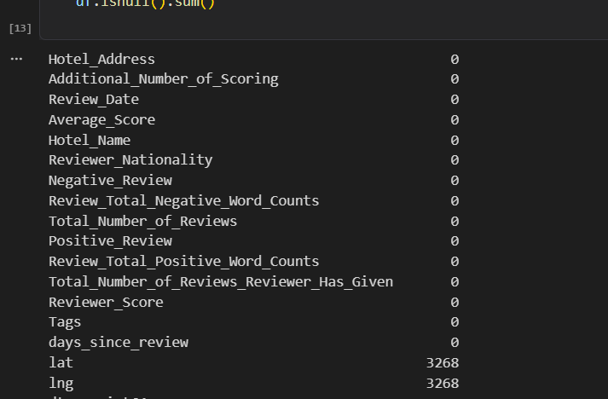
Learning 1 Data Cleaning & Preparation
What I learned
✔ Handling missing values
✔ Removing duplicates
✔ Standardizing data
✔ Preparing datasets for analysis

Slide 4
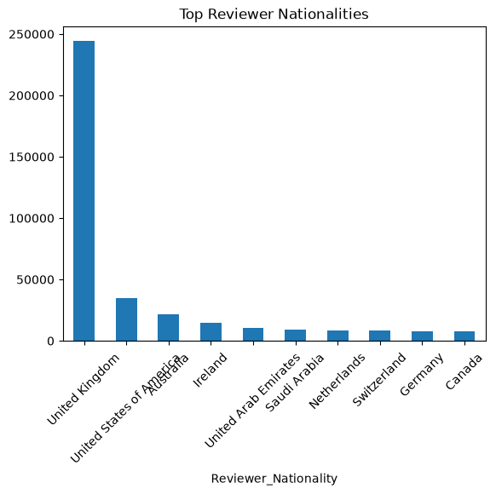
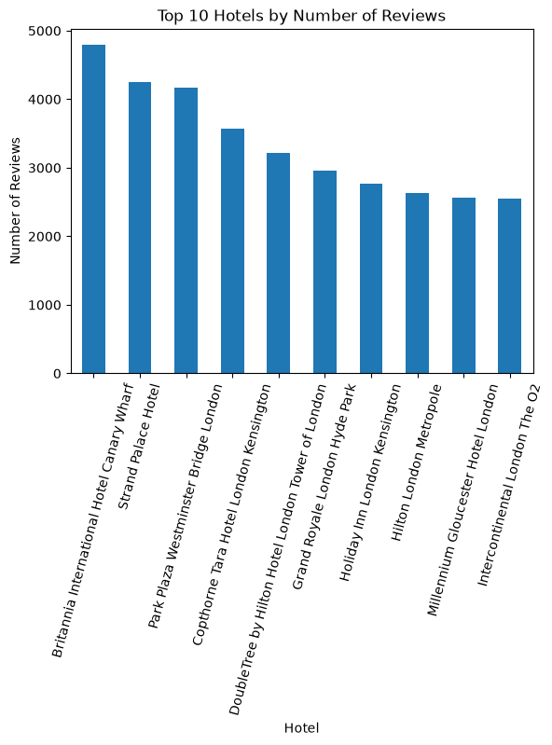
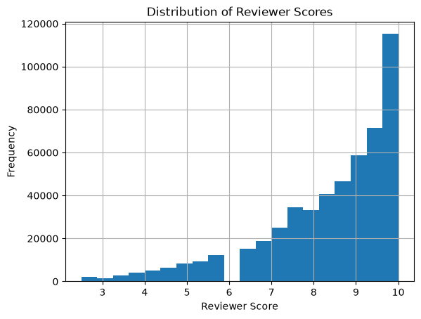
Learning 2 Exploratory Data Analysis
Insights Found
✔ Price distribution
✔ Room type popularity
✔ Neighborhood trends
✔ Review patterns
✔ Correlation analysis

Slide 5
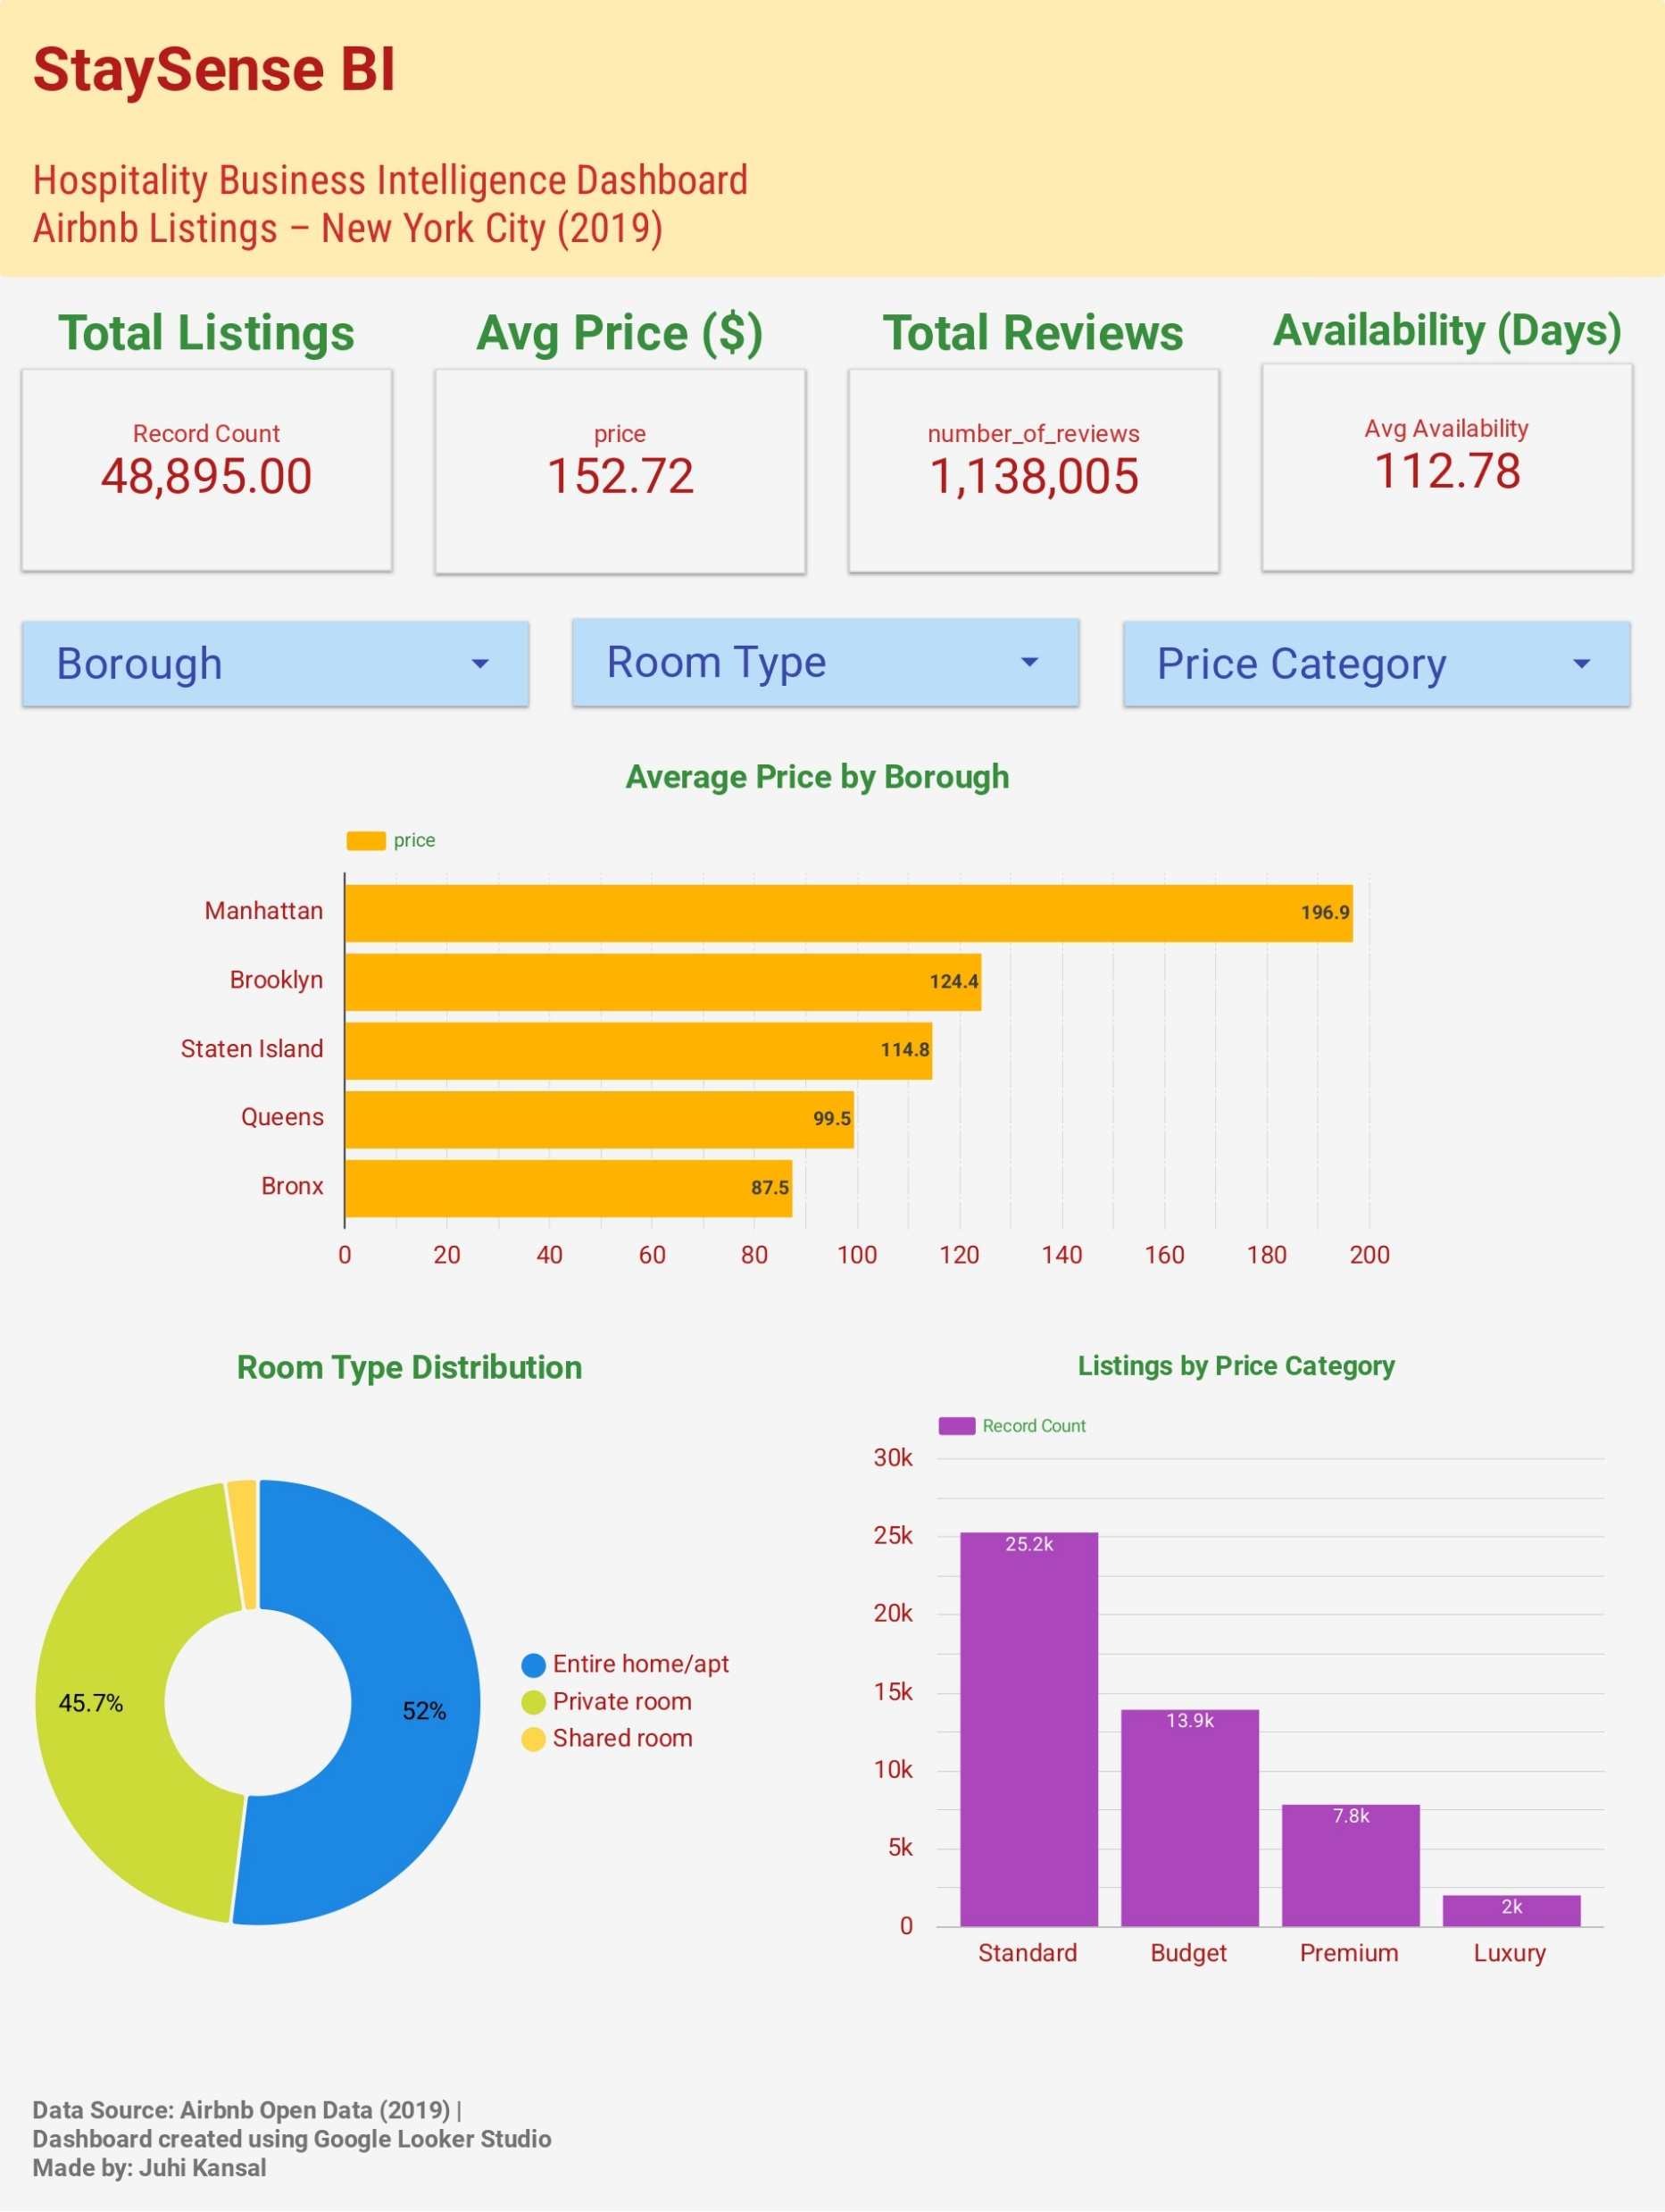
Learning 3 Dashboard Development
Created this dashboard on looker studio
https://datastudio.google.com/s/v_IxaJQv51o
Dashboard Features
✔ KPI Cards
✔ Maps
✔ Slicers
✔ Interactive Filters
✔ Business Insights

Slide 6
Challenges Faced Choosing the Right Visualizations
Problem: Initially, I created several charts that displayed similar information, making the dashboard repetitive and less effective.
Solution
✔ Refined dashboard layout
✔ Selected meaningful charts
✔ Added KPI cards
✔ Improved interactivity using slicers
✔ Focused on business decision-making

Slide 7
Future Goals
Technical Goals
Personal Goals
✔ Improve SQL
✔ Advanced Python
✔ Learn Predictive Analytics
✔ Explore AI-enabled BI
✔ Learn Cloud Data Pipelines
✔ Better Dashboard Design
✔ Stronger Business Storytelling
✔ Industry-ready BI Skills

Slide 8
THANK YOU
Week 1 ✓
↓
Week 2 ✓ Data Cleaning
↓
Week 3 ✓ EDA
↓
Week 4 ✓ Dashboard
↓
Week 5 ✓ BI Strategy
Month 1 Reflection
StaySense BI

