Slide 1
DeepLOB
fast-alphas
University of Chicago Project Lab with Daiwa Securities

Slide 2
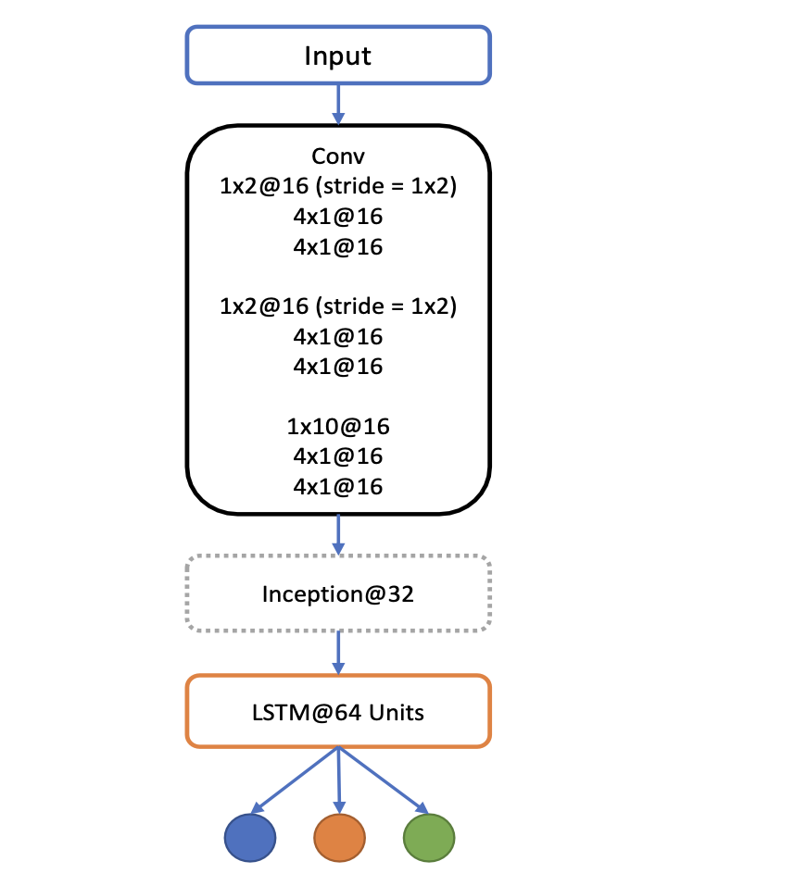
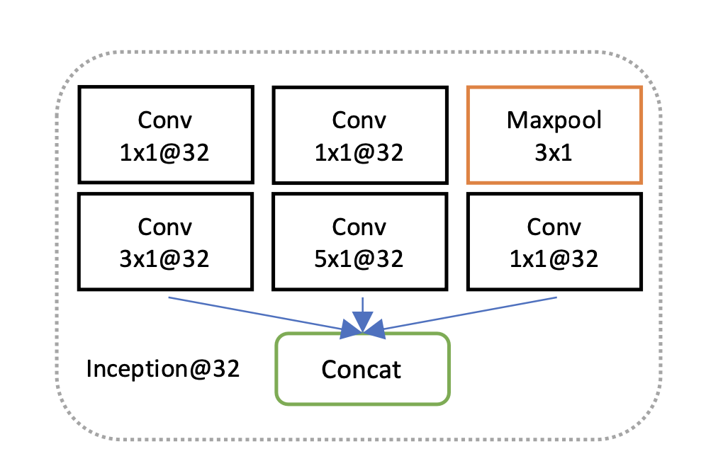
DeepLOB
"Deep Learning for Limit Order Books" by Zhang et al.
Key Contributions
A three-stage deep learning model:
CNN layers to extract spatial features from the LOB.
LSTM layers to model temporal dependencies in order book sequences.
A fully connected output layer for classification of price movement directions.
Dataset: Use of high-frequency LOB data (e.g., from the Nasdaq ITCH feed) to validate the model’s performance.
Performance: The DeepLOB architecture significantly outperforms traditional statistical models and baseline machine learning methods in predicting price movements, achieving high accuracy and robustness.

Slide 3
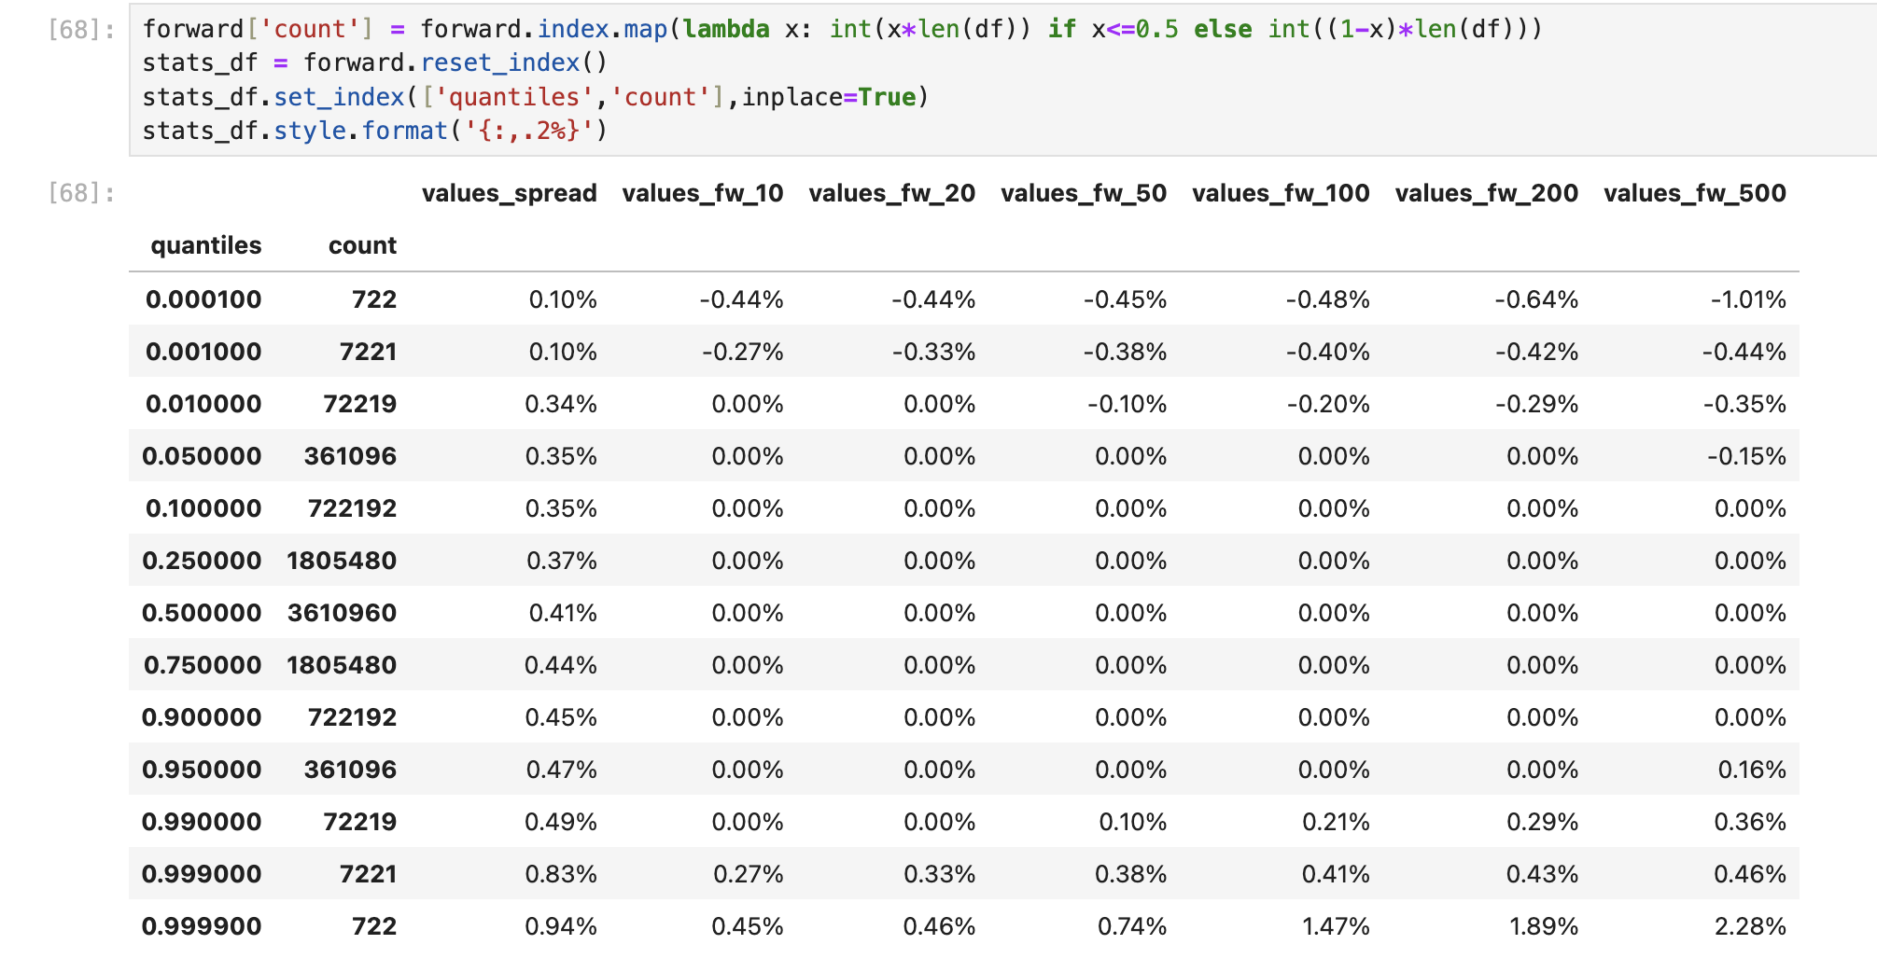
DeepLOB Training (ECC Market data)
Based on the stock forward return characteristics, we picked a fixed threshold to classify the labels. Trained the model with 5,15 and 30 bps thresholds of forward_500 rets
Due the high skewness and higher liquidity in the stock compared to F1-2010 data, we trained the model with class weighted loss on a 5 days rolling window basis and evaluated the model performance

Slide 4
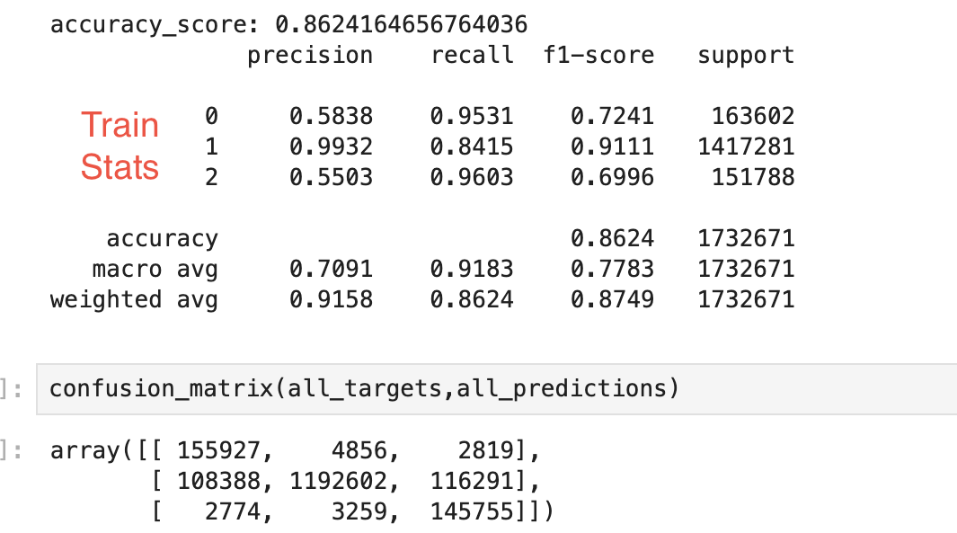
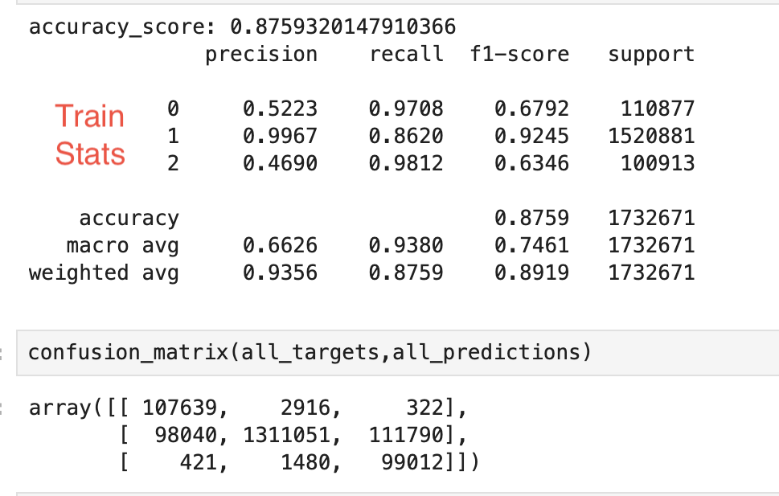
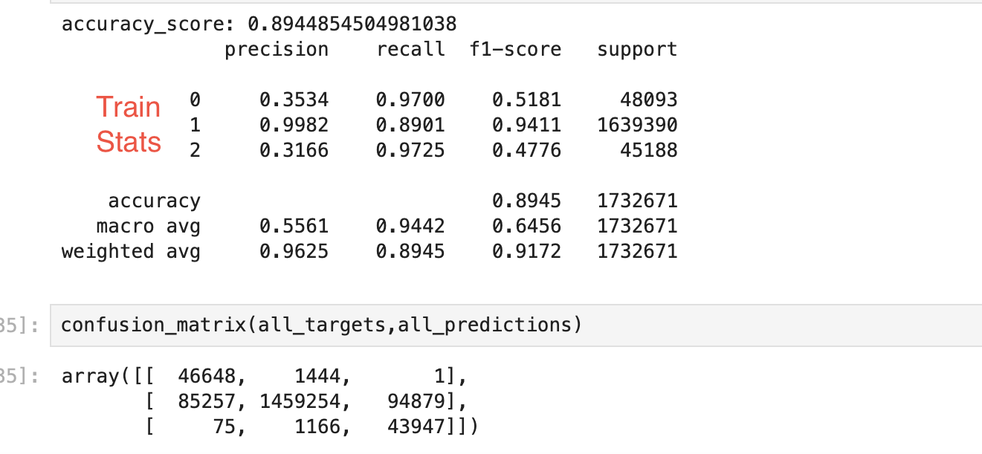
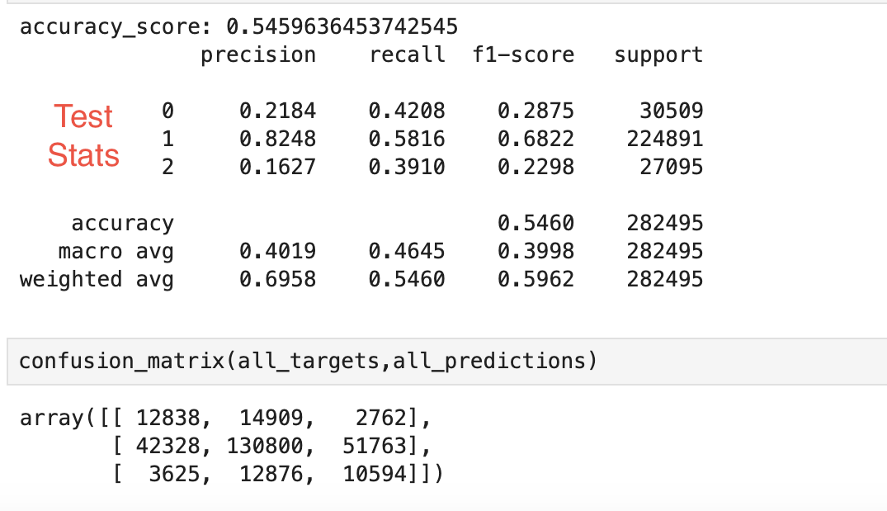
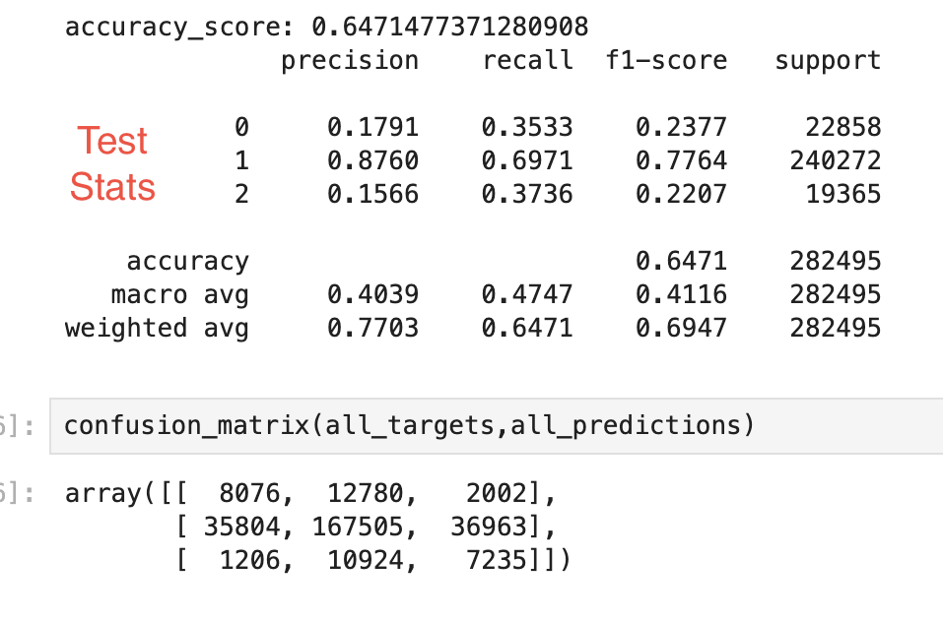
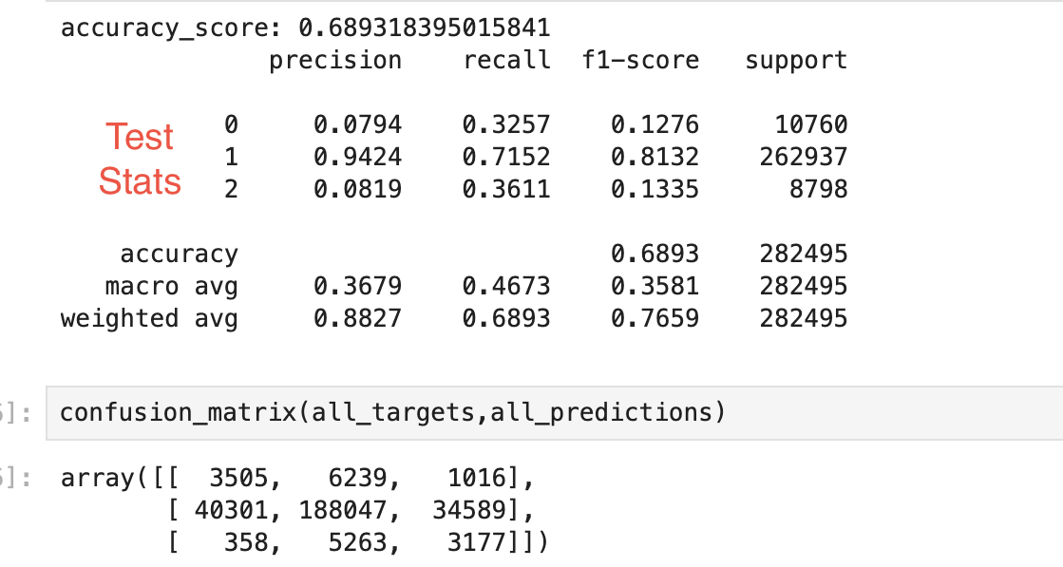
Weighted DeepLOB
The train and test results are presented in the following order: 5 bps,15 bps, 30 bps respectively

Slide 5
Back-test and Evaluation Methodology
Position changes are only based on model signal and nothing else (no time considerations, or anything else).
For every “new” long signal, we buy one lot and sell one lot for every “new” short signal. The way we characterize “new” is based on signal at previous tick, If previous tick signal is same as current tick signal, then the signal is not “new” and we don’t take any extra position.
One example is suppose the model gives 3 consecutive “new” long signals the position will be 3, and if the next “new” signal is -1 the position will be -1 ( sell all 3 and take short position of 1 lot , i.e. -1 is final position)
Another variation of strategy is instead of aggressively building up positions based on new signal, we passively hold the position until we get a “new” signal of opposite direction and only trade when there is change in signal from 1 to -1 or vice-versa. This doesn’t trade as frequently as above strategy.
This basic trading strategy is evaluated both at mid price trading and bid-ask trading without any transaction costs as we just want to evaluate if the model is picking up the signal

Slide 6
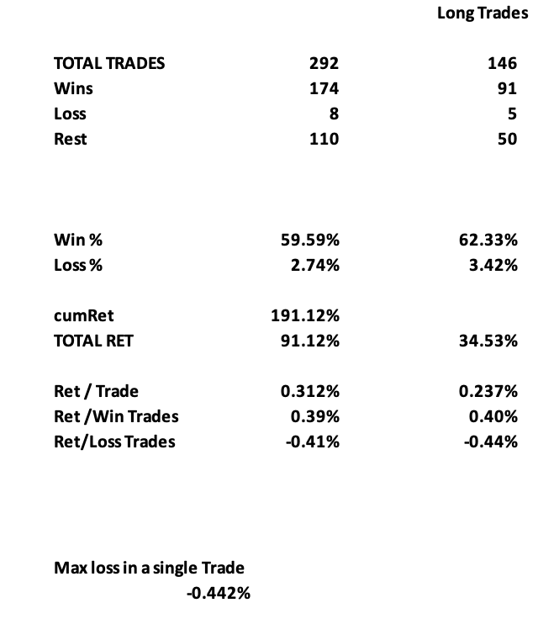
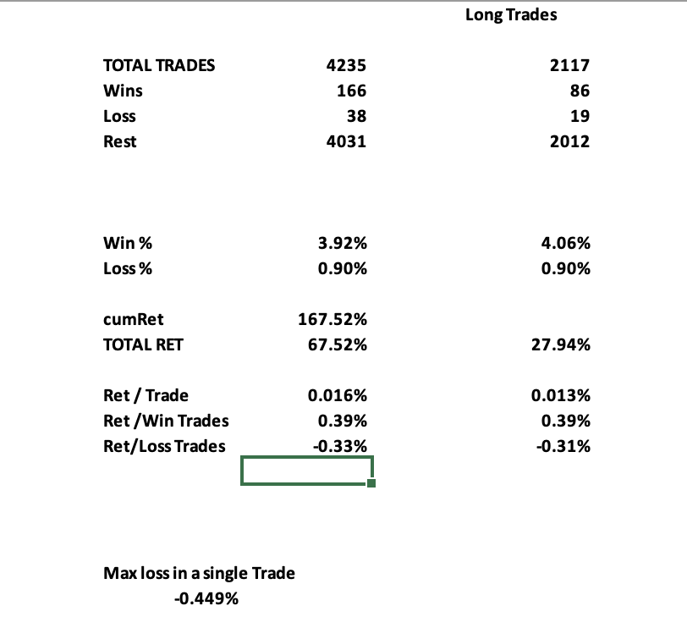
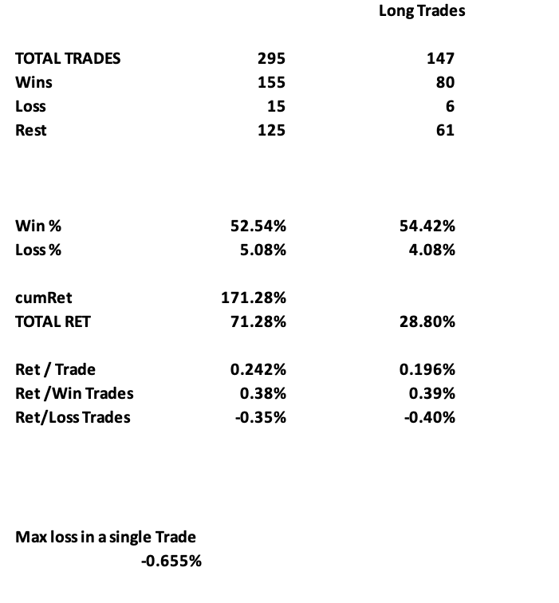
Back-test Results & Conclusion
The results of passive trading strategy at mid price are presented in the following order: 5 bps, 15 bps, and 30 bps, respectively
The model demonstrates weak signal capturing based on the test confusion matrix and win ratio. Model will likely show significant enhancements with training on longer time periods beyond the current 5 day window

