Slide 1
Profit-Based DQN for Bike Rebalancing
Comparing Profit vs Lost-Demand Objectives

Slide 2
Why Profit-Based Rewards?
• Current Approach: Minimize lost demand
• Ignores operational costs (truck travel, labor)
• May lead to excessive, unprofitable rebalancing
•
• Proposed Approach: Maximize profit
• Profit = Revenue - Truck Cost - Lost Demand Penalty
• Agent learns cost-efficient rebalancing strategies
•
• Goal: Show profit-DQN achieves better ROI

Slide 3
Economic Model
• Trip Revenue (Distance-Based Pricing):
• Revenue = $1.00 (base) + $0.75 × trip_km
•
• Truck Operating Cost:
• Cost = $1.00 × truck_distance_km
•
• Lost Demand Penalty:
• Penalty = $5.00 per lost trip
•
• Profit = Σ(Trip Revenue) - Truck Cost - Lost Penalty

Slide 4
Experimental Setup
• Environment: GT0 Toy Model
• 10 stations, 2 vehicles, 15-bike capacity
•
• Training: 50,000 timesteps each
• Profit-DQN (PReLU): Trained with profit reward
• Lost-Demand-DQN (ELU): Trained with -lost_demand reward
•
• Evaluation: 50 test episodes (unseen data)
• Both models evaluated on same test scenarios

Slide 5
Policy Comparison Results (50 Test Episodes)
Metric | Lost-Demand DQN | Profit DQN | Difference
Avg Profit | $113.95 | $128.01 | +$14.06 (better)
Avg Revenue | $194.87 | $198.20 | +$3.33
Avg Truck Cost | $57.22 | $49.59 | -$7.63 (less)
Avg Lost Penalty | $23.70 | $20.60 | -$3.10
Truck Distance | 57.22 km | 49.59 km | -7.63 km
Lost Demand Rate | 6.60% | 5.96% | -0.64%

Slide 6
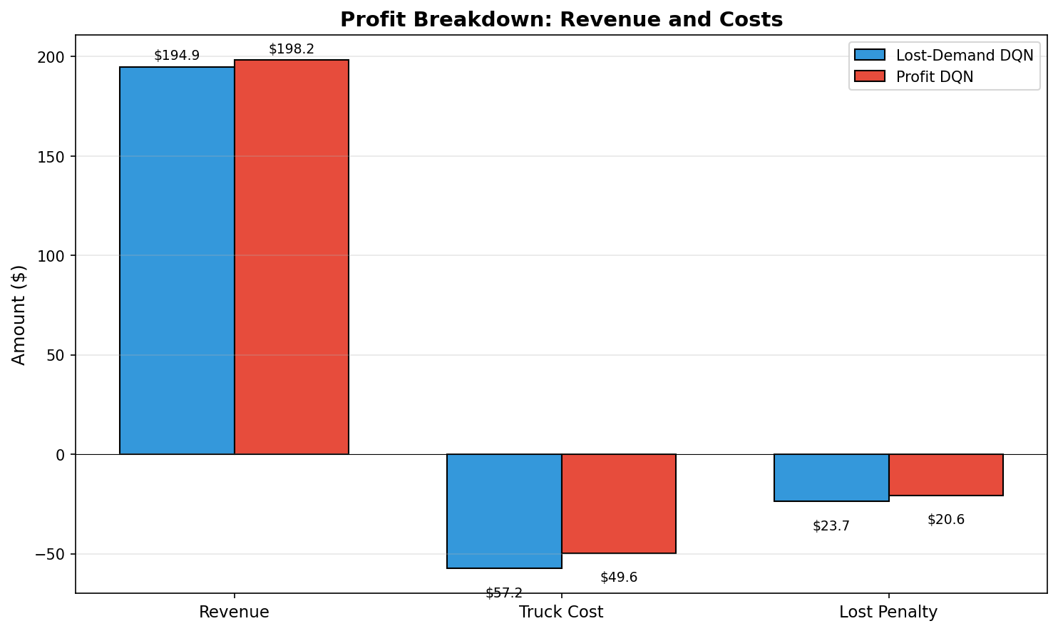
Profit Breakdown: Revenue vs Costs
Profit DQN reduces truck costs while maintaining revenue

Slide 7
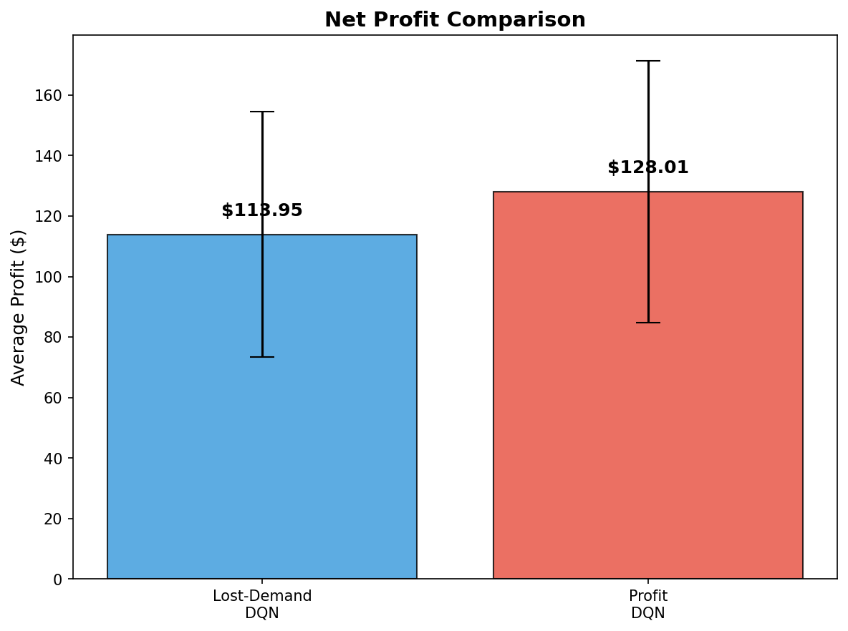
Net Profit Comparison
Profit DQN achieves $14.06 higher average profit per episode

Slide 8
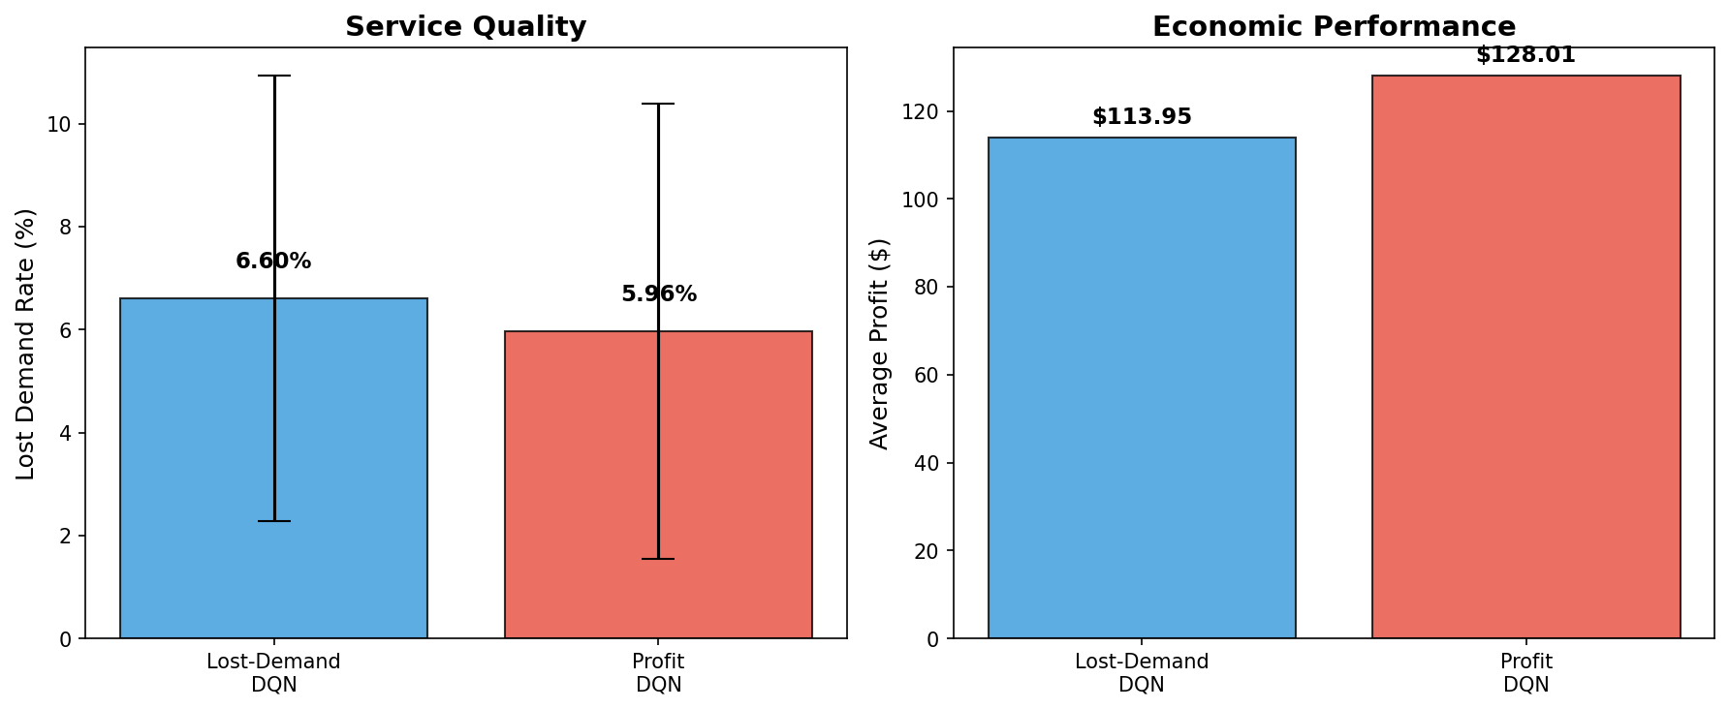
Service Quality vs Economic Performance
Profit DQN balances service quality with economic efficiency

Slide 9
Economic Parameter Sensitivity
• Research Question:
• How do economic parameters affect learned policies?
•
• Parameters varied:
• Trip revenue: $0.50-$2.00 base + $0.50-$1.00/km
• Truck cost: $0.50, $1.00, $2.00 per km
• Lost demand penalty: $2.00, $5.00, $10.00 per trip
•
• Each config trained 50,000 timesteps, evaluated 50 episodes

Slide 10
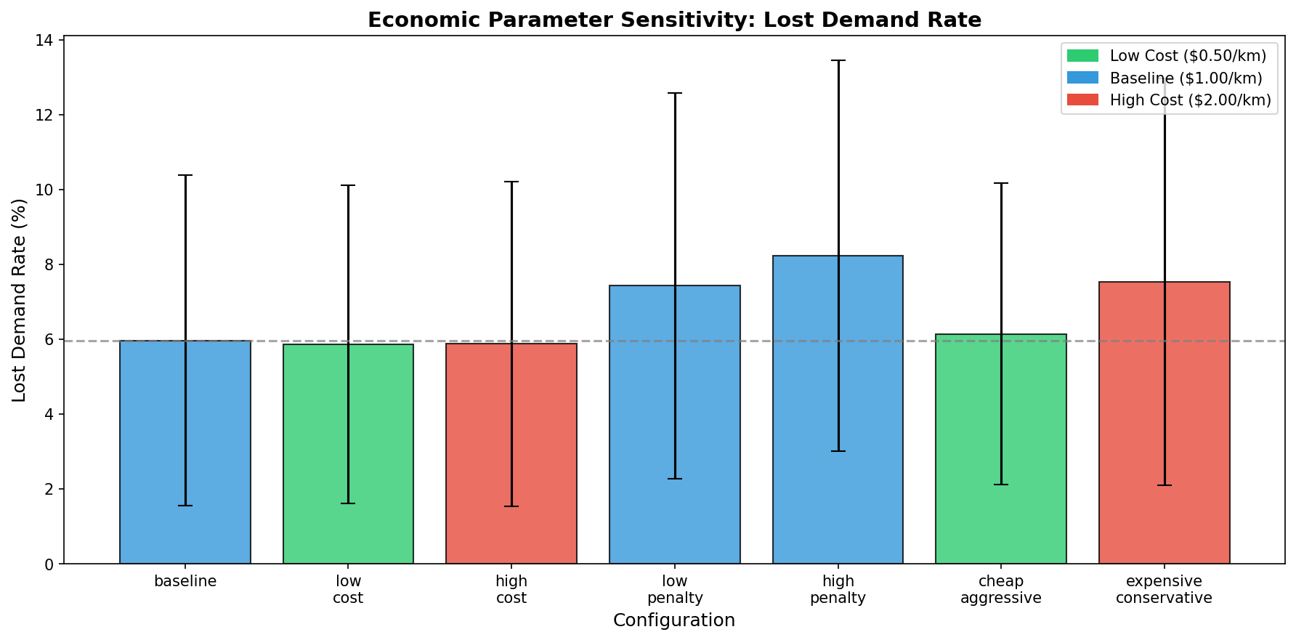
Economic Sensitivity: Lost Demand Rate
Lower truck cost and baseline penalty achieve best service quality

Slide 11
Economic Parameter Sensitivity: Full Results
Configuration | Revenue | Cost/km | Penalty | Profit | Lost %
baseline | $1+$0.75/km | $1.00 | $5.00 | $128.01 | 5.96%
high_revenue | $2+$1/km | $1.00 | $5.00 | $243.00 | 5.92%
low_revenue | $0.5+$0.5/km | $1.00 | $5.00 | $48.33 | 7.49%
low_cost | $1+$0.75/km | $0.50 | $5.00 | $149.09 | 5.86%
high_cost | $1+$0.75/km | $2.00 | $5.00 | $80.93 | 5.87%
low_penalty | $1+$0.75/km | $1.00 | $2.00 | $135.35 | 7.43%
high_penalty | $1+$0.75/km | $1.00 | $10.00 | $93.83 | 8.22%
cheap_aggressive | $1+$0.75/km | $0.50 | $10.00 | $124.60 | 6.13%
expensive_cons. | $1+$0.75/km | $2.00 | $2.00 | $97.88 | 7.53%

Slide 12
Key Findings
• Policy Comparison:
• Profit DQN achieves $14.06 higher profit per episode
• Reduces truck costs by 13%, improves service by 0.64%
•
• Economic Parameter Impact (ranked by profit):
• 1. Revenue pricing: Strongest impact ($48 → $243)
• 2. Truck cost: Moderate ($81 → $149 at low cost)
• 3. Lost penalty: Inverse effect (high penalty hurts)
•
• Best config: high_revenue ($243), Worst: low_revenue ($48)

Slide 13
Conclusions
• Profit-Based DQN Benefits:
• Better service: 5.96% vs 6.60% lost demand
• Cost-aware decisions: Balances service vs efficiency
•
• Economic Parameter Insights:
• Moderate penalty ($5) is optimal
• Extreme penalties hurt convergence
• Truck cost less impactful than expected
•
• Recommendations:
• Use profit-based objectives for real deployments
• Tune lost demand penalty carefully

