Slide 1
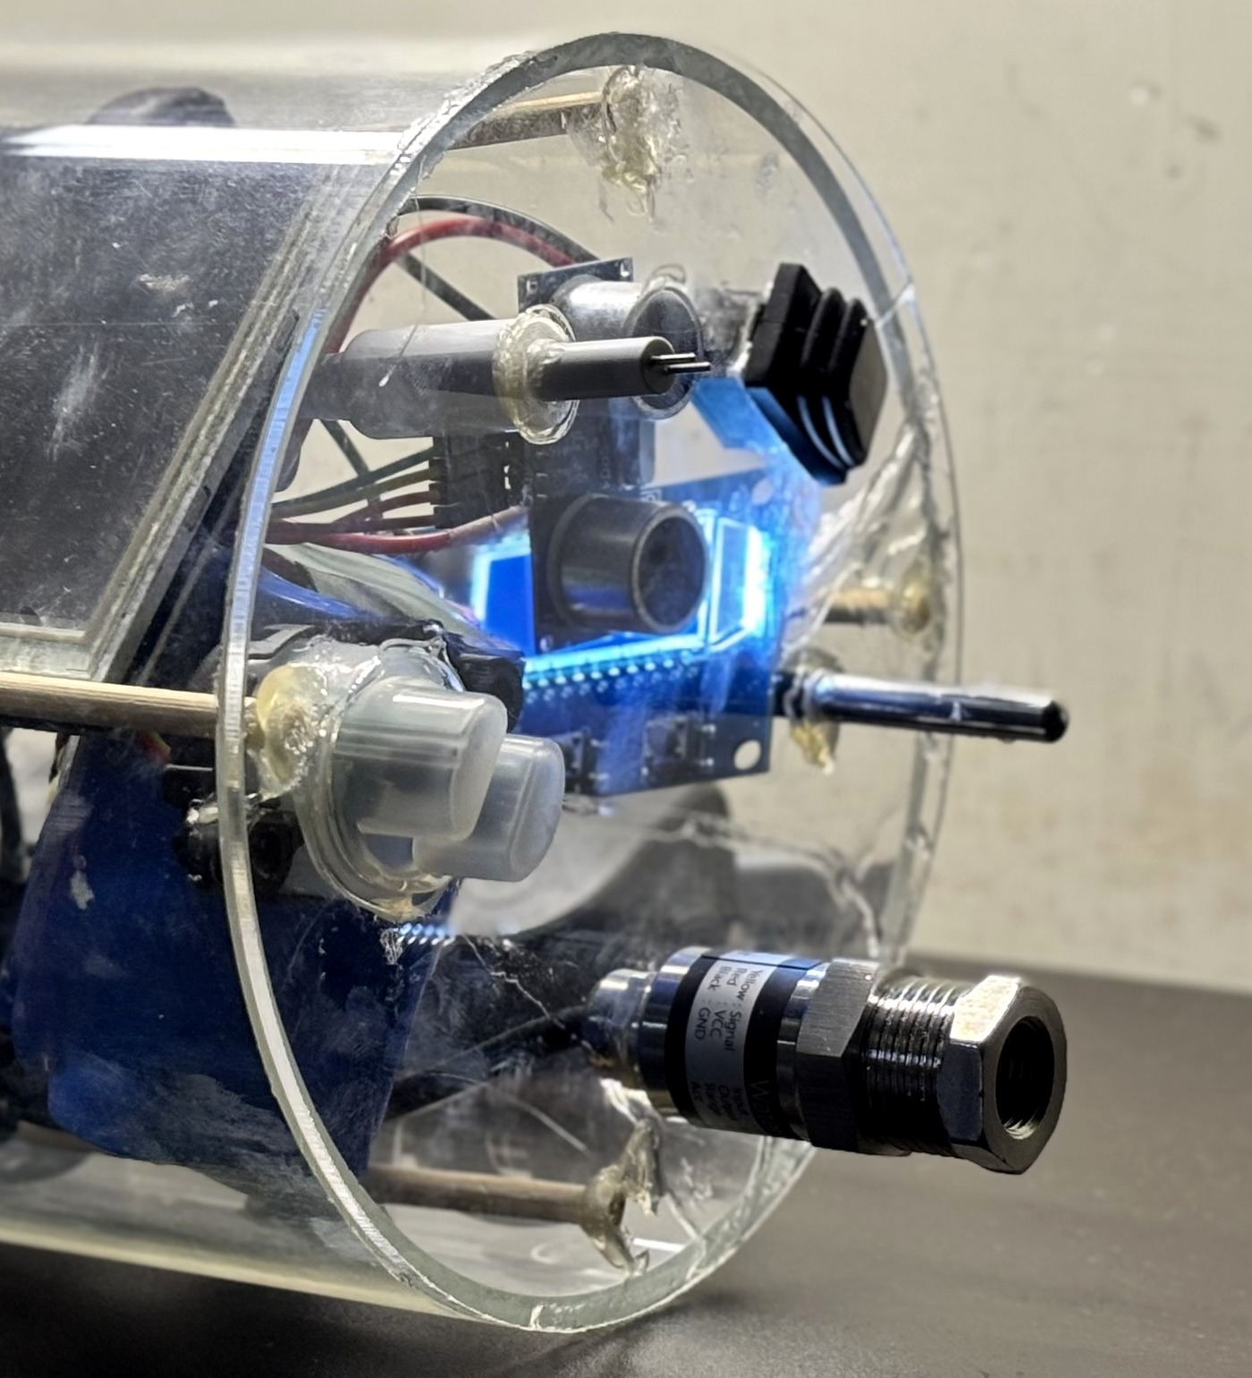
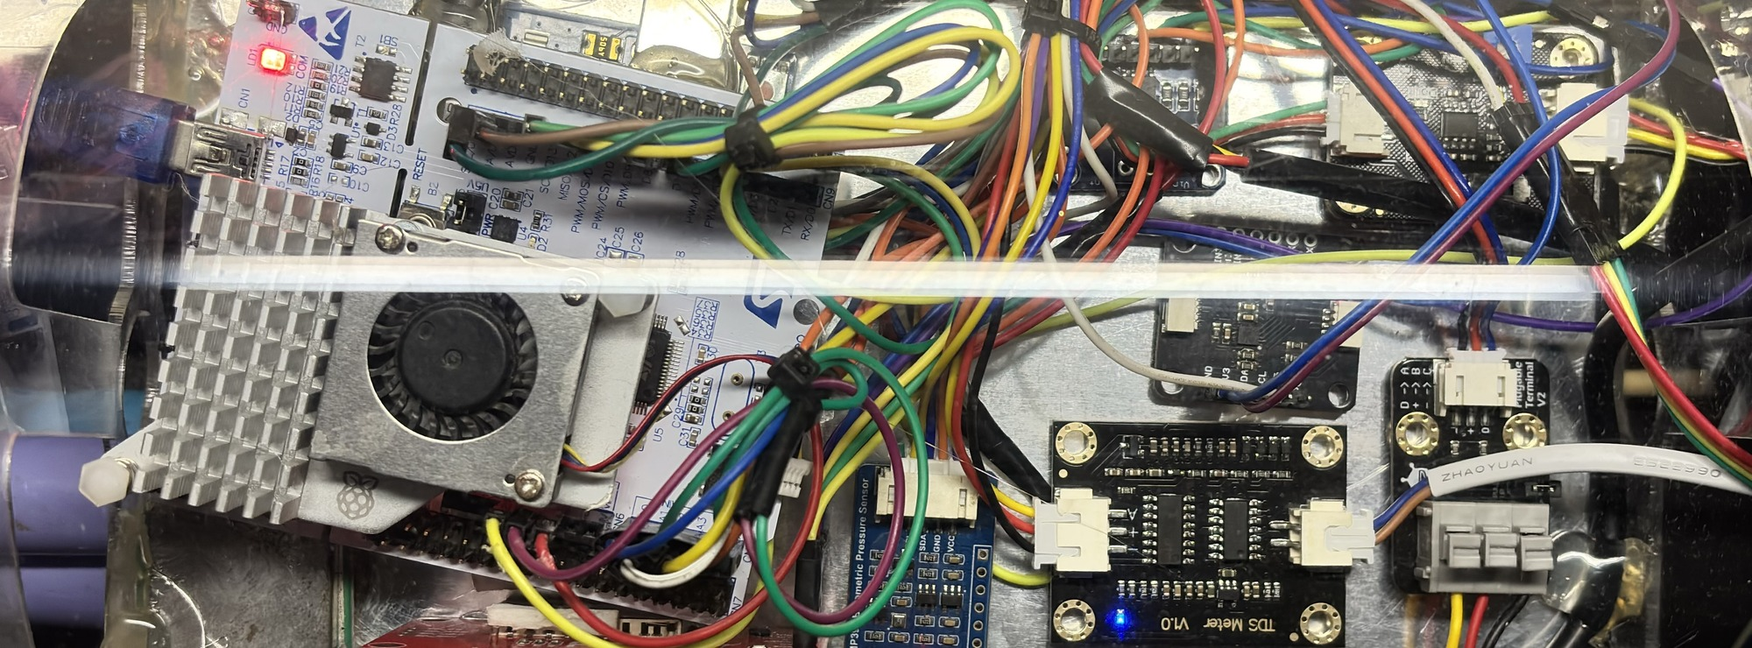
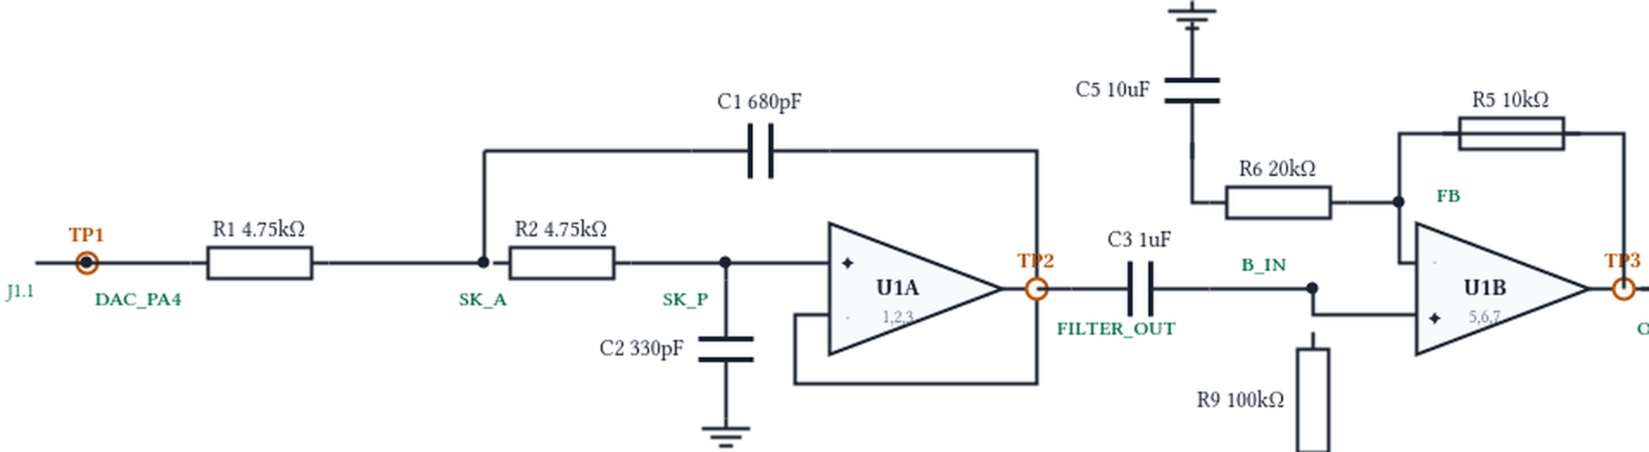
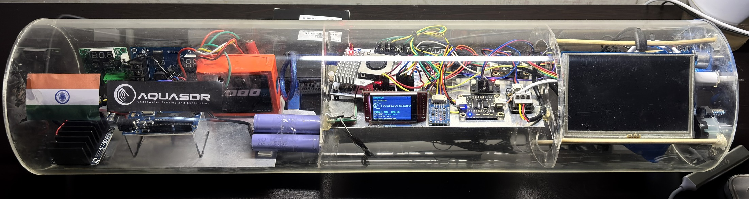

SENSE · REAL ENVIRONMENT
STM32F446RE · EMBEDDED CONTROL
ADAPTIVE NEXT PING
Live water-condition inputs
Firmware in C / C++ on the payload's own MCU
Parameters chosen per water condition
THE NEXT PING IS COMPUTED FROM THE CURRENT ENVIRONMENT
PARAMETER
CLEAR
TRANSITION
MURKY
TURBIDITY
CENTRE
42 kHz
40 kHz
38 kHz
Sensor interface boards
BANDWIDTH
4 kHz
2 kHz
1 kHz
TDS / SALINITY PROXY
PULSE
2 ms
4 ms
8 ms
AMPLITUDE
35 %
50 %
62 %
PRESSURE / DEPTH
STM32 NUCLEO-F446RE
CLEAR → shorter / sharper ping
MURKY → lower band / longer pulse / higher output demand
01
ACQUIRE
CONDITION · ANALOG FRONT END
DS18B20 TEMPERATURE
Read environmental inputs · reject stale / invalid readings
LPF → TLV9062 → output
2nd-order low-pass · 70.7 kHz
op-amp gain ×1.5
02
DECIDE
Smoothing + hysteresis → CLEAR / TRANSITION / MURKY
03
ADAPT
ADC · 1-Wire · I²C
Centre / bandwidth · pulse duration · amplitude
04
SYNTHESISE
Environmental inputs provide the state used to select the next ping.
LFM · geometric · Barker-13 × Hann / Hamming / Blackman
05
STREAM
TIM6 + DMA → 12-bit DAC1 / PA4 · 1 MS/s
06
VERIFY
AQUASDR PAYLOAD physical acrylic payload prototype for AUV integration
ADC + DMA capture → FFT · spectrogram · matched filter
VALIDATION MCU ADC capture · FFT · spectrogram · matched filter
+ external instrument (oscilloscope / spectrum analyzer)
TECHNOLOGIES
TO BE USED
Embedded C/C++ · STM32F446RE · ADC · TIM6 · DMA · 12-bit DAC
Signal processing LFM · Geometric sweep · Barker-13 · FFT · Windowing
Analog Sallen-Key LPF · TLV9062
Software React · Node.js · Python · OpenSCAD
SENSE
DECIDE
ADAPT
SYNTHESISE
STREAM
CONDITION
VERIFY

