Slide 1

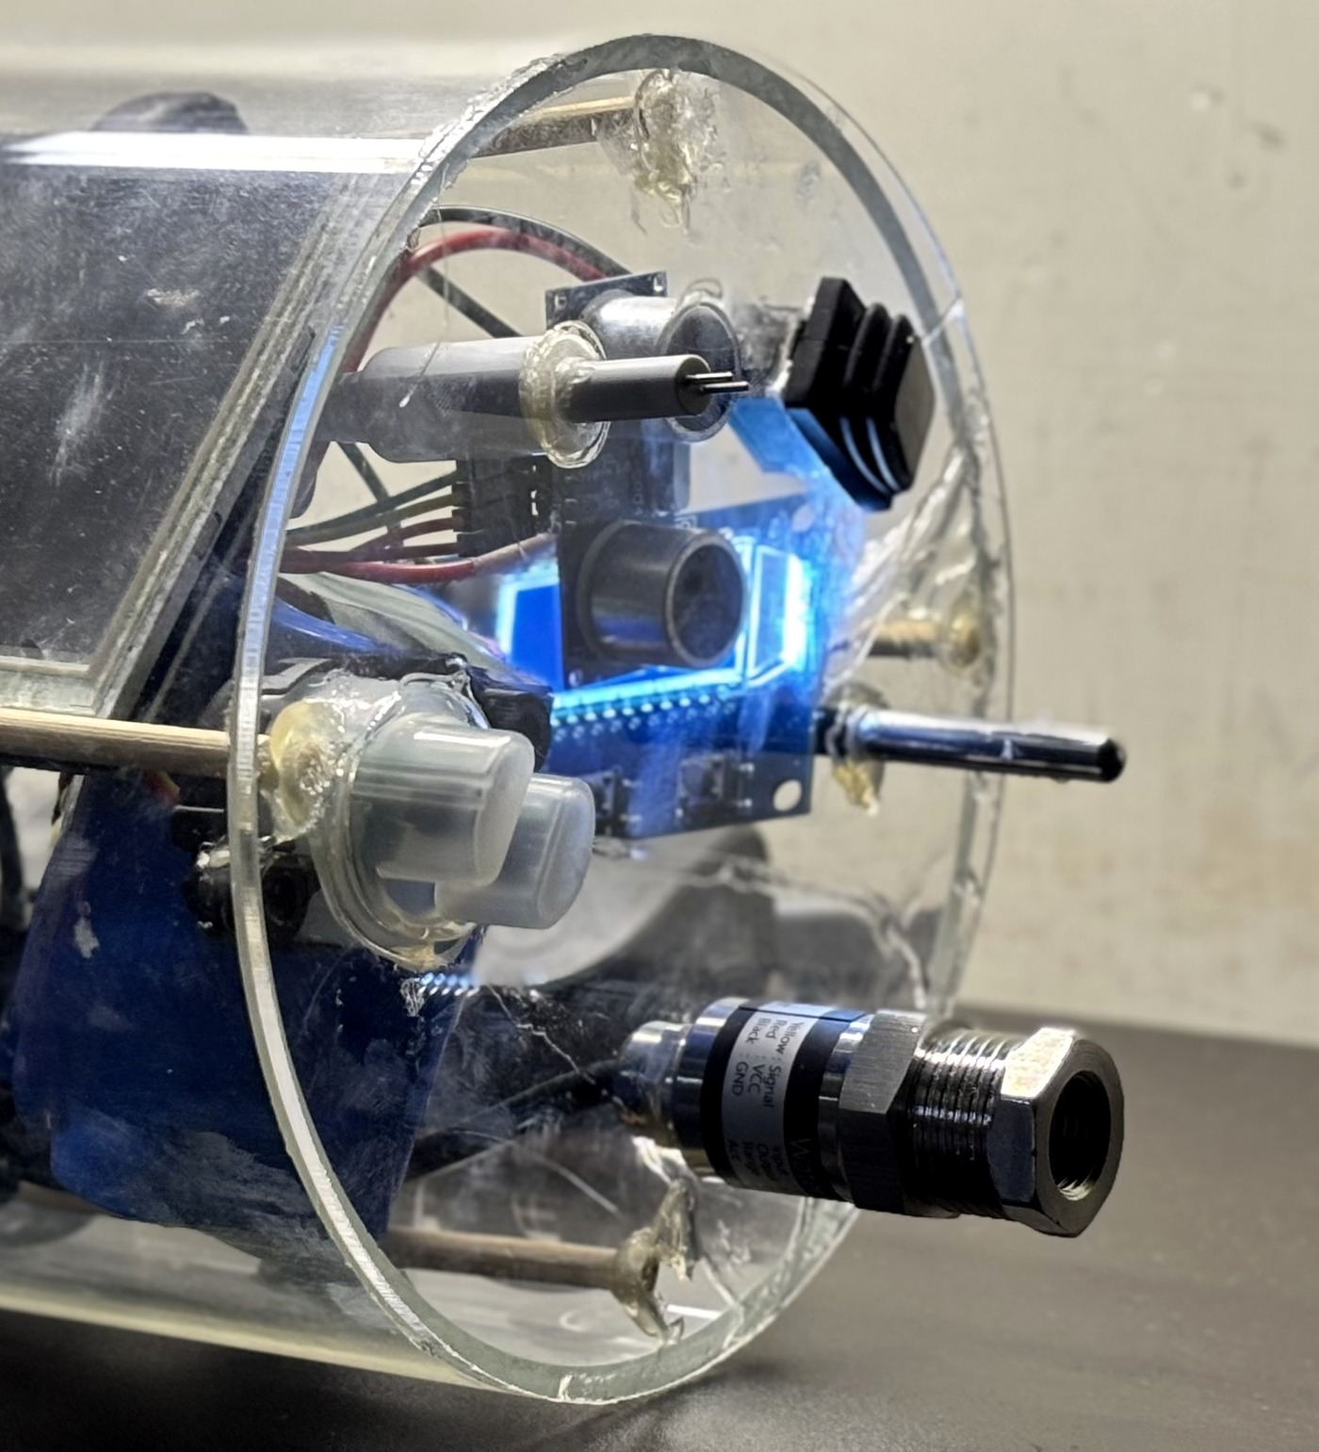
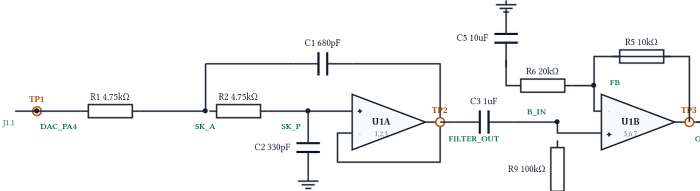
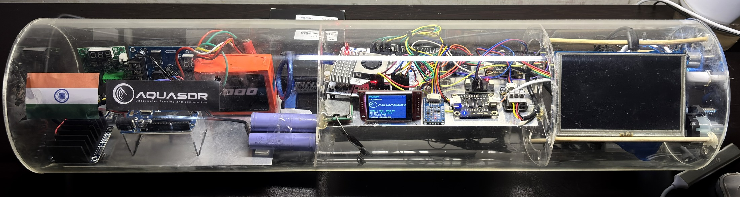
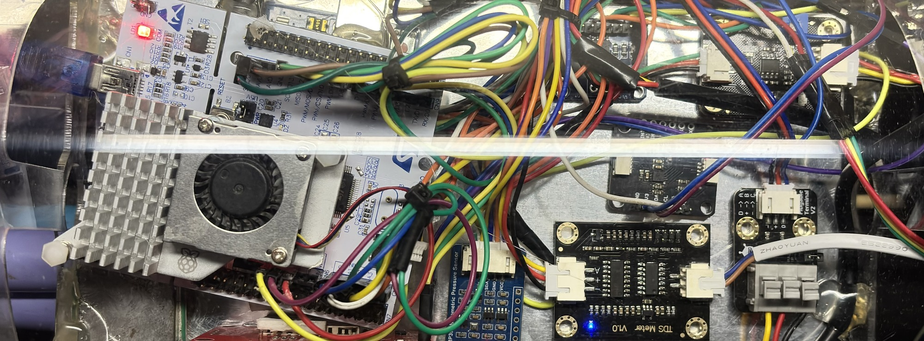
TECHNICAL APPROACH
Your Team Name
SENSE · REAL ENVIRONMENT
STM32F446RE · EMBEDDED CONTROL methodology & process
ADAPTED NEXT PING
THE NEXT PING IS COMPUTED ON THE MCU
CLEAR
TRANSITION
MURKY
TDS / salinity proxy
ACQUIRE
Centre
42 kHz
40 kHz
38 kHz
01
Bandwidth
4 kHz
2 kHz
1 kHz
HC-SR04 ultrasonic
ADC · 1-Wire · I²C · stale / out-of-range readings rejected
02
DECIDE
Pulse
2 ms
4 ms
8 ms
Turbidity sensor
smoothing + hysteresis → CLEAR / TRANSITION / MURKY
Amplitude
35 %
50 %
62 %
03
SYNTHESISE
CLEAR → shorter, sharper ping MURKY → lower band · longer · more output
DS18B20 temperature
LFM chirp · geometric sweep · Barker-13 × Hann / Hamming / Blackman
05
CONDITION · analog front end
Pressure / depth
04
STREAM
2nd-order LPF
70.7 kHz cut-off
TLV9062 ×1.5
TIM6 → DMA → 12-bit DAC1 (PA4) · 1 MS/s · CPU sleeps between pings
ADC · 1-Wire · I²C
06
SELF-VALIDATE
also on board: IMU + magnetometer · BMP390 cabin pressure · INA219 ×2 (mounted, not yet commissioned)
ADC3 + DMA capture of the DAC pin (PA4 → A5) → FFT / spectral analysis
DESIGNED · NEXT BUILD
ONE ADAPTATION POLICY · TWO INPUTS
MCU ADC CAPTURE 42.00 kHz centre · 4 kHz sweep · 2 ms pulse · HANN
LINK + STREAM 330 / 330 commands acknowledged · 0 DMA underruns
A0 sensor
TDS_PROXY · ADC
Web command
console → UART
TDS meter (A0)
TECHNOLOGIES TO BE USED
STM32F446RE (Cortex-M4F) · embedded C / C++
TIM6 + DMA + 12-bit DAC · ADC / 1-Wire / I²C
Sallen-Key LPF + TLV9062 op-amp (analog)
Node.js + React console · Python / NumPy · OpenSCAD
STM32 NUCLEO-F446RE
BMP390
AQUASDR PAYLOAD physical prototype · acrylic payload hull
External scope validation → PENDING · AUV hull-slot pod → NEXT BUILD
built / running
designed / next build
SENSE THE WATER → COMPUTE THE NEXT PING → STREAM THE WAVEFORM → VERIFY THE OUTPUT

