Slide 1

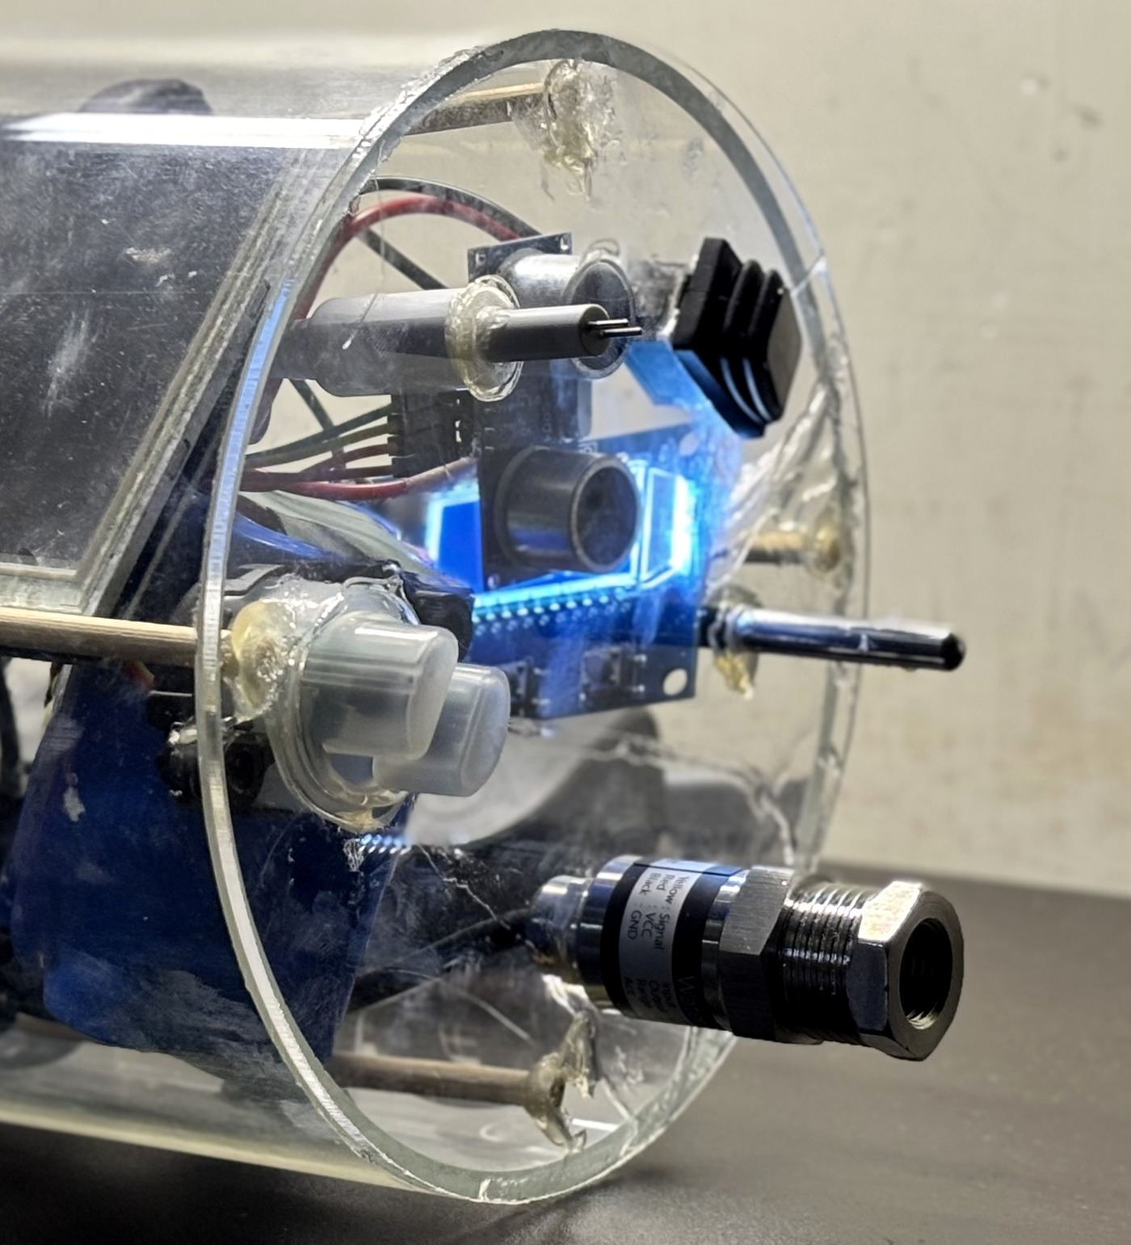
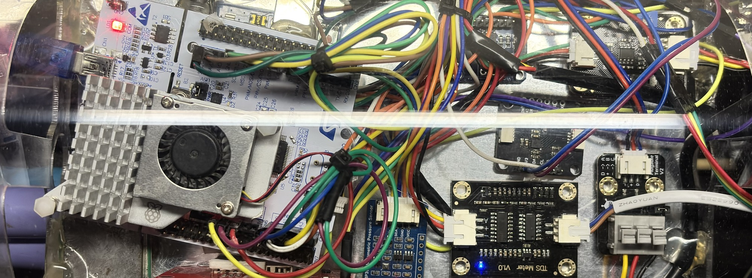
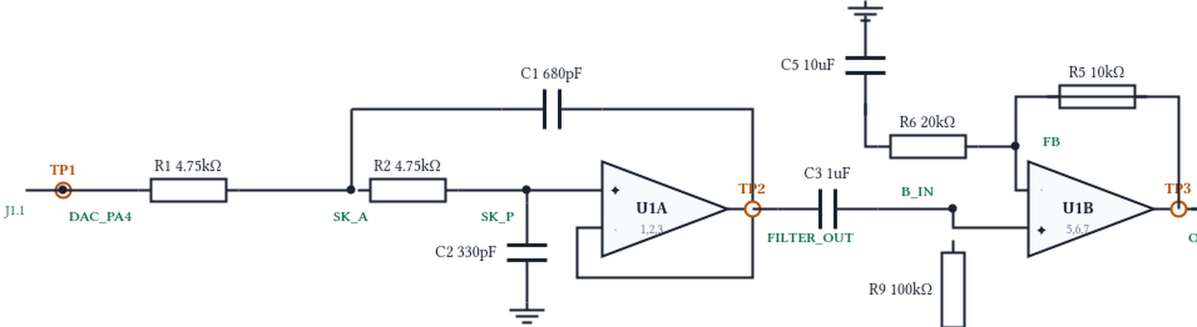
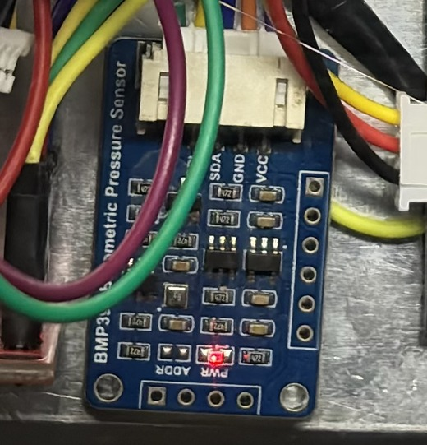
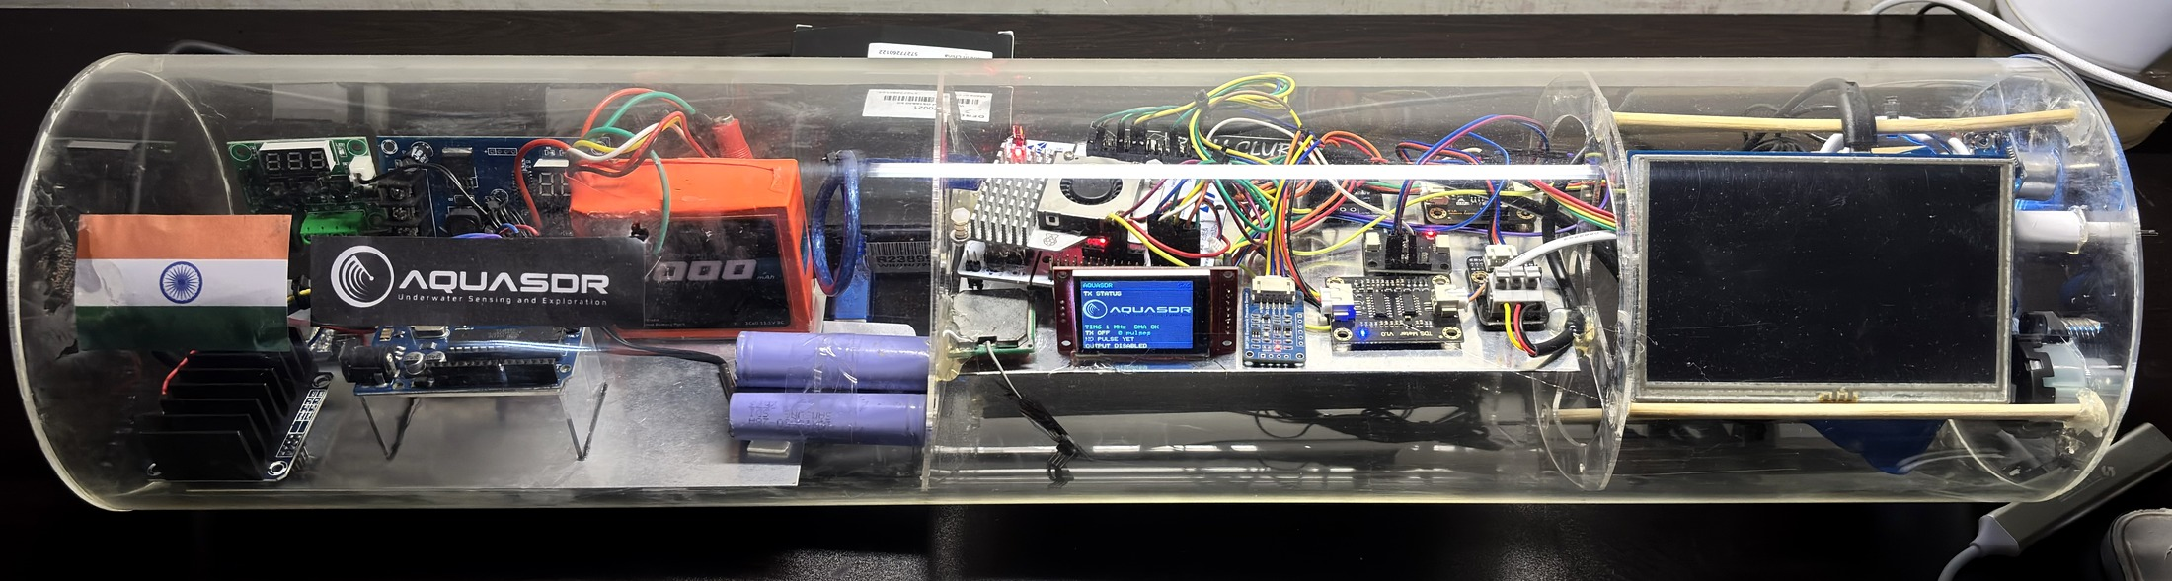
AquaSDR · TECHNICAL APPROACH
Your Team Name
Adaptive Software-Defined Sonar Transmitter for AUVs
REAL SENSORS → ON-CHIP LOGIC → REAL PAYLOAD
SENSE · REAL ENVIRONMENT
STM32F446RE · EMBEDDED CONTROL methodology & process
ADAPTED NEXT PING
THE NEXT PING IS COMPUTED ON THE MCU
CLEAR
TRANSITION
MURKY
TDS / SALINITY PROXY
Centre
42 kHz
40 kHz
38 kHz
HC-SR04 · AIR RANGE
Sensor interface boards
MCU ADC CAPTURE
LFM example · on-board
Centre 42 kHz
Sweep 4 kHz
Pulse 2 ms
Window Hann
330/330 cmds ACKed
0 DMA underruns
Bandwidth
4 kHz
2 kHz
1 kHz
Pulse
2 ms
4 ms
8 ms
TURBIDITY
Amplitude
35 %
50 %
62 %
STM32 NUCLEO-F446RE
CLEAR → shorter / sharper ping
MURKY → lower band / longer pulse / higher output demand
DS18B20 TEMPERATURE
PRESSURE / DEPTH
01
ACQUIRE
05
CONDITION · ANALOG FRONT END
ADC · 1-Wire · I²C
stale / out-of-range inputs rejected
2nd-order low-pass filter
70.7 kHz design target
TLV9062 ×1.5
ADC · 1-Wire · I²C
DECIDE
ADDITIONAL SENSORS
02
smoothing filter + hysteresis
CLEAR / TRANSITION / MURKY
DESIGNED · NEXT BUILD
BMP390
cabin pressure
I²C
IMU + magnetometer
ISM330 · MMC5983
I²C
INA219 ×2
MOUNTED · NOT
COMMISSIONED
SYNTHESISE
03
LFM chirp · geometric sweep · Barker-13
Hann · Hamming · Blackman windows
ONE ADAPTATION POLICY · TWO INPUTS
04
STREAM
A0 SENSOR
TDS_PROXY → ADC
WEB COMMAND
console → UART
TIM6 + DMA → 12-bit DAC1 / PA4
1 MS/s · 0 underruns · CPU free between transfers
06
SELF-VALIDATE
ADC + DMA capture of the DAC output
FFT · spectrogram · matched filtering
AQUASDR PAYLOAD · PHYSICAL PROTOTYPE acrylic payload hull
External scope validation → PENDING · AUV hull-slot pod → NEXT BUILD
built / running
designed / next build
SENSE
DECIDE
SYNTHESISE
STREAM
CONDITION
VERIFY

