Slide 1

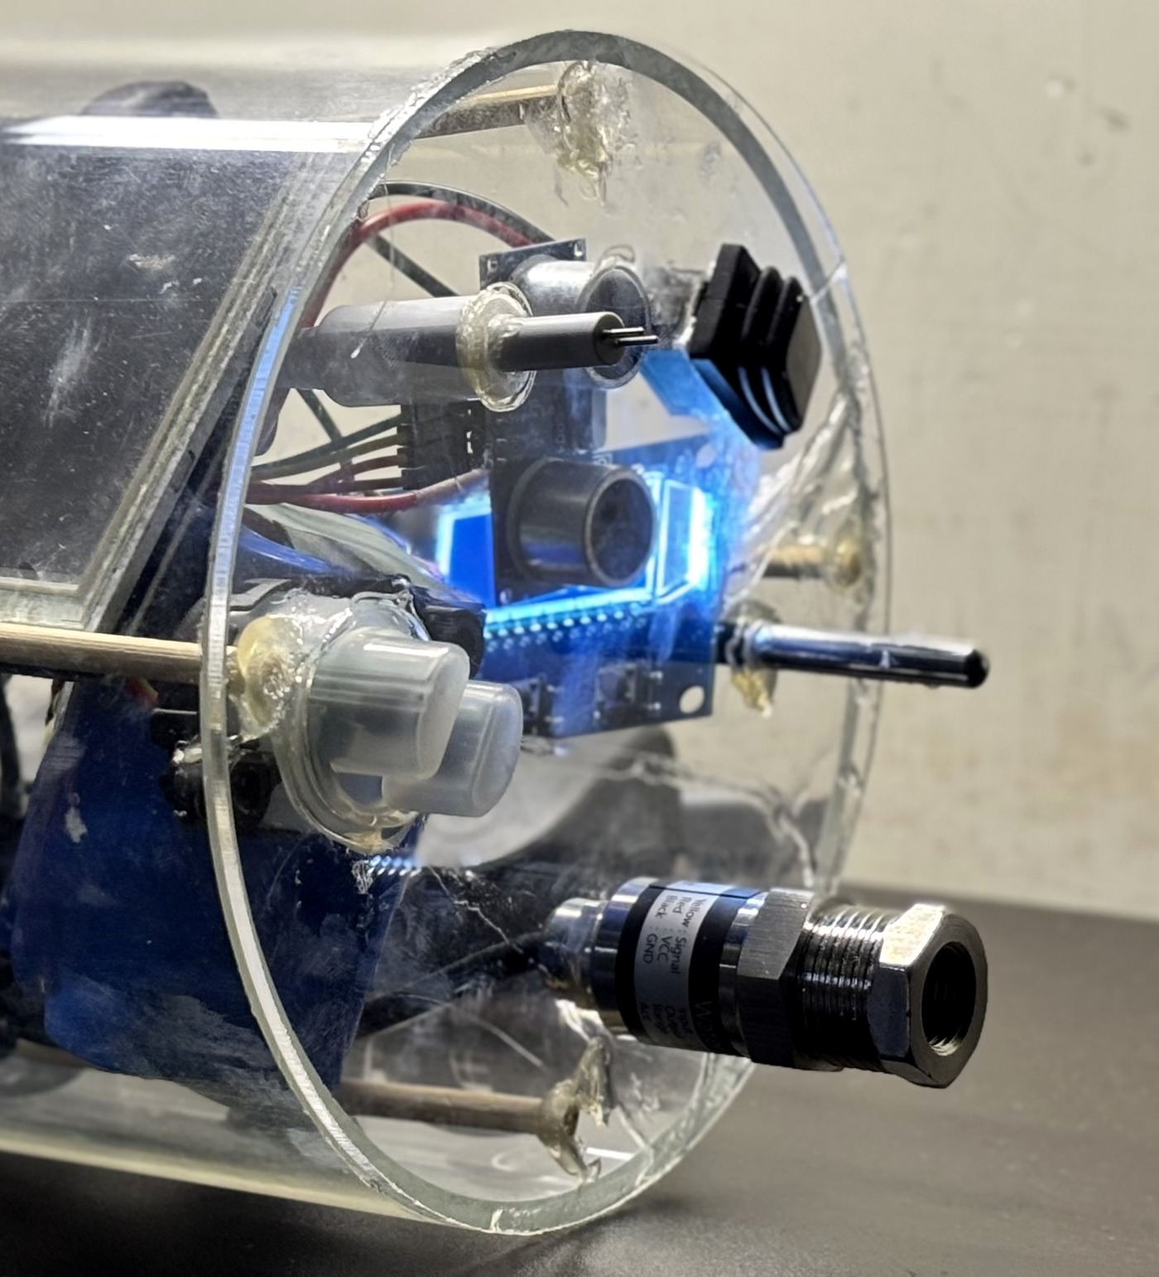
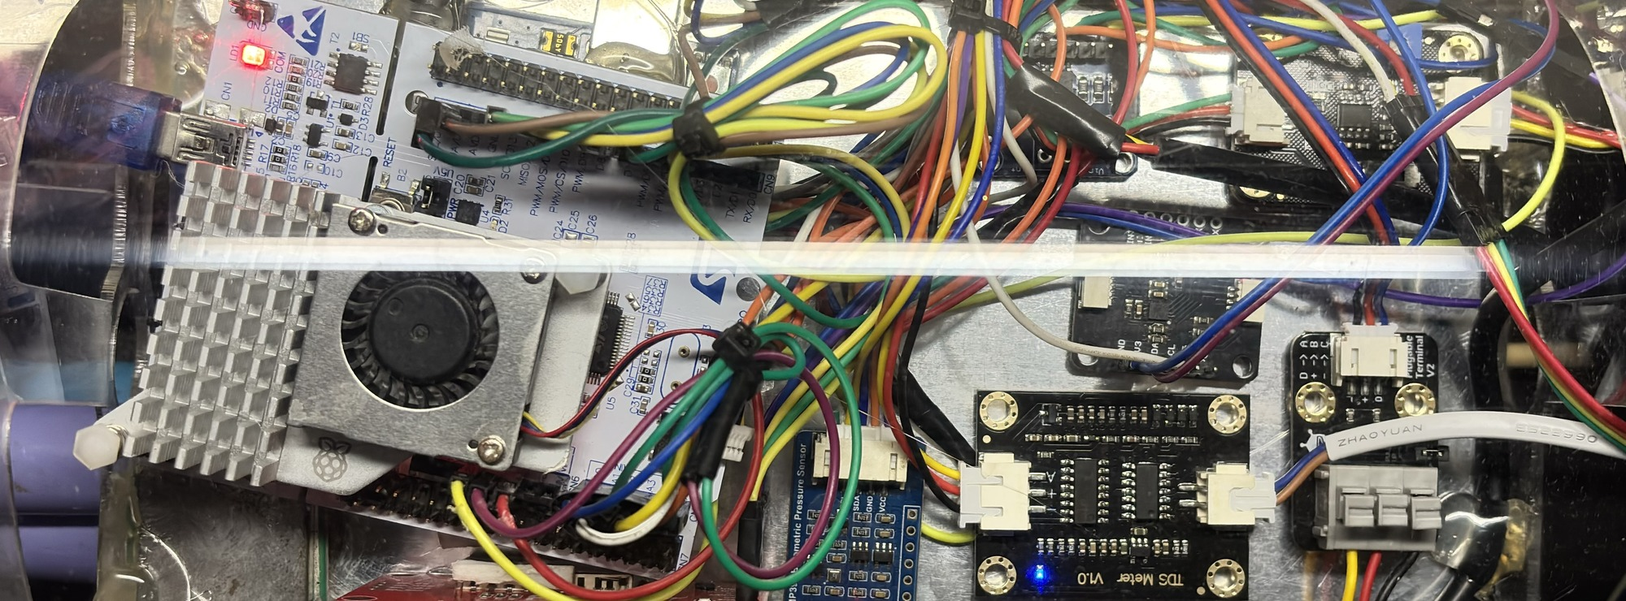
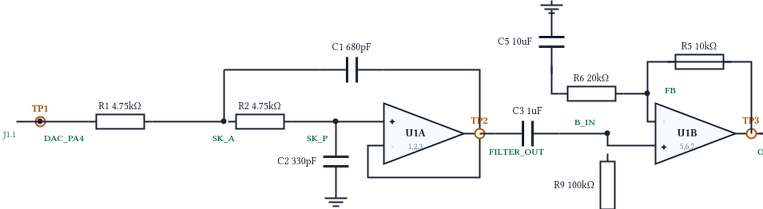
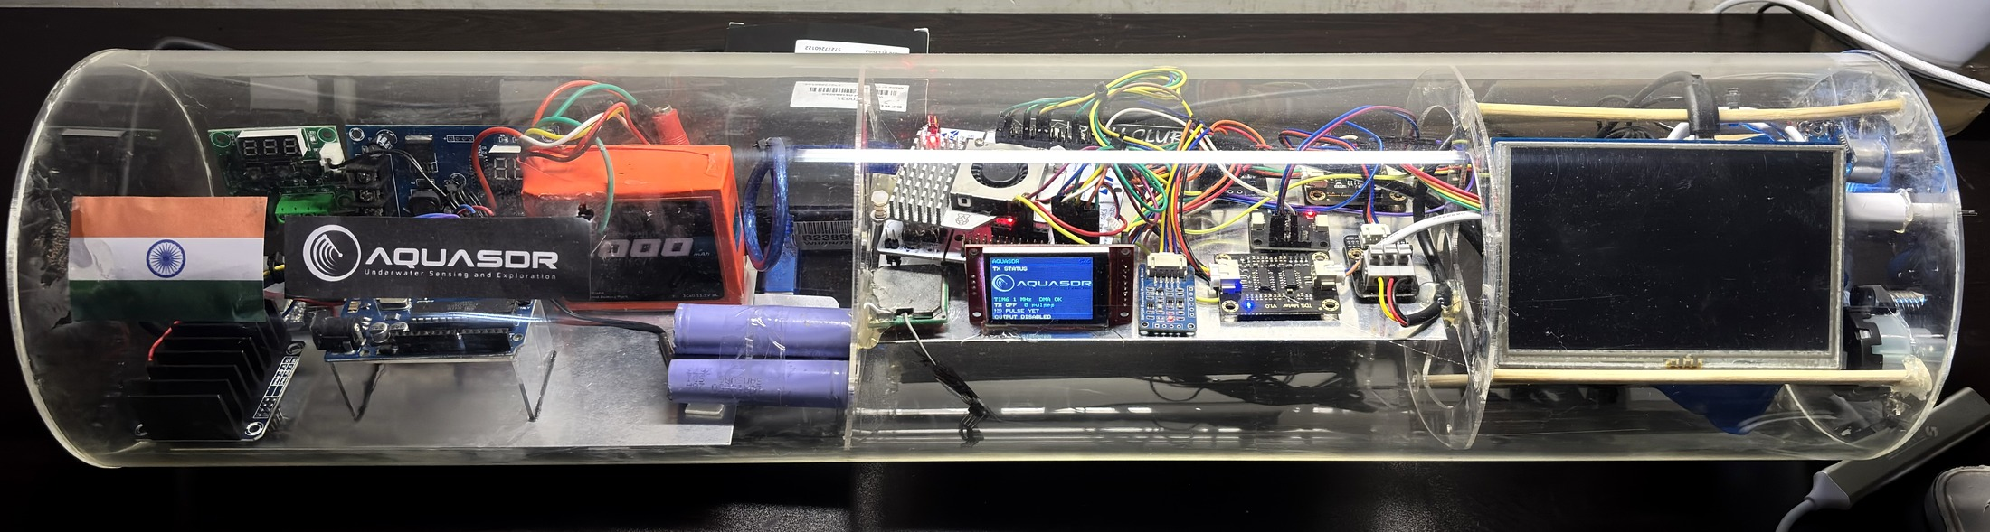
AquaSDR · TECHNICAL APPROACH
Your Team Name
Adaptive Software-Defined Sonar Transmitter for AUVs
SENSE
DECIDE · SYNTHESISE · STREAM
NEXT PING
Real environment · real sensors
STM32F446RE embedded control · methodology & process
Adaptive waveform parameters
THE NEXT PING IS COMPUTED ON THE MCU
CLEAR
TRANSITION
MURKY
TDS / SALINITY PROXY
CENTRE
42 kHz
40 kHz
38 kHz
HC-SR04 · AIR RANGE
Sensor interface boards
MCU ADC CAPTURE
LFM example · on-board
Centre 42 kHz
Sweep 4 kHz
Pulse 2 ms Hann
330/330 cmds ACKed
0 DMA underruns
BANDWIDTH
4 kHz
2 kHz
1 kHz
PULSE
2 ms
4 ms
8 ms
TURBIDITY
AMPLITUDE
35 %
50 %
62 %
DS18B20 TEMPERATURE
STM32 NUCLEO-F446RE
Water condition changes → next-ping parameters change
05 CONDITION · ANALOG FRONT END
PRESSURE / DEPTH
01
ACQUIRE
2nd-order low-pass filter
70.7 kHz design target
TLV9062 ×1.5
ADC · 1-Wire · I²C · stale / out-of-range inputs rejected
ADC · 1-Wire · I²C
02
DECIDE
DESIGNED · NEXT BUILD
Also on board BMP390 · IMU + magnetometer (I²C) · INA219 ×2 mounted, not commissioned
smoothing filter + hysteresis → CLEAR / TRANSITION / MURKY
03
SYNTHESISE
ONE POLICY · TWO INPUTS
LFM · geometric sweep · Barker-13 × Hann / Hamming / Blackman
A0 sensor
TDS_PROXY → ADC
Web command
console → UART
04
STREAM
TIM6 + DMA → 12-bit DAC1 / PA4 · 1 MS/s · 0 underruns
06
SELF-VALIDATE
ADC + DMA capture of the DAC output → FFT · spectrogram · matched filter
AQUASDR PAYLOAD · PHYSICAL PROTOTYPE acrylic payload hull
External scope validation → PENDING · AUV hull-slot pod → NEXT BUILD
TECHNOLOGIES
TO BE USED
Programming C / C++ · Python · JavaScript
Embedded STM32F446RE · ADC · TIM6 · DMA · 12-bit DAC
Signal processing LFM · geometric sweep · Barker-13 · FFT · windowing
Analog Sallen-Key LPF · TLV9062 op-amp
Software React · Node.js / Express · WebSocket · OpenSCAD
Hardware Turbidity · TDS · pressure · DS18B20 · IMU · BMP390 · INA219
SENSE
DECIDE
SYNTHESISE
STREAM
CONDITION
VERIFY
built / running
designed / next build

