Slide 1

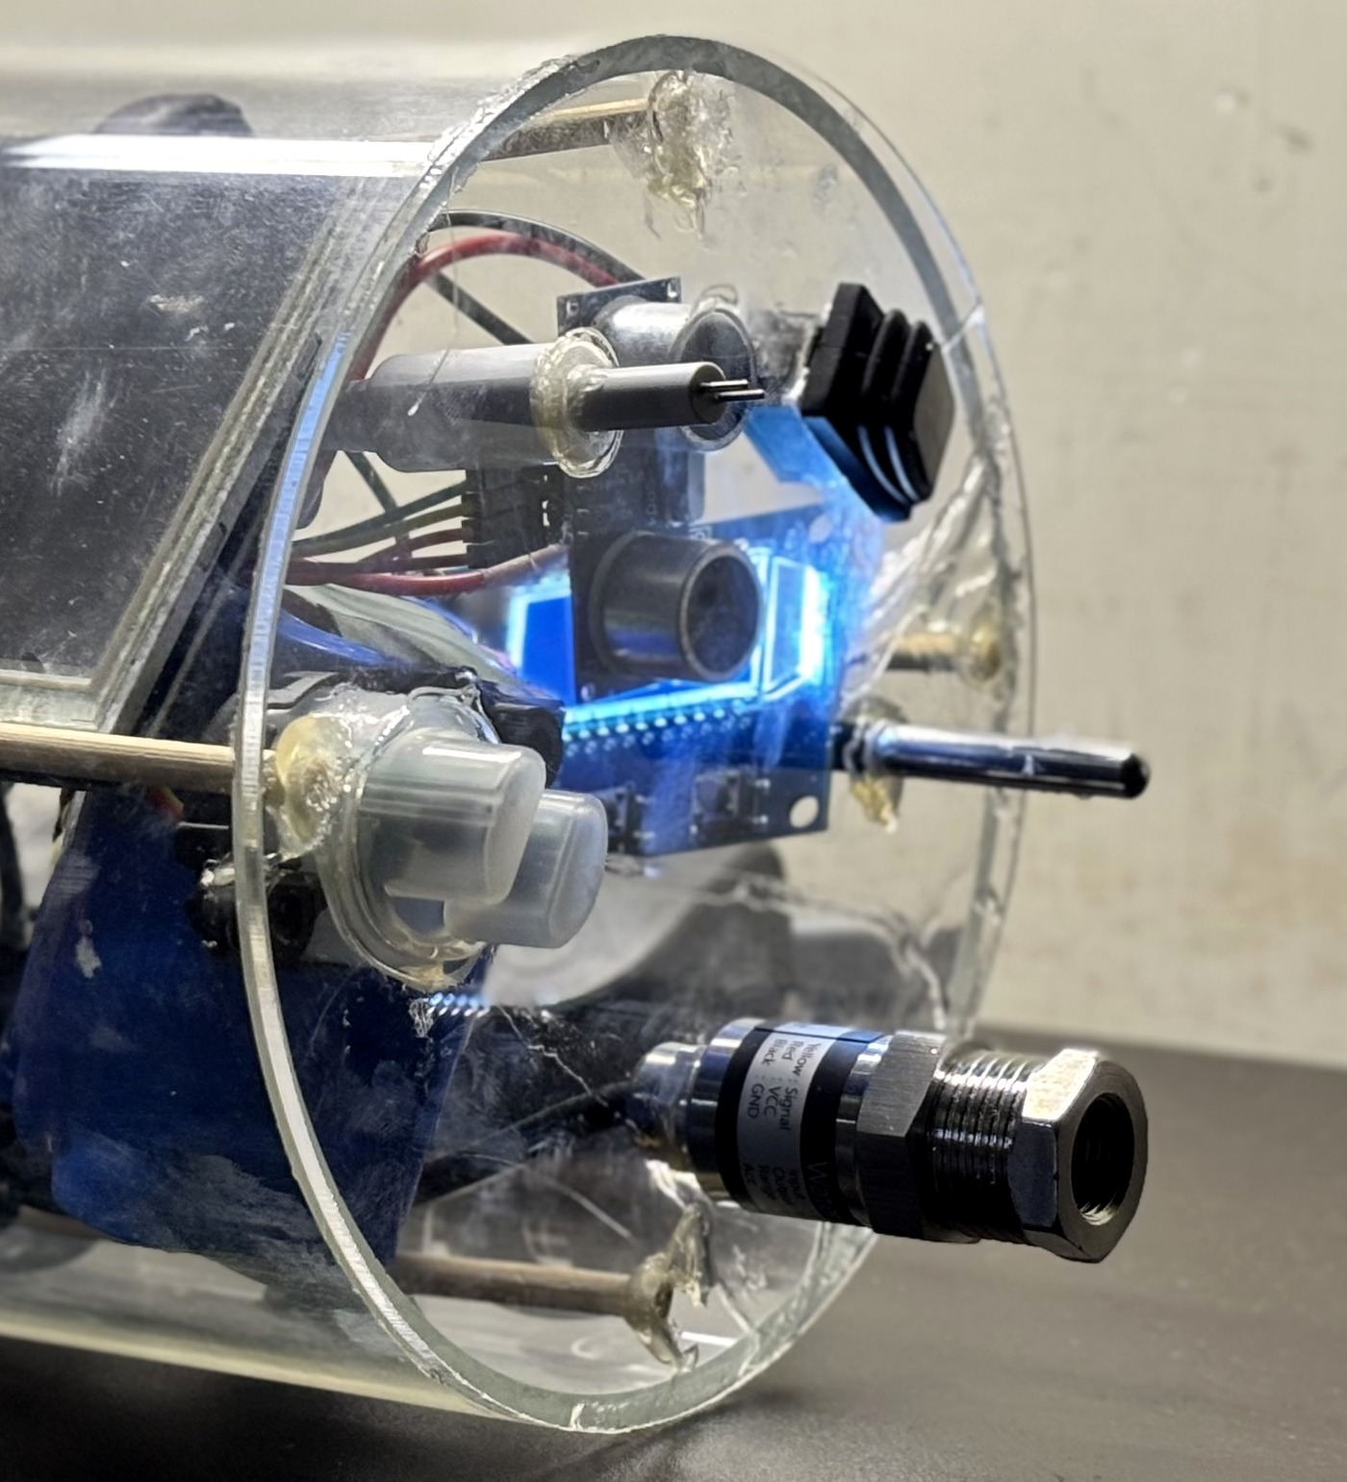
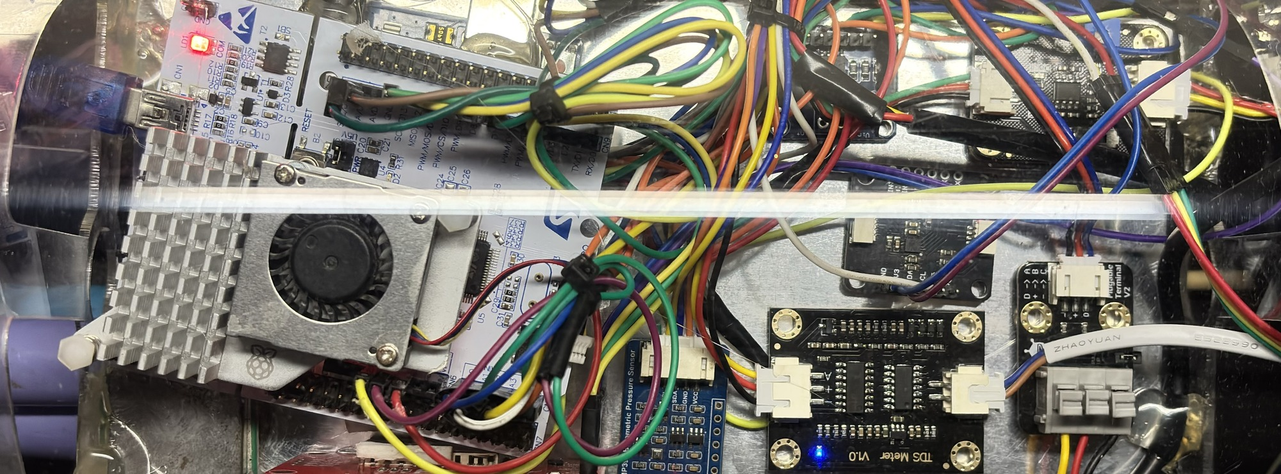
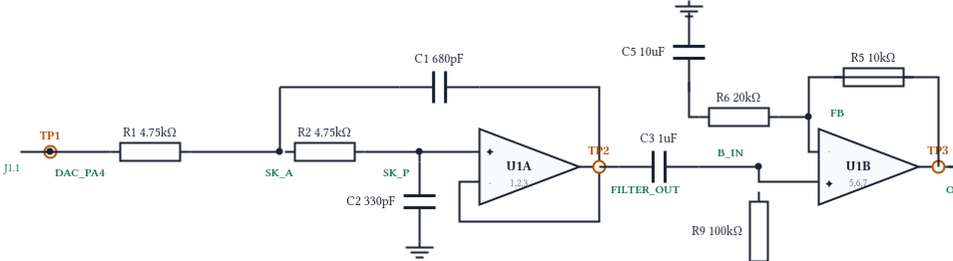
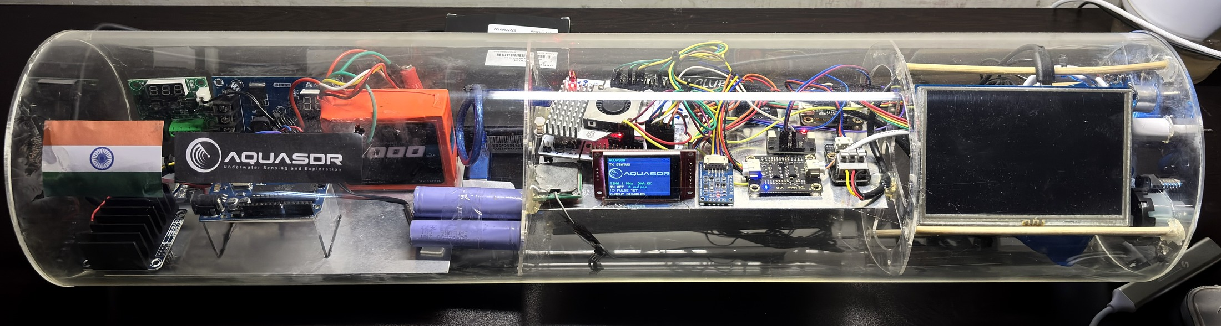
AquaSDR · TECHNICAL APPROACH
Your Team Name
Adaptive Software-Defined Sonar Transmitter for AUVs
SENSE
DECIDE · SYNTHESISE · STREAM
ADAPTED NEXT PING
Real environment · real sensors
STM32F446RE embedded control
Adaptive waveform parameters
TDS / SALINITY PROXY
BUILT
THE NEXT PING IS COMPUTED ON THE MCU
CLEAR
TRANSITION
MURKY
BUILT
Sensor interface boards
MCU ADC CAPTURE · LFM
42 kHz
4 kHz BW
2 ms
Hann · 330/330 commands
0 DMA underruns
CENTRE
42 kHz
40 kHz
38 kHz
HC-SR04 · AIR RANGE
BANDWIDTH
4 kHz
2 kHz
1 kHz
PULSE
2 ms
4 ms
8 ms
TURBIDITY
AMPLITUDE
35 %
50 %
62 %
DS18B20 TEMPERATURE
STM32 NUCLEO-F446RE
CLEAR → shorter / sharper ping
MURKY → lower band / longer pulse / higher output demand
PRESSURE / DEPTH
01
ACQUIRE
05 CONDITION · ANALOG FRONT END
ADC · 1-Wire · I²C
Reject stale / invalid inputs
02
DECIDE
2nd-order low-pass filter
70.7 kHz design target
TLV9062 ×1.5
ADC · 1-Wire · I²C
Smoothing + hysteresis
CLEAR / TRANSITION / MURKY
Also on board BMP390 · IMU + magnetometer · INA219 ×2 (mounted, not commissioned)
SYNTHESISE
DESIGNED · BUILDING NEXT
03
ONE POLICY · TWO INPUTS
LFM · Geometric · Barker-13
Hann · Hamming · Blackman
BUILT
A0 sensor
TDS_PROXY → ADC
Web command
console → UART
04
STREAM
TIM6 + DMA → 12-bit DAC1 / PA4
1 MS/s · 0 underruns · CPU free between transfers
06
SELF-VALIDATE
ADC + DMA capture of DAC output
FFT · spectrogram · matched filter
AQUASDR PAYLOAD · PHYSICAL PROTOTYPE acrylic hull
Scope validation → PENDING · AUV hull-slot pod → NEXT BUILD
TECHNOLOGIES
TO BE USED
Embedded STM32F446RE · C/C++ · ADC · TIM6 · DMA · DAC
Signal processing LFM · Geometric · Barker-13 · FFT · Windowing
Analog Sallen-Key LPF · TLV9062
Software React · Node.js · WebSocket · Python · OpenSCAD
SENSE
DECIDE
SYNTHESISE
STREAM
CONDITION
VERIFY
built / running
designed / building next

