Slide 1
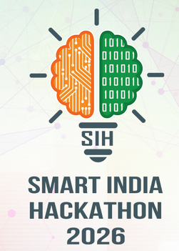
IMPACT AND BENEFITS
Your Team Name
IMPACT on the target audience
NIOT · MoES · DEEP OCEAN MISSION
AUV & SURVEY OPERATORS
RESEARCHERS & STUDENTS
One payload for every water
Sharper seabed data
An open sonar test bed
Adapts to clear, coastal and murky water with no hardware change.
Every ping is re-tuned to the water instead of one fixed setting.
A new waveform or policy is a firmware update, checked on-board.
3 profiles · 4 parameters · switched in < 100 ms
Windowed pulses: leakage −14.6 → −35 dB
LFM · Geometric · Barker-13 · 161 tests
BENEFITS economic · environmental · strategic
ECONOMIC
ENVIRONMENTAL
STRATEGIC
Low cost, off the shelf
Only the power the water needs
Sonar built in India
STM32, a standard op-amp and common sensors. No imported custom sonar electronics.
Clear water pings at 35 % amplitude, not a fixed maximum: less acoustic noise for marine life.
Indigenous technology for port security, cable and pipeline inspection, and coastal monitoring.
One adaptive ping, any water — better data, less power, built in India.

