Slide 1
Automating MEDIcal coding using nlp for improved content management in healthcare By- JK Vishwanath

Slide 2

a data SCIENCE Graduate Student with over six years of professional experience in data analytics, business intelligence, and cloud solutions. Currently I am pursuing Master of Science in Data Analytics and Visualization from Yeshiva University with a GPA of 3.89.
About me

Slide 3
Problem Statement and introduction
The process of mapping relevant standardized codes like ICD codes based on the patient healthcare information like clinical notes is called medical coding.
Content management in healthcare is critical for billing and medical coding.
Manual coding is time-consuming and prone to errors.
The solution: Automating medical coding using NLP to map clinical text to ICD codes.

Slide 4
Project Overview
The project involves aligning provided text with ICD Codes (international Classification of Diseases ) using Natural Language Processing and Machine Learning.
Data Preparation: ICD codes and descriptions collected from this Link. For POC purpose, this dataset is manually created with 100 ICD Codes and its relevant description obtained from a public website.
The objective is to build a ML model which could provide closest N number of ICD Codes for a given input text.
Text Processing: Tokenization, embedding, and cleaning.
Model Development: KNN Classification Algorithm using Cosine Similarity and TF-IDF used for Vectorization.
Deployment: Model wrapped in a Flask API for easy integration.

Slide 5
Data Preprocessing and model building
Load dataset and preprocess text by converting text to lowercase, removing punctuation and tokenizing.
Lemmatize tokens and remove stopwords.
Apply TF-IDF Vectorization to processed text. .
Implement KNN Classification with Cosine Similarity.
Fit the model with TF-IDF Vectors.
Function to get closest ICD codes for given text.
Create Flask API Model wrapper for easy integration.

Slide 6
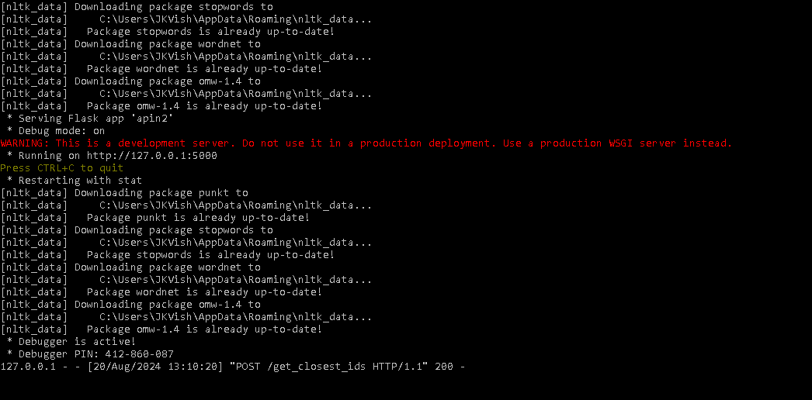
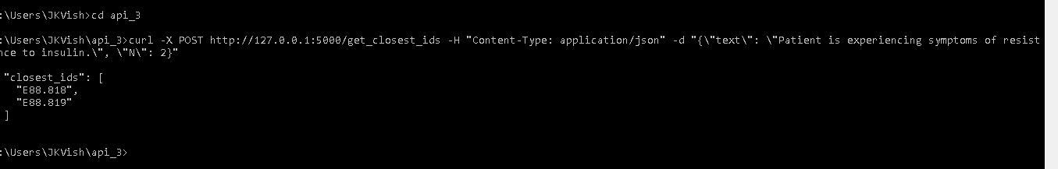
Proof of concept Demonstration
User enters input text and N number of closes ICD Codes for the given text.
NLP Model analyzes and maps the closes ICD codes based on input Text and N.
Flask API returns relevant ICD Codes.

Slide 7
Recommendations
Pilot Testing: Implement the solution in select healthcare facilities.
Collaboration: Work with healthcare providers to refine the model.
Continuous Improvement: Update the model regularly with new data and ICD codes.
Integration: Consider full-scale integration after successful pilot testing.

Slide 8
Conclusion
Automated ICD Coding offers accurate and much faster coding.
Next steps for this would include further testing, refining model and scaling solution.
This approach can enhance healthcare content management, automate manual processes and reduce errors in healthcare billing.

Slide 9
References
Dataset was created referring the below mentioned website: https://www.icd10data.com/ICD10CM/Codes/Changes/New_Codes/1?year=2024

Slide 10

Thank you

