Slide 1
IdVg Characterization Update
3/29/2023

Slide 2
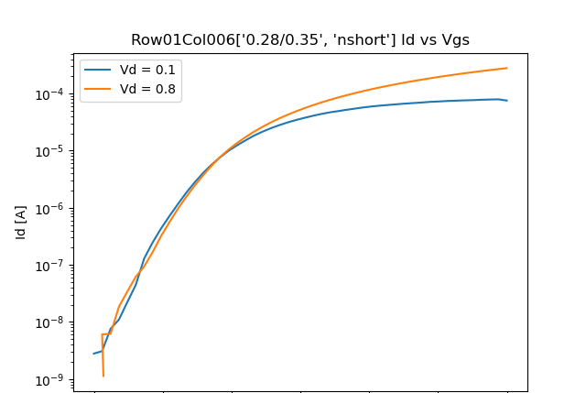
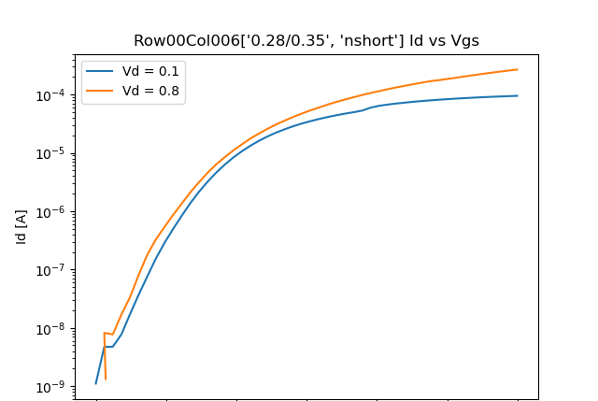
Id vs Vg column 6
Type | Vd | Vg | Id | W/L | Temp(K) | Die X | Die Y | Vth | Gm
nshort | 0.099576 | 0.023348 | 1.42E-08 | 0.28/0.1 | 295 | 6p | 3 | 0.261541 | 3.10E-07
nshort | 0.799432 | 0.023246 | 4.80E-08 | 0.28/0.1 | 295 | 6p | 3 | 0.140138 | -0.01984

Slide 3
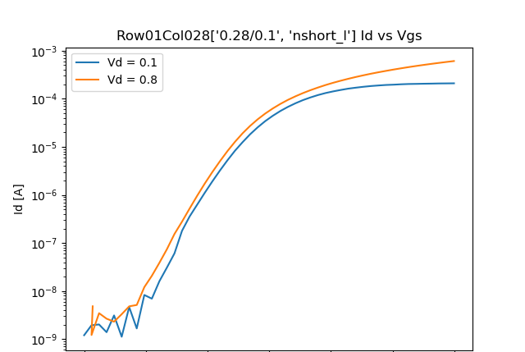
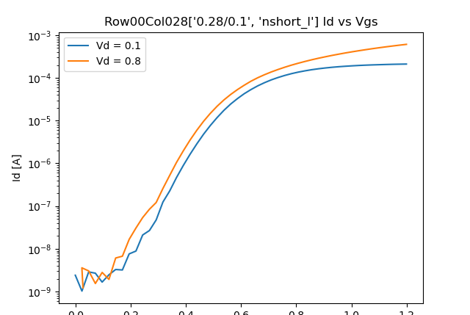
Id vs Vg column 28
Type | Vd | Vg | Id | W/L | Temp(K) | Die X | Die Y | Vth | Gm
nshort_l | 0.099518 | 0.02352 | 1.93E-09 | 0.28/8 | 295 | 6p | 3 | 0.532326 | -8.89E-09
nshort_l | 0.799649 | 0.023751 | 9.91E-10 | 0.28/8 | 295 | 6p | 3 | 0.019325 | 0.007111

