Slide 1
RTS Update
4/26/2023

Slide 2
RTS Data Collection Progress
Bank | Type | W/L | Column | Bias Condition | Samples | Bias Condition | Samples | Bias Condition | Samples | Bias Condition | Samples
1 | nshort | 0.28/0.1 | 0,1 | 10 uA | 96 | 1uA | 96 | 100 nA | 0 | 10 nA | 0
2 | nshort | 0.28/0.1 | 32,33 | 10 uA | 68 | 1uA | 24 | 100 nA | 34 | 10 nA | 80
2 | nshort | 0.28/8 | 34,35 | 10 uA | 68 | 1uA | 24 | 100 nA | 34 | 10 nA
2 | nshort | 1.5/0.1 | 36,37 | 10 uA | 67 | 1uA | 24 | 100 nA | 34 | 10 nA
2 | nshort | 1.5/0.35 | 38,39 | 10 uA | 66 | 1uA | 24 | 100 nA | 34 | 10 nA
2 | nshort | 1.5/1.6 | 40,41 | 10 uA | 66 | 1uA | 24 | 100 nA | 34 | 10 nA
2 | nshort | 1.5/8 | 42,43 | 10 uA | 66 | 1uA | 24 | 100 nA | 34 | 10 nA
2 | nshort | 8/0.1 | 44,45 | 10 uA | 66 | 1uA | 24 | 100 nA | 34 | 10 nA
2 | nshort | 8/8 | 46,47 | 10 uA | 66 | 1uA | 24 | 100 nA | 34 | 10 nA
2 | nshort_l | 0.28/0.1 | 48,49 | 10 uA | 66 | 1uA | 24 | 100 nA | 34 | 10 nA
2 | nshort_l | 0.28/8 | 50,51 | 10 uA | 66 | 1uA | 24 | 100 nA | 34 | 10 nA
2 | nshort_l | 1.5/0.1 | 52,53 | 10 uA | 66 | 1uA | 24 | 100 nA | 34 | 10 nA
2 | nshort_l | 1.5/0.35 | 54,55 | 10 uA | 66 | 1uA | 24 | 100 nA | 34 | 10 nA
2 | nshort_l | 1.5/1.6 | 56,57 | 10 uA | 66 | 1uA | 24 | 100 nA | 34 | 10 nA
2 | nshort_l | 1.5/8 | 58,59 | 10 uA | 66 | 1uA | 24 | 100 nA | 34 | 10 nA
2 | nshort_l | 8/0.1 | 60,61 | 10 uA | 66 | 1uA | 24 | 100 nA | 34 | 10 nA
2 | nshort_l | 8/8 | 62,63 | 10 uA | 66 | 1uA | 24 | 100 nA | 34 | 10 nA

Slide 3
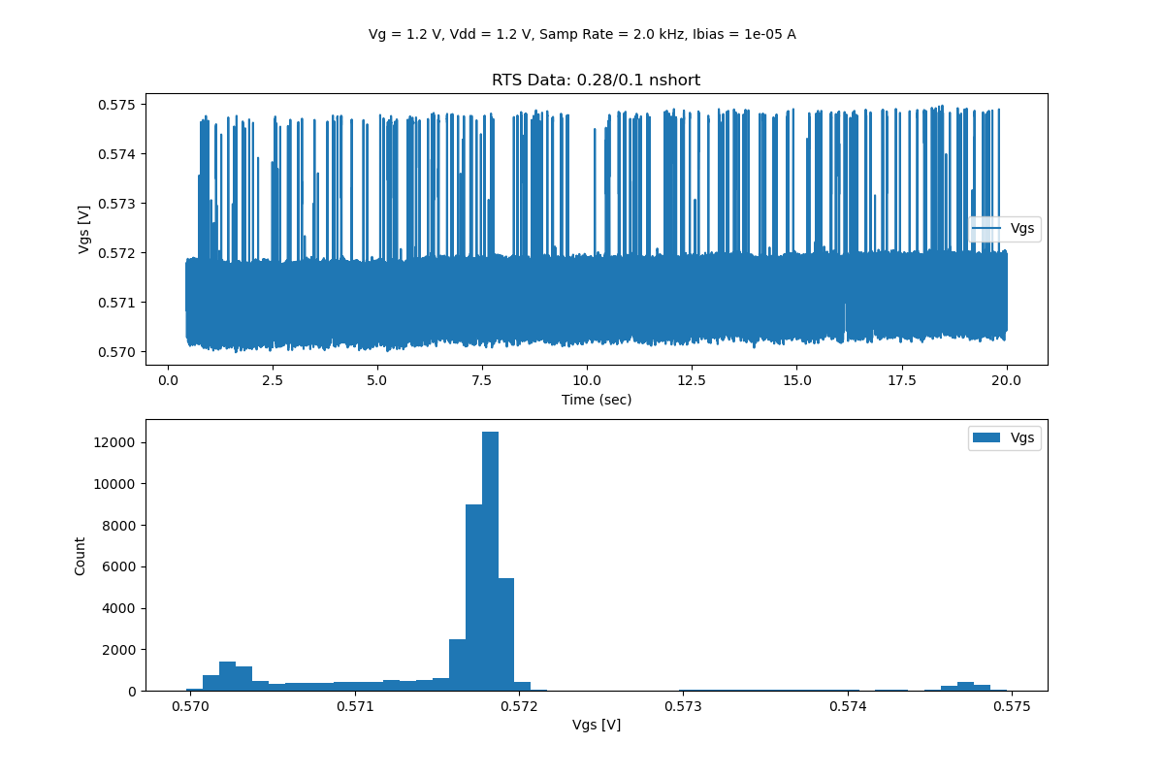
10 uA Bias Condition

Slide 4
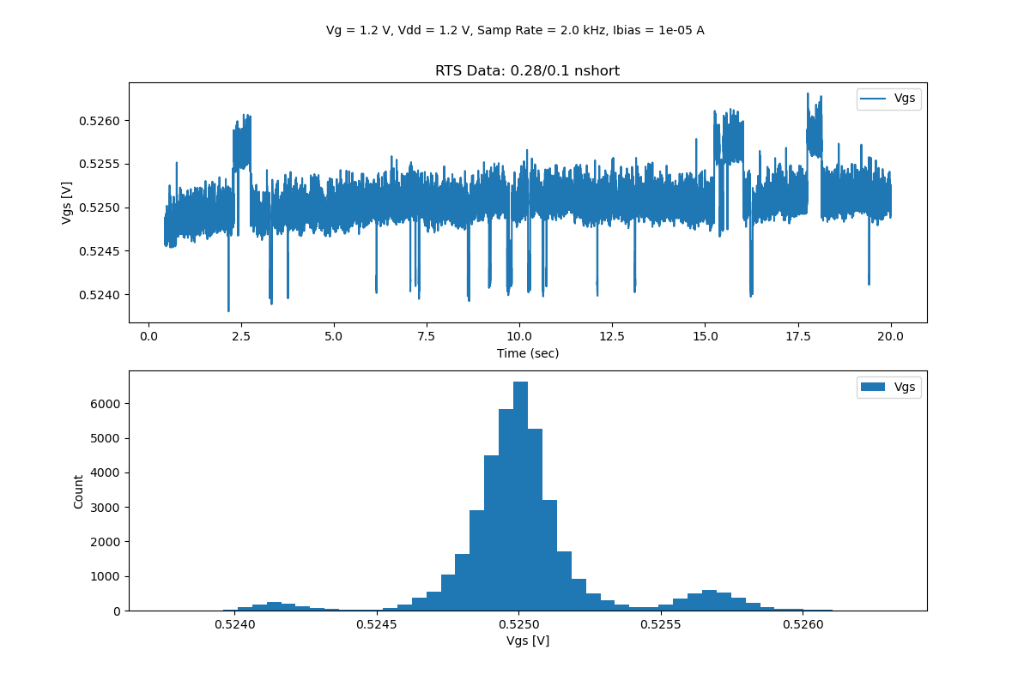
10 uA Bias Condition

Slide 5
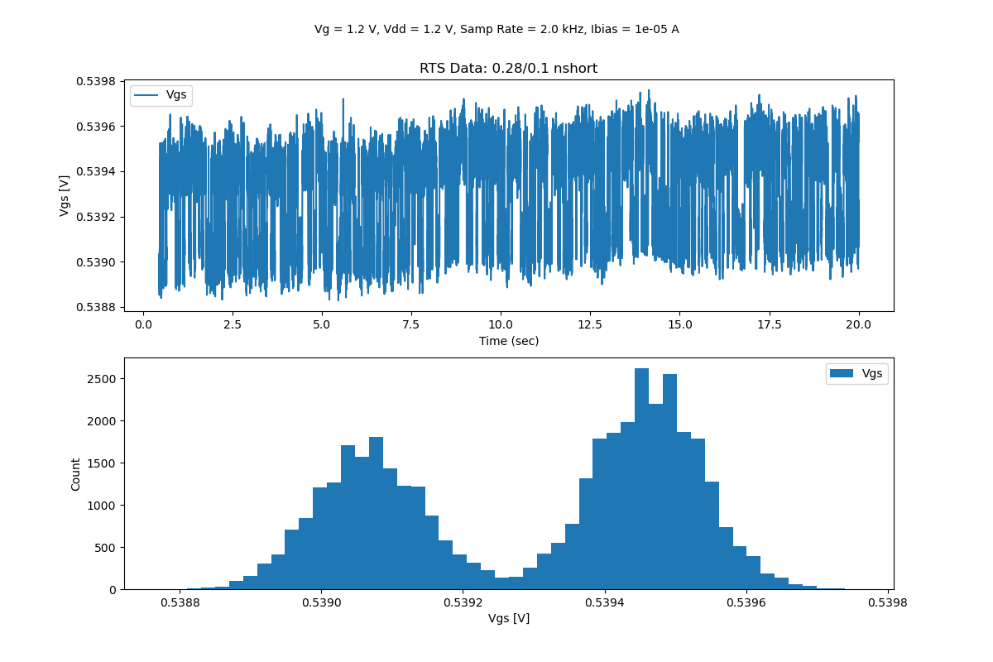
10 uA Bias Condition

Slide 6
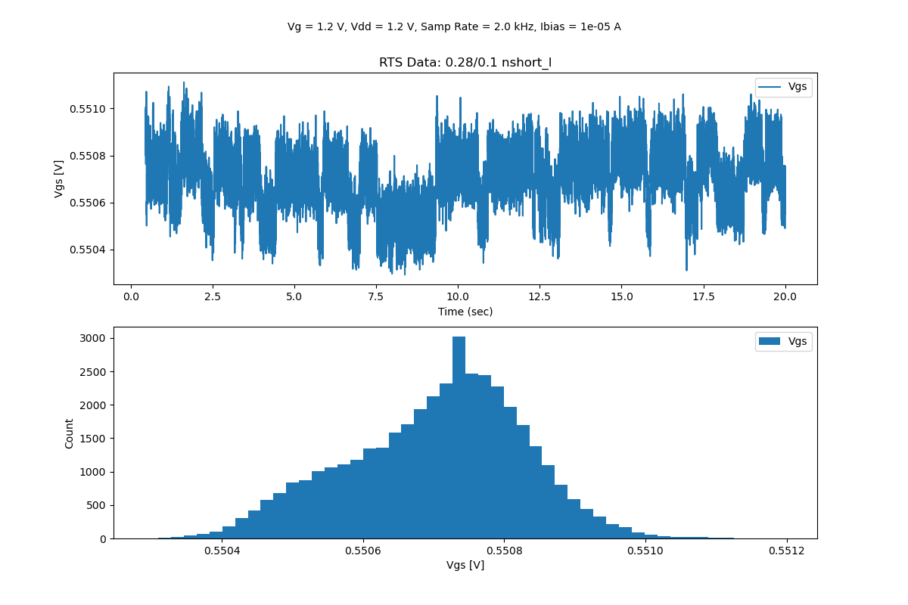
10 uA Bias Condition

Slide 7
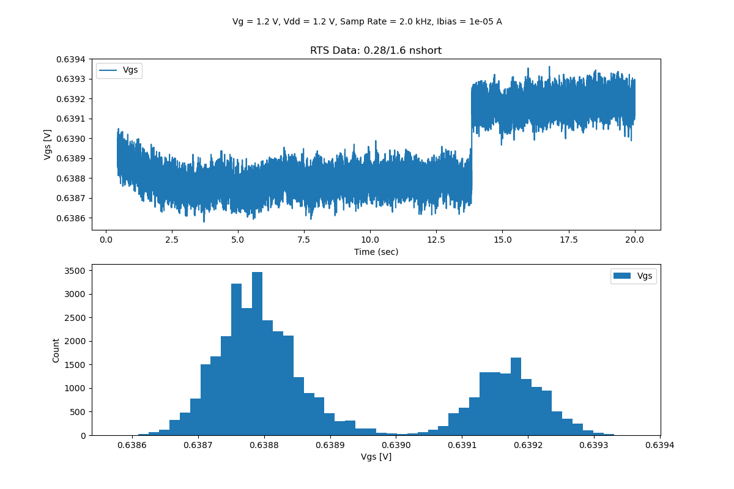
10 uA Bias Condition

Slide 8
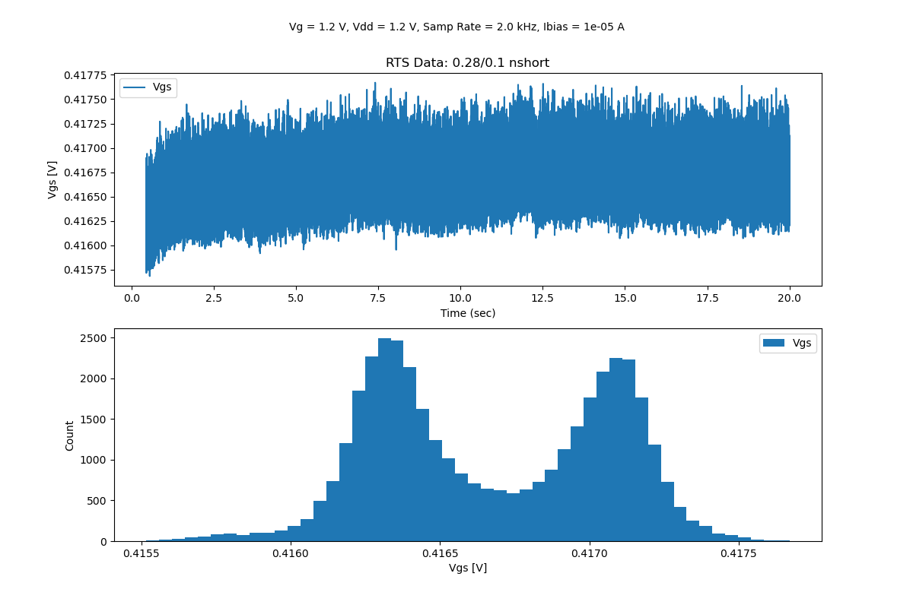
10 uA Bias Condition

Slide 9
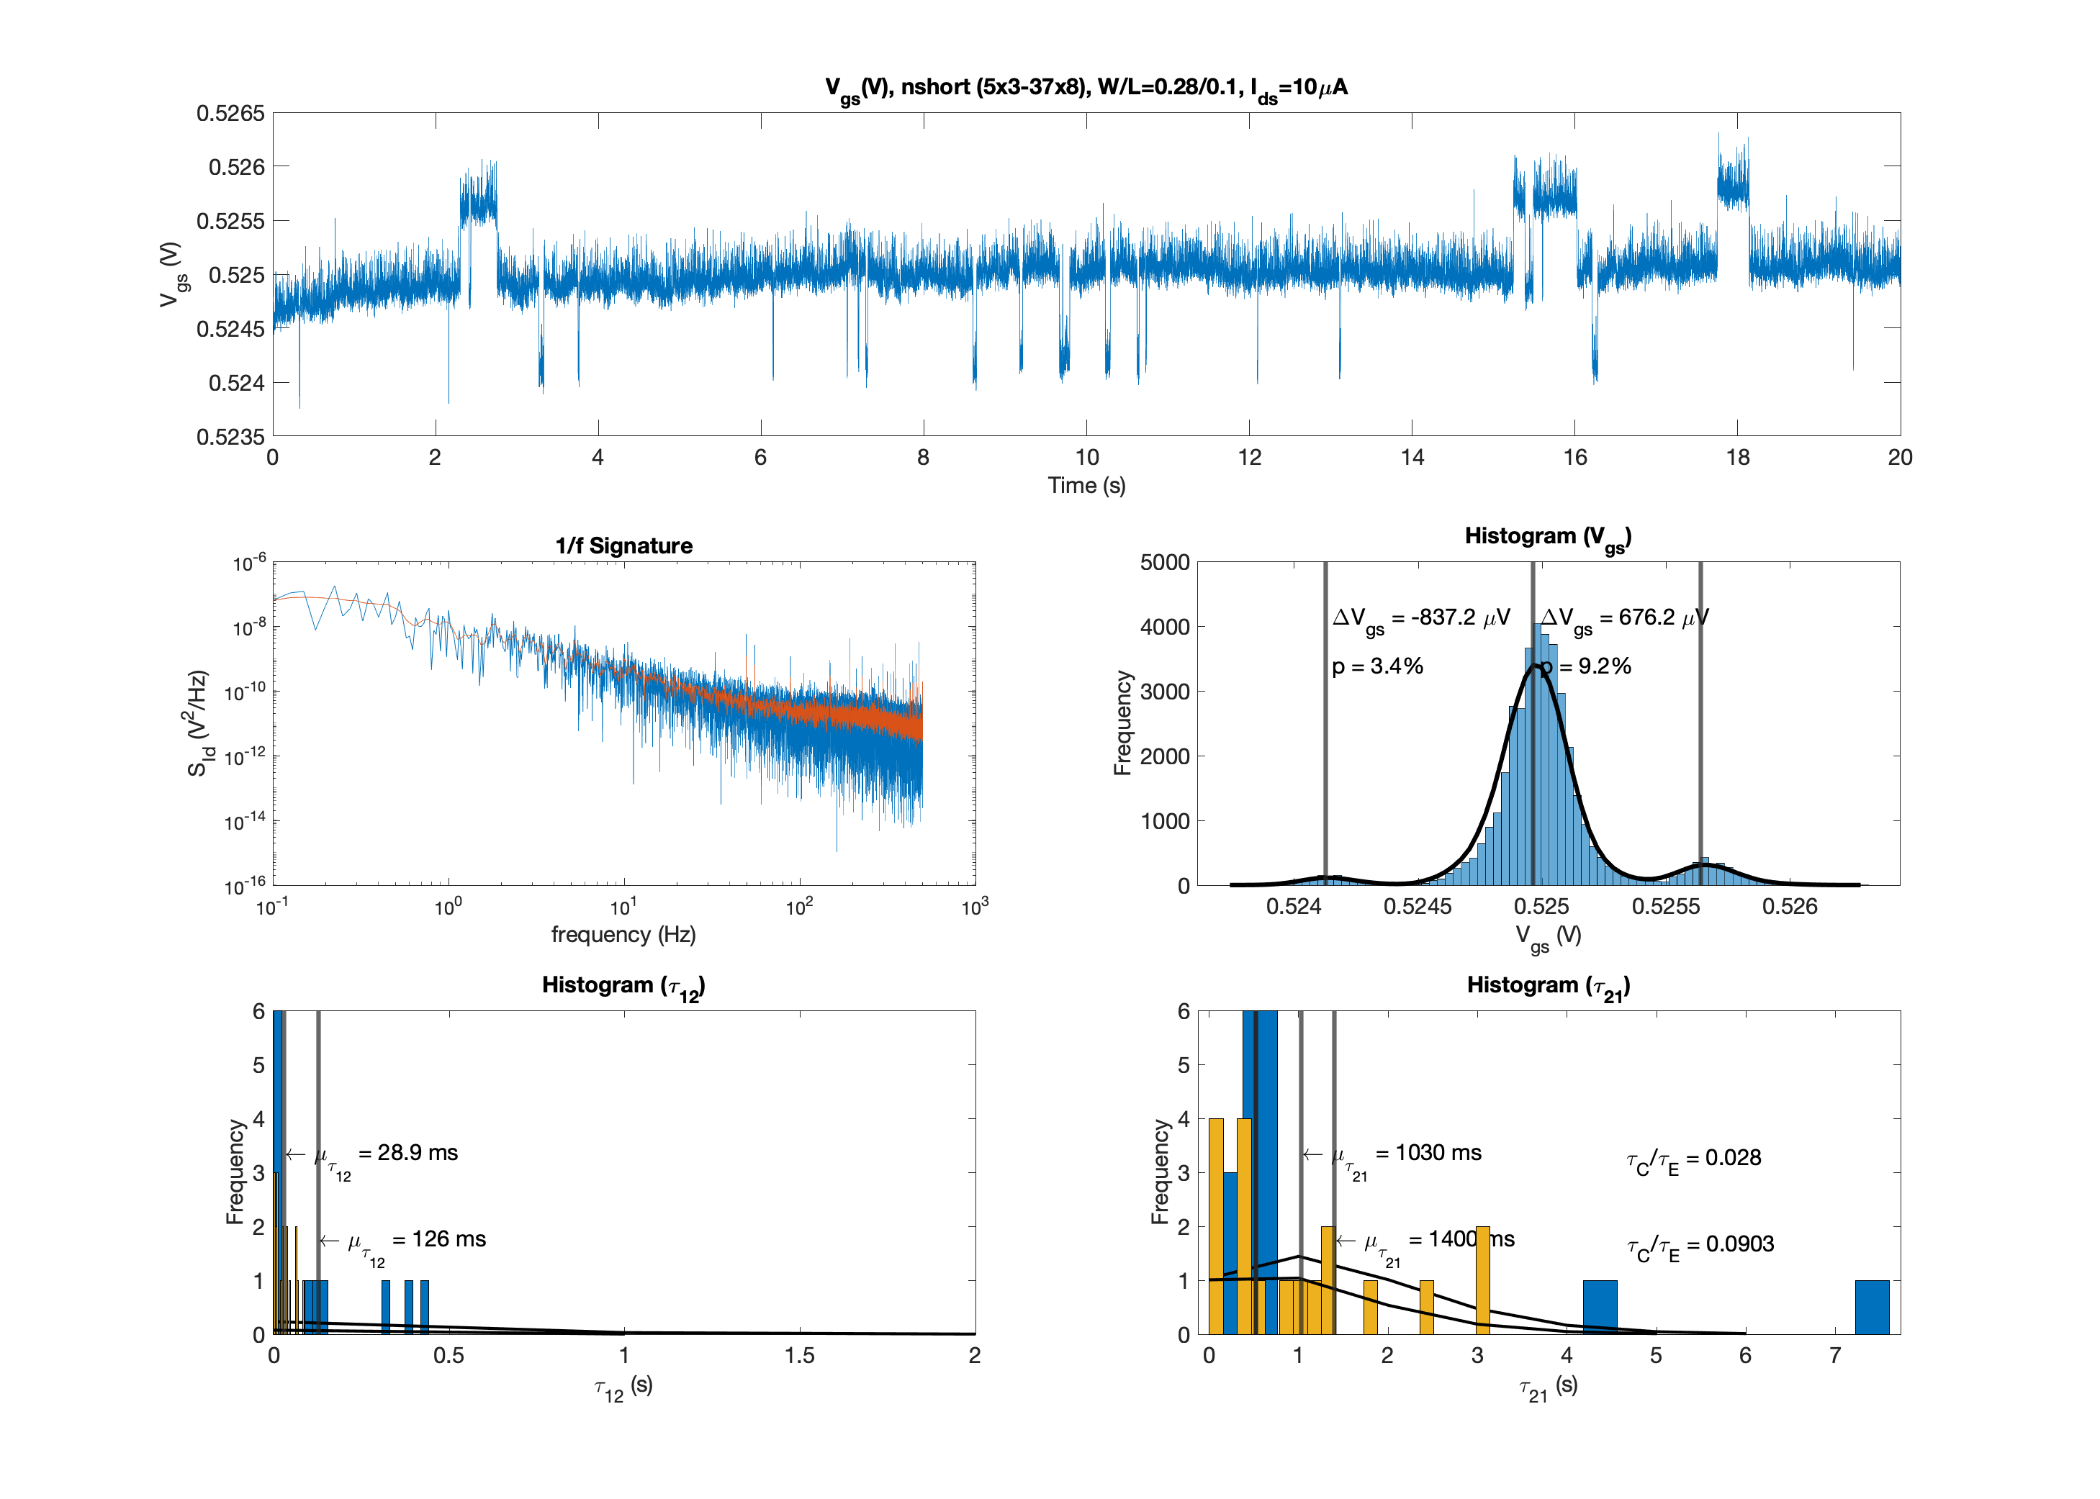
10 uA Bias Condition

Slide 10
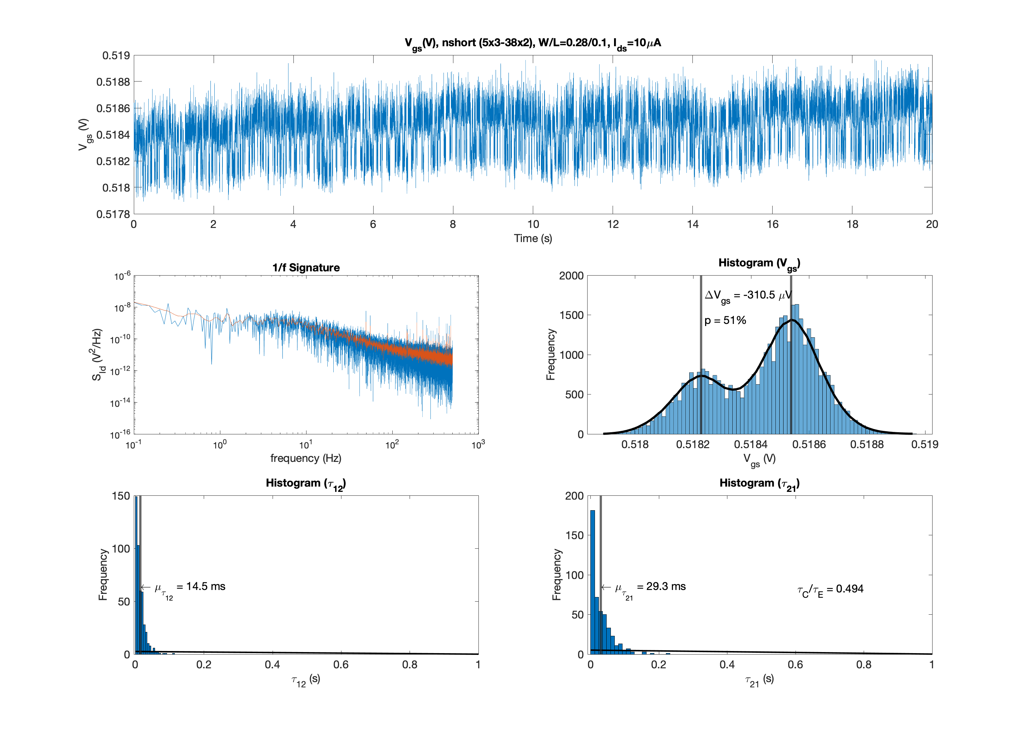
10 uA Bias Condition

Slide 11
10 uA Bias Condition

Slide 12
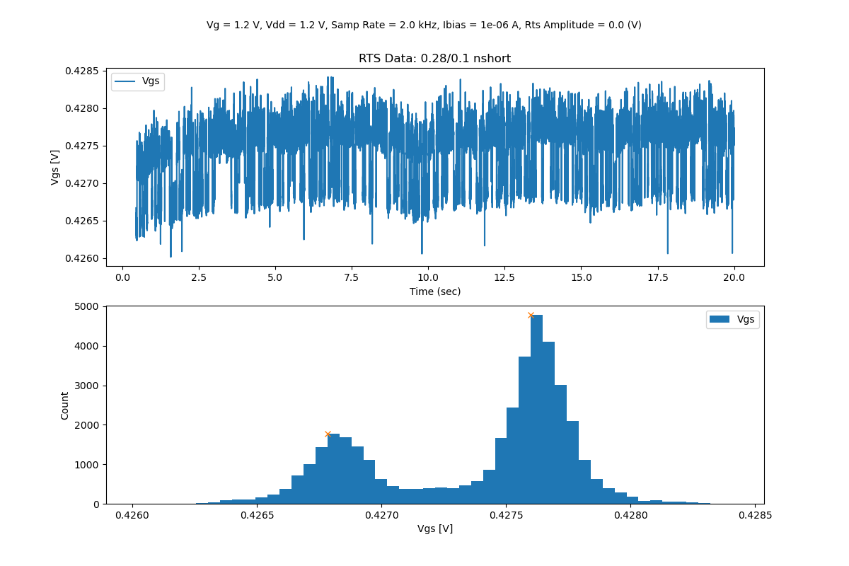
1 uA
Bias Condition

Slide 13
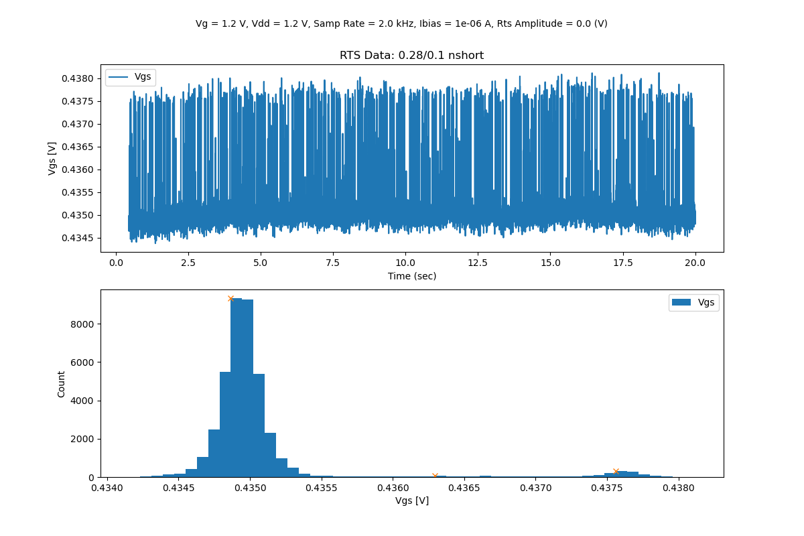
1 uA
Bias Condition

Slide 14
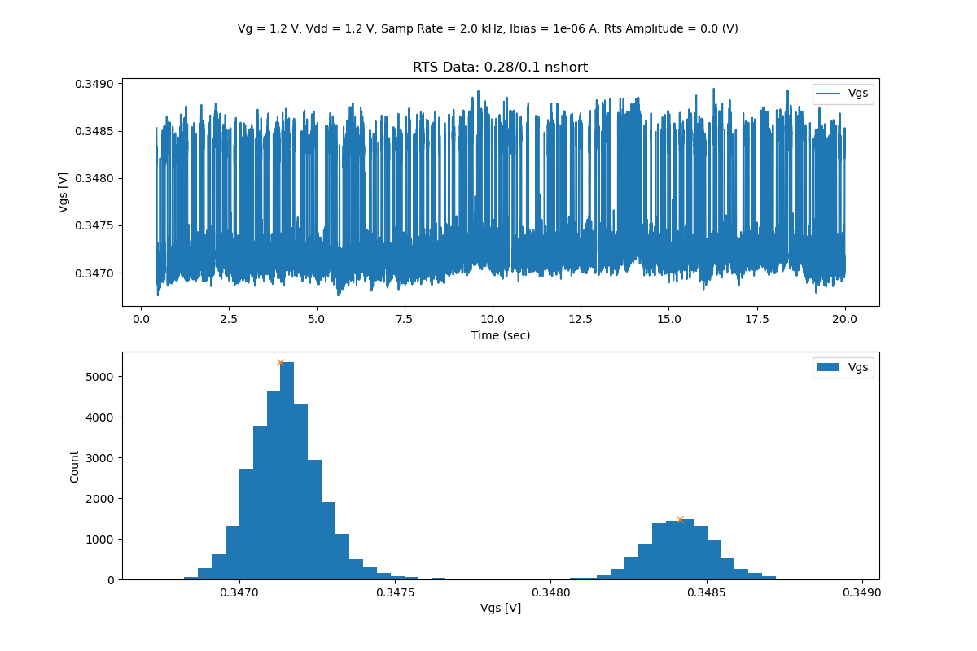
1 uA
Bias Condition

Slide 15
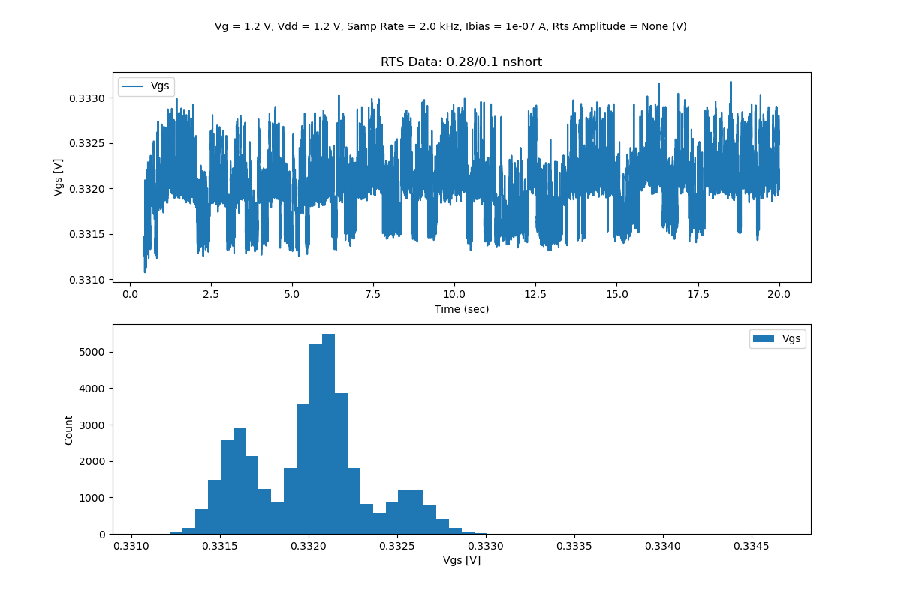
100 nA Bias Condition

Slide 16
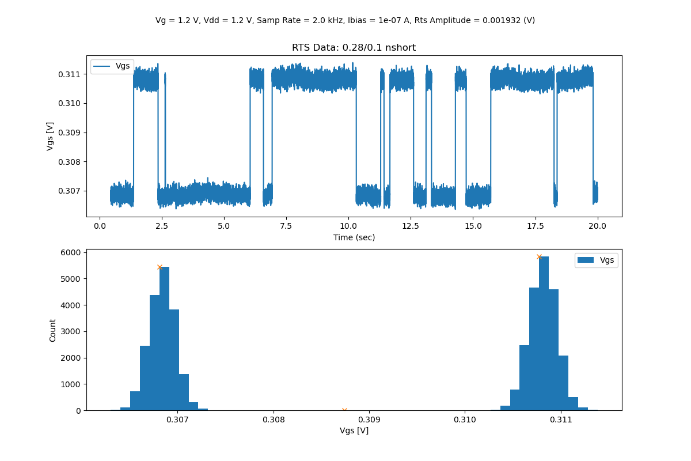
100 nA Bias Condition

Slide 17
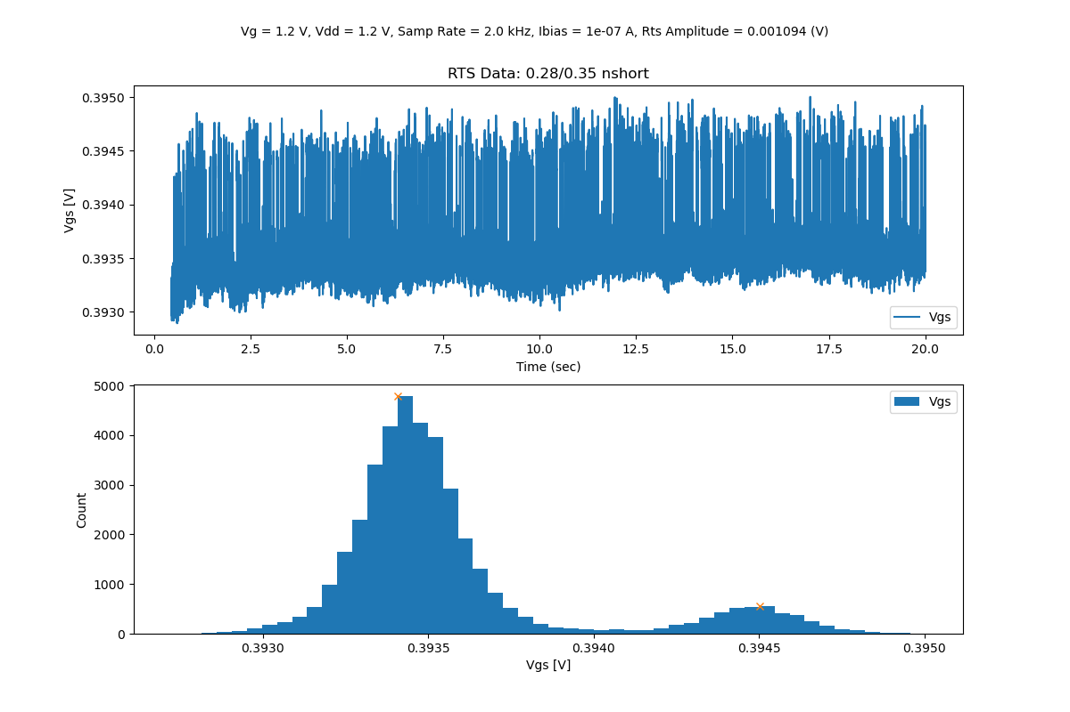
100 nA Bias Condition

Slide 18
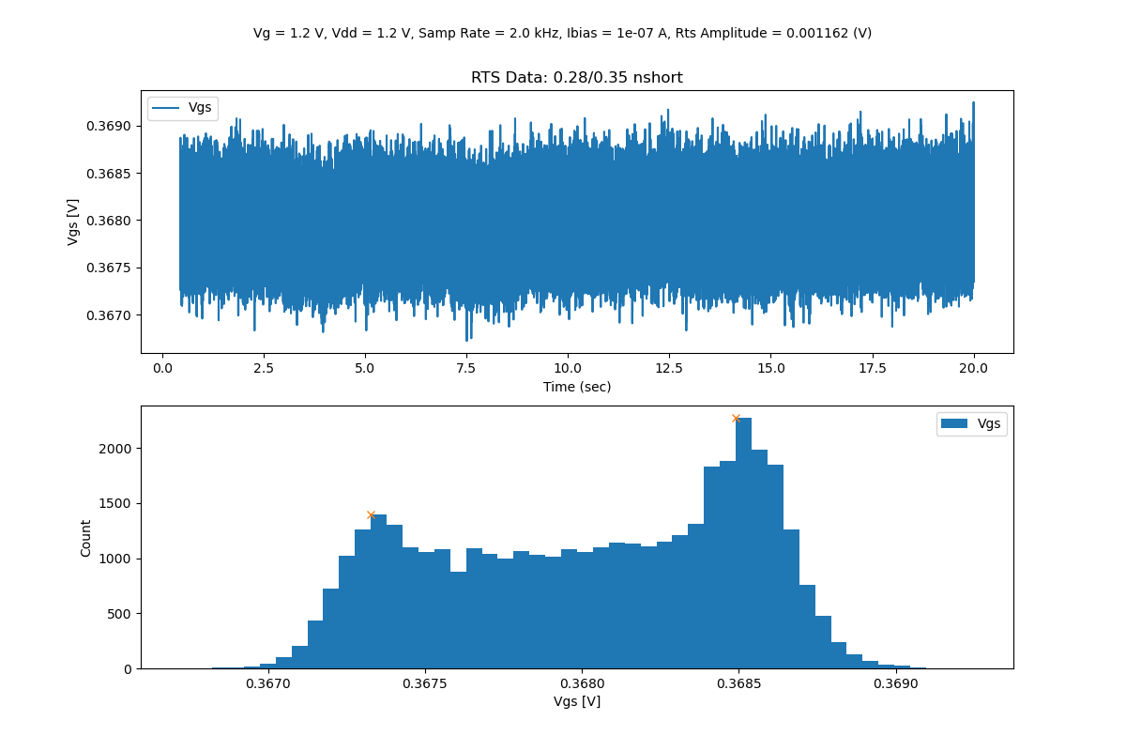
100 nA Bias Condition

Slide 19
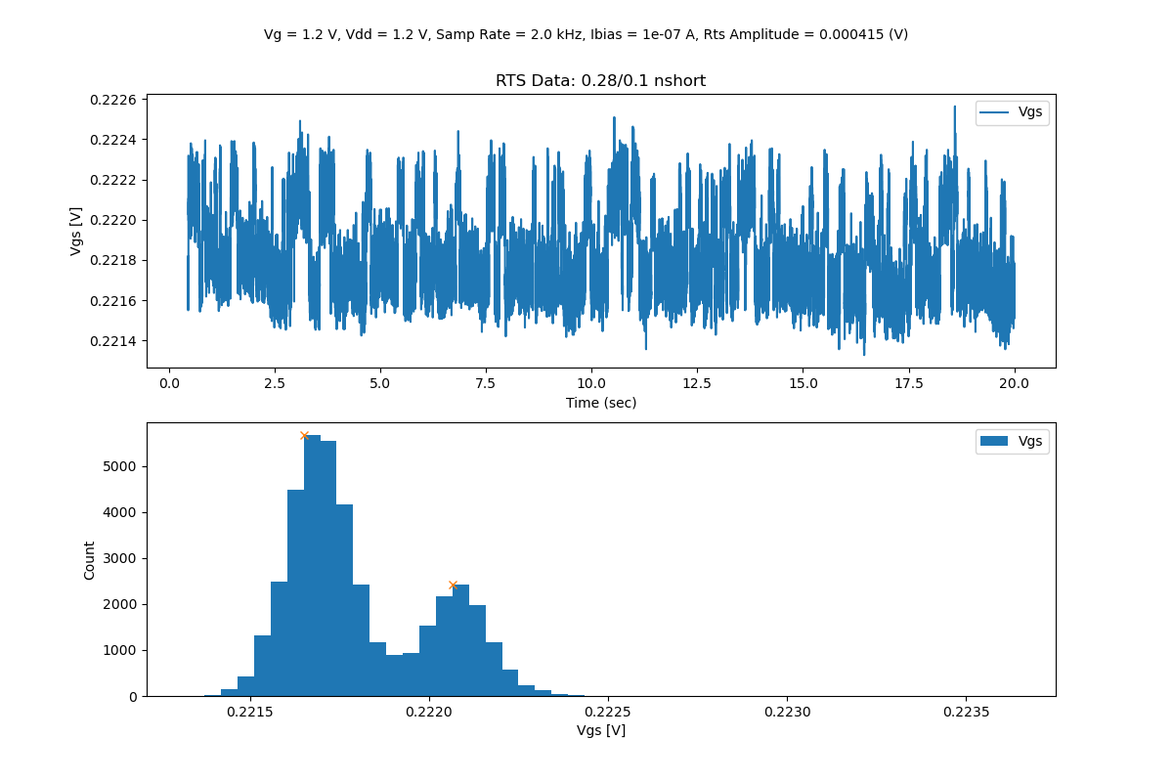
100 nA Bias Condition

Slide 20
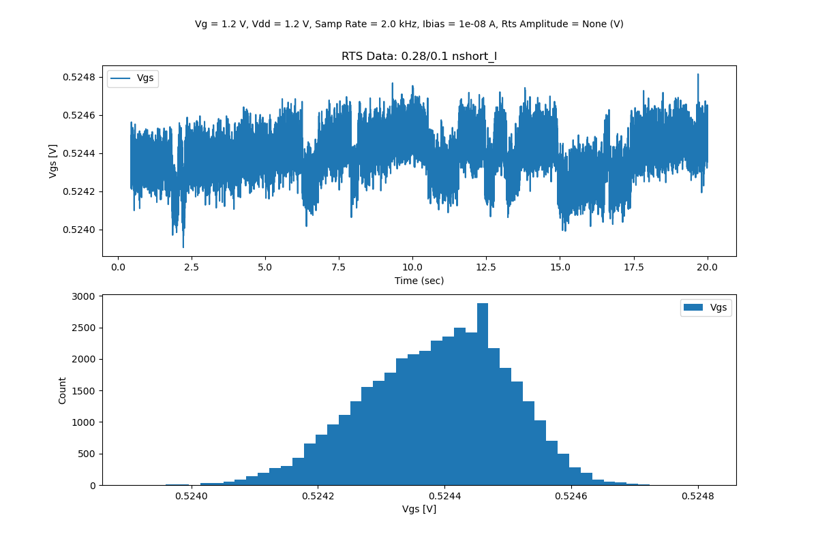
10 nA Bias Condition

Slide 21
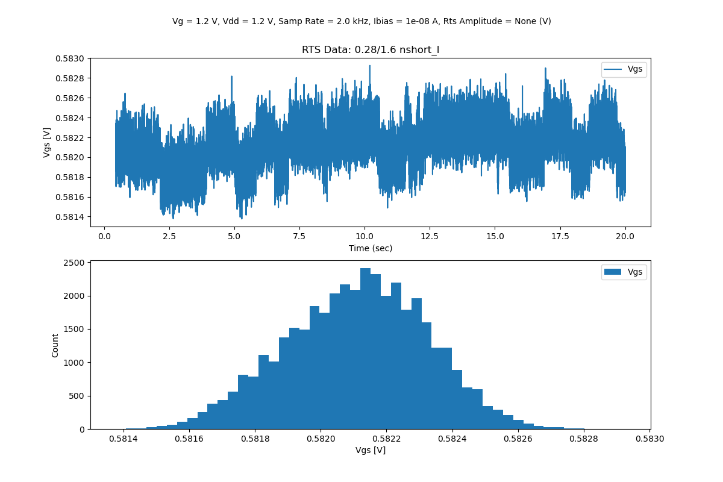
10 nA Bias Condition

Slide 22
10 nA Bias Condition

