Slide 1
How would you shoot against Team X?
Brooklyn Neural Nets

Slide 2
We thought about Prompt 1, but…
“Importantly, it is nearly impossible to assess defensive ability without understanding defensive intent... Future work on quantifying defensive ability ought to incorporate defensive schemes and intent into measurements of both the team and individual players” – Franks et al, 2015

Slide 3
Prompt 3
Suppose you are against Team X; if you were to shoot at spot Y, how likely are you to make it from that spot?
And which players, in the same circumstances, thrive in that spot vs which players do not?

Slide 4
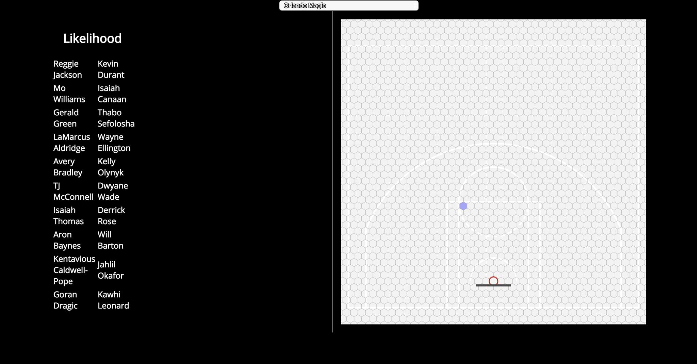
Prototype

