Slide 1

Offline A/B Testing For Recommender Systems

Slide 2
1. Background and Problem Definition

Slide 3


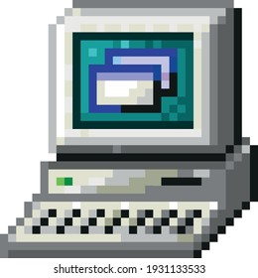

1.1. User Story
Popularity-based
Recommendation System
A streaming company currently uses a popularity-based recommendation system
that suggests the same popular movies to all users.

Slide 4


1.1. User Story
User1
personalized ML-based recommender
User2
a new personalized ML-based recommender
using collaborative filtering that could improve user engagement.

Slide 5



1.2. Problem Definition
Revenue Loss
User Churn
System Rollback
Deploying the new system directly to production poses significant risks

Slide 6

1.2. Problem Definition
Model A Recommends
Model B Recommends
User rates
The team needs to validate the new system's performance before production deployment through offline A/B testing using historical data.

Slide 7
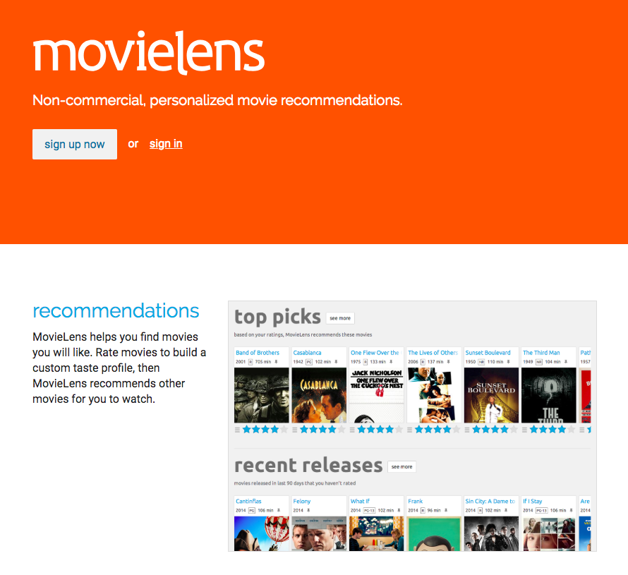

1.3. Dataset
MovieLens 32M (2023)
MovieLens dataset from GroupLens: 32M user ratings, large-scale movie rating data.

Slide 8
2. Data Wrangling

Slide 9
2.1. Data loading
MovieLens 32M (2023)
239 MB
sampled_movie_data
139 MB
Sampled 20,000 users from the original 200,948 users, resulting in 3.2 million ratings.

Slide 10
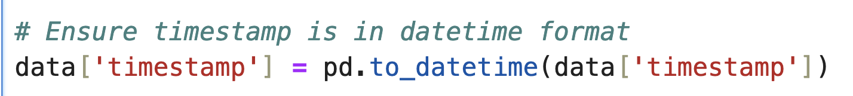
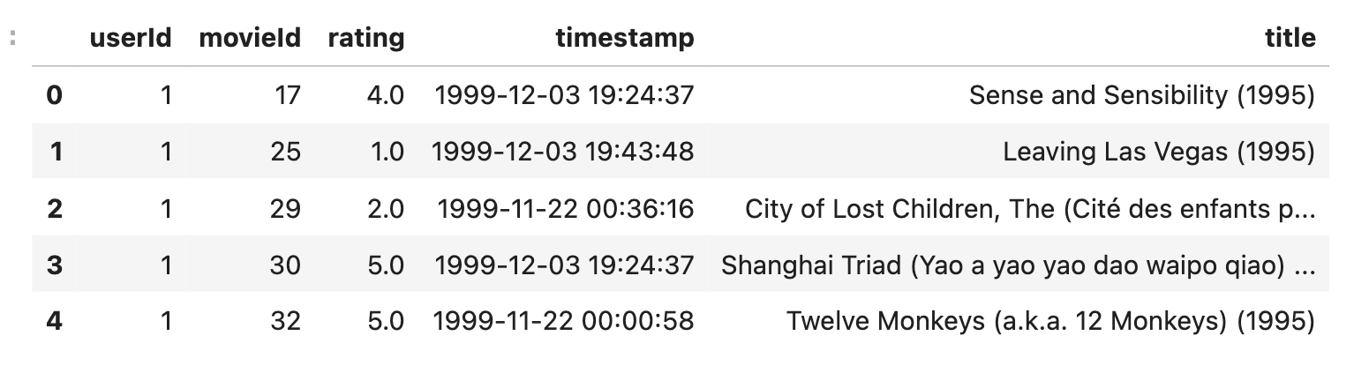
2.1. Data loading
sampled_movie_data.csv
139 MB
Historical user interactions used to simulate Model A (logging policy)
and evaluate Model B (new policy) offline.

Slide 11
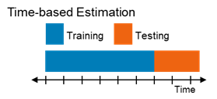
2.2. Train/Test Split
To prevent data leakage: Training on future data to predict the past is invalid.

Slide 12
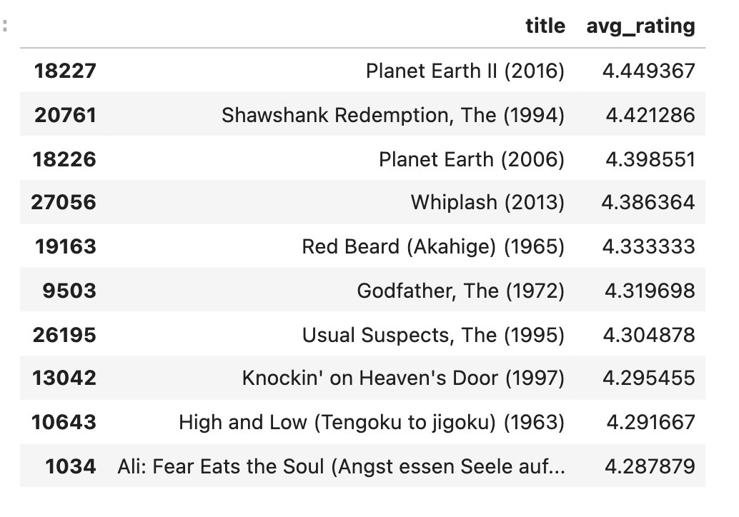
2.3. Model A: Popularity-Based
Popularity-based
Recommendation System
Model A: Top Recommended Movies
Model A recommends highly-rated popular movies consistently to all users
Non-personalized baseline that ignores individual user preferences.

Slide 13
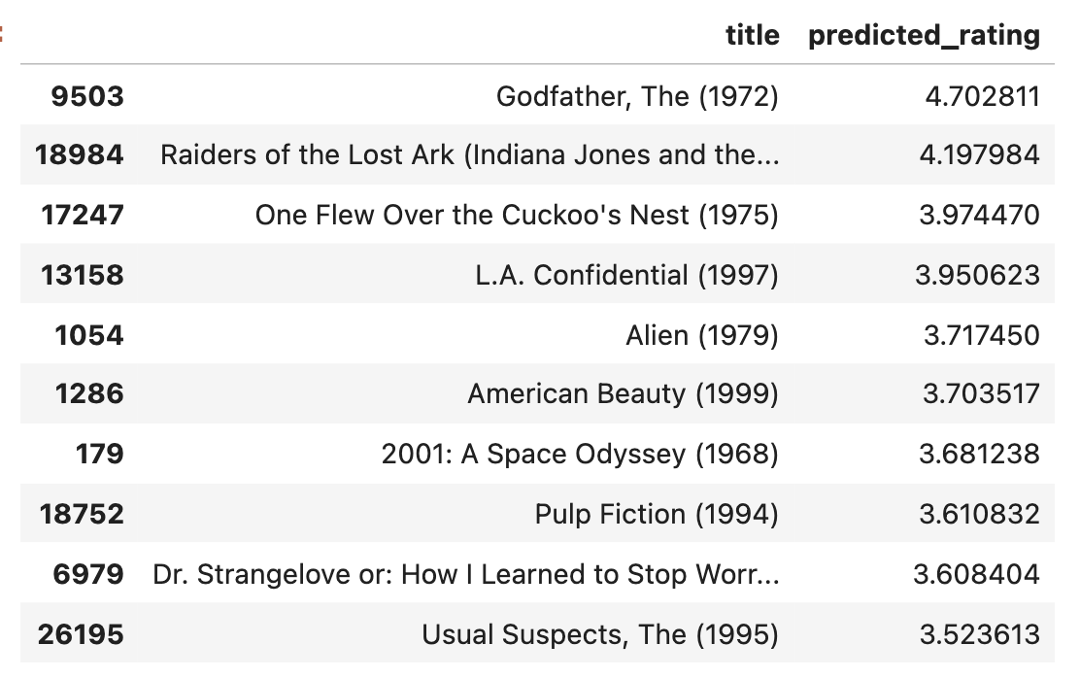
2.4. Model B: SVD-Based
personalized ML-based recommender
Model B: Personalized Recommendations
Model B uses SVD to predict ratings based on
User 1's historical preferences and similar users' behavior

Slide 14
3. EDA

Slide 15
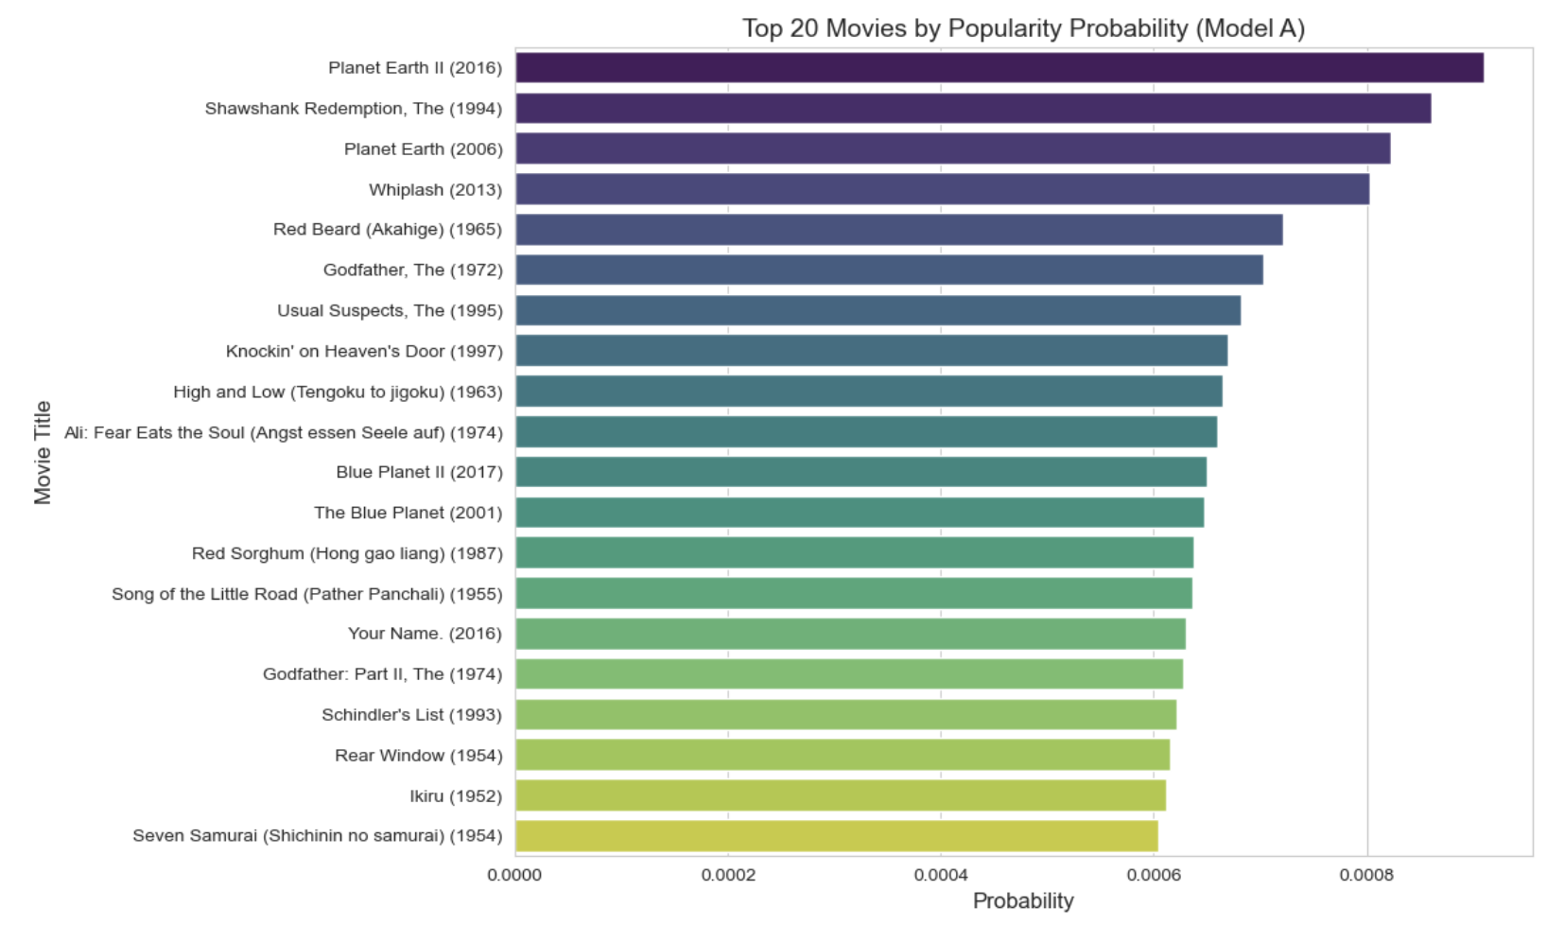
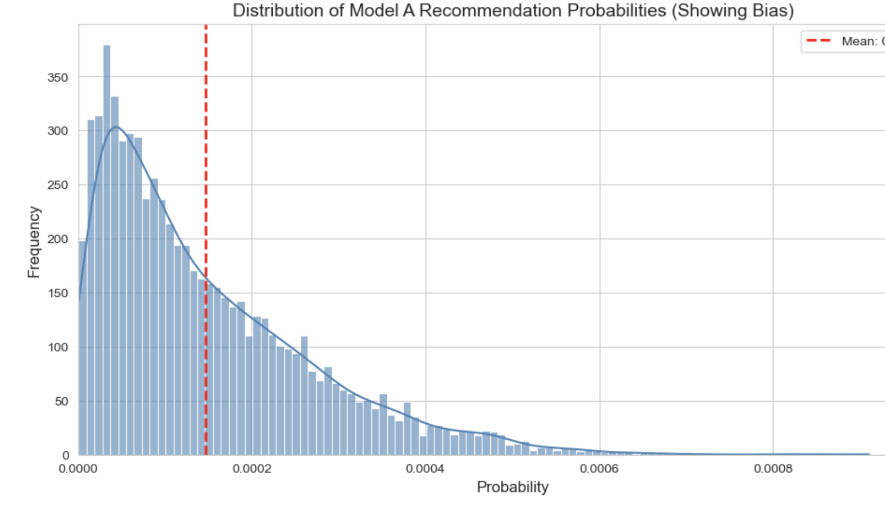
3.1. Probability Distribution - Model A
Model A's recommendations shows extreme bias.
Model A repeatedly recommends the same popular movies

Slide 16
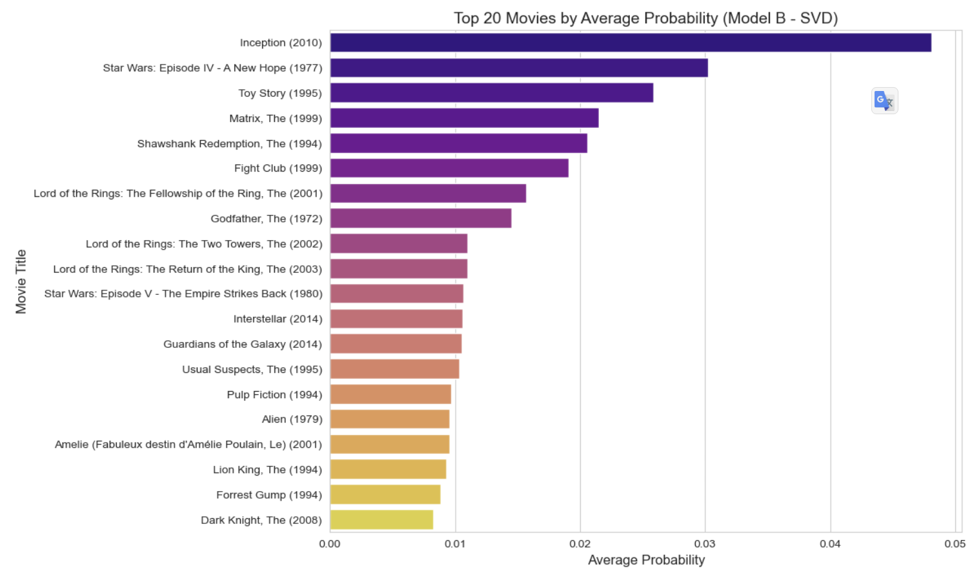
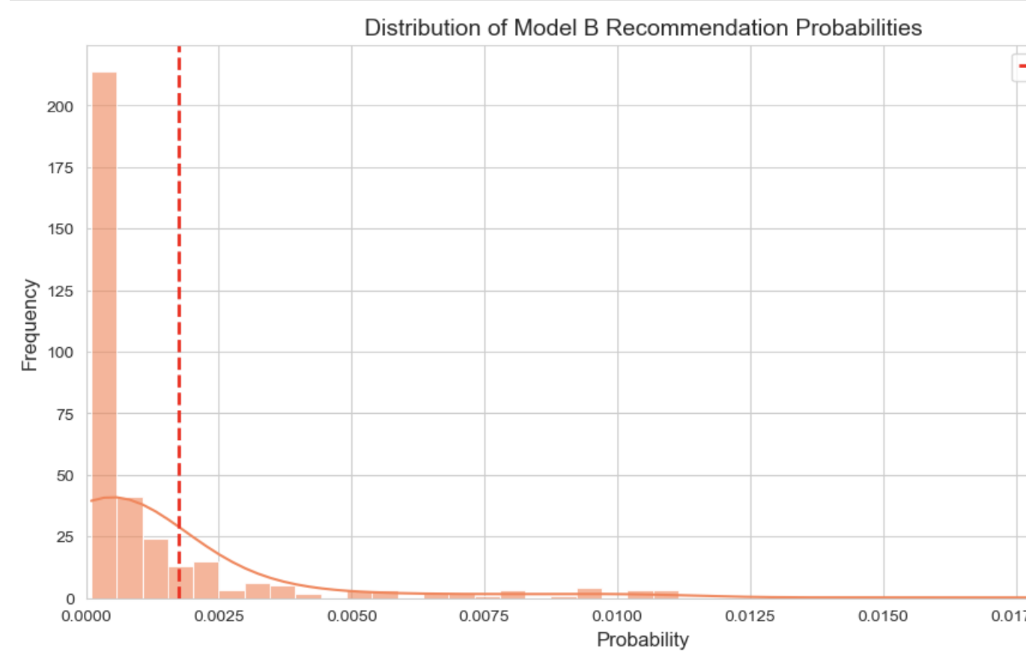
3.1. Probability Distribution - Model B
Model B shows less extreme bias compared to Model A
To obtain unbiased performance estimates, apply Inverse Propensity Scoring (IPS)

Slide 17
4. Offline A/B Testing with
Inverse Propensity Scoring (IPS)

Slide 18
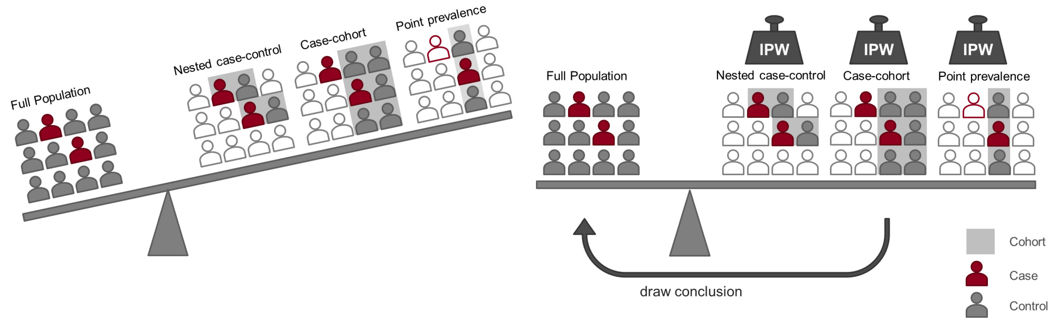
4.1. IPS (=IPW)
Model B evaluation is biased.
because historical data was generated by Model A, so we apply IPS to correct this bias.

Slide 19
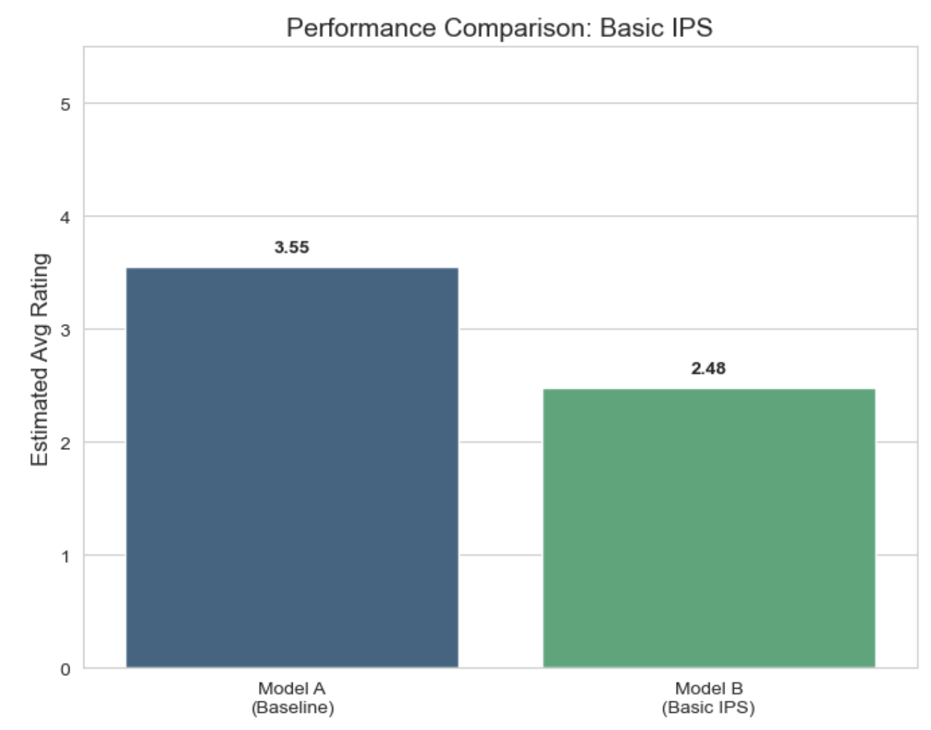
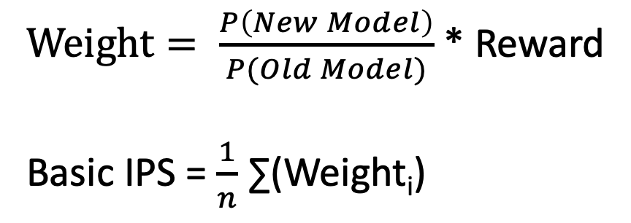
4.2. Basic IPS
$Weight= \frac{P\left(New Model\right)}{P(Old Model)}$ * Reward
Basic IPS = $\frac{1}{n}$ ∑(Weight_{i})
Model B's estimate is significantly lower than Model A
To investigate this unexpected result, we analyze the weight distribution.

Slide 20
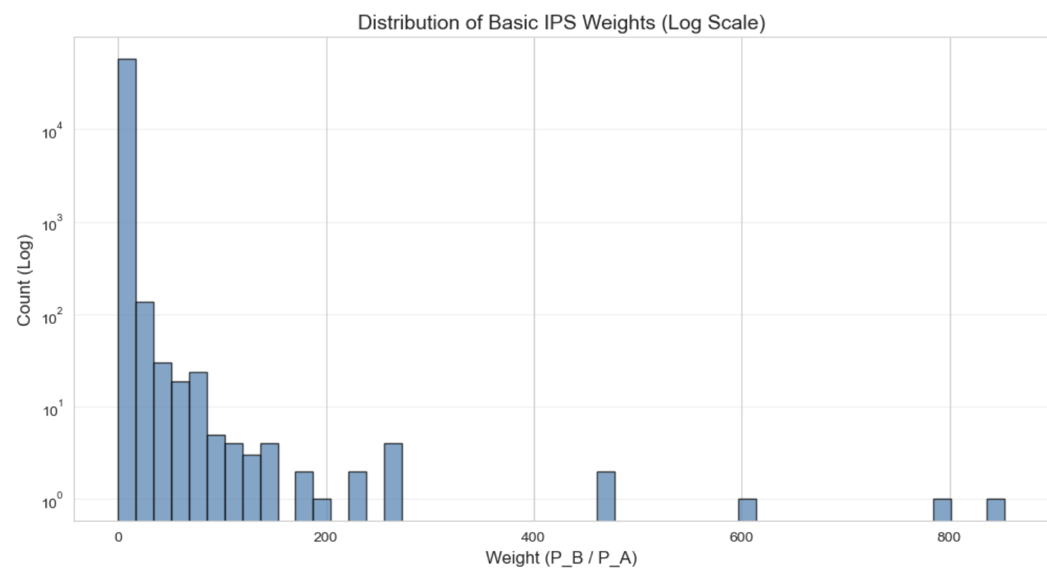
4.2. Basic IPS
Basic IPS suffers from high variance due to these extreme importance weights.
apply Capped IPS to limit extreme weights and reduce variance.

Slide 21
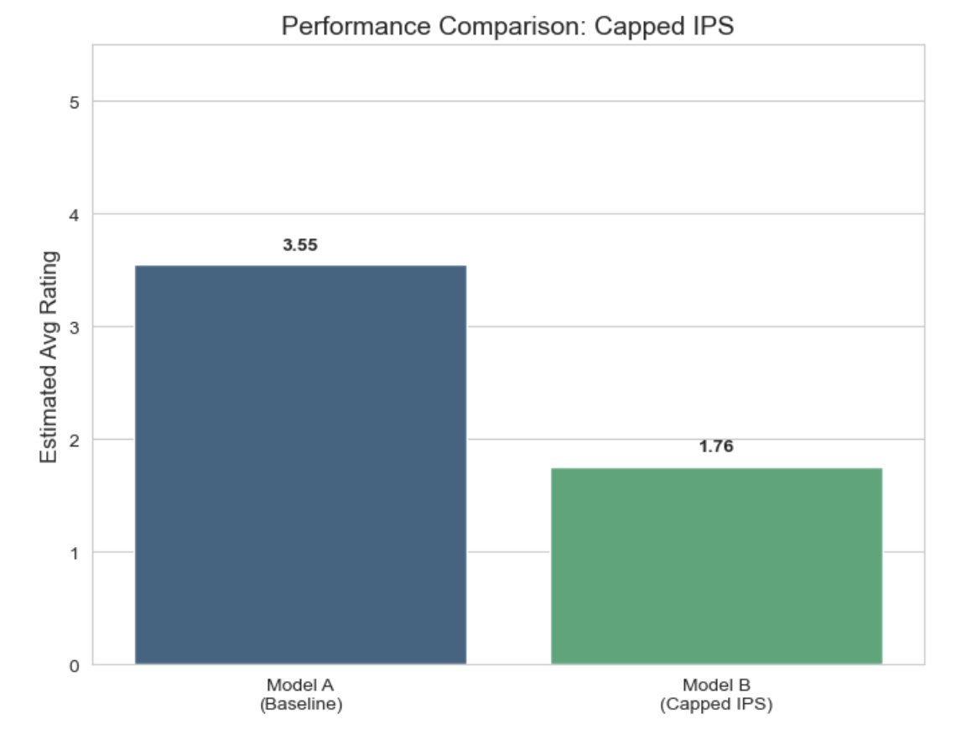
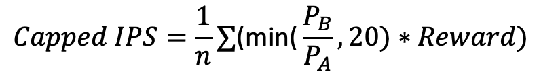
4.3. Capped IPS
$$Capped IPS=\frac{1}{n}∑\text{(}\text{min}\text{(}\frac{P_{B}}{P_{A}}, 20)∗Reward)$$
Model B's estimate is significantly lower than Model A
To investigate this unexpected result, we analyze the weight distribution.

Slide 22
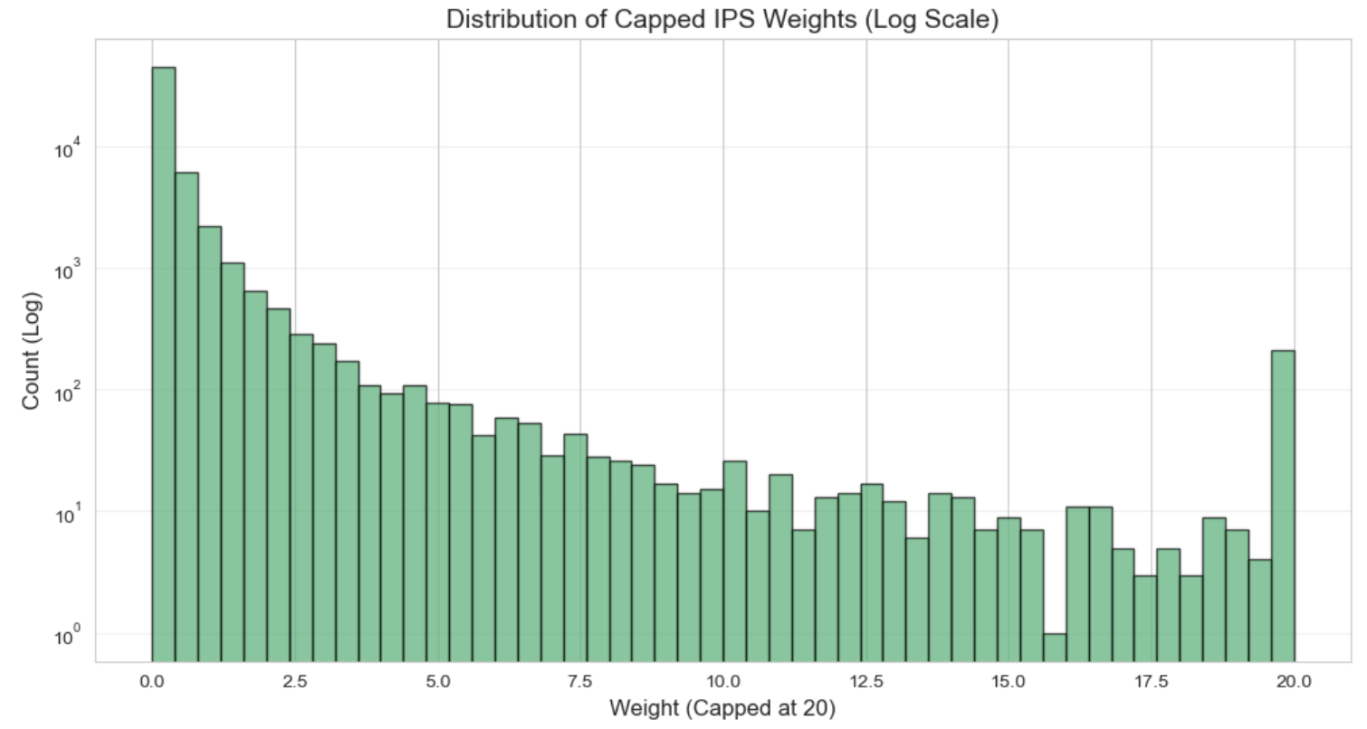
4.3. Capped IPS
he capped weight distribution shows improved variance
Model B's estimate worsened. Apply Normalized IPS

Slide 23
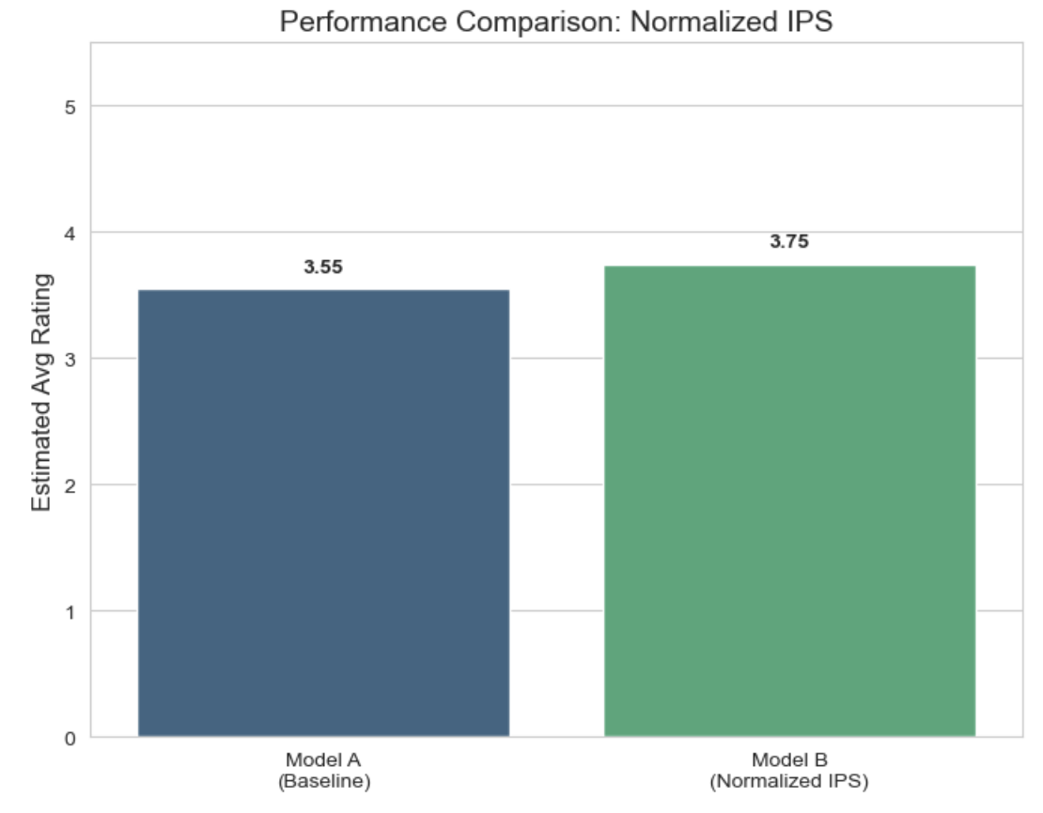
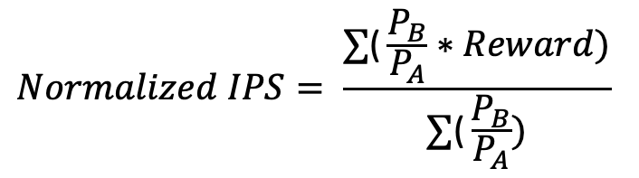
4.4. Normalized IPS
$$Normalized IPS= \frac{∑\text{(}\frac{P_{B}}{P_{A}}∗Reward)}{∑\text{(}\frac{P_{B}}{P_{A}})}$$
Model B outperforms Model A by approximately +0.20 points (+5.6%).

Slide 24
5. Conclusion

Slide 25
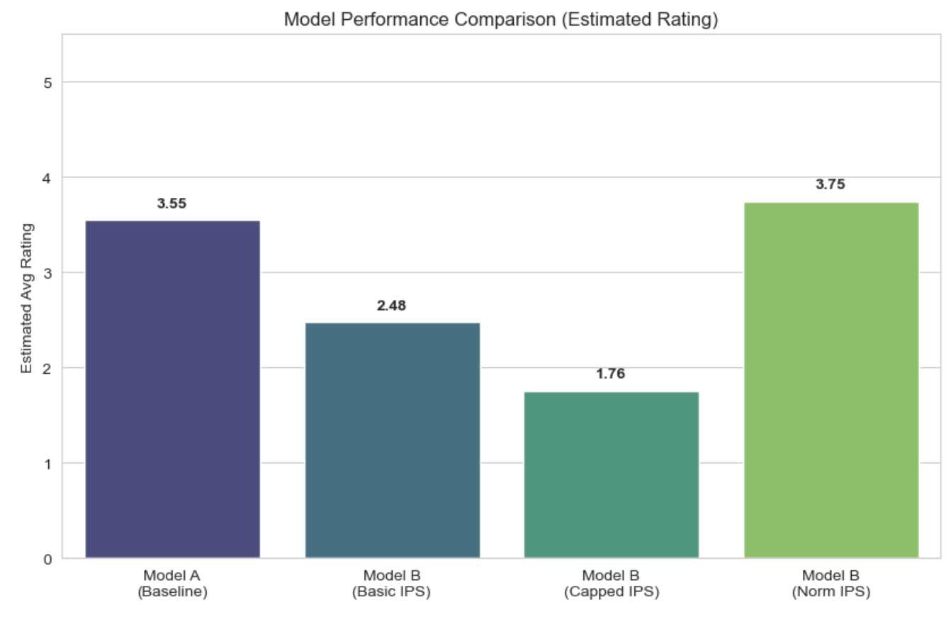
5. Conclusion
Model B demonstrates superior performance over the popularity-based baseline Model A

Slide 26
5. Conclusion
+5.6 %
Baseline
New Model
To enhance user satisfaction, I recommend deploying Model B

Slide 27
References
Gilotte, A., Calauzènes, C., Nedelec, T., Abraham, A., & Dollé, S. (2018).
“Offline A/B testing for Recommender Systems.”
Proceedings of the Eleventh ACM International Conference on Web Search and Data Mining (WSDM '18). https://doi.org/10.1145/3159652.3159687

