Slide 1

Jenkins
Prepared By: Jaya Kumar Rayala
Date: 07-June-2024

Slide 2
Agenda:
01
Build a Java application using Jenkins
04
How to run a selenium bat file using Jenkins
02
05
Build a Selenium TestNG test using Jenkins
Build a Selenium Maven Project using Jenkins
03
06
Selenium + Maven + GitHub with Jenkins Integration
How to run a selenium jar file using Jenkins

Slide 3
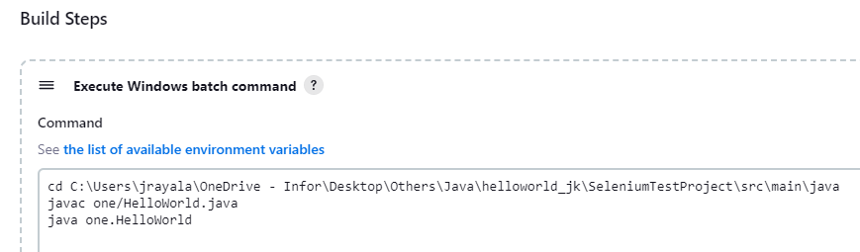
1. Build a Job for Sample Java application using Jenkins.
INFOR
Pre-Requisites:
Install any IDE like -> Download Eclipse from https://www.eclipse.org/downloads/, NetBeans etc..
Install JDK > = v1.8 from https://www.oracle.com/in/java/technologies/downloads/
Set Java Home and Path into the Environment Variables (Right Click on PC -> Properties -> Advanced System Settings -> Advanced tab -> Environment Variables -> User/System Variables)
Launch the Jenkins.war file where it was placed.
Windows Commands to run Java application:
Open command prompt and navigate to the directory which has the java program
Javac filename.java
Java filename
Run Java application using Jenkins:
Create a ‘Free Style Project’
Select Execute Windows batch command from ‘Build Steps’

Slide 4
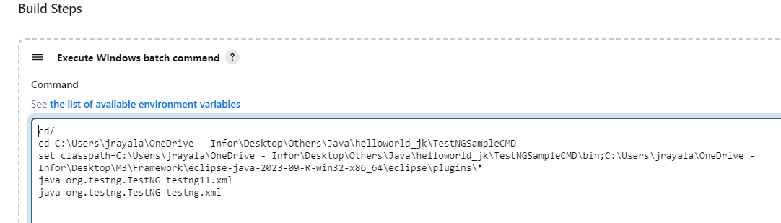
2. Build a Selenium TestNG test using Jenkins
INFOR
Pre-Requisites:
Install any IDE like -> Download Eclipse from https://www.eclipse.org/downloads/, NetBeans etc..
Install JDK > = v1.8 from https://www.oracle.com/in/java/technologies/downloads/
Set Java Home and Path into the Environment Variables (Right Click on PC -> Properties -> Advanced System Settings -> Advanced tab -> Environment Variables -> User/System Variables)
Install TestNG from Help-> Eclipse Marketplace (or) Add TestNG dependency in POM.xml file (or) Help -> Install New Software with this work URL: https://testng.org/testng-eclipse-update-site
Launch the Jenkins.war file where it was placed.
Windows Commands to run TestNG application:
Open command prompt and navigate to the directory which has the TestNG script.
set classpath=C:\Users\jrayala\OneDrive - Infor\Desktop\Others\Java\helloworld_jk\TestNGSampleCMD\bin;C:\Users\jrayala\OneDrive - Infor\Desktop\M3\Framework\eclipse-java-2023-09-R-win32-x86_64\eclipse\plugins\*
java org.testng.TestNG testng.xml
Run Selenium TestNG application using Jenkins:
Create a ‘Free Style Project’
Select “Execute Windows batch command” from ‘Build Steps’.

Slide 5
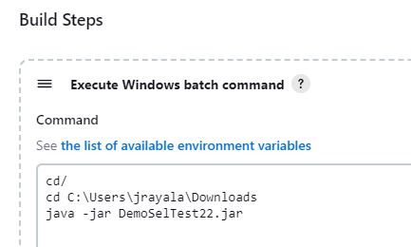
3. How to run a created selenium jar file using Jenkins
INFOR
Pre-Requisites:
Install any IDE like -> Download Eclipse from https://www.eclipse.org/downloads/, NetBeans etc..
Install JDK > = v1.8 from https://www.oracle.com/in/java/technologies/downloads/
Set Java Home and Path into the Environment Variables (Right Click on PC -> Properties -> Advanced System Settings -> Advanced tab -> Environment Variables -> User/System Variables)
Download Maven from https://maven.apache.org/download.cgi and place it anywhere in your local machine and provide the path in Environment variables.
Create a Maven project and add required selenium jar files in pom.xml
Launch the Jenkins.war file where it was placed.
Create a Runnable Jar file:
Right click on the selenium/java class and click on Export -> Navigate to Java -> Select Runnable Jar file -> click on Next button -> Select the Destination and provide a jar file name and click Finish button.
Open command prompt and navigate to the directory which has the created runnable jar file.
java –jar “filename.jar”
Run Java application using Jenkins:
Create a ‘Free Style Project’
Select “Execute Windows batch command” from ‘Build Steps’.

Slide 6
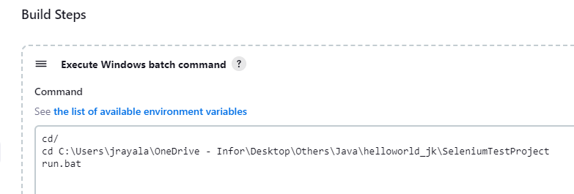
4. How to run a selenium bat file using Jenkins
INFOR
Pre-Requisites:
Install any IDE like -> Download Eclipse from https://www.eclipse.org/downloads/, NetBeans etc..
Install JDK > = v1.8 from https://www.oracle.com/in/java/technologies/downloads/
Set Java Home and Path into the Environment Variables (Right Click on PC -> Properties -> Advanced System Settings -> Advanced tab -> Environment Variables -> User/System Variables)
Download Maven from https://maven.apache.org/download.cgi and place it anywhere in your local machine and provide the path in Environment variables.
Create a Maven project and add required selenium jar files, Maven Compiler and Surefire plugin in pom.xml file
Launch the Jenkins.war file where it was placed.
Create a .bat file:
Navigate to any directory where you need to create a batch file.
Create a run.bat file with the below lines
cd/
cd C:\Users\jrayala\OneDrive - Infor\Desktop\Others\Java\helloworld_jk\SeleniumTestProject
mvn clean test
Run Java application using Jenkins:
Create a ‘Maven Project or Free Style Project’ build.
Select “Execute Windows batch command” from ‘Build Steps’.

Slide 7
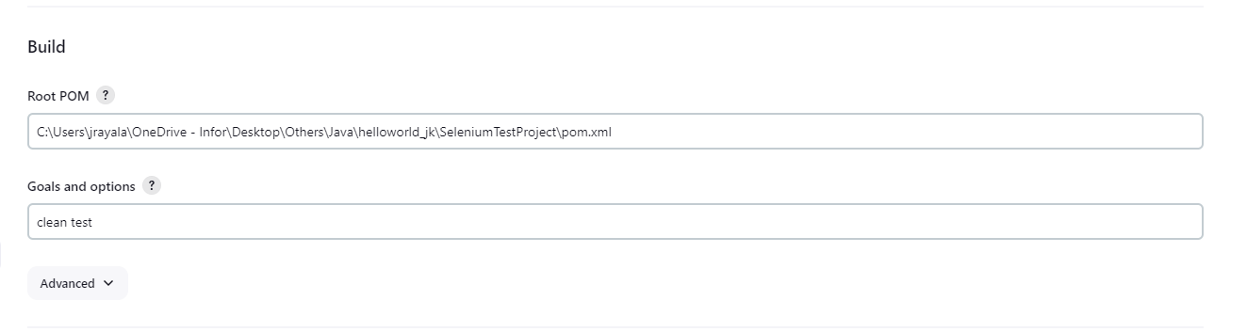
5. Build a Selenium Maven Project using Jenkins
INFOR
Pre-Requisites:
Install any IDE like -> Download Eclipse from https://www.eclipse.org/downloads/, NetBeans etc..
Install JDK > = v1.8 from https://www.oracle.com/in/java/technologies/downloads/
Set Java Home and Path into the Environment Variables (Right Click on PC -> Properties -> Advanced System Settings -> Advanced tab -> Environment Variables -> User/System Variables)
Download Maven from https://maven.apache.org/download.cgi and place it anywhere in your local machine and provide the path in Environment variables.
Create a Maven project and add required selenium jar files, Maven Compiler and Surefire plugin in pom.xml file
Update testing.xml file in maven-surefire-plugin.
Install and launch the Jenkins where it was placed.
Run Selenium Maven Project using Windows Cmds:
Open a terminal/command prompt and navigate to the directory where pom.xml file exist
mvn clean
mvn test / mvn install / mvn clean test / mvn clean install
Run Selenium Maven Project using Jenkins:
Create a ‘Maven Project’ build.
Provide the path of pom.xml file in Root POM
Provide the maven command to run the test in Goals and Options.

Slide 8
6. Selenium + Maven + GitHub with Jenkins Integration
INFOR
Pre-Requisites:
Install any IDE like -> Download Eclipse from https://www.eclipse.org/downloads/, NetBeans etc..
Install JDK > = v1.8 from https://www.oracle.com/in/java/technologies/downloads/
Set Java Home and Path into the Environment Variables (Right Click on PC -> Properties -> Advanced System Settings -> Advanced tab -> Environment Variables -> User/System Variables)
Download Maven from https://maven.apache.org/download.cgi and place it anywhere in your local machine and provide the path in Environment variables.
Create a Maven project and add required selenium jar files, Maven Compiler and Surefire plugin in pom.xml file
Update testing.xml file in maven-surefire-plugin
Download and install GIT from https://git-scm.com/downloads
Create a repository from https://github.com/
Install and launch the Jenkins where it was placed.
Use the below GIT commands to create a new Repository and push the Project code:
echo "# GitRepo22" >> README.md
git init
git add README.md
git commit -m "first commit"
git branch -M main
git remote add origin https://github.com/jk2403/GitRepo22.git
git push -u origin main [After pushing the origin main, we need to provide the username and access token]
Generate Personal Access Token: Click on Avatar circle at top right side of a page and select “Settings” -> Developer Settings -> Select Tokens(Classic) from Personal Access Token -> Select ‘Generate New Token(Classic) from Generate New Token -> Provide a name in Note and select all check boxes under Select Scopes then click on Generate Token button.

Slide 9
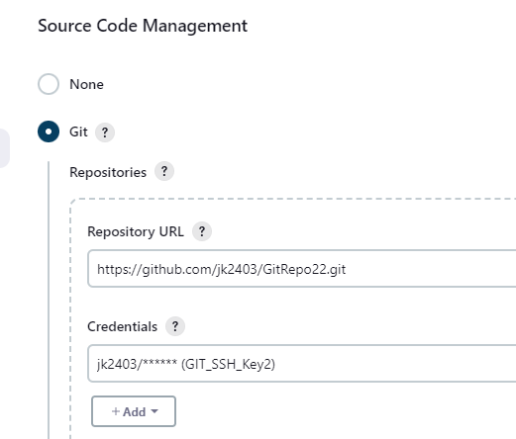
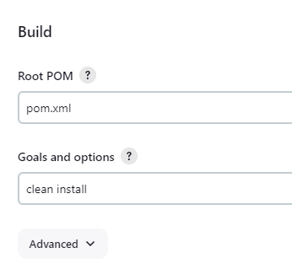
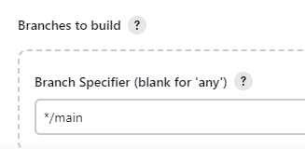
6. Selenium + Maven + GitHub with Jenkins Integration
Run Selenium+ Maven +GIT Project using Jenkins:
Create a ‘Maven Project’ build.
Provide GIT details and correct branch specifier.
Just, provide the pom.xml file in Root POM.
Provide the maven command to run the test in Goals and Options.

Slide 10


Thank you

