Slide 1
EDA PROJECT ON AIR BNB DATASET
By :- Sachin
Prashant Singh
Jaanhvi khandelwal
Pankaj kumar pandit
Team name:-Achievers

Slide 2
Contents:-
About Airbnb
Statements.
About the dataset
Agenda
Questions.
Analysis Summary.

Slide 3

About:- airbnb
Since 2008, guests and hosts have used Airbnb to expand on traveling possibilities and present a more unique, personalized way of experiencing the world. Today, Airbnb became one of a kind service that is used and recognized by the whole world. Data analysis on millions of listings provided through Airbnb is a crucial factor for the company. These millions of listings generate a lot of data - data that can be analyzed and used for security, business decisions, understanding of customers' and providers' (hosts) behavior and performance on the platform, guiding marketing initiatives, implementation of innovative additional services and much more.
Airbnb takes a unique approach toward lodging. Part of the “sharing economy,” Airbnb offers you someone’s home as a place to stay instead of a hotel. On Airbnb, you can find places to crash on your backpacking trip through Europe, or a spot to rent for a month during your internship in Los Angeles. It’s also a great way to explore a town you’re thinking about moving to, or finding an alternative to traditional hotel options in 2022 if you’re just around for a weekend. If you want to rent out extra space in your own home, you can host through Airbnb and make money for allowing a guest to stay the night.

Slide 4
Statements
1.For this project we have analyze Airbnb's New York City(NYC) data of 2019. NYC is not only the most famous city in the world but also top global destination for visitors drawn to its museums, entertainment, restaurants and commerce.
2.Our main objective is to find out the key metrics that influence the listing of properties on the platform. For this, we will explore and visualize the dataset from Airbnb in NYC using basic exploratory data analysis (EDA) techniques.
3.Data analysis on thousands of listings provided through Airbnb is a crucial factor for the company.
4.We will be finding out the distribution of every Airbnb listing based on their location in NYC,including their price range, room type, listing name, and other related factors.

Slide 5
About the Dataset
ID-These gives us the listing id Name listing name
Host_id-host id
Host_name-host name
Neighbourhood_group- NYC borough
Neighbourhood- NYC neighborhood
Latitude-listing latitude
Longitude-listing longitude
Room_type-type of rooms (Entire home/apt, Private room, Shared room)
Price-listing price
Minimum_nights-minimum nights people stay
Number_of_reviews-Total number of reviews Last review-Date of last review
Reviews_per_month-Average number of reviews per month
Calculated_host_listing_count-total number of listings for this host
availabilty_365-number of days listing is available.
Number of Data set were nearly 49000.

Slide 6
Agenda
We try to answer the following questions for airbnb:-
What can we learn about different hosts and areas?
What can we learn from predictions?(ex:locations,prices,reviews,etc)
Which hosts are the busiest and why?
Is there any noticeable difference of traffic among different areas and what could be the reason for it?
Neighbourhood groups vs Availability room.
Types of properties listed.
Map of neighbourhood group.
Price distribution in different types of room

Slide 7
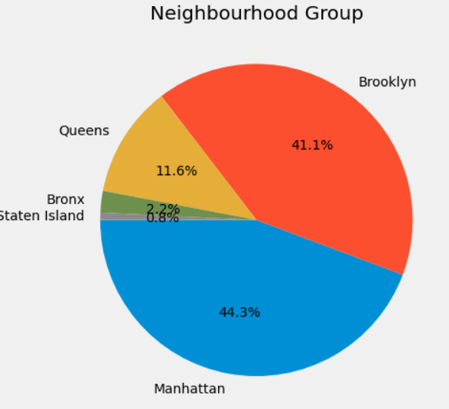
What can we learn about different hosts and areas?
Manhattan has the highest number of listings of about 44.3% followed by brooklyn of 41%.
State island stands the least number of listings less than 1%.

Slide 8
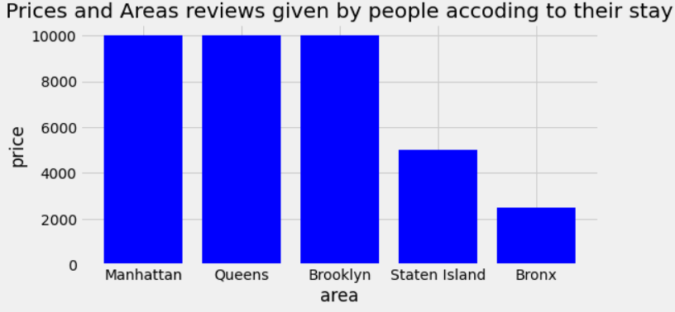
What can we learn from predictions?(ex:locations,prices,reviews,etc)
As shown in fig that most expensive places are manhattan queens and brooklyn and the cheapest place is bronx.
Number of reviews are high at expensive places where most people like to stay.

Slide 9
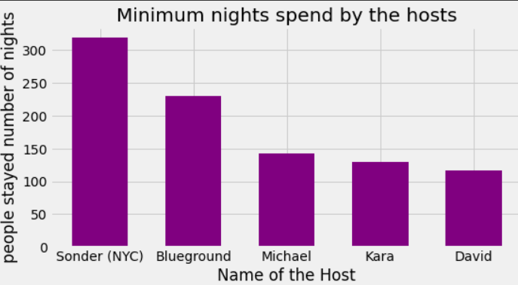
Which Hosts are the busiest and why?
Most busiest host among them is Sonder(NYC) followed by Blueground and Michael.
As shown earlier manhattan has the highest number of listings thats why sonder from nyc is busiest.

Slide 10
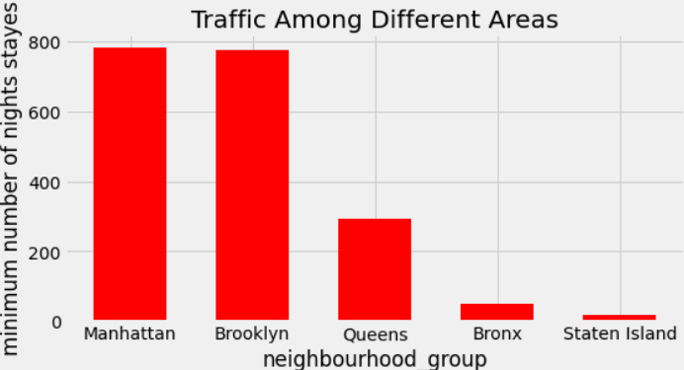
Is there any noticeable difference of traffic among different areas and what could be the reason for it?
Manhattan and brooklyn are the places with most number of nights spend by the people followed by Queens,Bronx and staten island.

Slide 11
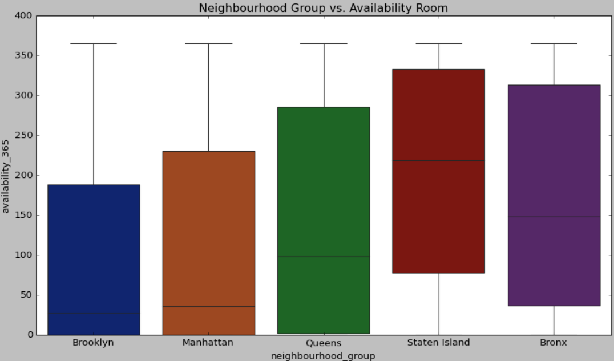
Neighbourhood groups vs Availability room.
As shown in boxplot graph that in Brooklyn most of the properties are available between 0 to 200 little bit of number increased by manhattan and most diverse room availaibilitiy is of Queens

Slide 12
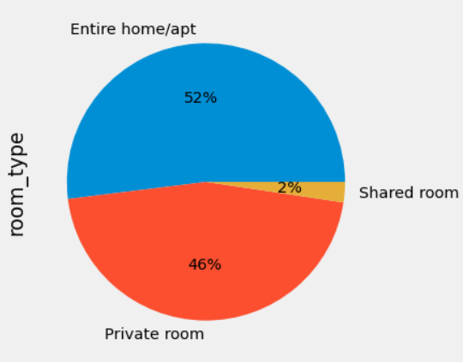
Types of properties listed
Most famous types of properties are Entire/apt and private room and shared rooms are very less as most of the people don't like to share their personal space.

Slide 13
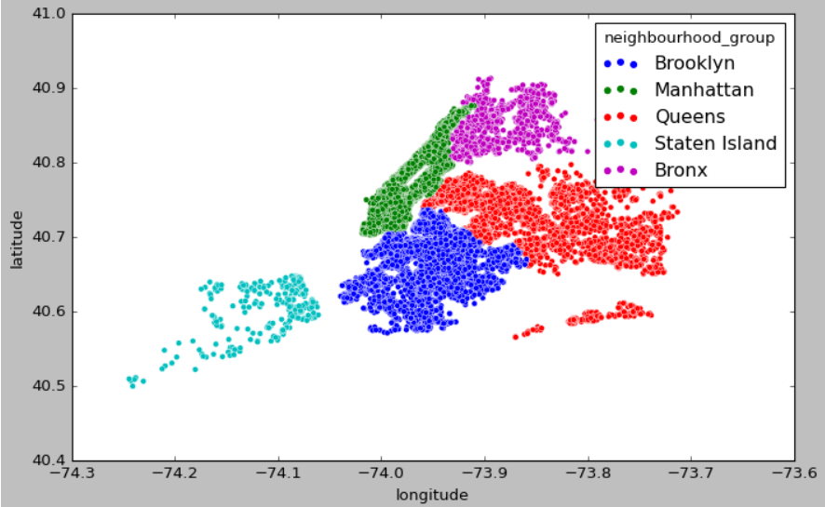
Map of neighbourhood group.
As shown in the graph the closeby areas i.e brooklyn,Manhatten,queens are the most popular.

Slide 14
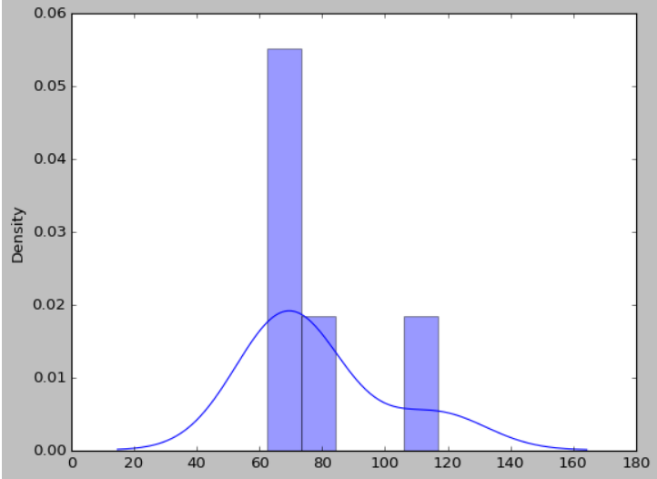
Price distribution in different types of room
1.Private room:-Private rooms on average are priced from 60-120 dollars per night on an average depending upon the neighbourhood group it is located.

Slide 15
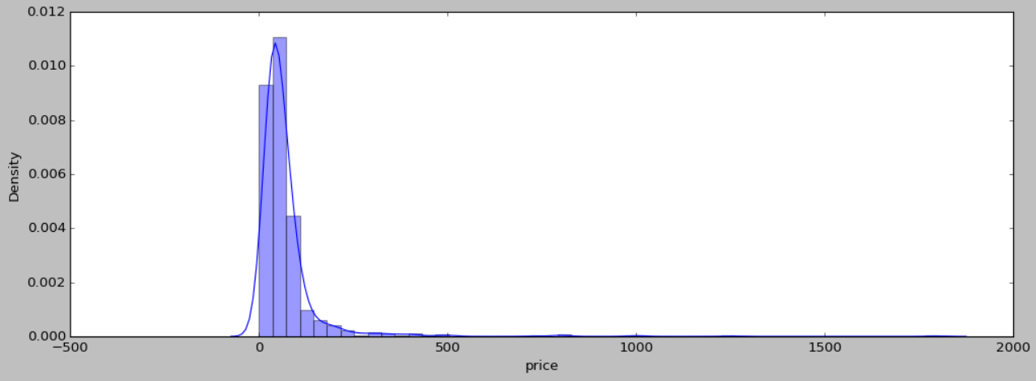
contd…
2.Shared rooms:-Most of the shared rooms have the price range between 50-70 dollars per night depending upon the neighbourhood groups.

Slide 16
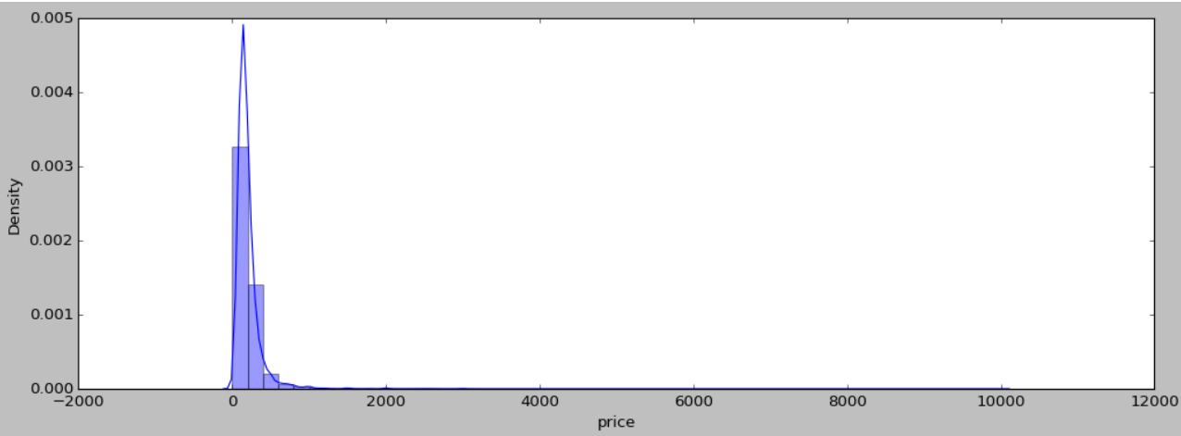
contd..
Price Distribution of Entire home/apt:-Most of the Entire home/apt are priced between 0 to 1000.

Slide 17
Analysis summary
Manhattan is the most focused place in New York for hosts to do their business.
As people loved to stay when in need for maximum number of nights in Entire Apartment and Brooklyn stands second highest focused place by people. Also, as the average cost in Brooklyn is 80 USD which is less then Manhattan Airbnb can increase number of entire apartment in Brooklyn.
Top most place in nighbourhood is williamsburg and Bedford.
Top rated host as per number of reviews are Dona and The avability of rooms in a year is highest in Queens Island and lowest in Brooklyn.

Slide 18


