Slide 1
Semantic analysis of feedback using pytorch

Slide 2
Problem statement
Businesses receive large volumes of feedback.
Manual analysis is slow.
Need automated sentiment detection

Slide 3
Objective
Build an API to analyze customer sentiment.
Support real-time usage.
Compare custom vs pretrained model.

Slide 4
What is sentiment analysis ?
It’s a Natural Language Processing task where we classify text based on emotional tone.
Positive / Neutral / Negative

Slide 5
Applications
Used in
Product reviews,
Twitter analysis,
Customer support
Automation etc.

Slide 6
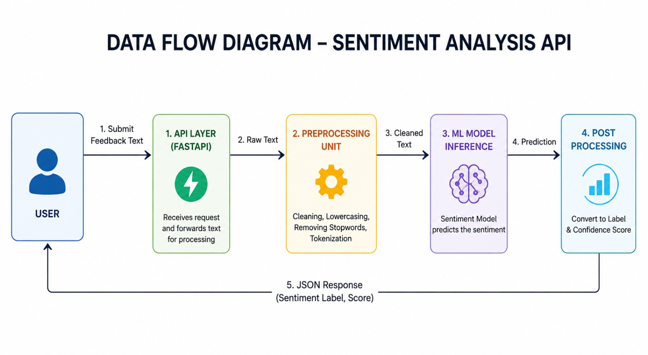

Slide 7
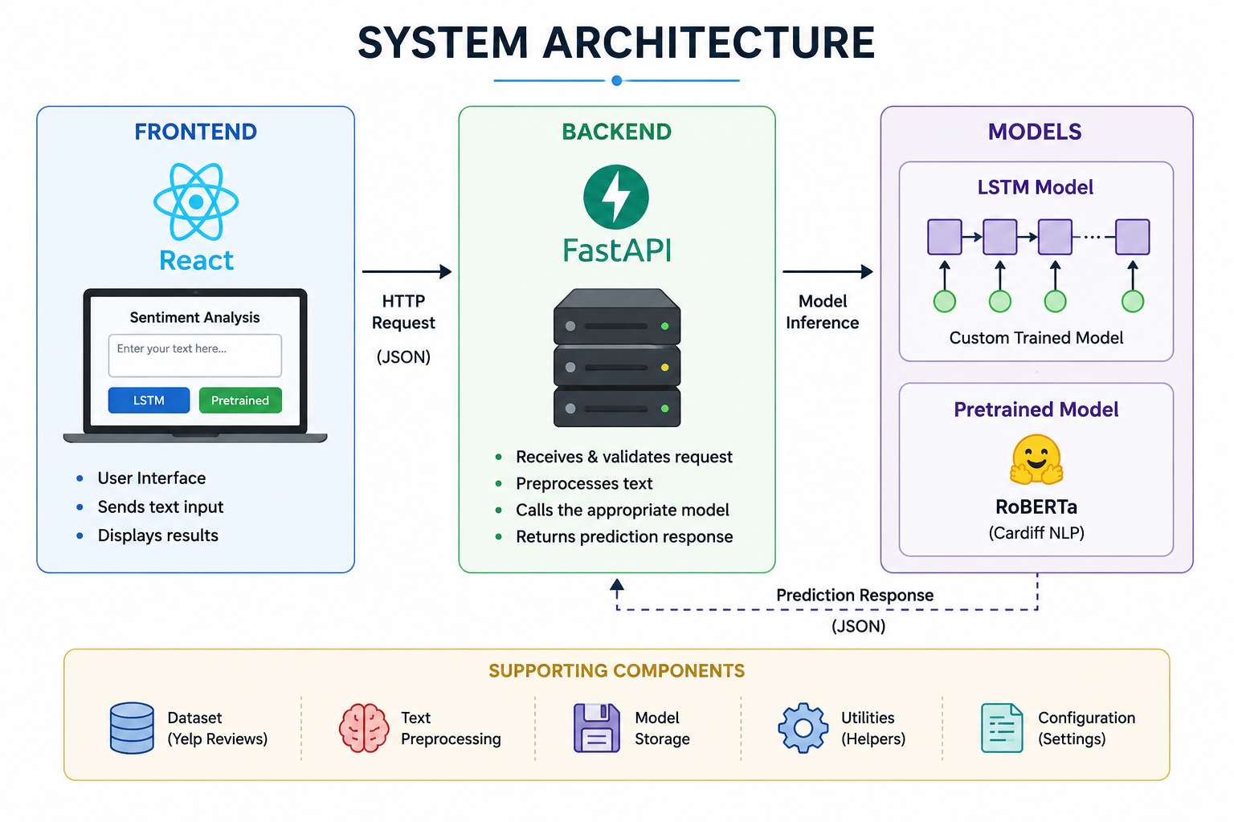

Slide 8
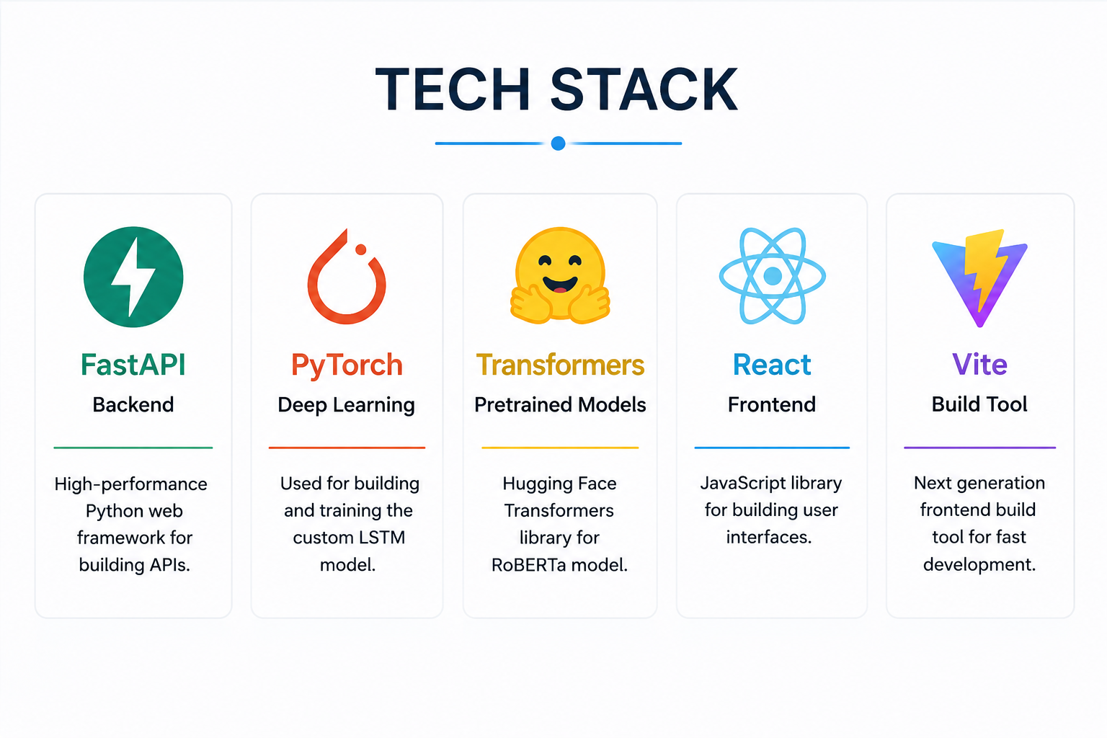

Slide 9
dataset
We used 3000 YELP reviews divided in
positive | neutral | negative feedbacks.
This will be used to train out model.

Slide 10
The lstm model
LSTM = Recurrent Neural Network (RNN) + Memory Gates.
It remembers important words, forgets irrelevant ones, and understands text in order.

Slide 11
The rnn
RNN is a neural network designed for sequential data.
Unlike other networks, it has a loop that passes information from one step to the next.

Slide 12
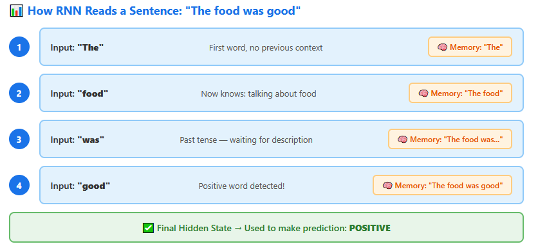

Slide 13
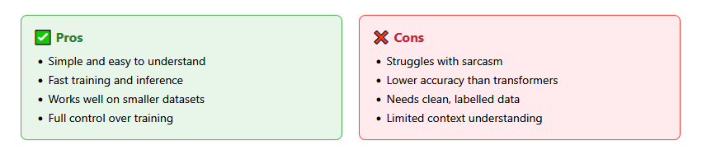
Pros / cons

Slide 14
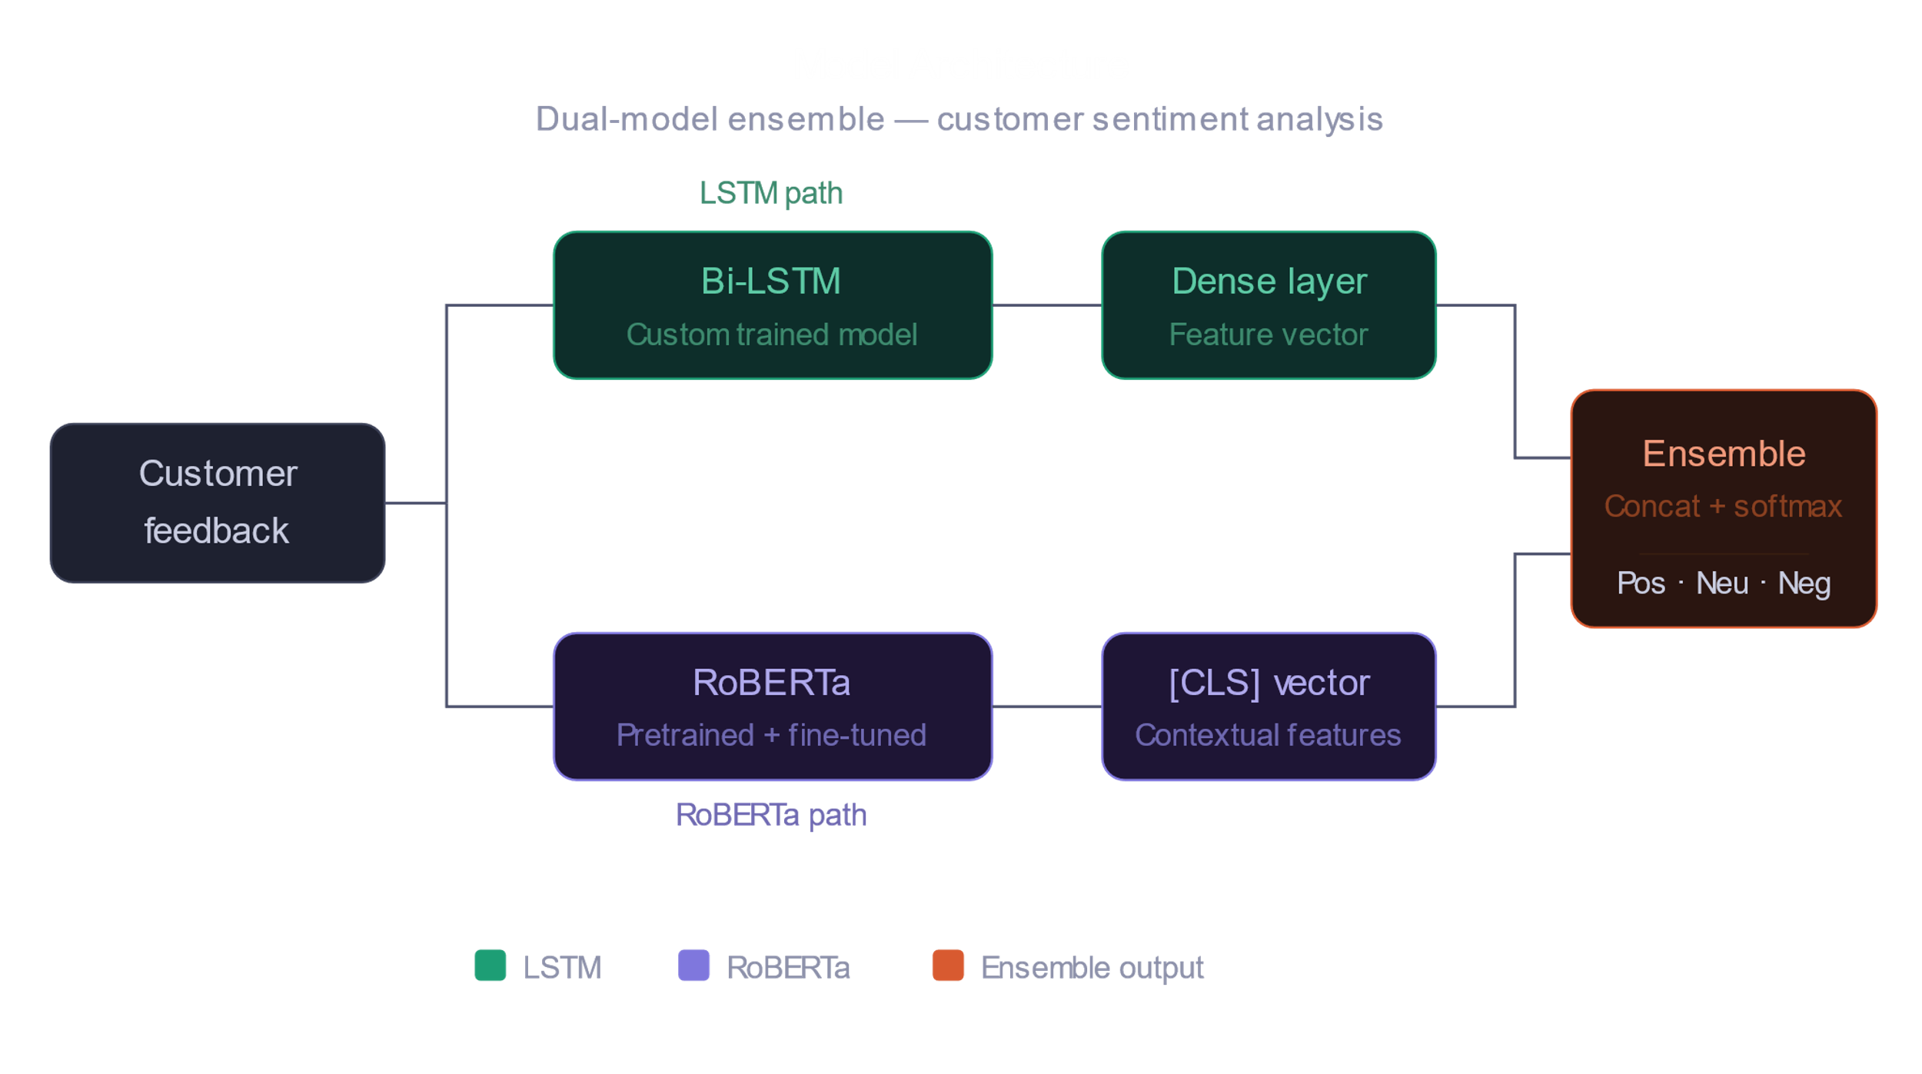

Slide 15
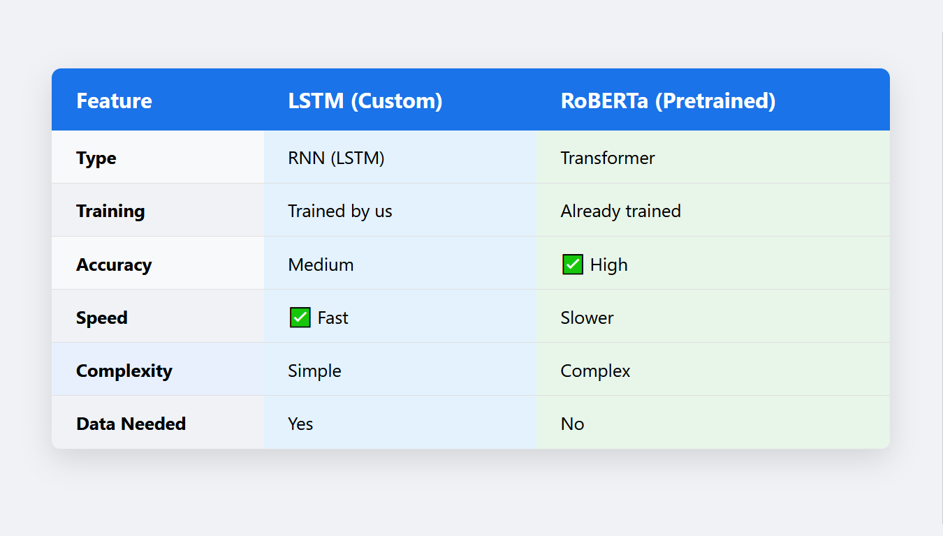

Slide 16
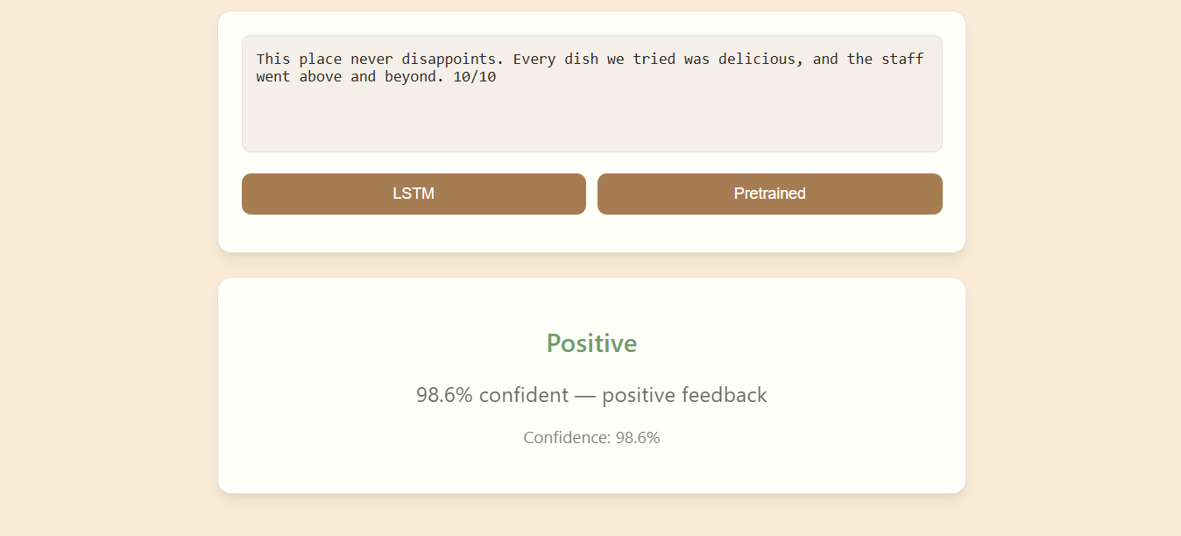
Sample / screenshots

Slide 17
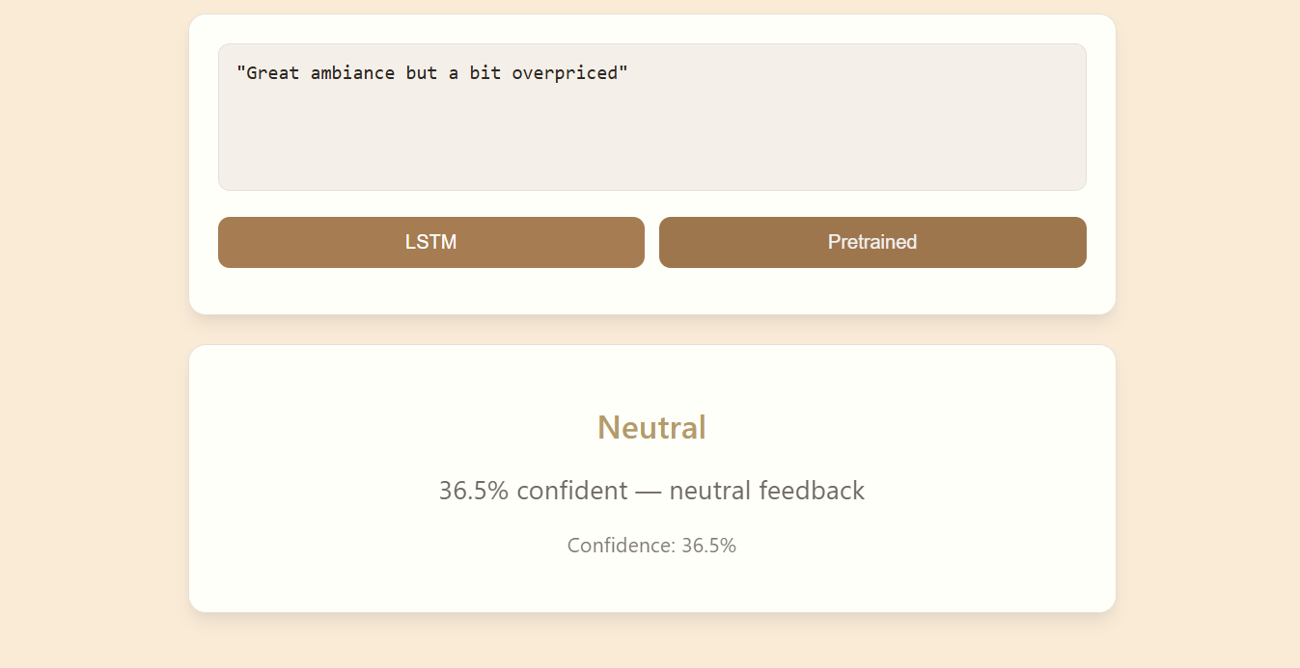

Slide 18
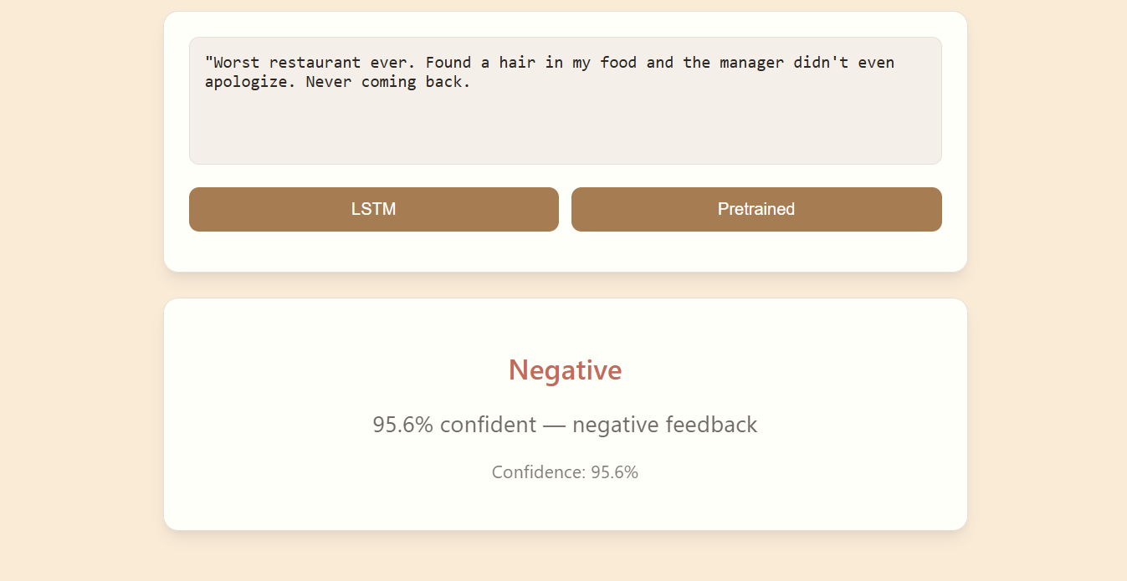

Slide 19
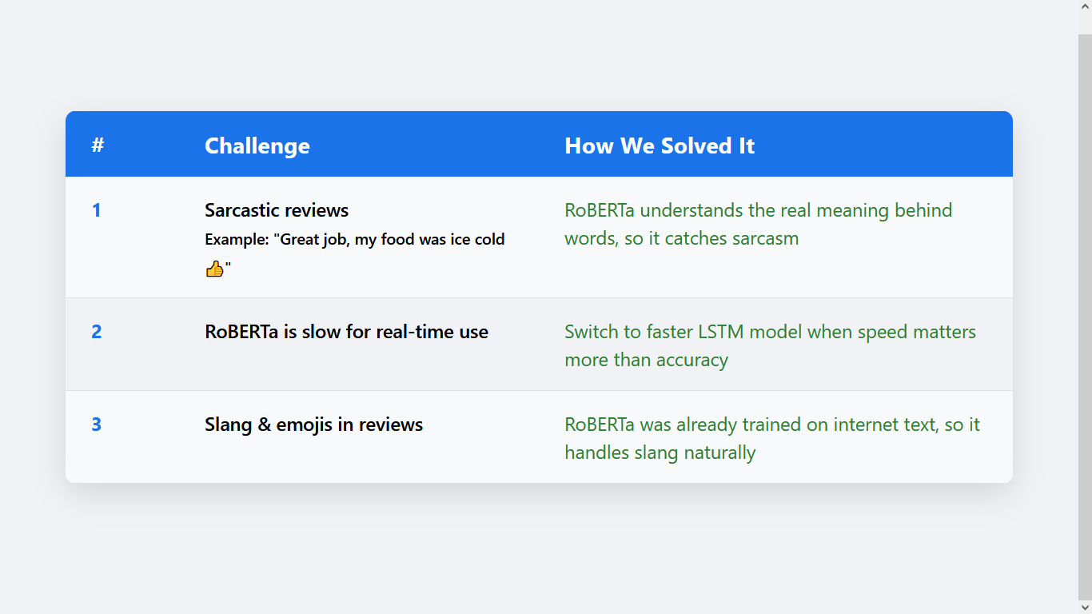

Slide 20
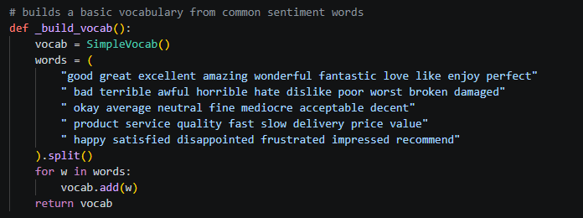
Code snippet/s

Slide 21
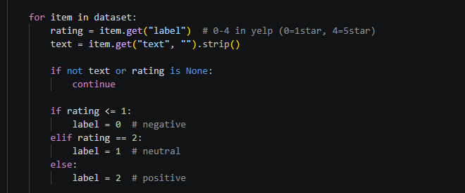
Code snippet/s

Slide 22
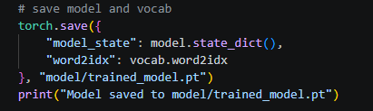
Code snippet/s

Slide 23
conclusion
Successfully built a sentiment analysis tool for customer feedback
Compared two models: custom LSTM vs pretrained RoBERTa
RoBERTa = higher accuracy | LSTM = faster inference

Slide 24
Q & A
Any questions for us ?

Slide 25
The end
Thank you

