Slide 1
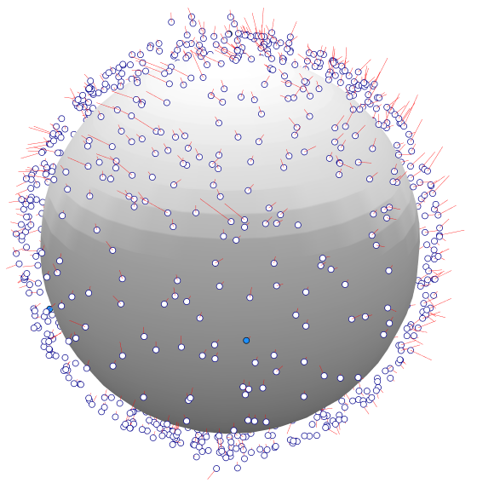
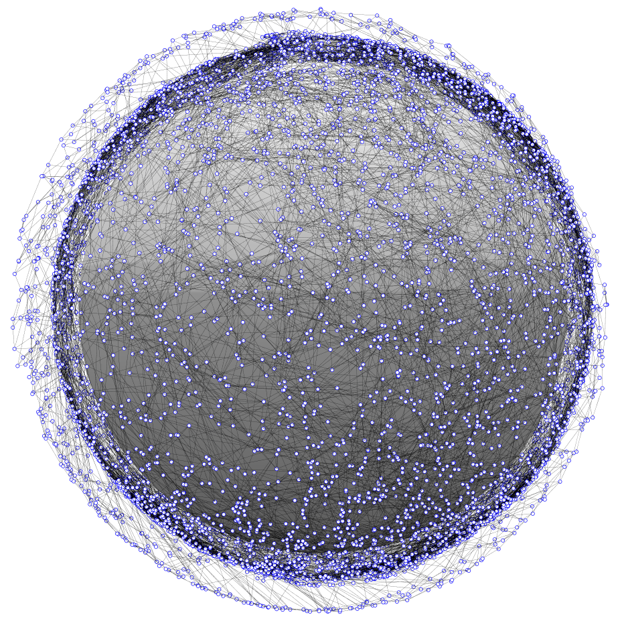
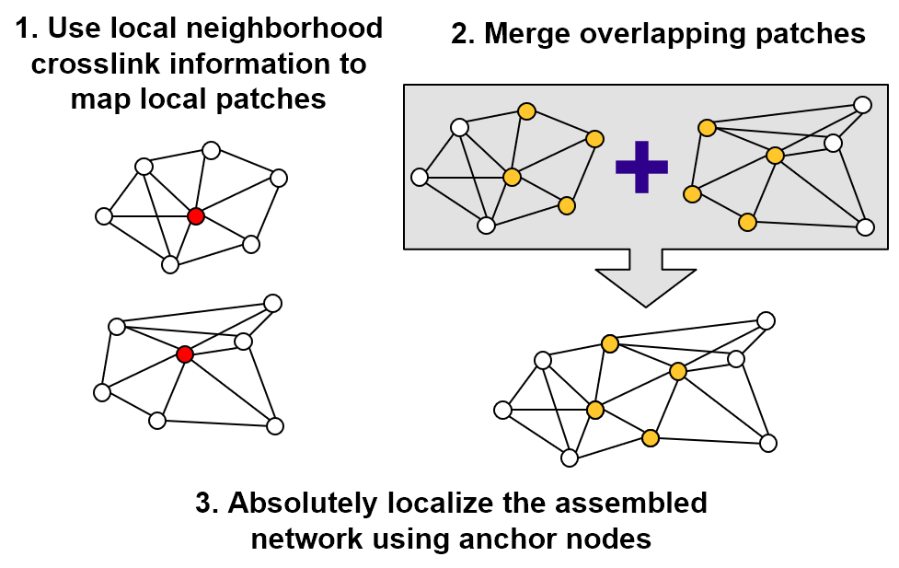
Chain mail – dial
Distributed Ad-hoc Localization (DiAL) – position estimation in a large proliferated constellation
DiAL is for rapidly determining satellite position in a proliferated network. Distributed localization is performed using crosslink and range information.
Can network topology be used to determine node positions?
Rapid localization in large, ad-hoc networked constellations
Current LEO satellites rely on some combination of sensors, GPS, and ground tracking to determine their positions. In a very large ad-hoc network, these methods may be prohibitively time/cost/effort expensive. As large, proliferated constellations come to fruition, position estimation will be a critical issue for operators.
Leverages wireless terrestrial localization methods
Range-based localization based on ad-hoc networking
There is a wealth of unique research to be performed in distributed network localization and its application to large, ad-hoc, 3-dimensional networks.
Distributed localization enables parallel computing
DiAL is an investigation into rapid and distributed position estimation in large proliferated networks. CSWaP constraints on proliferated satellites may limit position estimation abilities. Wireless localization algorithms can be computationally low-cost and performed without the need for a centralized computing resource. Distributed localization can reduce operator and computational workload, which will allow space operators to safely and efficiently manage large networks.
Algorithms scale to very large networks
DiAL leverages algorithms and methods developed for terrestrial localization in wireless networks. Results from Project Packet are used to initialize the crosslinks and network topology. Multi-Dimensional Scaling (MDS) is used to map the networks with an algorithm called MDS-MAP. A distributed form of MDS-MAP is implemented called MDS-MAP(P), which enables parallel computation and mapping.
Local neighborhoods are independently mapped and then merged. As the local maps are aggregated into a total map, an absolute map can be constructed with the inclusion of 3 (in 2 dimensions) or 4 (in 3 dimensions) anchors nodes that are position-aware.
As large proliferated satellite constellations come to fruition, position estimation and collision avoidance will pose a major challenge for future space operators.
Network topology and mapping error
Managing very large networks may pose a challenge to constellation operators
Justin Kim
841757

Slide 2
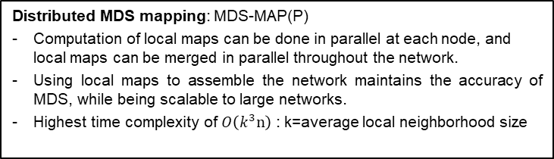
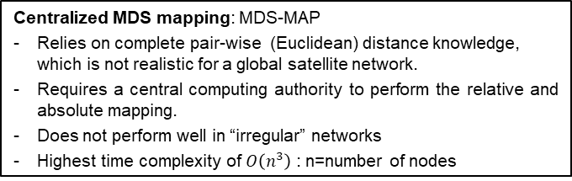
Chain mail – dial
Distributed Ad-hoc Localization (DiAL) – position estimation in a large proliferated constellation
DiAL is based on wireless localization methods for terrestrial networks. After a survey of existing algorithms, Multidimensional Scaling (MDS) based algorithms were selected for implementation. Results from Project Packet are used to set the network topology, including crosslink, connectivity, and range information. MDS-MAP is a localization method that uses connectivity information to estimate network node positions. MDS-MAP generates a relative map of the network, which then can be absolutely localized using “anchor” nodes that are “smart”, i.e. position aware.
MDS-MAP, being a centralized algorithm, uses connectivity information between all nodes at the same time to determine positions. However, MDS-MAP does not perform well on irregular networks where the path between nodes does not necessarily correspond to the true Euclidean distance (as would be the case in a global satellite network). Therefore a distributed approach to MDS mapping (MDS-MAP(P)) was implemented. In MDS-MAP(P), each node’s local neighborhood is mapped with MDS. The local maps are then merged based on their overlapping nodes and an optimal linear transformation. When all the local maps are merged, a total relative map is produced. Using anchor nodes (3 anchors in 2 dimensions, 4 anchors in 3 dimensions), the relative map can be absolutely localized with an optimal linear transformation. A brief comparison of the centralized and distributed algorithms is shown below:
MDS-MAP was successfully implemented in a centralized 2-dimensional case with high accuracy. Position estimation was nearly perfect for networks ranging from 100 to 10,000 nodes. In the 3-D case, the average root mean square error (RMSE) decreases as a function of network size. MDS-MAP results for 3-D networks are shown on slide 4.
MDS-MAP(P) was implemented and tested on networks from 100 to 5,000 nodes. Results are shown on slides 5 and 6, for networks where the local neighborhoods are limited by 2 and 3 hops. Clear trends are not observed, with a general conclusion that larger networks result in larger errors. This is likely a result of the merging process, where local maps are aggregated into a complete map. As the aggregate map is assembled, each subsequent linear transformation introduces and compounds error in the position estimation. So in larger networks, there are more patches to merge, resulting in a larger average estimation error. A refinement process was attempted between each merging step, but results were not improved and computation time increased considerably.
Centralized MDS mapping: MDS-MAP
Relies on complete pair-wise (Euclidean) distance knowledge, which is not realistic for a global satellite network.
Requires a central computing authority to perform the relative and absolute mapping.
Does not perform well in “irregular” networks
Highest time complexity of $O\left(n^{3}\right)$ : n=number of nodes
Distributed MDS mapping: MDS-MAP(P)
Computation of local maps can be done in parallel at each node, and local maps can be merged in parallel throughout the network.
Using local maps to assemble the network maintains the accuracy of MDS, while being scalable to large networks.
Highest time complexity of $O\left(k^{3}n\right)$ : k=average local neighborhood size
Localization, position estimation, proliferated network, proliferated constellation
Justin Kim
841757

Slide 3
Distributed Ad-hoc Localization (DiAL) – position estimation in a large proliferated constellation
Current LEO satellites rely on some combination of sensors, GPS, and ground tracking to determine their positions. In very large networks, these methods may be prohibitively expensive with time, effort, and cost. As large proliferated satellite networks are realized, position estimation will be a critical issue for operators. DiAL is an investigation into rapid and distributed position estimation in large proliferated networks. CSWaP constraints on proliferated satellites may limit position estimation abilities. Distributed localization methods can be computationally low-cost, using network topology information that would already exist in a networked constellation. Distributed localization can reduce operator and computational workload, without the need for a centralized computing resource, which will allow space operators to safely and efficiently manage large networks.
Next steps:
Refactor refinement process in MDS-MAP(P)
Implement uncertainty in ranging measurements
Investigate anchor node selection effects
Investigate network topology effects: local neighborhood range, connections per satellite, connection range, range-free localization
Justin Kim
841757

Slide 4
Distributed Ad-hoc Localization (DiAL) – position estimation in a large proliferated constellation
I was glad to have the opportunity to perform some independent research, even without a direct customer connection. The iLab funding allowed me to pursue and develop experience in an area of interest that is relevant to the corporate strategies of innovation and velocity.
Justin Kim
841757

Slide 5
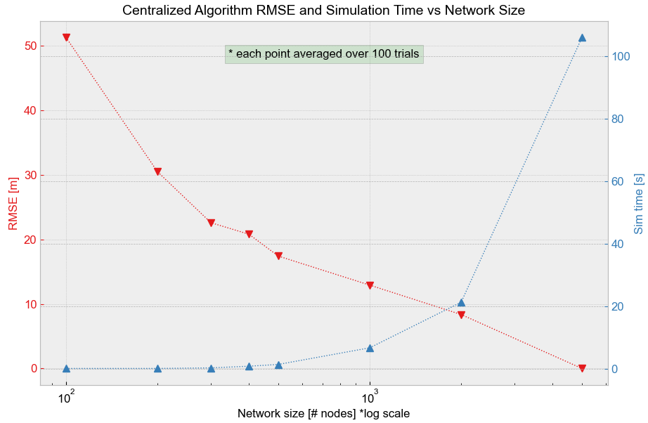
Distributed Ad-hoc Localization (DiAL) – position estimation in a large proliferated constellation
Plot below shows the average root mean square error (RMSE) of the position estimation as a function of network size, for the centralized algorithm MDS-MAP. Also shown is simulation time as a function of network size. RMSE goes nearly to zero at 5,000 nodes, though had a reasonable error even at 100 nodes.
Justin Kim
841757

Slide 6
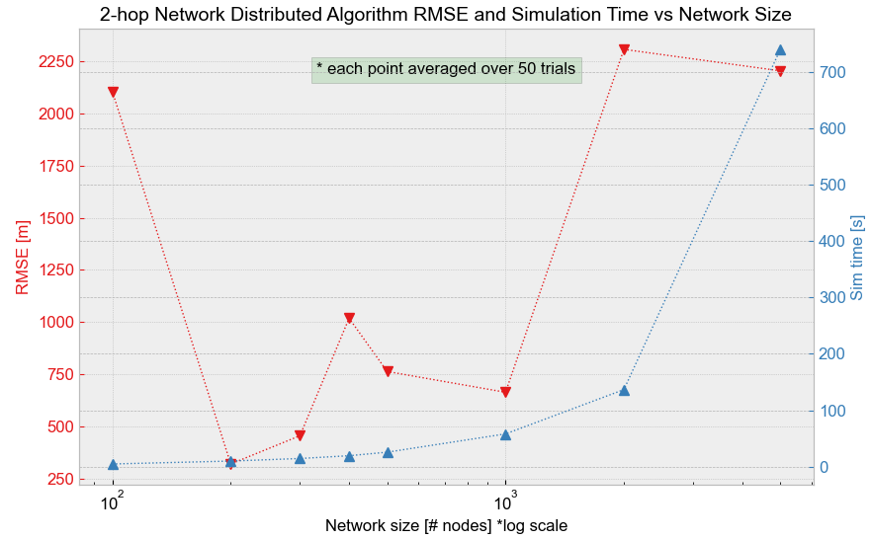
Distributed Ad-hoc Localization (DiAL) – position estimation in a large proliferated constellation
Plot below shows the average root mean square error (RMSE) of the position estimation as a function of network size, for the distributed algorithm MDS-MAP(P). In these simulations, the local neighborhood size is limited to 2 hops. Also shown is simulation time as a function of network size. A clear relationship is not observed between network size and error. Compared to the 3-hop network (shown on the next slide), the error is considerably larger. With smaller local neighborhoods, more merges are required to assemble the full network. Error compounds with every merge, resulting in a very large error.
Justin Kim
841757

Slide 7
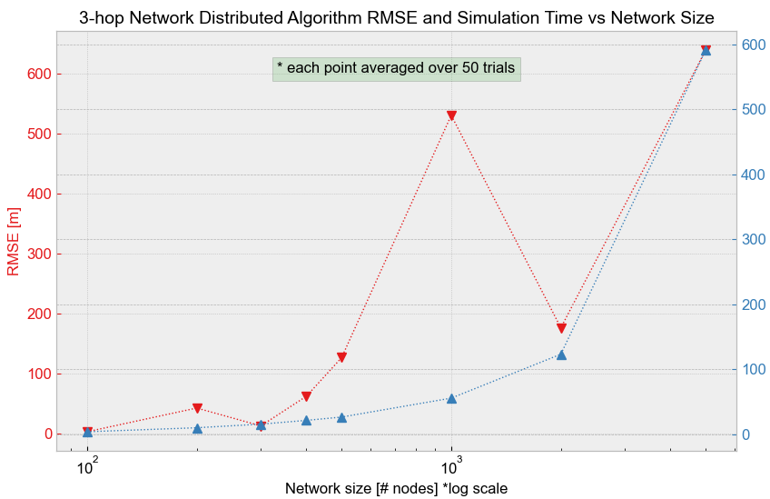
Distributed Ad-hoc Localization (DiAL) – position estimation in a large proliferated constellation
Plot below shows the average root mean square error (RMSE) of the position estimation as a function of network size, for the distributed algorithm MDS-MAP(P). In these simulations, the local neighborhood size is limited to 3 hops. Also shown is simulation time as a function of network size. A relationship could be inferred that RMSE increases with network size. Again, this is likely due to the number of merges required to assemble the full network. Error compounds with every merge, resulting in increasing error.
Justin Kim
841757

