Slide 1
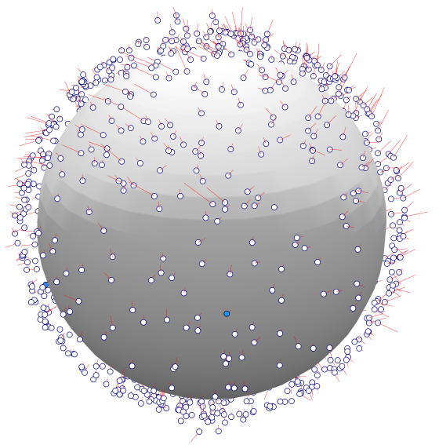
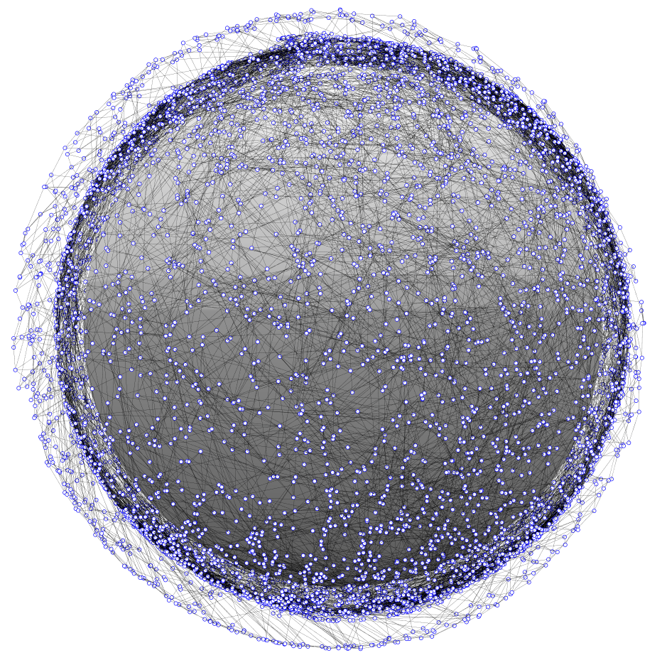
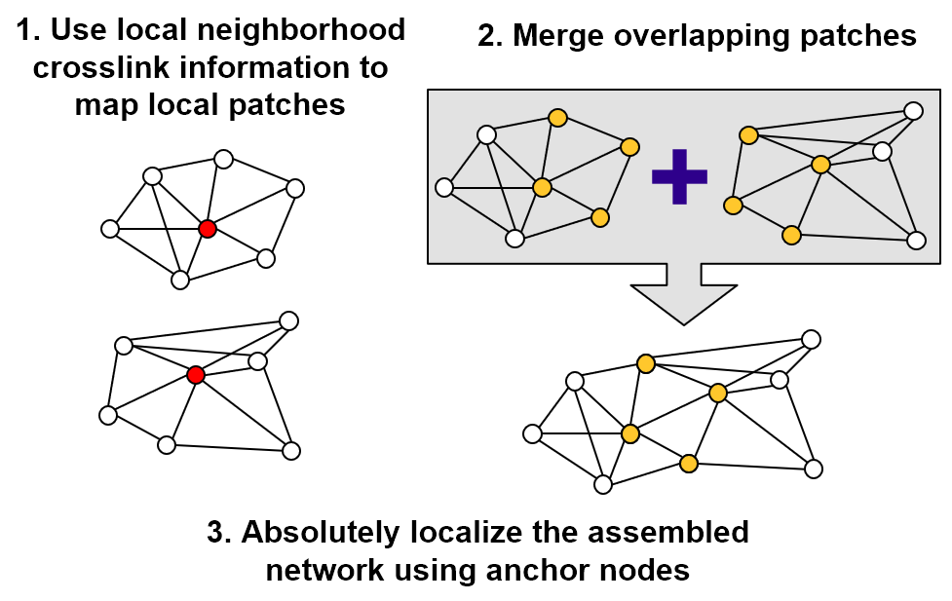
Chain mail – dial
Distributed Ad-hoc Localization (DiAL) – position estimation in a large proliferated constellation
DiAL is for rapidly determining satellite position in a proliferated network. Distributed localization is performed using crosslink and range information.
Can network topology be used to determine node positions in a large distributed network?
Distributed localization in large, ad-hoc networked constellations
Current LEO satellites rely on some combination of sensors, GPS, and ground tracking to determine their positions. In a very large ad-hoc network, these methods may be prohibitively time/cost/effort expensive. As large, proliferated constellations come to fruition, position estimation will be a critical issue for operators.
Leverage wireless terrestrial localization methods
Range-based localization based on ad-hoc networking
There is a wealth of unique research to be performed in distributed network localization and its application to large, ad-hoc, 3-dimensional networks.
Distributed localization enables parallel computing
DiAL is an investigation into rapid and distributed position estimation in large proliferated networks. CSWaP constraints on proliferated satellites may limit position estimation abilities. Wireless localization algorithms can be computationally low-cost and performed without the need for a centralized computing resource. Distributed localization can reduce operator and computational workload, which will allow space operators to safely and efficiently manage large networks.
Algorithms scale to very large networks
DiAL leverages algorithms and methods developed for terrestrial localization in wireless networks. Results from Project Packet are used to initialize the crosslinks and network topology. Multi-Dimensional Scaling (MDS) is used to map the networks with an algorithm called MDS-MAP. A distributed form of MDS-MAP is implemented called MDS-MAP(P), which enables parallel computation and mapping.
Local neighborhoods are independently mapped and then merged. As the local maps are aggregated into a total map, an absolute map can be constructed with the inclusion of 3 (in 2 dimensions) or 4 (in 3 dimensions) anchors nodes that are position-aware.
As large proliferated satellite constellations come to fruition, position estimation and collision avoidance will pose a major challenge for future space operators.
Network topology and mapping error
Managing very large networks may pose a challenge to constellation operators
FY21
Justin Kim
840738

Slide 2
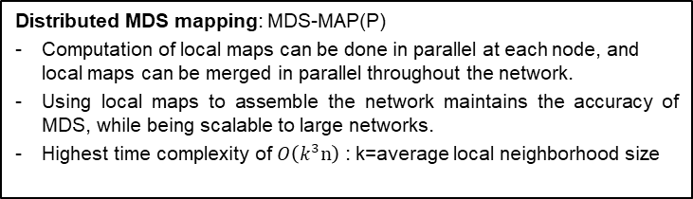
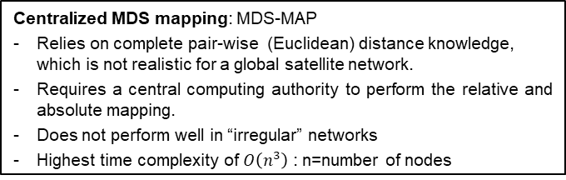
Chain mail – dial
Distributed Ad-hoc Localization (DiAL) – position estimation in a large proliferated constellation
DiAL is based on wireless localization methods for terrestrial networks. After a survey of existing algorithms, Multidimensional Scaling (MDS) based algorithms were selected for implementation. Results from Project Packet are used to set the network topology, including crosslink, connectivity, and range information. MDS-MAP is a localization method that uses connectivity information to estimate network node positions. MDS-MAP generates a relative map of the network, which then can be absolutely localized using “anchor” nodes that are “smart”, i.e. position aware.
MDS-MAP, being a centralized algorithm, uses connectivity information between all nodes at the same time to determine positions. However, MDS-MAP does not perform well on irregular networks where the path between nodes does not necessarily correspond to the true Euclidean distance (as would be the case in a global satellite network). Therefore a distributed approach to MDS mapping (MDS-MAP(P)) was implemented. In MDS-MAP(P), each node’s local neighborhood is mapped with MDS. The local maps are then merged based on their overlapping nodes and an optimal linear transformation. When all the local maps are merged, a total relative map is produced. Using anchor nodes (3 anchors in 2 dimensions, 4 anchors in 3 dimensions), the relative map can be absolutely localized with an optimal linear transformation. A brief comparison of the centralized and distributed algorithms is shown below:
MDS-MAP was successfully implemented in a centralized 2-dimensional case with high accuracy. Position estimation was nearly perfect for networks ranging from 100 to 10,000 nodes. In the 3-D case, the average root mean square error (RMSE) decreases as a function of network size.
MDS-MAP(P) was implemented and tested on networks from 100 to 5,000 nodes. Clear trends are not observed, with a general conclusion that larger networks result in larger errors. This is likely a result of the merging process, where local maps are aggregated into a complete map. As the aggregate map is assembled, each subsequent linear transformation introduces and compounds error in the position estimation. So in larger networks, there are more patches to merge, resulting in a larger average estimation error.
A refinement process was implemented between each merging step. In the refinement step, the initial MDS-MAP of the local neighborhood is used as an initial guess to a minimization function, whose objective is the Euclidean distance error between points in the local neighborhood.
Centralized MDS mapping: MDS-MAP
Relies on complete pair-wise (Euclidean) distance knowledge, which is not realistic for a global satellite network.
Requires a central computing authority to perform the relative and absolute mapping.
Does not perform well in “irregular” networks
Highest time complexity of $O\left(n^{3}\right)$ : n=number of nodes
Distributed MDS mapping: MDS-MAP(P)
Computation of local maps can be done in parallel at each node, and local maps can be merged in parallel throughout the network.
Using local maps to assemble the network maintains the accuracy of MDS, while being scalable to large networks.
Highest time complexity of $O\left(k^{3}n\right)$ : k=average local neighborhood size
Localization, position estimation, proliferated, network, constellation, ad-hoc, distributed
FY21
Justin Kim
840738

Slide 3
Chain mail – dial
Distributed Ad-hoc Localization (DiAL) – position estimation in a large proliferated constellation
Current LEO satellites rely on some combination of sensors, GPS, and ground tracking to determine their positions. In very large networks, these methods may be prohibitively expensive with time, effort, and cost. As large proliferated satellite networks are realized, position estimation will be a critical issue for operators. DiAL is an investigation into rapid and distributed position estimation in large proliferated networks. CSWaP constraints on proliferated satellites may limit position estimation abilities. Distributed localization methods can be computationally low-cost, using network topology information that would already exist in a networked constellation. Distributed localization can reduce operator and computational workload, without the need for a centralized computing resource, which will allow space operators to safely and efficiently manage large networks.
Next steps:
Implement uncertainty in ranging measurements
Investigate anchor node selection effects
Investigate network topology effects: local neighborhood range, connections per satellite, connection range, range-free localization
Implement DiAL algorithm on Greenfield platform
FY21
Justin Kim
840738

Slide 4
Chain mail – dial
Distributed Ad-hoc Localization (DiAL) – position estimation in a large proliferated constellation
The purpose of DiAL was to investigate localization techniques in a large, proliferated, three-dimensional network using network topology information. Literature review did not find applications of such techniques for very large, 3-dimensional networks. The effort was to implement established techniques in wireless terrestrial localization to a space-based use-case.
“Improved MDS-Based Localization”
Yi Shang, Wheeler Ruml
“Distributed Locating Algorithm MDS-MAP (LF) Based on Low-Frequency Signal”
Chunyue Zhou, Tong Zu, Hairong Dong
“Localization and Position Estimation in Wireless Sensor Networks”
Muhammad Farooq-i-Azam, Muhammad Naeem Ayyaz
“Localization Algorithms and Strategies for Wireless Sensor Networks”
Guoqiang Mao, Baris Fidan
“A Survey and Comparison on Localization Algorithms for Wireless Ad Hoc Networks”
Saad Biaz, Yiming Ji
Existing localization algorithms described in the literature references are generally focused on terrestrial applications such as Internet of Things, in 2-dimensional networks with relatively few nodes. The described techniques, such as MDS-MAP, are in theory implementable on networks of any size in any number of dimensions, being based on simple linear algebra.. DiAL was an investigation into the application of such techniques to large, proliferated, space-based networks.
Justin Kim
840738

Slide 5
Chain mail – dial
Distributed Ad-hoc Localization (DiAL) – position estimation in a large proliferated constellation
FY21
Justin Kim
840738

Slide 6
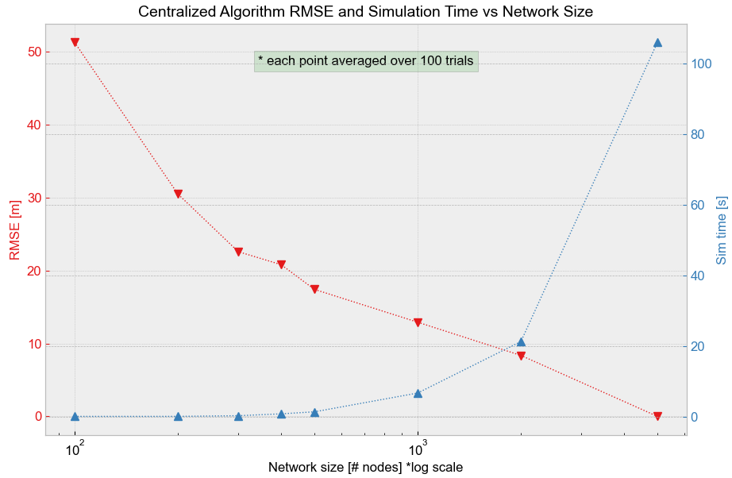
Chain mail – dial
Distributed Ad-hoc Localization (DiAL) – position estimation in a large proliferated constellation
Plot below shows the average root mean square error (RMSE) of the position estimation as a function of network size, for the centralized algorithm MDS-MAP. Also shown is simulation time as a function of network size. RMSE goes nearly to zero at 5,000 nodes, though had a reasonable error even at 100 nodes.
FY21
Justin Kim
840738

Slide 7
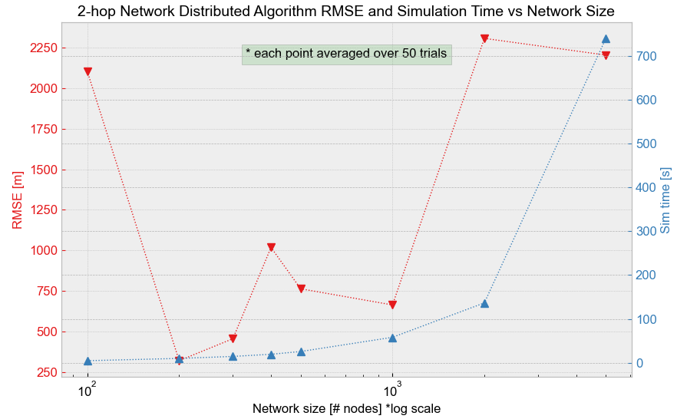
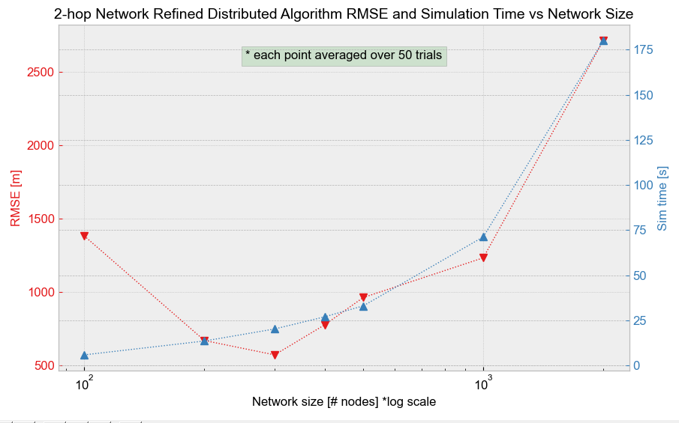
Chain mail – dial
Distributed Ad-hoc Localization (DiAL) – position estimation in a large proliferated constellation
Plot below shows the average root mean square error (RMSE) of the position estimation as a function of network size, for the distributed algorithm MDS-MAP(P). In these simulations, the local neighborhood size is limited to 2 hops. Also shown is simulation time as a function of network size. Compared to the 3-hop network (shown on the next slide), the error is considerably larger. With smaller local neighborhoods, more merges are required to assemble the full network. Error compounds with every merge, resulting in a very large error. The plot on the right includes a refinement step in between each merge. The algorithm with refinement steps follows the same trend, but with larger error.
FY21
Justin Kim
840738

Slide 8
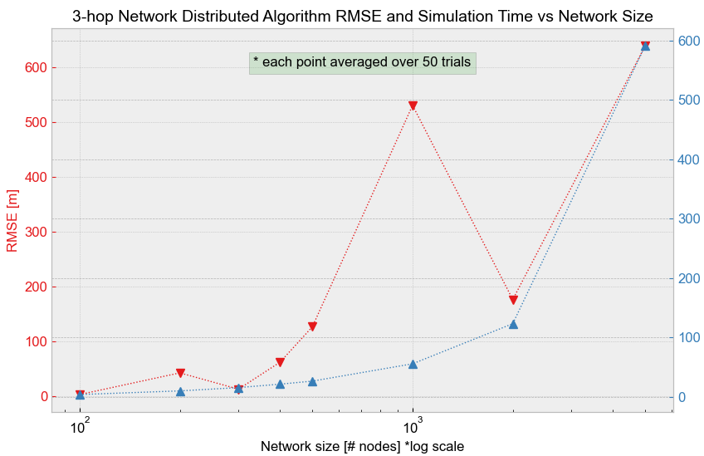
Chain mail – dial
Distributed Ad-hoc Localization (DiAL) – position estimation in a large proliferated constellation
Plot below shows the average root mean square error (RMSE) of the position estimation as a function of network size, for the distributed algorithm MDS-MAP(P) without the refinement step. In these simulations, the local neighborhood size is limited to 3 hops. Also shown is simulation time as a function of network size. A relationship could be inferred that RMSE increases with network size. Again, this is likely due to the number of merges required to assemble the full network. Error compounds with every merge, resulting in increasing error.
FY21
Justin Kim
840738

