Slide 1
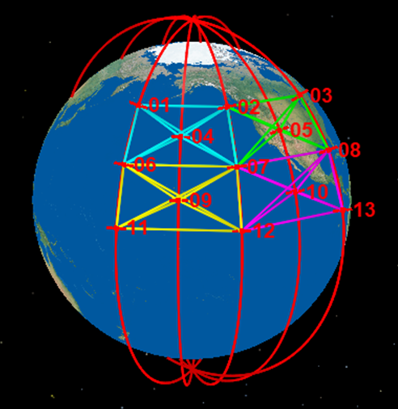
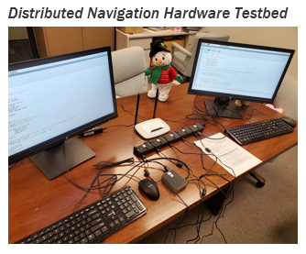
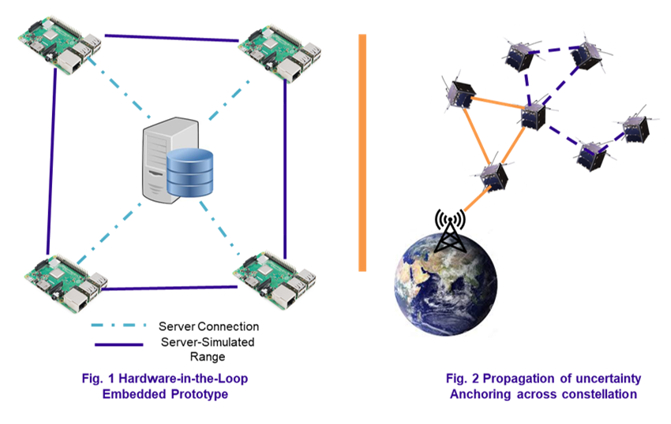
Chain Mail – Plate Mail
Distributed Navigation and Hardware-in-the-Loop Validation
Plate Mail is a distributed navigation architecture with a proliferated constellation hardware simulation testbed.
How do we obtain of rapid knowledge of satellite states in large constellations and formations?
Distributed state estimation and embedded hardware testbed implementation and validation
Proliferated and formation-flying space architectures enable novel, resilient space mission designs with enhanced capabilities. However with vulnerabilities in GPS and ground tracking systems becoming overwhelmed, management of these constellations requires a better way to maintain knowledge of the satellite states in a congested environment.
Designed a hierarchical, distributed nav. architecture
Implemented an experimental hardware testbed for distributed system validation
Aerospace's unique melting pot of experiences in pLEO, next generation space concepts, and resiliency of national space assets allows for novel concepts to form.
Implemented communication networking for distributed data transfer and communication
Plate Mail presents a scalable, hierarchical, distributed architecture for cooperative navigation
It then implements the architecture on an embedded hardware testbed to validate the architecture under emulated networking, data transfer, and SWaP constraints that are typical for distributed systems scenarios.
Deployed cooperative navigation algorithm on distributed embedded platforms
Plate Mail utilizes the theory of distributed Kalman filtering to realize a decentralized navigaton architecture for a futuristic space system where a filter runs on each node of the constellation in order to generate local state estimates. An experimental hardware testbed was built with interconnected Raspberry Pi units representing SVs in the system. A hybrid data management system utilizing database and pub./sub. models emulates measurements and constrained data transfer and comms typical of distributed navigation architectures.
As space becomes increasingly cluttered, constellations will need to assist space situational awareness (SSA) operators with rapid state estimation.
Plate Mail Hierarchical Distributed Nav. Concept
Rising Need for Rapid Distributed State Est. for Proliferated Constellations
Derek Chen
841753
Ventures

Slide 2
Chain Mail – Plate Mail
Distributed Navigation and Hardware-in-the-Loop Validation
Designed a decentralized navigation architecture which allows for local state estimation
Improves system resiliency by eliminating the need for a central processing center
Architecture is hierarchical in nature and can be scaled up to be used by variety of constellation designs
Distributed architecture reduces data transfer and communication concerns posed by mega-constellations
Implemented embedded hardware testbed with distributed networking and data transfer
Low SWaP embedded hardware to constrain computational resources
Orbit propagation with TRACE
Crosslink measurement simulation
Distributed data transfer since constellation information is not available to all nodes at all times
Deployed satellite navigation software on SWaP-constrained embedded nodes for decentralized state estimation
Validated capability of obtaining position, velocity, covariance (estimate uncertainty), and cross-covariance information for each node/pairs of nodes via decentralized state estimation
SDA, pLEO, Space Program Operations (PO) Program office
Demos to Customers
Capability demo was spotlight of Plate Mail project
Next Steps
Next steps for the scrimmage portion of the project will be determined by the iLab team in order to integrate our findings and platform with the other Chain Mail scrimmage teams.
From the customer perspective, next steps entail using testbed to validate various performance studies from customer funded analyses and studies.
Scale to more nodes by acquiring additional hardware
Designed scalable, hierarchical, distributed constellation navigation architecture
Developed hardware simulator for distributed system experimentation
Developed Documents
ATM-2020-00632: Aerospace Distributed Navigation Hardware Simulator
Conference Papers
N/A
Derek Chen
841753
Ventures

Slide 3
Chain Mail – Plate Mail
Distributed Navigation and Hardware-in-the-Loop Validation
Plate Mail successfully demonstrated the ability to simulate a decentralized navigation architecture in a distributed hardware-in-the-loop test environment
Distributed navigation architecture developed for scalable test scenarios
Distributed Kalman filter techniques implemented, with filter instance embedded in each satellite node
Data transfer protocols developed and implemented for distributed architecture to reduce potential data transfer burden for large constellations
Communication network implemented utilizing multiple Raspberry Pis
Capability showed ability to efficiently communicate necessary data and quickly determine state estimates across constellation
Validated distributed navigation algorithm leveraged in other SDA, SPO, and Chief Engineer’s Office Work.
Prior analysis and studies applied covariance analysis to distributed algorithms to evaluate the theory and performance bounds of distributed pLEO architectures
Plate Mail validates:
Rapid constellation state estimation may be accurately obtained
Distributed navigation may be accomplished in a distributed communications setting where networking and SWaP constraints limit data transfer capacity and synchronicity of data reception
Because of iLab funding, we were able to establish the hardware implementation platform to prototype our algorithms beyond the simulation-level analysis that our customers were interested in.
As such, we were able to create an end-to-end, hardware-in-the-loop simulation validating our architecture and methods.
X
X
X
Numerous customers interested in proliferated constellations.
Derek Chen
841753
Ventures

Slide 4
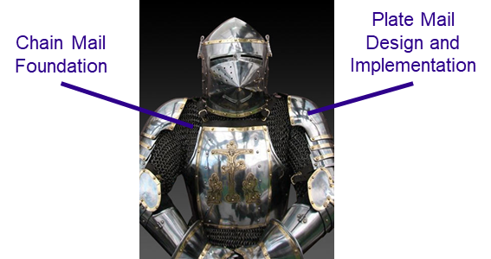
Chain Mail – Plate Mail
Distributed Navigation and Hardware-in-the-Loop Validation
Plate Mail is a hierarchical and scalable architecture.
Revisiting hierarchical image from the first page, a node-cell (each color) consists of 5 nodes (SVs) which can message pass and perform cooperate state estimation.
Taking nodes with measurements to nodes in adjacent node-cells allows for inter-cell relative positioning. This is shown as the connection of 4 node cells into large-cell.
Multiple adjacent large-cells may then be interconnected to form mega-cells and achieve constellation level estimation
To expand hardware simulation, process is straightforward of adding embedded device and porting image.
Plate Mail estimates the position, velocity, clock, clock rate, and covariances for each node
Position: Required to know where each node is
Velocity: Required in conjunction with position to propagate SV state forward in time
Covariances: Required for conjunction analysis, navigation relay, geolocations applications where position/clock uncertainty is necessary for accuracy
Clock/Clock Rate: Required to sync up measurements and state estimates constellation-wide
Derek Chen
841753
Ventures

