Slide 1
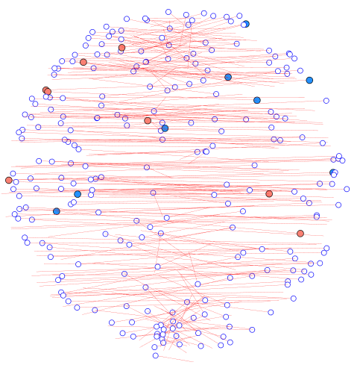
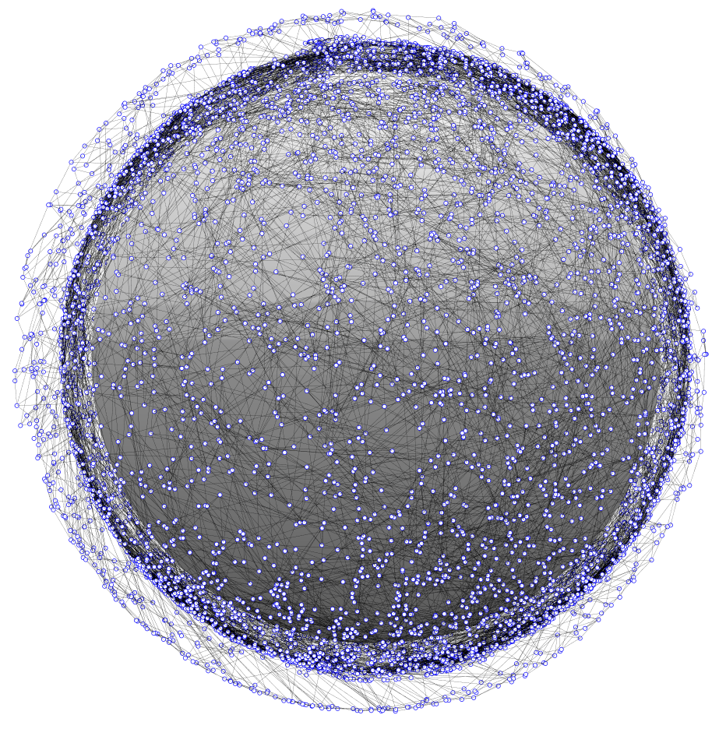
dial – Distributed ad-hoc localization
Rapid and distributed position estimation in a large proliferated satellite constellation
DIAL is for rapidly determining satellite position in a proliferated network. Distributed localization is performed using crosslink and range information.
Can connectivity and crosslink information be used to determine satellite positions?
Rapid localization in large, ad-hoc networked constellations
Current LEO satellites rely on some combination of sensors, GPS, and ground tracking to determine their positions. In a very large ad-hoc network, these methods may be prohibitively time/cost/effort expensive. As large, proliferated constellations come to fruition, position estimation will be a critical issue for operators.
Distributed localization enables parallel computing
Distributed algorithms scale to very large networks
Distributed localization has not been thoroughly investigated in large, ad-hoc, three-dimensional networks. There is a wealth of unique research to be performed.
Leverages wireless terrestrial localization methods
DIAL is an investigation into rapid and distributed position estimation in large proliferated networks. SWaP constraints on proliferated satellites may limit position estimation abilities. Wireless localization algorithms can be computationally low-cost, and performed without the need for a centralized computing resource. Distributed localization can reduce operator and computational workload, which will allow space operators to safely and efficiently manage large networks.
Range-based localization based on ad-hoc networking
DIAL leverages algorithms and methods developed for terrestrial localization in wireless networks. Results from Project Packet are used to initialize the crosslinks and network topology. Multi-Dimensional Scaling (MDS) is used to map the networks with an algorithm called MDS-MAP. A distributed form of MDS-MAP is implemented, called MDS-MAP(P), which enables parallel computation and mapping.
Local neighborhoods are independently mapped and then merged. As the local maps are aggregated into a total map, an absolute map can be constructed with the inclusion of 3 (in 2 dimensions) or 4 (in 3 dimensions) anchors nodes that are position-aware.
As large proliferated satellite constellations come to fruition, position estimation and collision avoidance will pose a major challenge for future space operators.
1. Use local neighborhood crosslink information to map local patches
2. Merge overlapping patches
Managing Very Large Networks Poses a Challenge to Space Operators
3. Absolutely localize the assembled network using anchor nodes
Justin Kim
841757
Ventures

Slide 2
dial – Distributed ad-hoc localization
Rapid and distributed position estimation in a large proliferated satellite constellation
MDS-MAP was successfully implemented in a centralized 2d case with high accuracy. Position estimation was nearly perfect for networks ranging from 100 to 10,000 nodes. In the 3d MDS-MAP case, the relative map was accurately produced, but the absolute mapping was not accurate. The Kabsch algorithm was used to find an optimal rotation to absolutely localize the network, but it did not produce an accurate transformation. Similar results were observed using a linear least squares transformation.
Extension to the distributed case, using MDS-MAP(P), did not produce accurate results. Unacceptably large errors were observed in both the 2d and 3d cases. The large error was likely a result of the merging process, where local maps are aggregated into a complete map. As the aggregate map is assembled, each subsequent linear transformation introduces and compounds error in the position estimation. A refinement process between each merging may be necessary to improve results.
A distributed approach is advantageous for 2 main reasons:
1. Computation of local maps can be done locally at each node in parallel with others, while local maps can be merged in parallel in different parts of the network.
2. Traditional MDS does not perform well in irregular networks. Using local maps to assemble the network maintains the accuracy of MDS, while being scalable to large networks.
Next steps:
Document code and results
Improve method for optimal linear transformation
Implement refinement process in MDS-MAP(P)
Investigate:
Anchor node optimization
Different merging methods
Network topology: local neighborhood range, connections per satellite, connection range
Justin Kim
841757
Ventures

Slide 3
dial – Distributed ad-hoc localization
Rapid and distributed position estimation in a large proliferated satellite constellation
I was glad to have the opportunity to perform some independent research. Although I did not achieve the results I had hoped for, hopefully the work can be leveraged for future efforts.
Justin Kim
841757
Ventures

