Slide 1
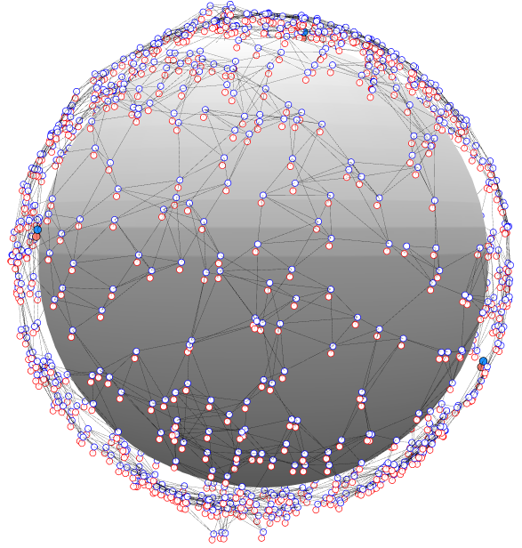
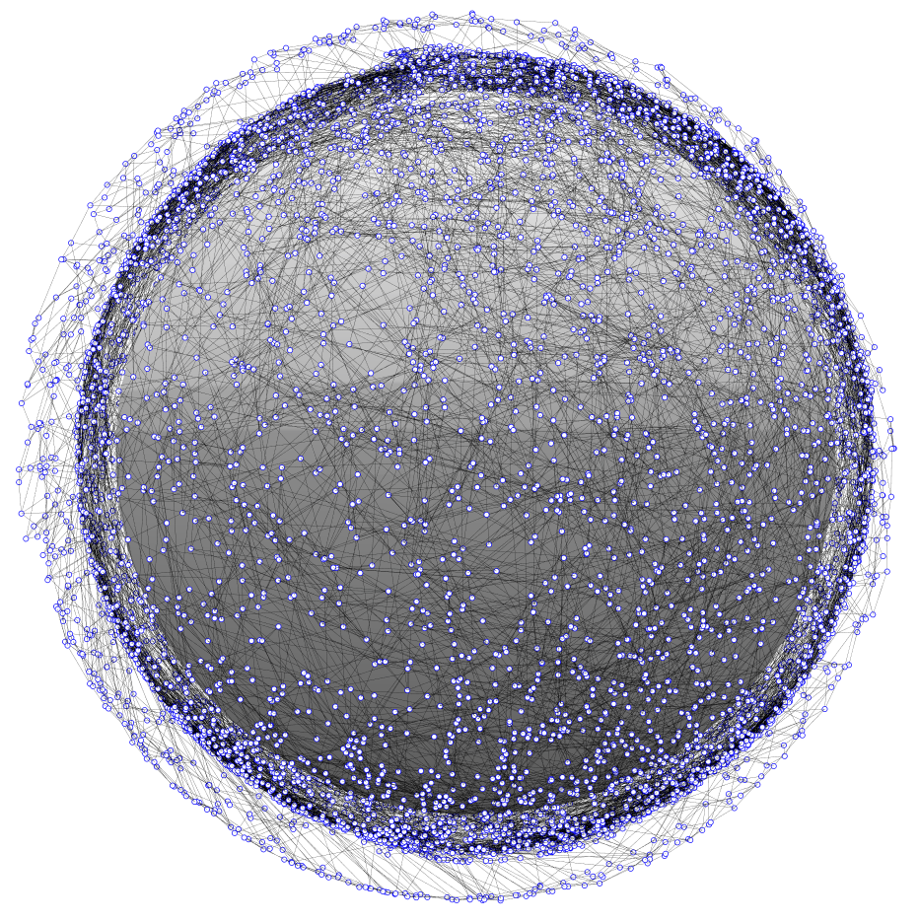
dial – Distributed ad-hoc localization
Rapid and distributed position estimation in a large proliferated satellite constellation
DiAL is for rapidly determining satellite position in a proliferated network. Distributed localization is performed using crosslink and range information.
Can connectivity and crosslink information be used to determine satellite positions?
Rapid localization in large, ad-hoc networked constellations
Current LEO satellites rely on some combination of sensors, GPS, and ground tracking to determine their positions. In a very large ad-hoc network, these methods may be prohibitively time/cost/effort expensive. As large, proliferated constellations come to fruition, position estimation will be a critical issue for operators.
Distributed localization enables parallel computing
Distributed algorithms scale to very large networks
Distributed localization has not been thoroughly investigated in large, ad-hoc, three-dimensional networks. There is a wealth of unique research to be performed.
Leverages wireless terrestrial localization methods
DiAL is an investigation into rapid and distributed position estimation in large proliferated networks. SWaP constraints on proliferated satellites may limit position estimation abilities. Wireless localization algorithms can be computationally low-cost and performed without the need for a centralized computing resource. Distributed localization can reduce operator and computational workload, which will allow space operators to safely and efficiently manage large networks.
Range-based localization based on ad-hoc networking
DiAL leverages algorithms and methods developed for terrestrial localization in wireless networks. Results from Project Packet are used to initialize the crosslinks and network topology. Multi-Dimensional Scaling (MDS) is used to map the networks with an algorithm called MDS-MAP. A distributed form of MDS-MAP will be implemented, called MDS-MAP(P), which enables parallel computation and mapping.
Local neighborhoods are independently mapped and then merged. As the local maps are aggregated into a total map, an absolute map can be constructed with the inclusion of 3 (in 2 dimensions) or 4 (in 3 dimensions) anchors nodes that are position-aware.
As large proliferated satellite constellations come to fruition, position estimation and collision avoidance will pose a major challenge for future space operators.
1. Use local neighborhood crosslink information to map local patches
2. Merge overlapping patches
Managing Very Large Networks Poses a Challenge to Space Operators
3. Absolutely localize the assembled network using anchor nodes
Justin Kim
841757
Ventures

Slide 2
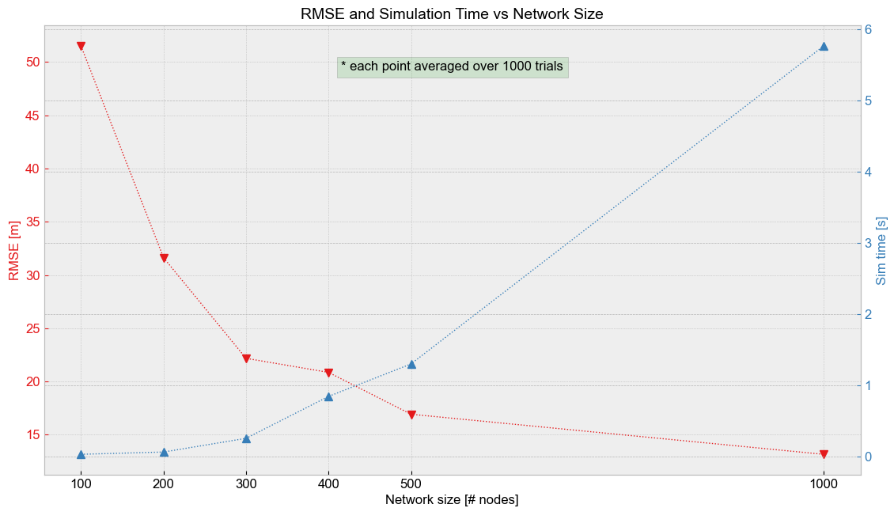
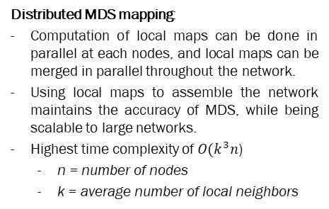
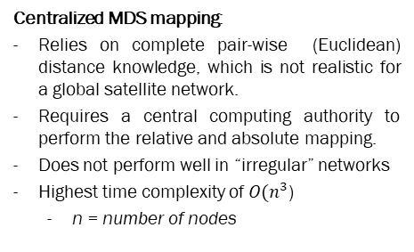
dial – Distributed ad-hoc localization
Rapid and distributed position estimation in a large proliferated satellite constellation
MDS-MAP was implemented in a centralized 2-D case with high accuracy. Position estimation was near-perfect for networks ranging from 100 to 10,000 nodes. MDS-MAP was also implemented for the 3-D case for networks between 100 and 1,000 nodes with high accuracy. RMSE and simulation time are plotted below.
Centralized MDS mapping:
Relies on complete pair-wise (Euclidean) distance knowledge, which is not realistic for a global satellite network.
Requires a central computing authority to perform the relative and absolute mapping.
Does not perform well in “irregular” networks
Highest time complexity of $O(n^{3}$)
n = number of nodes
Distributed MDS mapping:
Computation of local maps can be done in parallel at each nodes, and local maps can be merged in parallel throughout the network.
Using local maps to assemble the network maintains the accuracy of MDS, while being scalable to large networks.
Highest time complexity of $O(k^{3}n$)
n = number of nodes
k = average number of local neighbors
Next steps:
Implement distributed algorithm MAP(P) and characterize performance
Implement uncertainty in ranging knowledge
Investigate range-free localization and effects of network topology on accuracy (local neighborhood range, connections per satellite, crosslink range)
Implement on SWaP-limited hardware
Justin Kim
841757
Ventures

