Slide 1
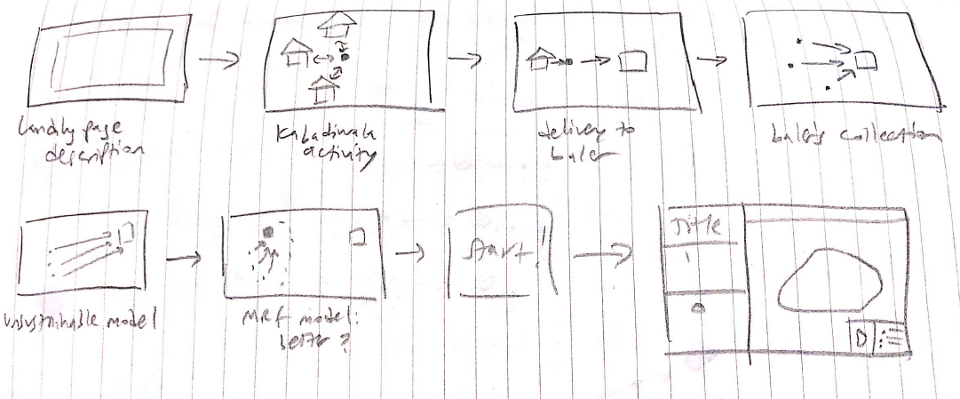
Storyboard
Notes:
Sequence of events making up experience of using this software.
I am public and I want to explore where I live (Bandra).
How many kabadiwalas are near me?
What quantities do they pick up per day?
How does this compare to other areas?

Slide 2
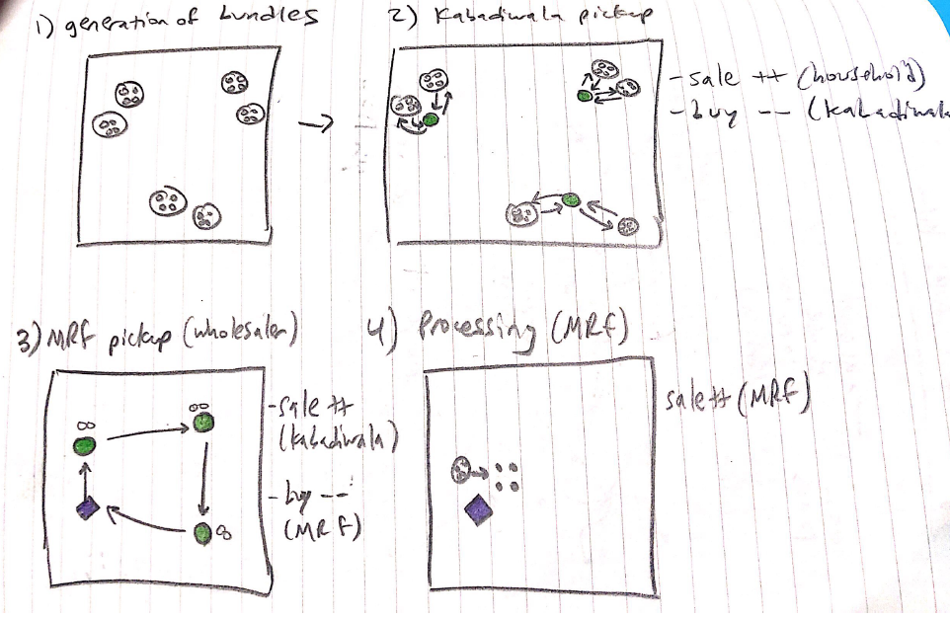
Storyboard
Notes:
Sequence of events making up experience of using this software.
I am public and I want to explore where I live (Bandra).
How many kabadiwalas are near me?
What quantities do they pick up per day?
How does this compare to other areas?

Slide 3
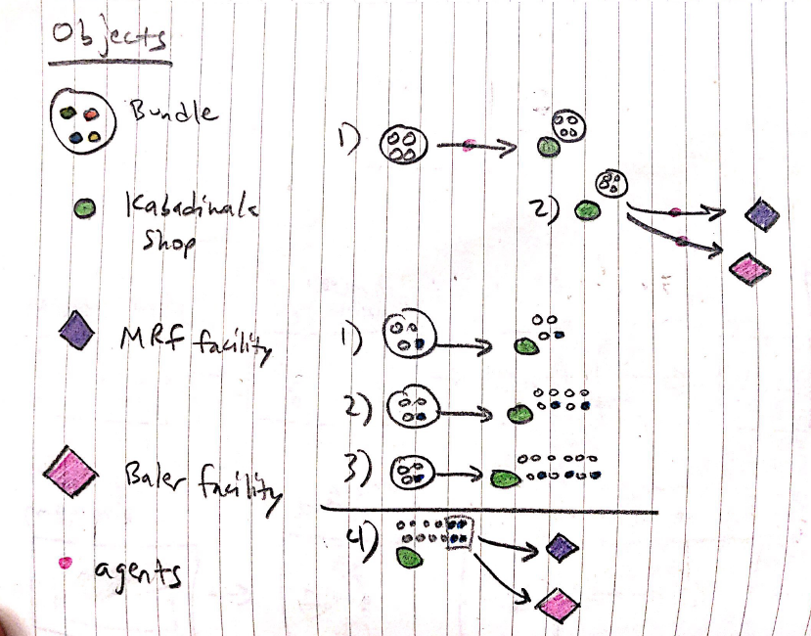
Storyboard
Notes:
Sequence of events making up experience of using this software.
I am public and I want to explore where I live (Bandra).
How many kabadiwalas are near me?
What quantities do they pick up per day?
How does this compare to other areas?

Slide 4
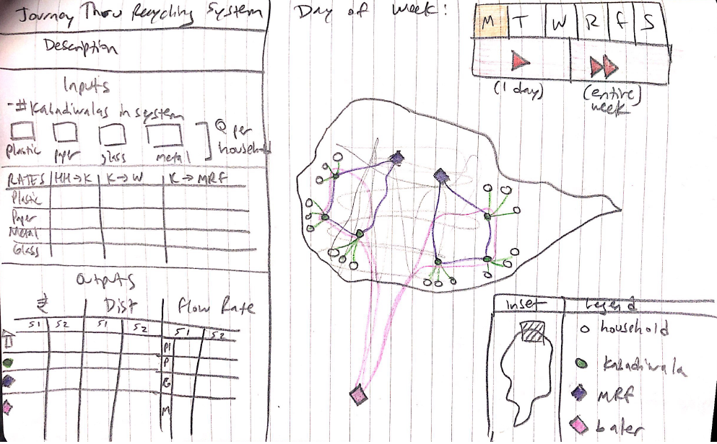
UI Mock-Up
Notes:
Look and feel of the tool; full scope of features to implement

