Slide 1
Project1 ME-781
Name- Swapnil Jayant Kumar
Roll no- 160100022
Course Instructor- Prof. Asim Tewari

Slide 2
Some analysis of Data
The following slide shows variation of Output Y with all the input variables X1, X2, X3, X4
It is clearly visible that the variation of output Y is much more better with respect to X1 than any other attribute
Plots for parameters are also shown below to give sense of correlation between them .

Slide 3
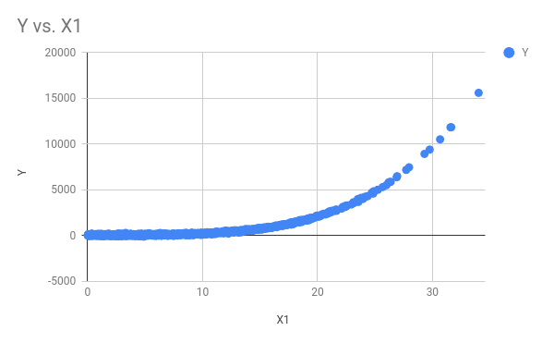
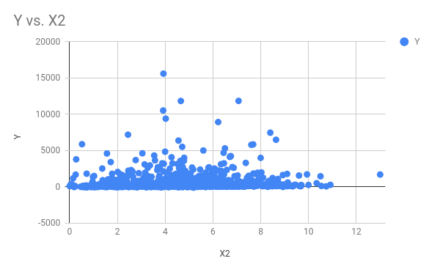
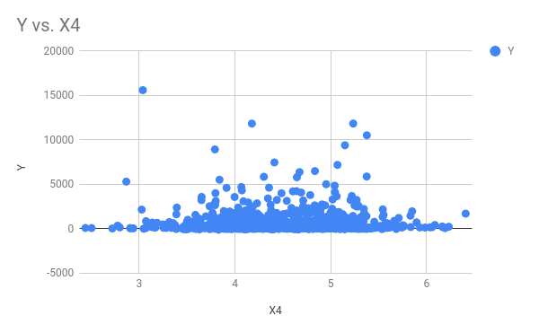

Slide 4
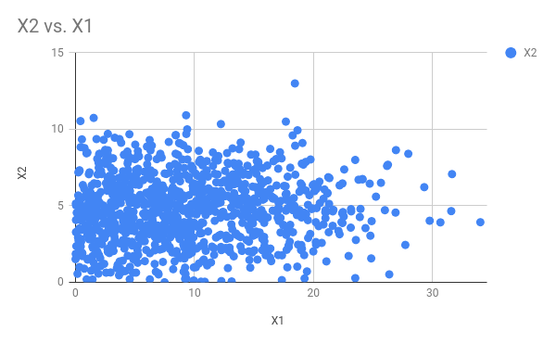
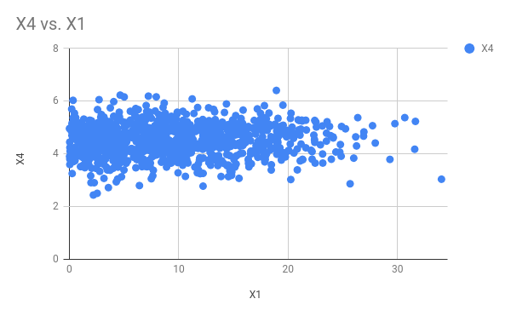
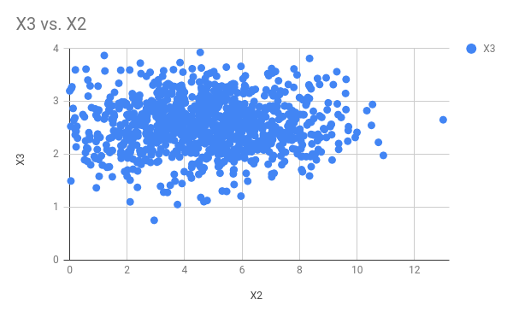

Slide 5
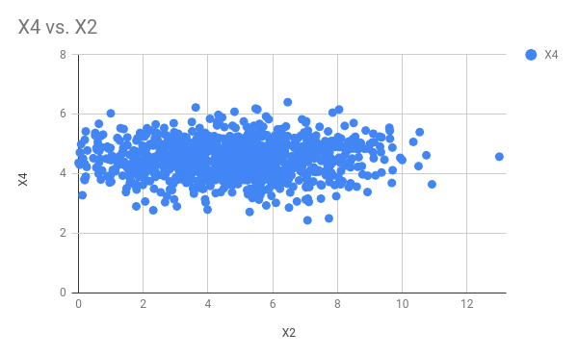
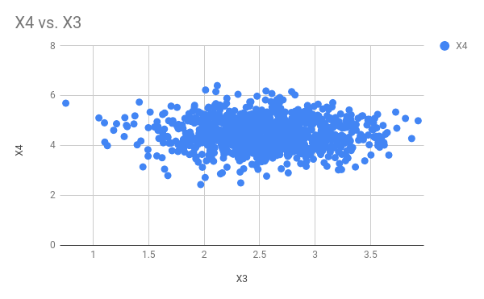

Slide 6
List of python files to be run for different parts
Part1- part1.py
Part2-part2.py
Part3-part3.py
Part4-part4.py
The results stated in this presentation are subjected to some variations on running the python files again
Python libraries used- argparse, matplotlib, sklearn, numpy, scipy
First ¾ of data used as training data and remaining ¼ used as test for part 1, 2 and 4

Slide 7
Linear Regression with all the four parameters-
The values of coefficients are as follows=
β0=-406.67873152 , β1=152.79384466 , β2=513.40190293 , β3=-42.79818088, β4= -80.82629064
MSE on the training data =763.435569
RSE for the test data =875.453535
P values for the coefficient are= 0.122, 0, 0.303, 0.442, 0.077

Slide 8
Subset sampling of the parameters-
The approach followed here was forward stepwise approach.
Test for lowest values of MSE was performed taking each variable at a time
After selecting the best variable, all the three combination with remaining variables with the selected were tried for minimum MSE. By this forward approach, two variables were selected.
Following are the result of the subset selection-
Best parameter = x1 and it gave an RSE of 753.637486
Two best parameters= x1 and x3 and it gave an RSE of 754.615828

Slide 9
Comparison of Non-linear regression and KNN
Nonlinear regression for polynomial degree 2,3,4 and 5 were performed.Similarly KNN for 1,2,3,5,7 neighbours was performed, following are the results
MSE for KNN regression with 1 neighbours: 24547.937533
MSE for KNN regression with 2 neighbours: 22424.387364
MSE for KNN regression with 3 neighbours: 27911.525357
MSE for KNN regression with 5 neighbours: 33621.518423
MSE for KNN regression with 7 neighbours: 47688.383294
MSE for Non-linear regression of degree 2: 107524.527721
MSE for Non-linear regression of degree 3: 5844.380224
MSE for Non-linear regression of degree 4: 3967.215040
MSE for Non-linear regression of degree 5: 3943.481922

Slide 10
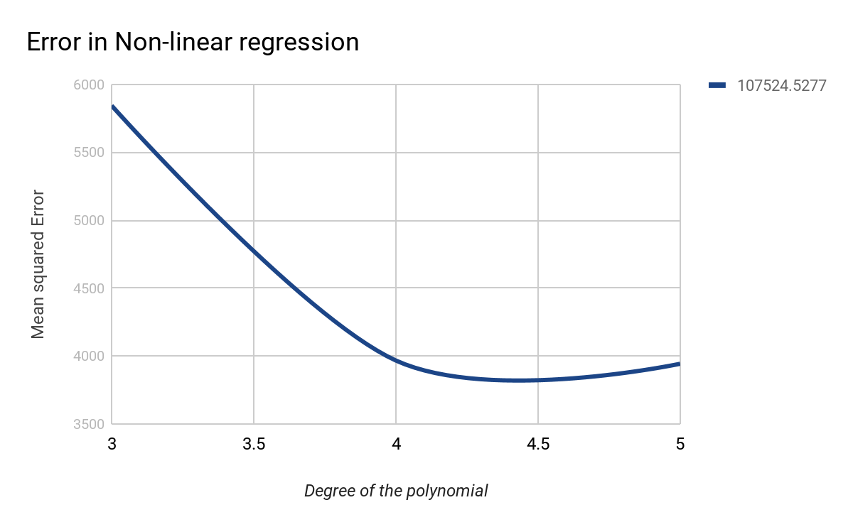
Comparison of Non-linear regression and KNN
Variation of error with degree of the polynomial.
The error starts to rise at the end due to the phenomena of overfitting

Slide 11
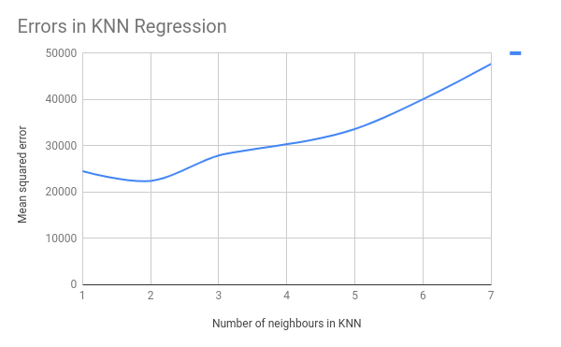
Comparison of Non-linear regression and KNN
Variation of error with the number of neighbours.
The error starts to rise after 2 neighbours end due to the phenomena of overfitting
It is clear from both the graphs that MSE of KNN is less than polynomial, but overfits much quickly than the polynomial.

Slide 12
PCA and comparison with subsets
PCA was performed on the data. Following are the values of RSE obtained for the two cases-
RSE for one component= 753.949240
RSE for two components= 755.920130
On an average error by PCA and subset sampling are almost same. It can be considered as effective as subset sampling.

Slide 13
Thank You!!

